Slide 1
Pilot survey on on-line patient registries
Go Yoshizawa
(Osaka University)

Slide 2
Background
Patient registry for rare diseases become gradually popular to collect more information for medical research
As the registration process is mostly on a paper basis, an online-based registration system can be more effective and efficient
But we need to know what patients really want, assuming most of them are elderly and unmechanical

Slide 3
Project Team
Masanori Takahashi, Department of Neurology, Graduate School of Medicine, Osaka University (PI)
Kazuto Kato, Department of Biomedical Ethics and Public Policy
Go Yoshizawa
Jusaku Minari
In collaboration with
Yasushi Matsumura, Department of Medical Informatics
Toshihiro Takeda
Yoshihiro Asano, Department of Medical Biochemistry
En Kimura, Translational Medical Center, National Center of Neurology and Psychiatry
Shimon Tashiro, Office of Bioethics, Center for Research Administration and Support, National Cancer Center
Harriet Teare, HeLEX, University of Oxford
Jane Kaye, University of Oxford

Slide 4
Survey Design
Survey is conducted at Osaka University Hospital, National Center of Neurology and Psychiatry and several hospitals under National Hospital Organization
Respondents are patients with myotonic dystrophy (MD), who go to hospital or have participated in a patients’ association or an open lecture

Slide 5
Questionnaire
Q1. Do you have anything to ask doctors and researchers?
General information on disease
Symptoms of my disease
Examination or treatment of my disease
The course of my disease
Other patient’s condition
News on medical research and clinical trial
Information on recruiting patients for medical research and clinical trial

Slide 6
Questionnaire
Q3. Do you have anything more to tell doctors and researchers?
My physical condition (rather positive)
My physical condition (rather negative)
My psychological condition (rather positive)
My psychological condition (rather negative)
My living condition (economy, job, etc)
My family condition
Other

Slide 7
Questionnaire
Q7. We asked you whether you would like to receive information on clinical trials at the time of registration, but we now consider making the change of your request easier. What do you think?
Do not need to change my request
I would like to change my request whenever I want
Once a year when updating the patient registry
Other

Slide 8
Questionnaire
Q8. A researcher who would like to examine a certain symptom of your disease (e.g. slow on the uptake) would appear in future. Would you like to receive information on the participation of the research via e-mail or web?
Yes, I would
No, I wouldn’t
Don’t know

Slide 9
Questionnaire
Q9. Data on registered patients (including personal data) can be offered to researchers and pharmaceutical companies if approved by ethics review board. Do you wish to receive what kind of data can be offered?
I want to get contacted in each case
I want to get contacted periodically
I don’t need to get contacted
Don’t know

Slide 10
Questionnaire
Q11. What do you think about utilising computers or mobiles for the interaction between patients and doctors/researchers, as described in Q1-9?
I want to use them actively
I may want to use them conditionally
I am not too eager to use them
I will never use them

Slide 11
Questionnaire
Q12. For those who did not answer “never” to Q11, what kind of device, care and effect do you think is preferred? Choose no more than 3 options.
Easy to input and browse
Understandability of the message
The input terminal is not computer but smartphone or tablet
My family can help me to input
Immediate response
Secure information and privacy
I can get information to be useful for the care of my physical and psychological condition
Useful for the diagnosis and treatment of patients of my disease with the advance of medical research

Slide 12
Questionnaire
Q14. What type of computer or information device do you use? Please tick all you use.
Desktop computer
Laptop computer
Tablet computer
Smartphone
Game console
Other
Never

Slide 13
Questionnaire
Q15. What purpose do you use computer or other information device?
Business
Personal matters
Communication (e.g. Skype or Line)
Hobby (e.g. television, game)
Other
Never

Slide 14
Preliminary Findings
n=42 (m10 : f26), response rate 71%
Half are 30s and 40s
[Q7] 71% like to change their request whenever they want
[Q9] 40% want to get contacted in each case and 33% want to get contacted periodically
[Q11] 50% are positive about using ICT and 33% may want to use

Slide 15
Preliminary Findings
[Q12] security > useful for my health > understandability > useful for medical research
[Q14] smartphone (55%), laptop (50%), tablet (29%), desktop (24%)
[Q15] 57% use for personal matters, 45% for communication and hobby, 36% for business

Slide 16
Methodological Reflection
Mechanical respondents
Risk adverse
Willing to put time and effort

Slide 17
Collaborative Project with HeLEX
“Development of a Framework for Medical Research Governance involving Patients and Citizens” (2014-17)
Main aims
Compare differences in ethical, legal and research governance structures between Japan and the UK
Explore possibilities of IT systems for communication with patients and citizens applying the concept of ‘dynamic consent’ (Kaye et al. 2014)
Members
Kazuto Kato, Go Yoshizawa, Jusaku Minari (Dept. Biomedical Ethics and Public Policy)
Yasushi Matsumura, Toshihiro Takeda (Dept. Medical Informatics, Graduate School of Medicine)
Jane Kaye, Sarah Coy, Harriet Teare, Colin Mitchell (HeLEX, Nuffield Department of Population Health, University of Oxford)

Slide 18
Research Framework
Kaye, Kato:
Grand design, analysis of ethical and legal issues
Patients and Citizens
Yoshizawa, Minari:
Design of interactive interface involving patients and citizens
Interactive Interface
Clinical Database
(Osaka Univ. Hospital)
Medical Research Database (Osaka University Medical School)
Matsumura, Takeda:
System development of medical research database and interactive interface
Researchers

Slide 19
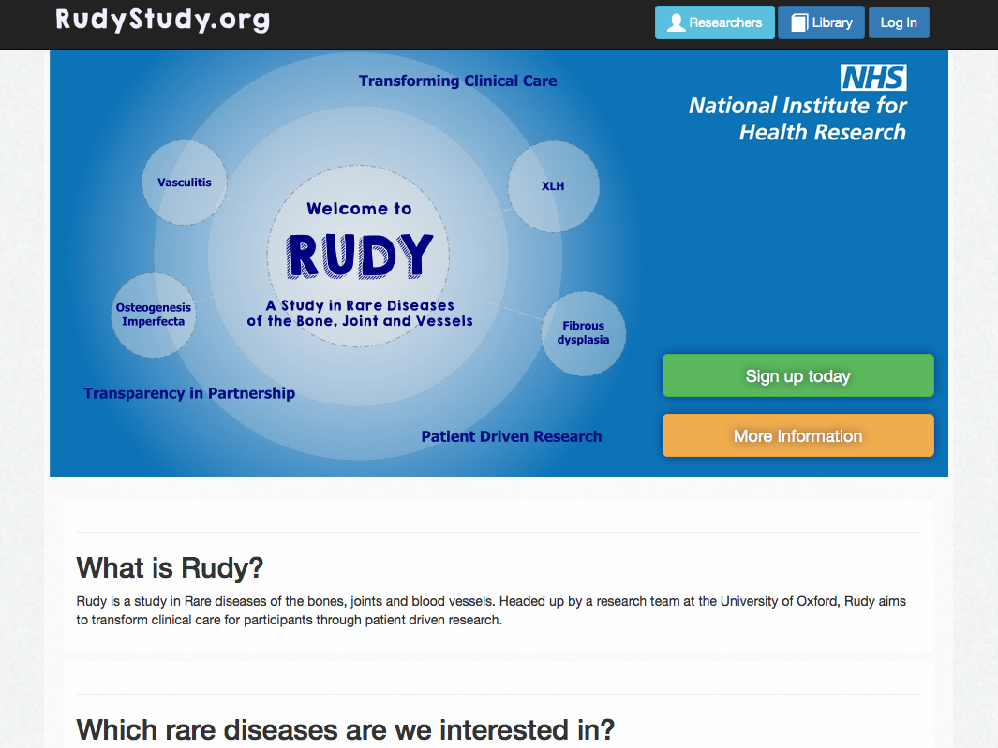

Slide 20
Prospects
Development of an web-based interactive system dedicated to myotonic dystrophy (MD)
Comparison between Japan and UK
Implications for dynamic consent

