Slide 1

How can we ensure that medical and healthcare systems can adapt to the social challenges of using personal data?
-- PechaKucha June 24, 2015 --
Natsuko Yamamoto, Minae Kawashima, Takanori Fujita, Kazuto kato,
Masatomo Suzuki
Healthcare Transformation Plans around the world

Slide 2
How can we ensure that medical and healthcare systems can adapt to the social challenges of using personal data?
-- PechaKucha June 24, 2015 --
Natsuko Yamamoto, Minae Kawashima, Takanori Fujita, Kazuto kato,
Masatomo Suzuki
Healthcare Transformation Plans around the world

Slide 3
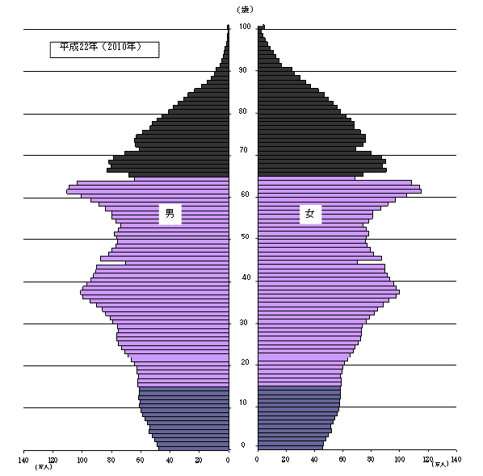
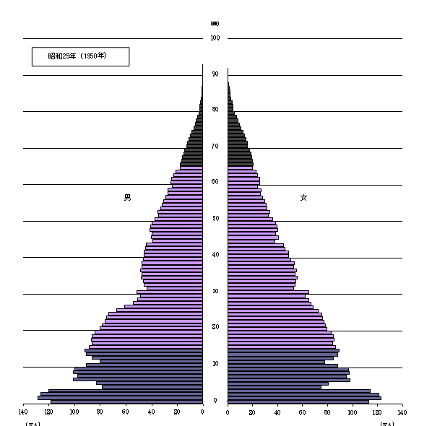
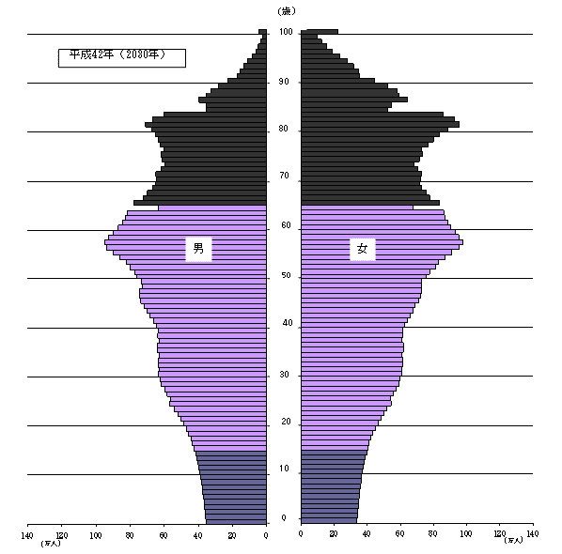
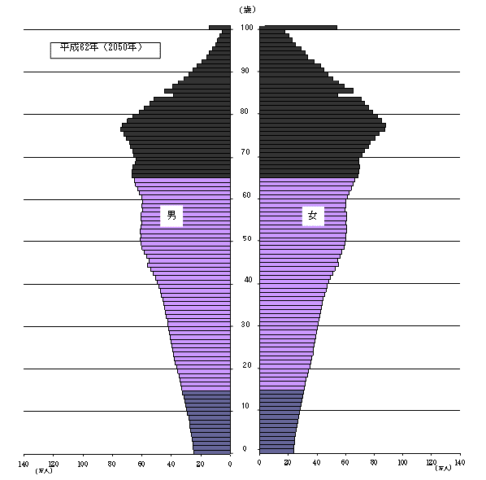
2010
Aging Society
and Shrinking Population
Age 100
1950
2030
Age 0
Male
Female
2050
ex) Estimated population of Japan
(by Statistics Bureau, Ministry of Internal Affairs and Communication)

Slide 4
2010
Aging Society
and Shrinking Population
Age 100
1950
2030
Age 0
Male
Female
2050
ex) Estimated population of Japan
(by Statistics Bureau, Ministry of Internal Affairs and Communication)

Slide 5
2010
Aging Society
and Shrinking Population
Age 100
1950
2030
Age 0
Male
Female
2050
ex) Estimated population of Japan
(by Statistics Bureau, Ministry of Internal Affairs and Communication)

Slide 6


ICT, personal data
Big data science
More inclusive, more comfortable
lower cost healthcare system

Slide 7

Healthcare Transformation Plans in Japan
Japan Revitalization Strategy, Cabinet decision
2013 Act for the Promotion of Regenerative Medicine
Act to Ensure safety in Regenerative Medicine
2013 Revised Japanese Pharmaceutical Law
2013 Act on the Use of Numbers to Identify a Specific Individual in the Administrative Procedure
2014 Act on Promotion of Healthcare Policy
Act on the Independent Administrative Agency of Japan Agency for Medical Research and Development
(Revising the Personal Information Protection Law)

Slide 8
Healthcare Transformation Plans in Japan
Japan Revitalization Strategy, Cabinet decision
2013 Act for the Promotion of Regenerative Medicine
Act to Ensure safety in Regenerative Medicine
2013 Revised Japanese Pharmaceutical Law
2013 Act on the Use of Numbers to Identify a Specific Individual in the Administrative Procedure
2014 Act on Promotion of Healthcare Policy
Act on the Independent Administrative Agency of Japan Agency for Medical Research and Development
(Revising the Personal Information Protection Law)

Slide 9
New healthcare system which Japan will be implemented within the next 5 years
Beep!
Hospital
Pharmacy
National ID Number
Local healthcare network
ID, Clinical Data,
Pharmaceutical Data, …
ID, Clinical Data,
Pharmaceutical Data,
Care manage-ment office
Analysis, R&D
Family doctor
(Modified Fig. from Council for Industrial Competitiveness 2015. 5.29)

Slide 10
New healthcare system which Japan will be implemented within the next 5 years
Beep!
Hospital
Pharmacy
National ID Number
Local healthcare network
ID, Clinical Data,
Pharmaceutical Data, …
ID, Clinical Data,
Pharmaceutical Data,
Care manage-ment office
Analysis, R&D
Family doctor
(Modified Fig. from Council for Industrial Competitiveness 2015. 5.29)

Slide 11
New healthcare system which Japan will be implemented within the next 5 years
Beep!
Hospital
Pharmacy
National ID Number
Local healthcare network
ID, Clinical Data,
Pharmaceutical Data, …
ID, Clinical Data,
Pharmaceutical Data,
Care manage-ment office
Analysis, R&D
Family doctor
(Modified Fig. from Council for Industrial Competitiveness 2015. 5.29)

Slide 12
Our project: providing new/useful data
(genomic data, etc) to the system
Beep!
Hospital
Pharmacy
National ID Number
Genetic/Genomic data
Genomic data
Genomic data
Local healthcare network
ID, Clinical Data,
Pharmaceutical Data, …
ID, Clinical Data,
Pharmaceutical Data,
Care manage-ment office
Analysis, R&D
Family doctor
(Modified Fig. from Council for Industrial Competitiveness 2015. 5.29)

Slide 13
Our project: providing new/useful data
(genomic data, etc) to the system
Beep!
Hospital
Pharmacy
National ID Number
Genetic/Genomic data
Genomic data
Genomic data
Local healthcare network
ID, Clinical Data,
Pharmaceutical Data, …
ID, Clinical Data,
Pharmaceutical Data,
Care manage-ment office
Analysis, R&D
Family doctor
(Modified Fig. from Council for Industrial Competitiveness 2015. 5.29)

Slide 14
Our project: providing new/useful data
(genomic data, etc) to the system
Beep!
Hospital
Pharmacy
National ID Number
Genetic/Genomic data
Genomic data
Genomic data
Local healthcare network
ID, Clinical Data,
Pharmaceutical Data, …
ID, Clinical Data,
Pharmaceutical Data,
Care manage-ment office
Analysis, R&D
Family doctor
(Modified Fig. from Council for Industrial Competitiveness 2015. 5.29)

Slide 15

New healthcare system with strong ELSI activity - Revision of the Personal Data Protection Law in Japan
Japan started to revise the personal data protection law
(2015 This revision will be approved sometime this year)
This revision will enables us to utilize various kinds of data safely, while protecting privacy
of 20

Slide 16
New healthcare system with strong ELSI activity - Revision of the Personal Data Protection Law in Japan
Japan started to revise the personal data protection law
(2015 This revision will be approved sometime this year)
This revision will enables us to utilize various kinds of data safely, while protecting privacy
of 20

Slide 17
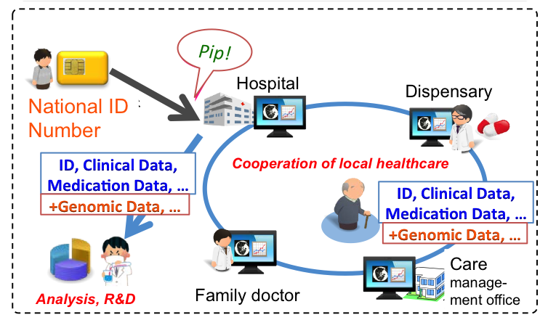


Data sharing
ELSI2.0
GA4GH
ICGC
…
New data protection legislation (EU, 201?~)
Medical data using guideline (OECD, 2015?)

Slide 18
Data sharing
ELSI2.0
GA4GH
ICGC
…
New data protection legislation (EU, 201?~)
Medical data using guideline (OECD, 2015?)

Slide 19
Data sharing
ELSI2.0
GA4GH
ICGC
…
New data protection legislation (EU, 201?~)
Medical data using guideline (OECD, 2015?)

Slide 20
Thank you !!
This work was supported by MEXT/JSPS KAKENHI Grant Numbers 25500005 and 221S0002.

