Slide 1

Minding the Biobank Consent Gaps: Could a web-based informed consent portal help address the awkwardness surrounding “legacy” biobanks?
Daniel Thiel
Department of Health Management and Policy
School of Public Health, University of Michigan
Translation in Healthcare: Exploring the Impact of Emerging Technologies Conference,
University of Oxford, England, June 23-25, 2015

Slide 2
Outline
Overview of Consent Gaps
Background on Michigan BioTrust for Health
Discussion of Web-based Consent Portal
Pilot Test Results
Discussion and Implications

Slide 3
Ethical and practical goals of informed consent
Protection of human subjects
Act of communication regarding participation in research
Participation is voluntary and revocable
Risks and benefits of participation
Meaning of participation
How to end participation
Study PI contact information

Slide 4
Informed Consent: Problems
Biobanks defy the traditional model
Inflated expectations that consent is well understood and capable of facilitating informed decision making
Overly burdened with indemnification language
Inappropriate literacy levels
Forgetting that it is a communicative act and process, treating it as a bureaucratic annoyance
Permission and consent are not the same thing – Current BioTrust policy is about permission not informed consent
“The emperor has an embarrassingly small g-string on his corpulent body, and try as we might the little thing is not going to cover more. Worse, it might tear.”
–Michael M. Burgess “Proposing Modesty for Informed Consent” Social Science and Medicine, 65(2007) 2284-2295

Slide 5
Informed Consent: Approaches
specific consent to individual research projects
broad consent to area-specific health research
blanket consent to any health research
tiered consent participant determines the level of specificity
presumed consent participants may opt-out but are included by default
no consent

Slide 6

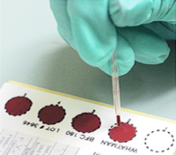

Michigan BioTrust for Health
Residual Dried Bloodspots (DBS) from state Newborn Screening programs have been identified as a “research goldmine and ethical minefield” for many years.
> 4 million Guthrie cards containing DBS have been stored by Michigan Department of Community Health since 1984.
The Michigan BioTrust for Health was formalized in 2010 to make this collection of “de-identified” bloodspots available to researchers.
Governance includes: Biobank Board, IRB, scientific advisory board and Community Values Advisory Board.
An available opt-out for the “legacy” collection (1984- April 2010)
Parental education and opt-in consent process since 2010 for new spots.
Recent state-wide surveys show that only ~6-7% of the population are aware that the BioTrust exists.

Slide 8
If only there were a…
means of communicating with people that could…
reach all areas of the state that was…
available 24/7/365 and…
capable of both sharing information and recording consent and contact preferences…
that could be integrated into a database…
at a relatively low cost to build and manage.
…of course we do!

Slide 9
Private Access & Explorebiobanking.org
.

Slide 10
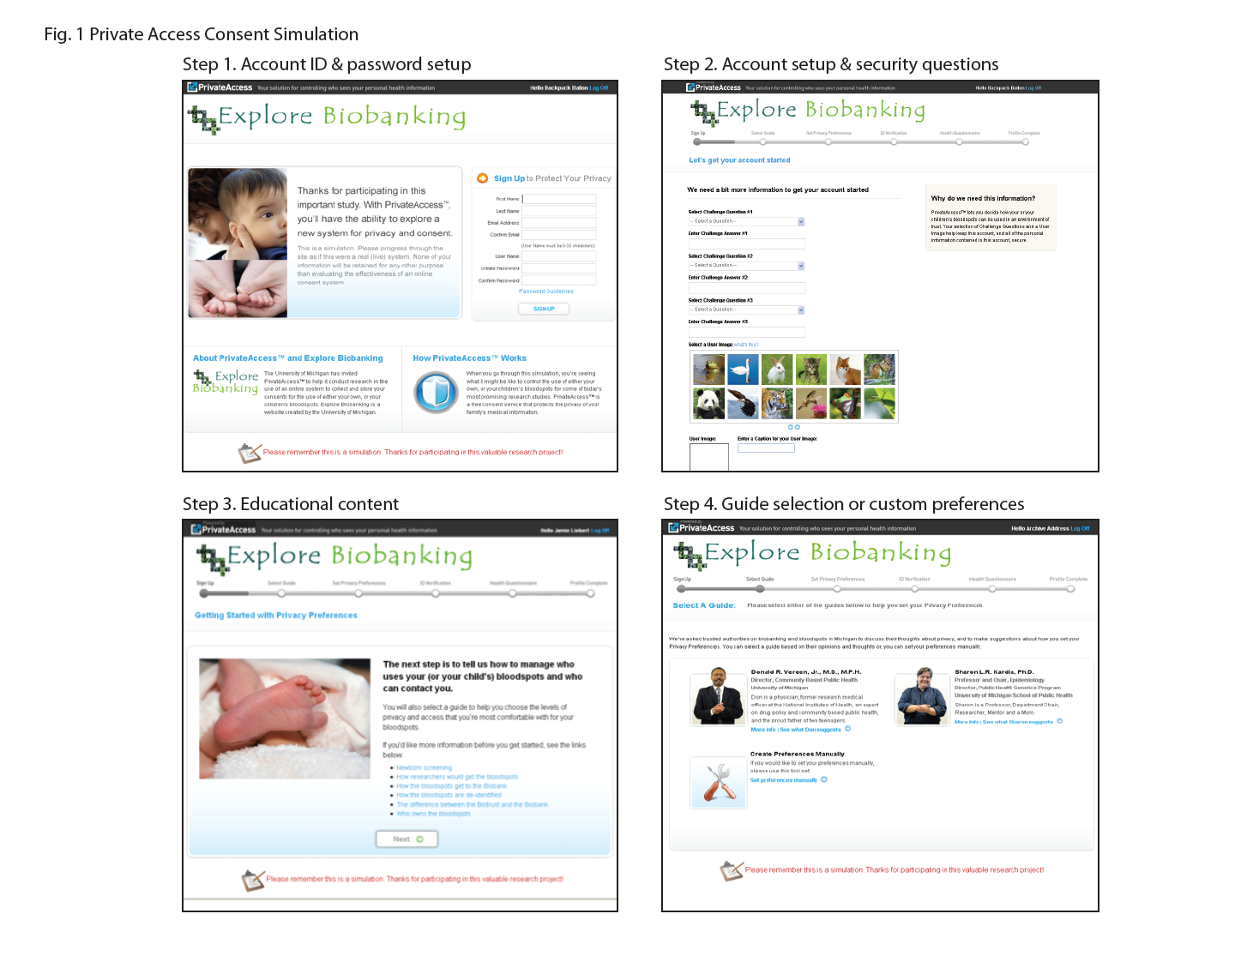

Slide 11
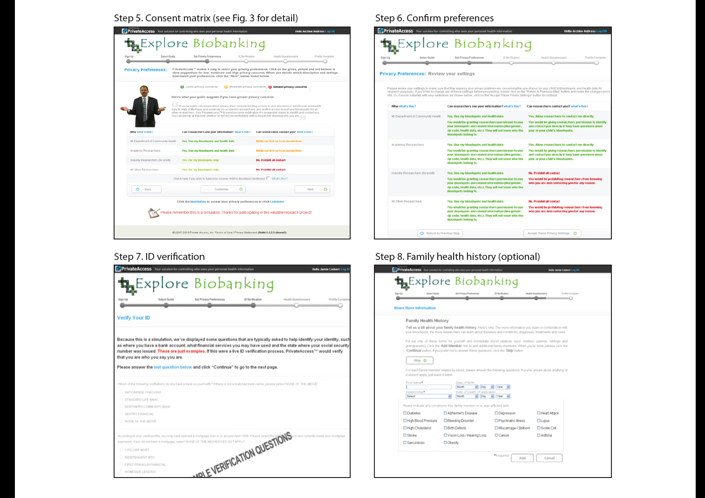

Slide 12
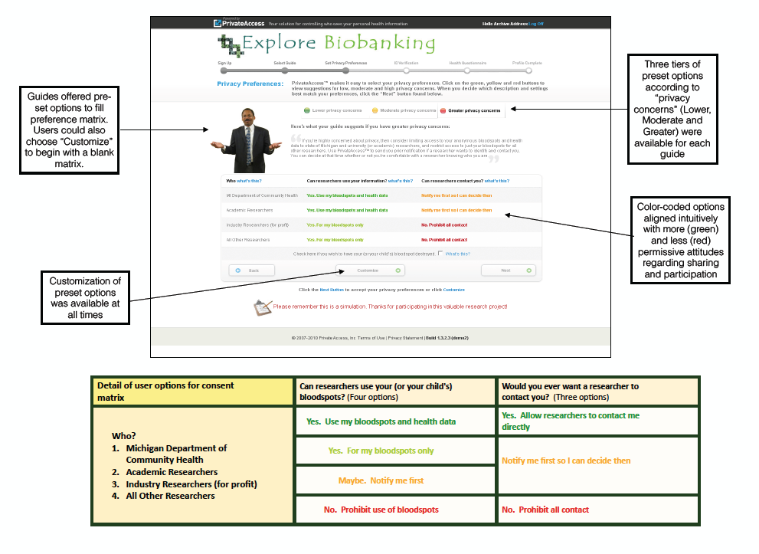

Slide 13
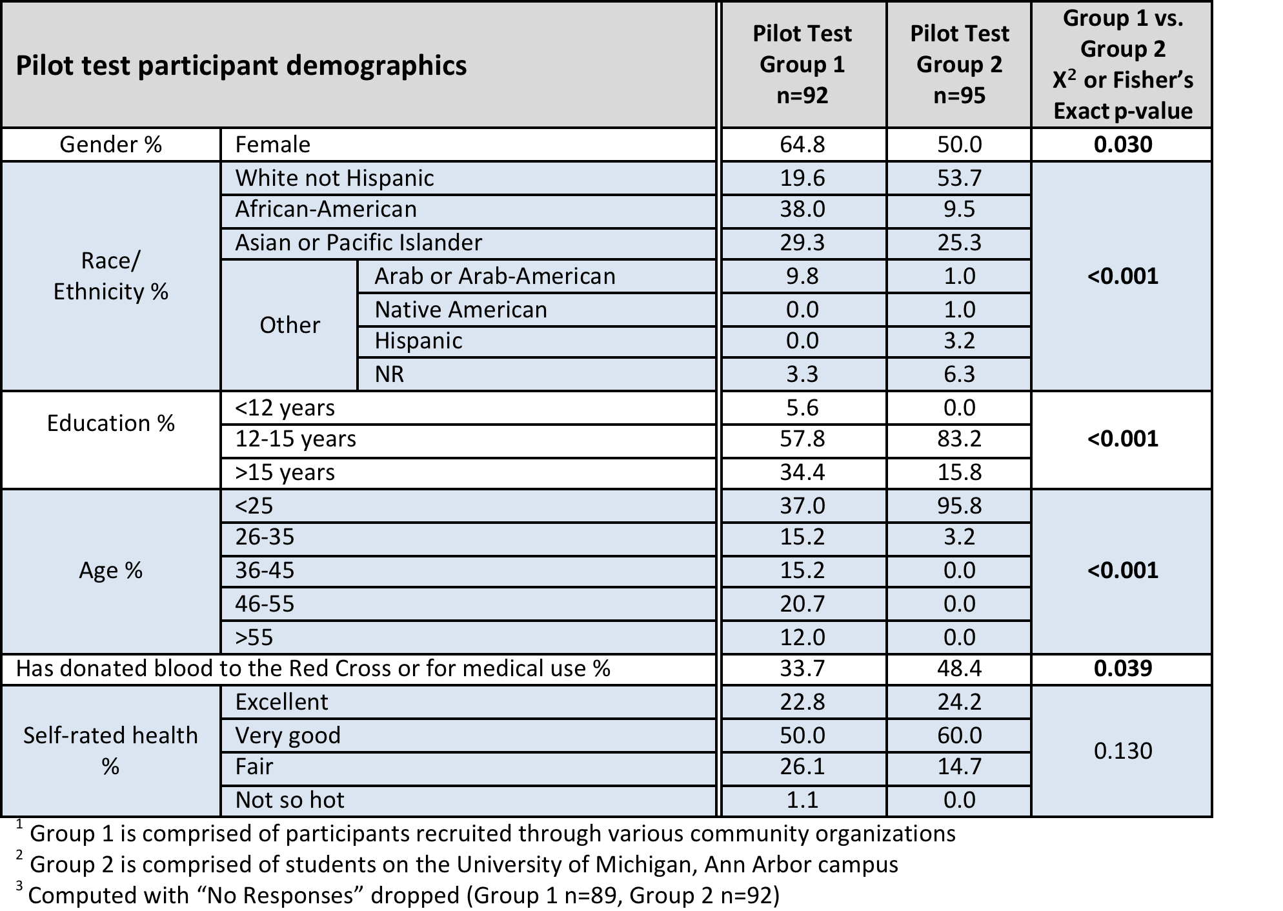

Slide 14
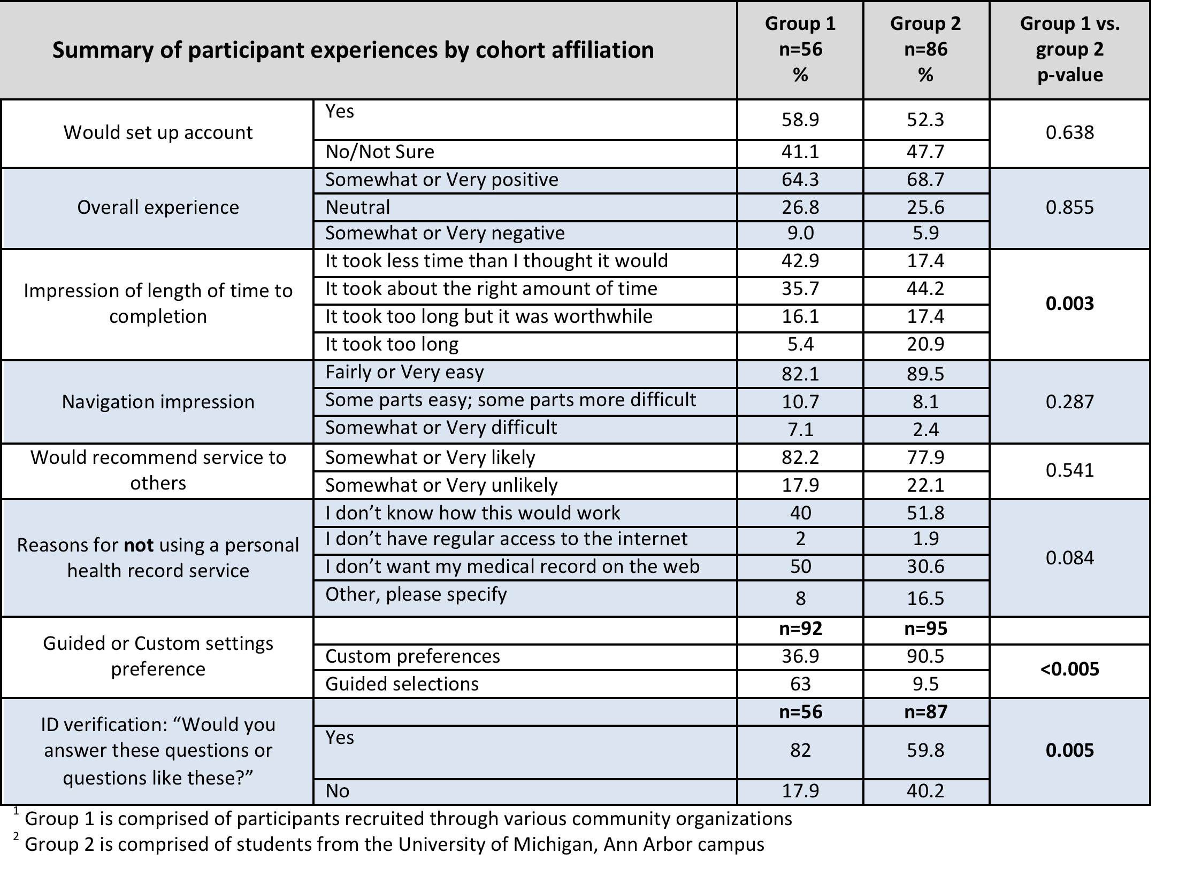

Slide 15
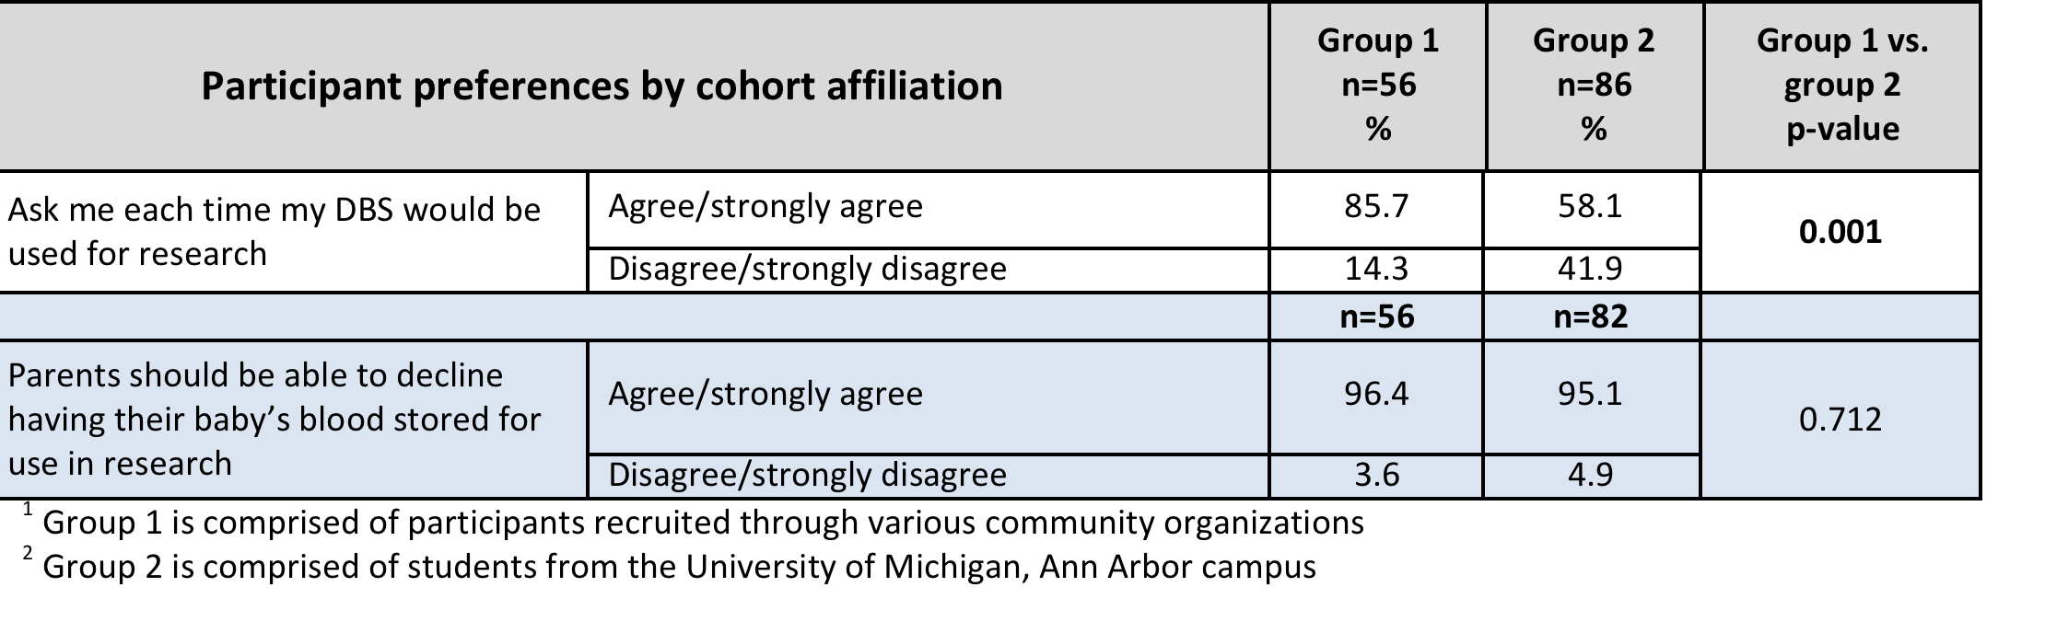

Slide 16
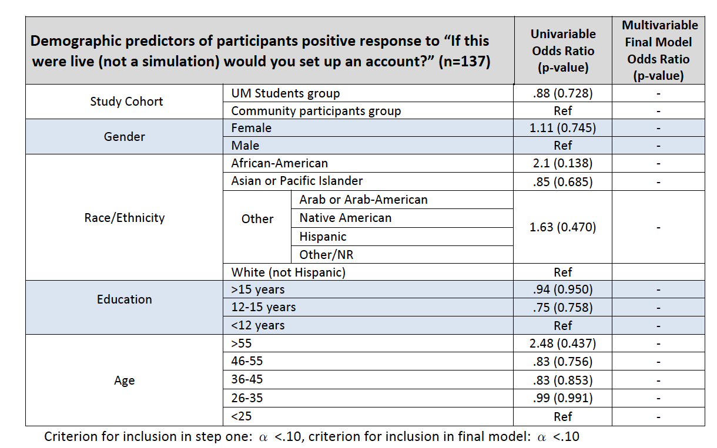

Slide 17
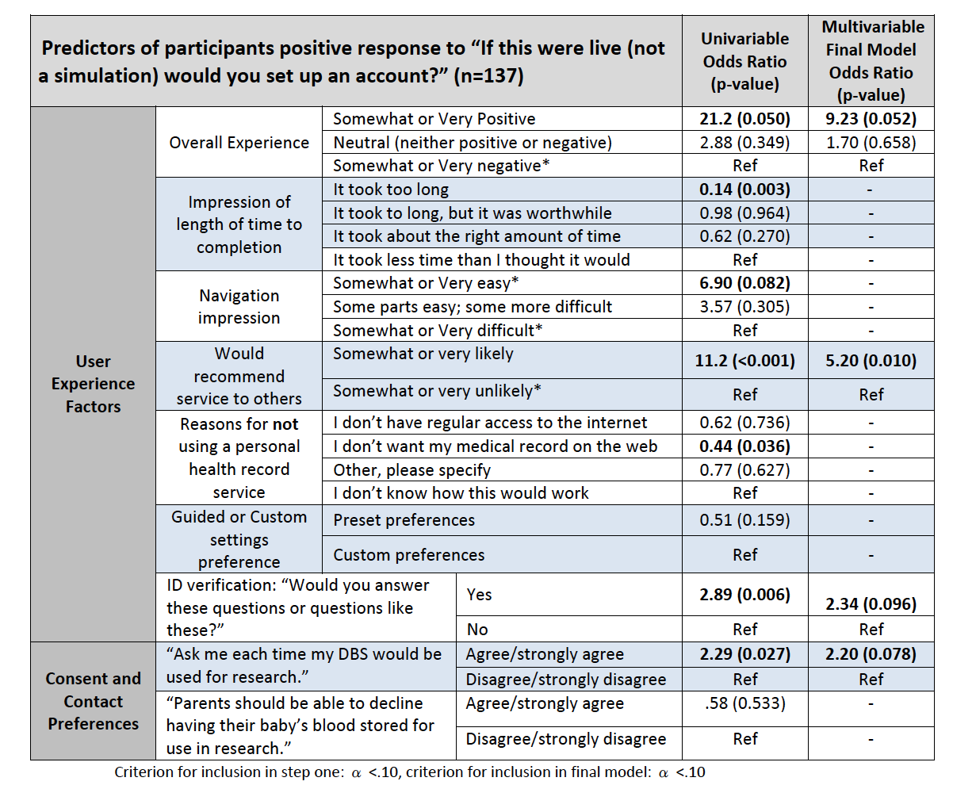

Slide 18
Discussion and Implications
What did our pilot test show?
Generally positive reaction
Strong desire to participate in consent decision
Some interesting cohort differences to note
ID Verification and contextual integrity
What questions did it leave untouched?
How to integrate this system with an active biobank or HER system.
Is the adoption of PCIs more challenging for Public Health vs. Clinical contexts?
III. Concluding thoughts
I. Participant-centric initiatives will be a part of the landscape to improve patients connection to the use of their samples and data. It i

