Slide 1

Practical and Ethical Challenges in Molecular Diagnostic Services of Genetic Disorders - Experiences of Universiti Sains Malaysia
Teguh Haryo Sasongko, MD, PhD
Human Genome Center, School of Medical Sciences Universiti Sains Malaysia
Translation in Healthcare – Exploring the Impact of Emerging Technologies
HeLEX Center, University of Oxford,
23-25 June 2015
of 20
Notes:
I thank the organizer for having this interesting conference and for providing generous supports for me. I will elaborate in this presentation our experiences in Universiti Sains Malaysia with regards to genetic disorders; the challenges as well as some of our recent initiatives in promotion of public awareness

Slide 2
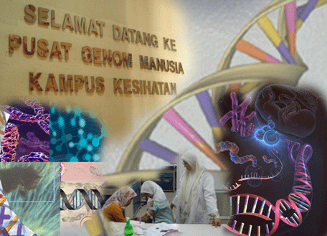
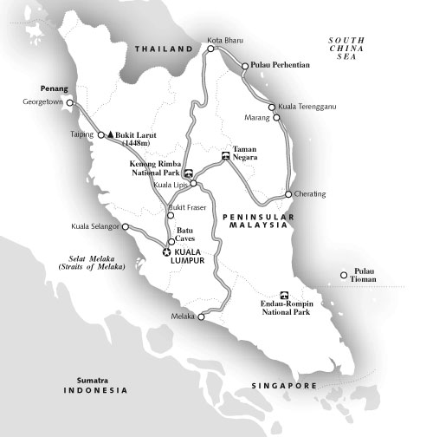
KOTA BHARU
Notes:
I have been working for the last 7 years in the Human Genome Center of Universiti Sains Malaysia. The center is located in Kota Bharu, capital of Kelantan state in northeastern part of Peninsular Malaysia and has been the region’s referral center for genetic diagnosis.

Slide 3
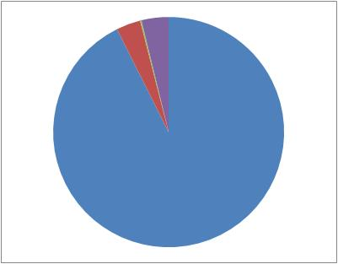
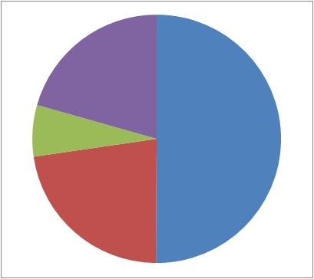
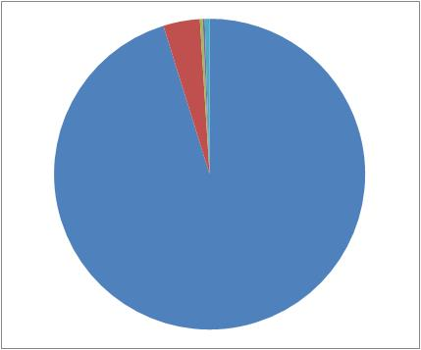
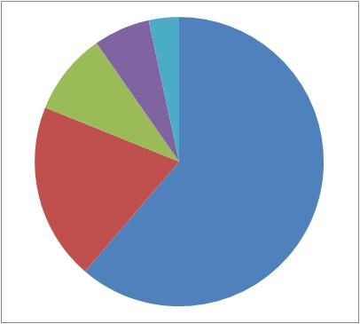
KELANTAN
MALAYSIA
Chinese 3.4%
Others 20.6%
Indian 0.2%
Others 3.8%
Indian 6.7%
Malay
50.1%
Malay 92.6%
Chinese 22.6%
Budhism 3.8%
Others 3.4%
Hinduism 6.3%
Christianity 0.3%
Christianity 9.2%
Hinduism 0.2%
Others 0.5%
Budhism 19.8%
Islam 61.3%
Islam 95.2%
Notes:
Kelantan is unique in terms of its demography as compared to the rest of the country. This is data from the latest census in the country, showing dominant representation Malay ethnicity and Muslim population in the State. This is an important factor to consider when dealing with inherited disorders.

Slide 4
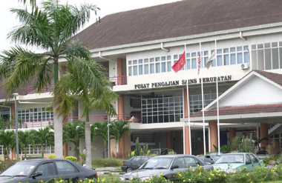
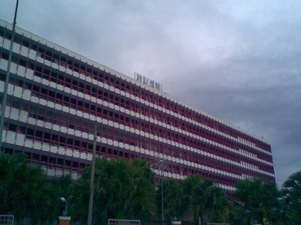
USM School of Medical Sciences
Hospital USM
Notes:
Human Genome Center is playing a dual role, to serve the school of medical sciences (for teaching and research programs) as well as the university’s hospital (for diagnostic services).

Slide 5
HGC-USM Diagnostic Services
Cyto-Molecular (Chromosome) Analyses :
Down, Edward, Patau, Klinefelter, Fragile X, Turner, Prader-Willi,
DiGeorge, Recurrent Miscarriages
Molecular (Gene) Analyses :
Ambiguous Genitalia (Sex-Determining Region Y – SRY)
Spinal Muscular Atrophy (SMA – SMN1)
Duchenne/ Becker Muscular Dystrophy (DMD/BMD - Dystrophin)
Gilbert Syndrome (UGT1A1)
Notes:
For the last 20 years, we have been catering diagnostic services for chromosomal analyses, karyotyping and FISH, as well as gene analyses for a few disorders. You may note here that for a 20-year-old institute, the advances made are not much.

Slide 6
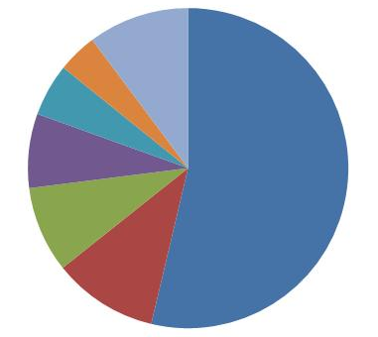
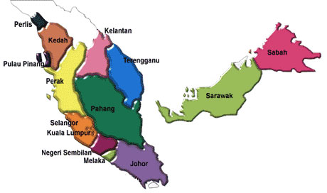
Sample Distributions
Others
10.2%
P.Pinang
4%
Kedah
5.3%
Terengganu
7.5%
Kelantan 53.7%
5.3%
Perak
8.7%
4%
53.7%
Selangor
10.6%
8.7%
7.5%
Other States 10.2%
10.6%
Human Genome Center USM
Notes:
As I mentioned earlier, most of the samples that came to our center are from the northeastern part of the country. Yet, more than half of the samples are coming from Kelantan itself.

Slide 7
In its report in 2004, WHO Southeast Asia Regional Office (SEARO) showed that countries of the region generally do not have adequate health program and/or
awareness campaign for addressing the burden of these diseases. This includes lack of expertise and general awareness.
Genetic services were incorrectly perceived as expensive, concerned with rare diseases, and considered mainly diagnostic rather than preventive and therapeutic.
Notes:
The South East Asia Regional Office of WHO has indicated lacks of health programs, awareness campaign as well as lack of expertise. Genetic services were incorrectly perceived as expensive, related only with rare diseases and have nothing to do with therapy

Slide 8
Lack of Knowledge and Awareness
Disorder
X
Psychosocial and Cultural Issues
Consequences
Prevention
Disclosure
Testing
(Chattophadyay 2006)
Notes:
Take Thalassemia for example, lack of knowledge and awareness about the disorder, its consequences and its psychosocial and cultural issues will lead to barriers to prevention, disclosure of disease status and testing for the disorder

Slide 9
In Malaysia, a nation-wide study about public perception on thalassemia indicated a general lack of knowledge among the study participants. The knowledge deficits may result in unnecessary anxiety among the public and may have profound emotional effects on the
carriers and patients of thalassaemia (Wong, 2011).
Notes:
In Malaysia, a nation-wide study about public perception on thalassemia indicated a general lack of knowledge among study participants. This may affect on how the public respond to patients and families as well as emotional effects on the carriers and patients of thalassemia.

Slide 10
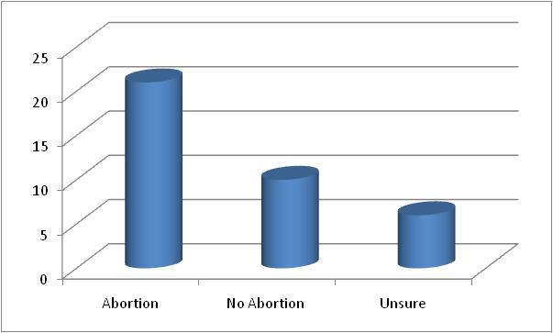
Would you consider PND for the next pregnancy ?
21
10
6
YES
NO
Unsure
Notes:
Another issue is related to Prenatal Genetic Diagnosis, which has been largely avoided in muslim countries. Our simple survey among parents with genetically disabled kids, most of them say yes to offer of PND in the next pregnancy

Slide 11
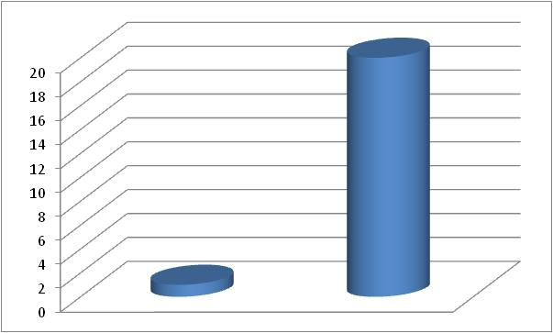
If the test turned up positive; What then ?
20
1
Abort
Not Abort
Notes:
However, of course, being a muslim, they would say no to abortion. This has indicated that information on genetic status of the fetus will always have meanings, whatever it is, to these parents. In short, promoting PND even in muslim communities.

Slide 12


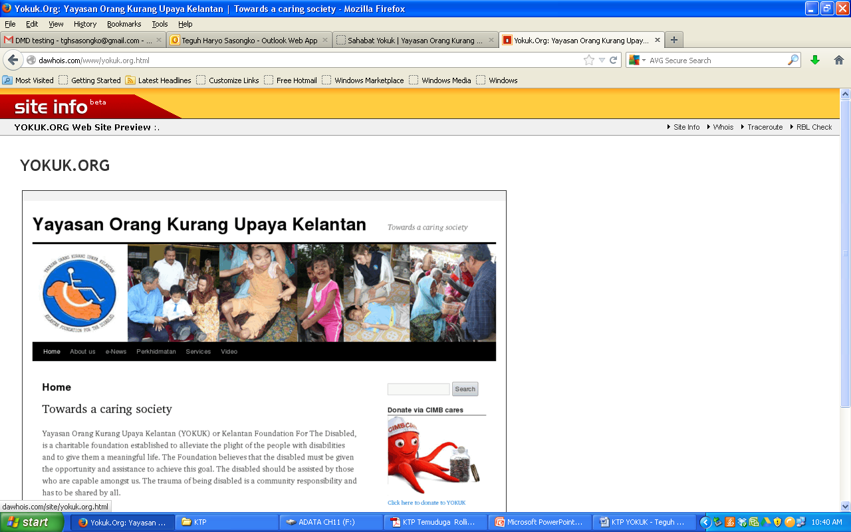


WHO has recommended to promote generation of public awareness about common genetic disorders and the potential for their
effective prevention and management. (WHO, 2004)
Knowledge Transfer Program:
Community Outreach for the Promotion of Public Awareness on Genetic Disorders; Targeting General Public and Patients/Families
Notes:
In response to recommendation from WHO, USM is currently engaging in a knowledge transfer program that aims at mobilizing university’s intellectual resources in human genetics and providing knowledge resources to the public. This is a collaborative project with the community and is funded by the government.

Slide 13
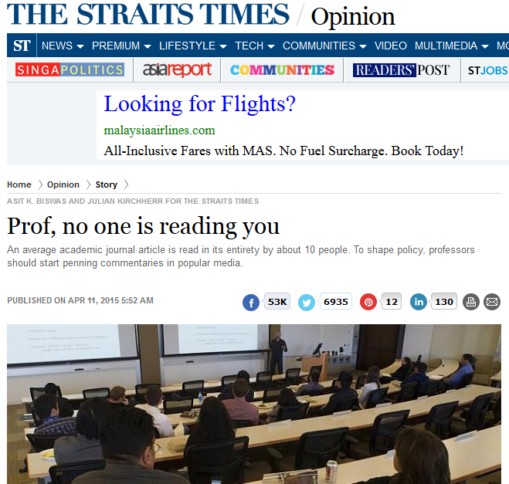
Notes:
I have been leading this initiative and I think this should serve as one of the background of the project, where intellectual products of university professors are actually rarely read, if at all. Yet, most of us working in university are spending huge energy on producing papers in scientific journals. So…start going to the community…

Slide 14


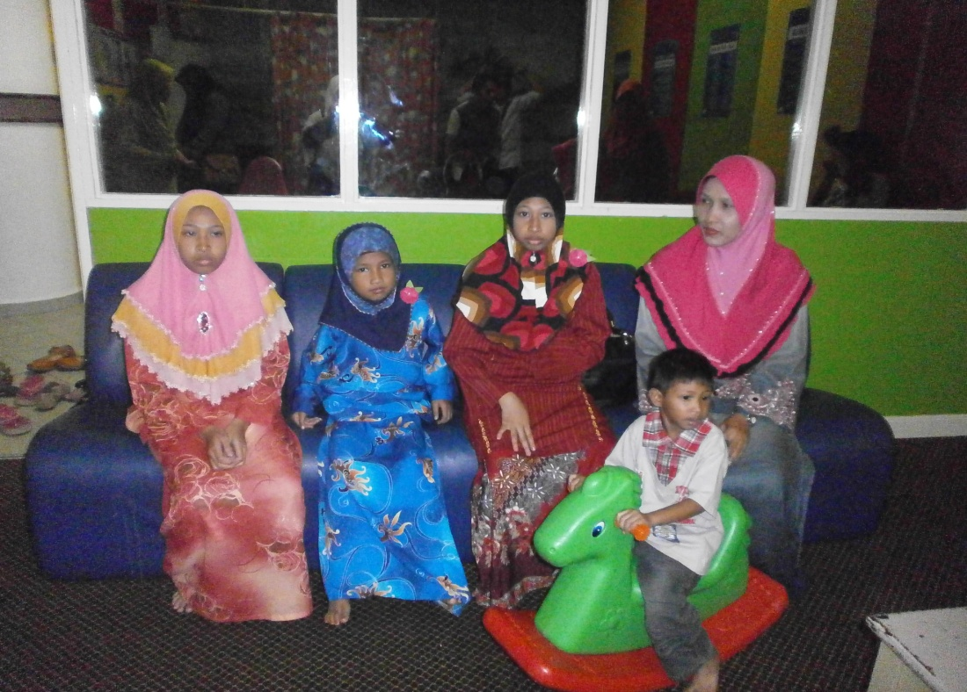
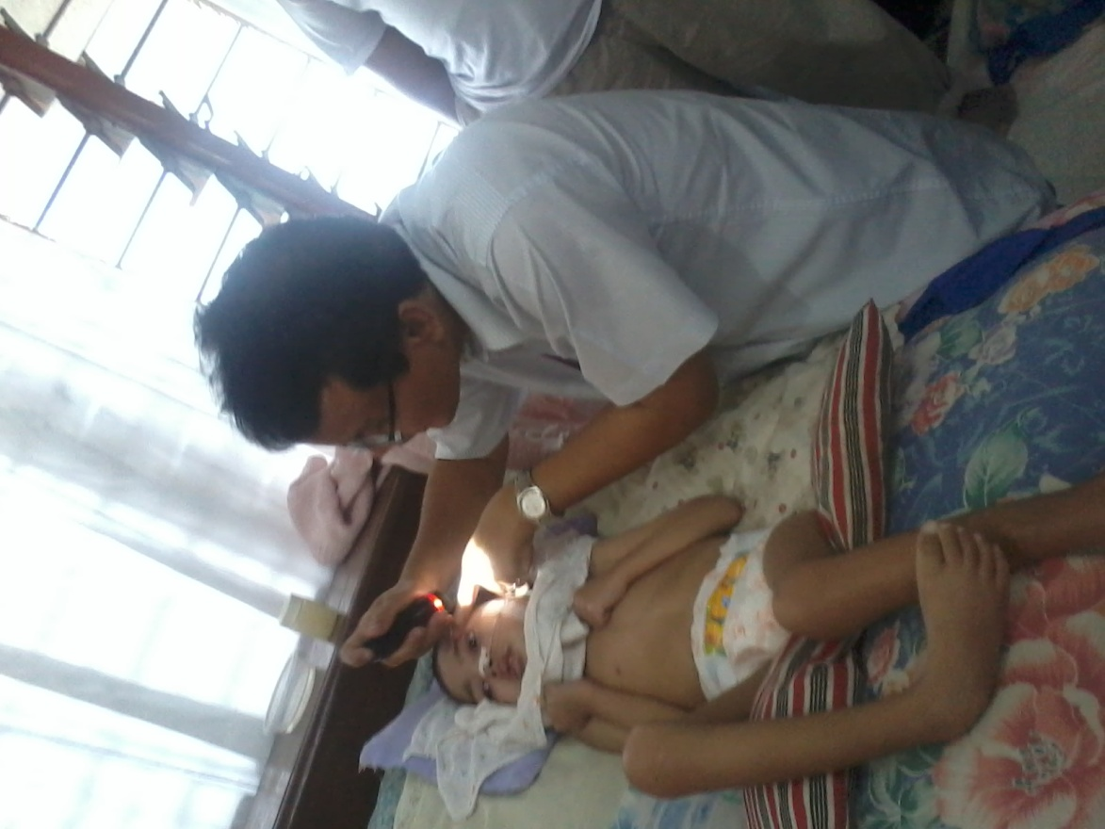
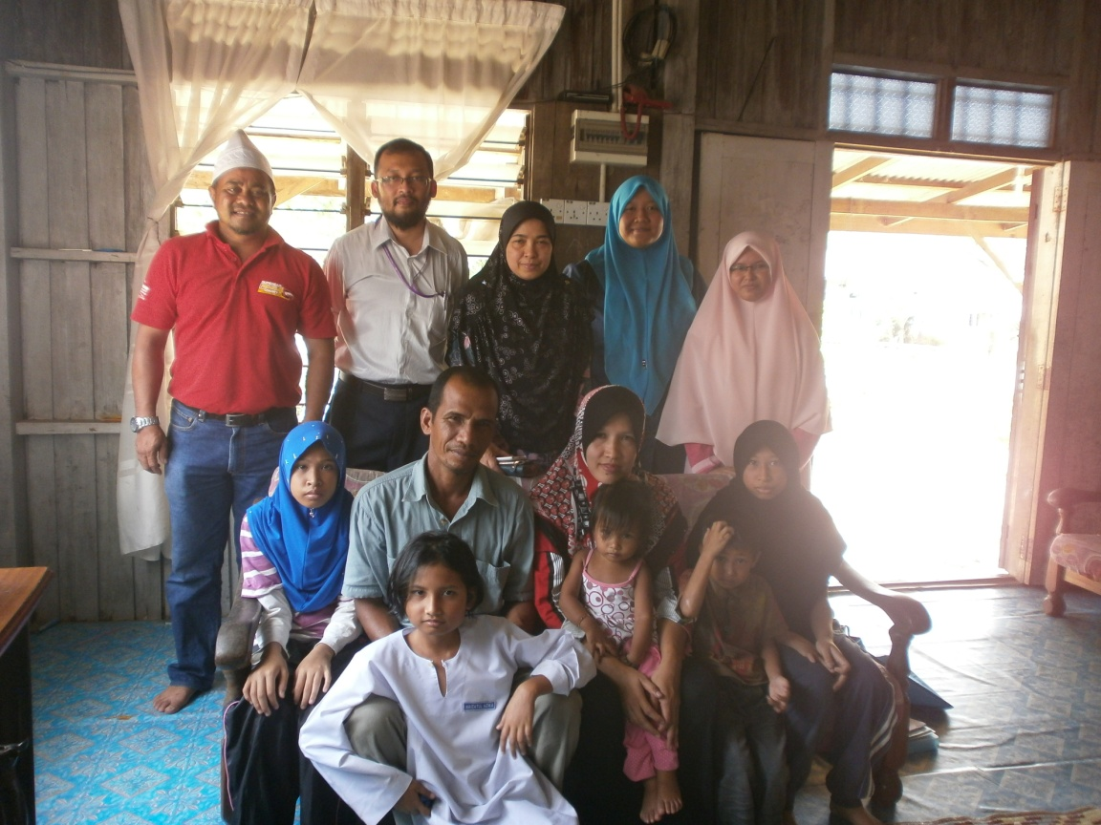
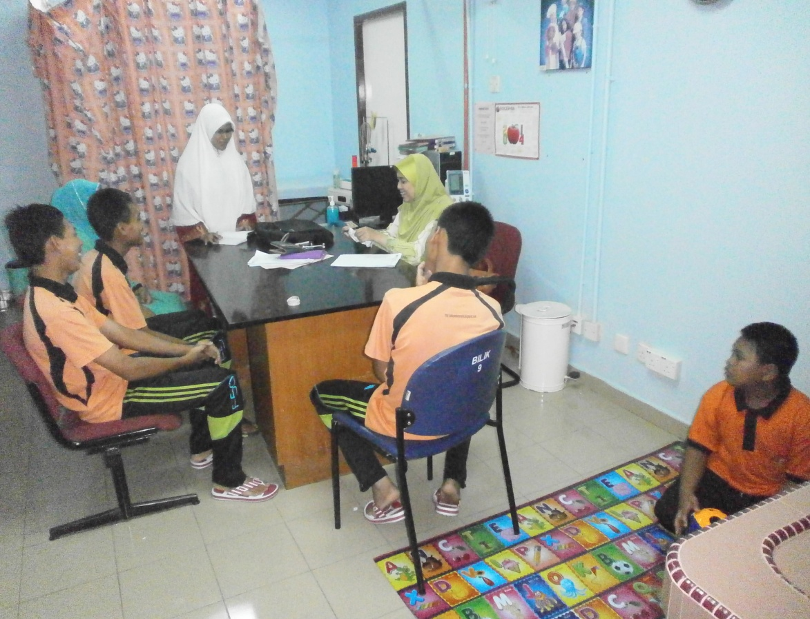
Home Visits and Clinic Day
Notes:
We do monthly home visits to families with indication of genetic disorders. We help with diagnosis, whenever necessary refer them to our hospital clinics, and help answer many of their queries about their family situation.

Slide 15
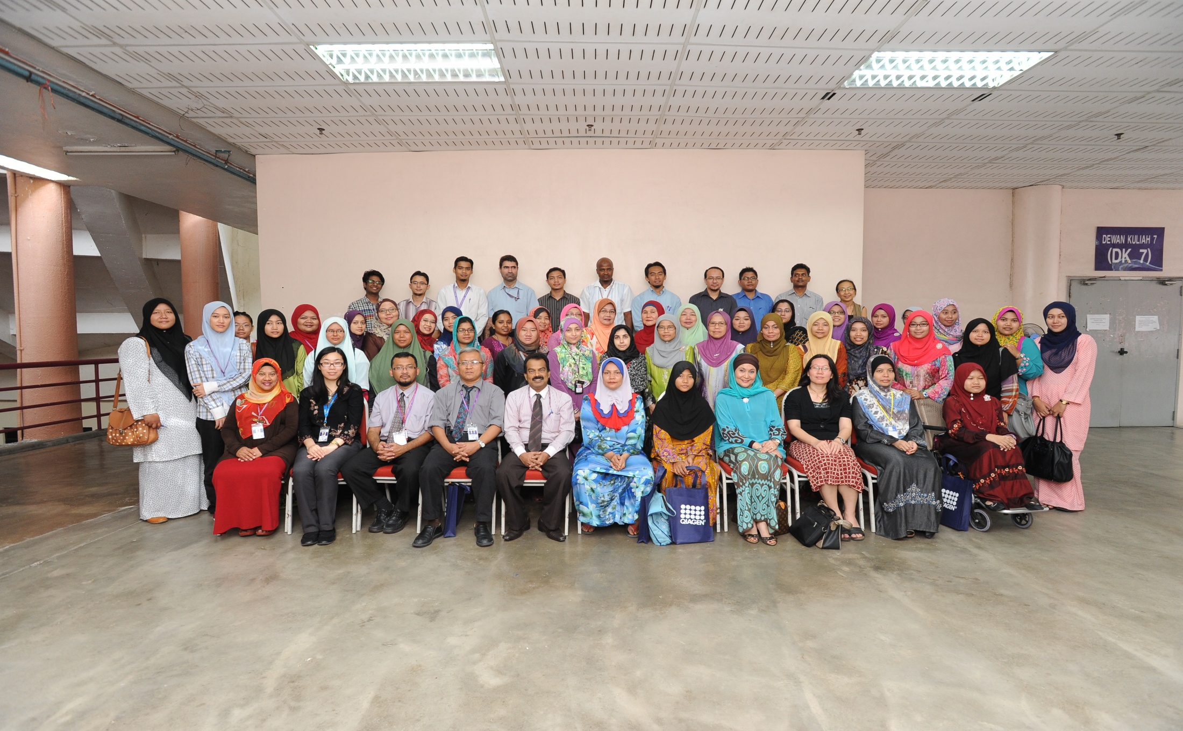
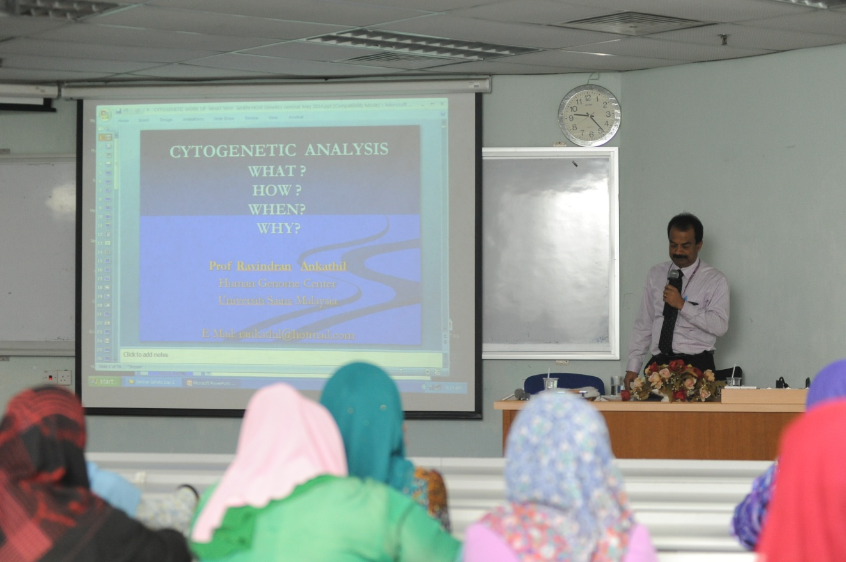
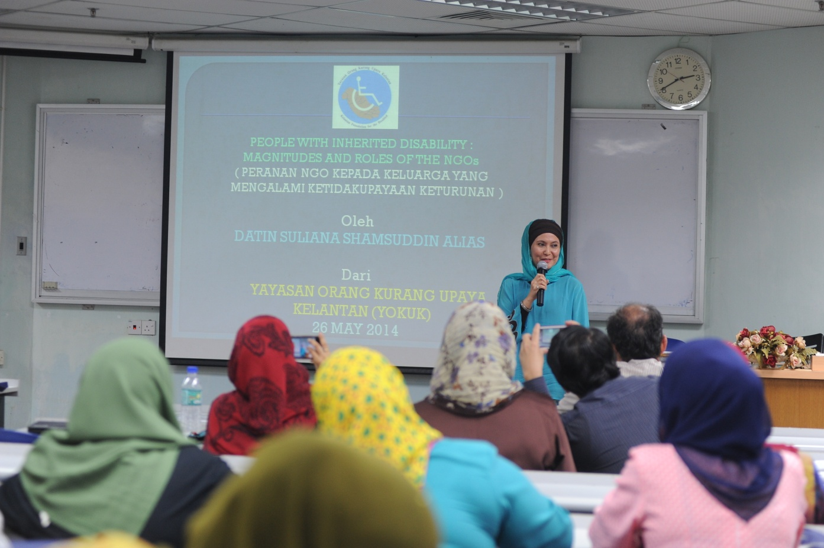
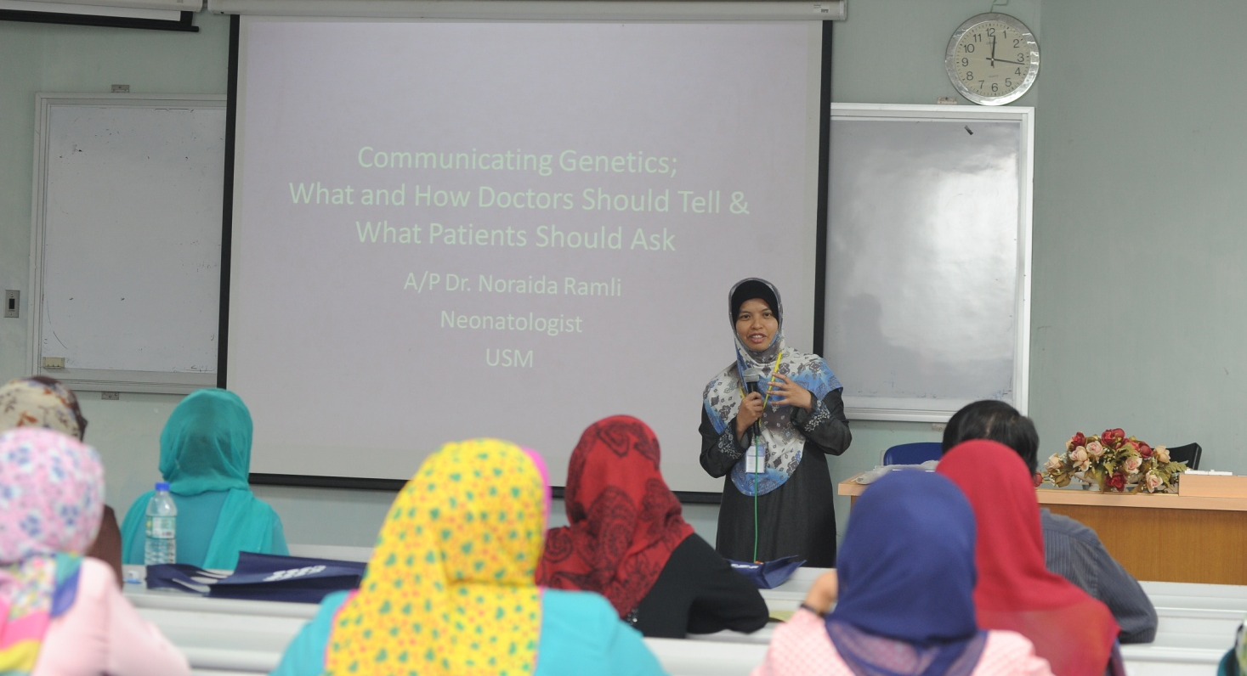
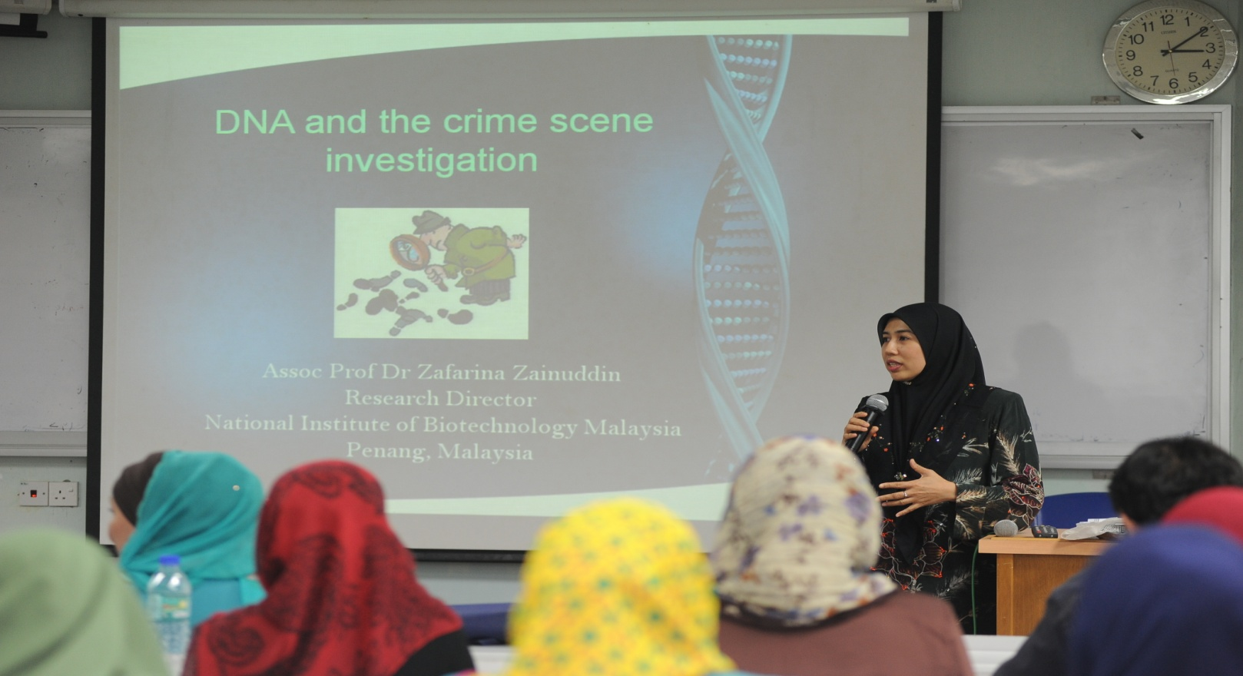
Seminars
Notes:
We organize seminars both to the public in generals and medical doctors about genetic disorders and other contemporary issues in human genetics. We also invite our counterparts in NGO to speak about their concerns.

Slide 16
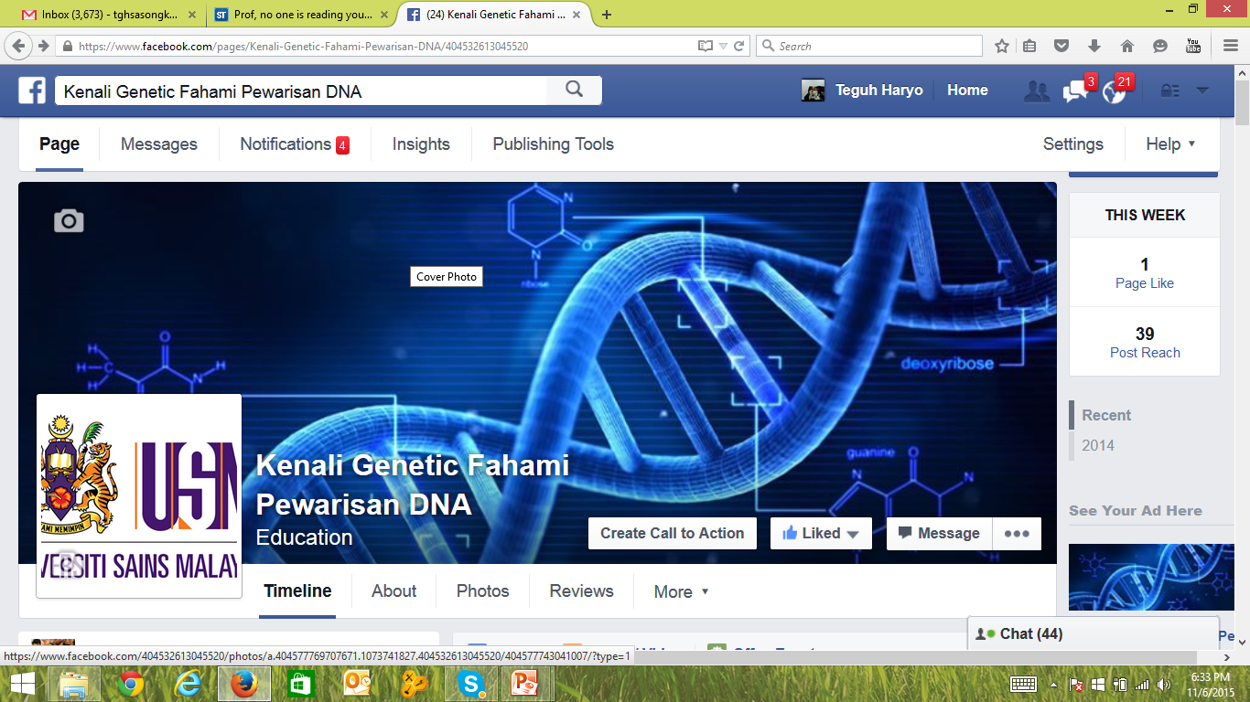
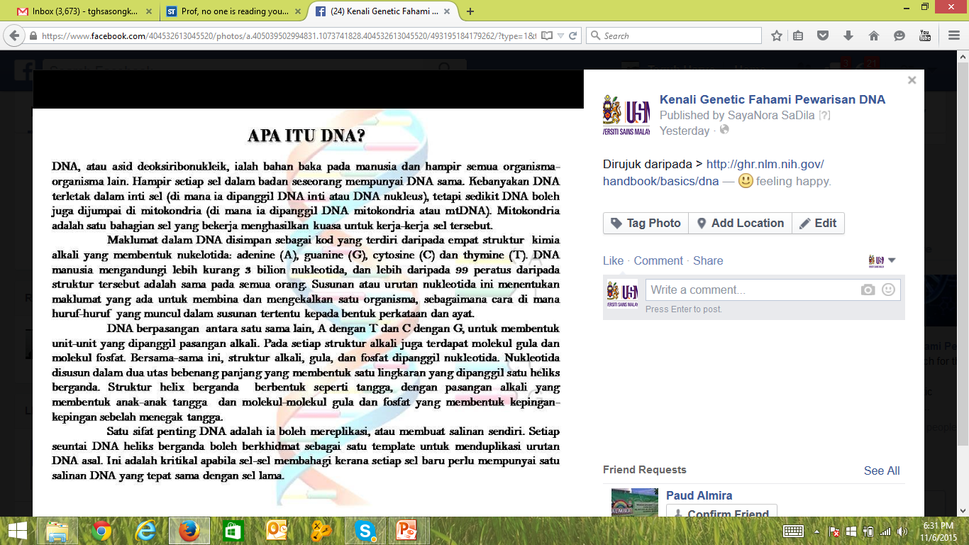
Notes:
We created a facebook page dedicated to providing scientific knowledge for lay reading. Most contents were translated from English sources, but we are also encouraging our local resources to contribute.

Slide 17
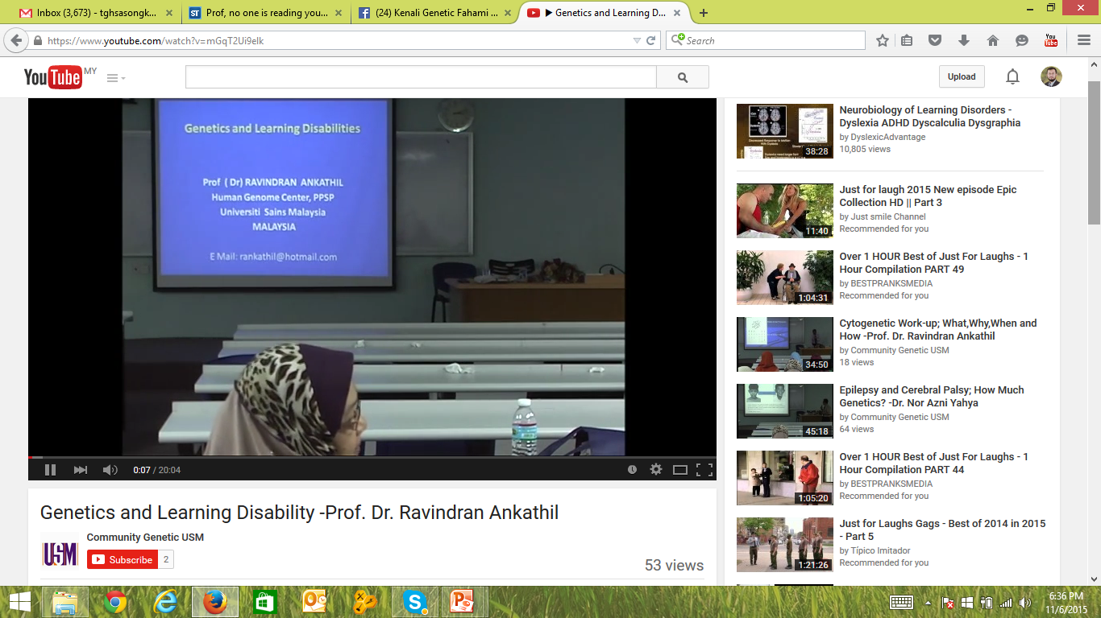
Notes:
We posted lectures on human genetics from our professors in youtube. We find this very practical for dissemination, although much more promotion should be done on the existence of such information

Slide 18
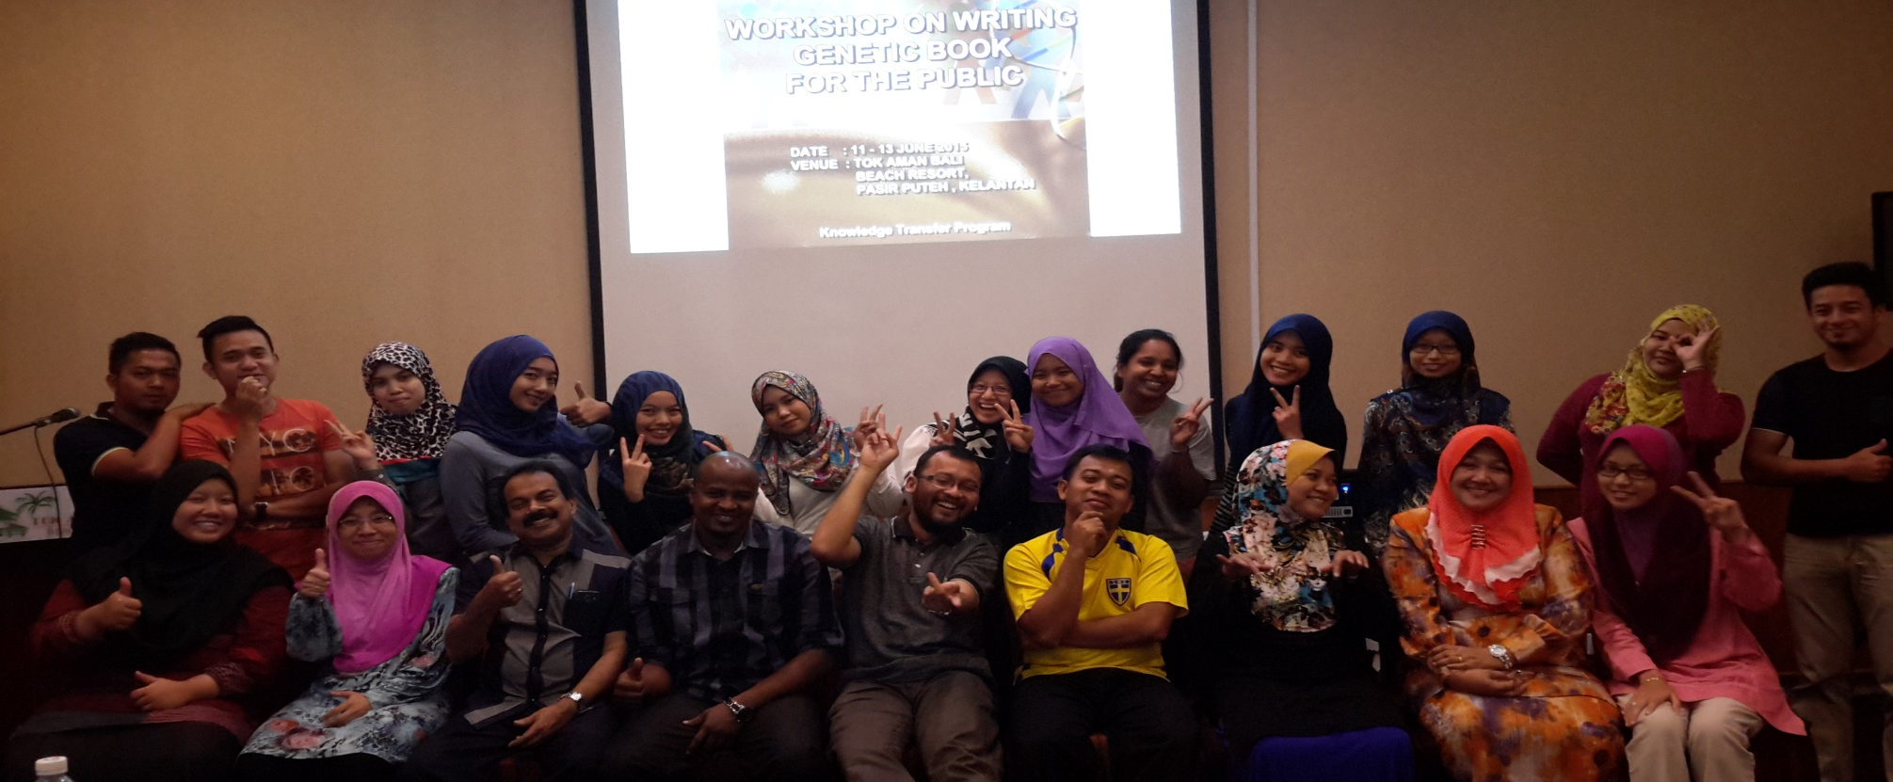
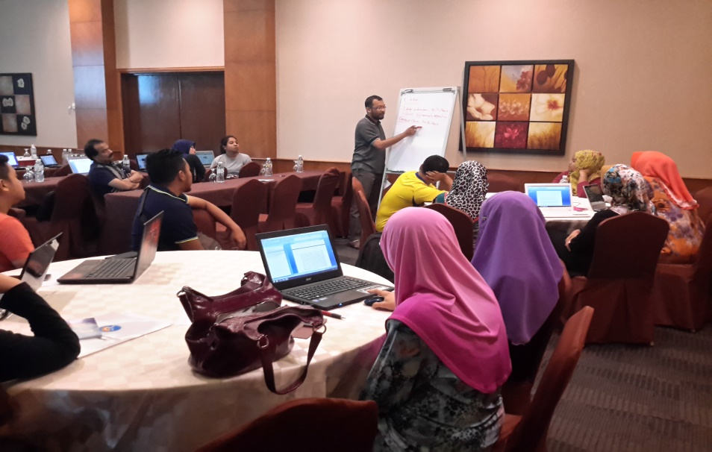
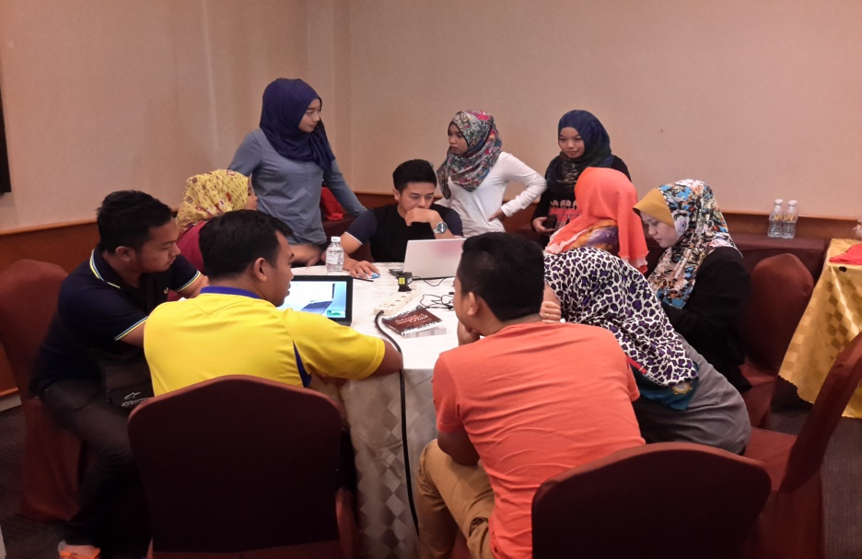
Notes:
Of recent initiative is our workshop for producing books on various topics in human genetics and genetic disorders. We mobilize our professors as well as postgraduate students to focus their time and energy for 2 days and produce simple books with topics of their choices

Slide 19
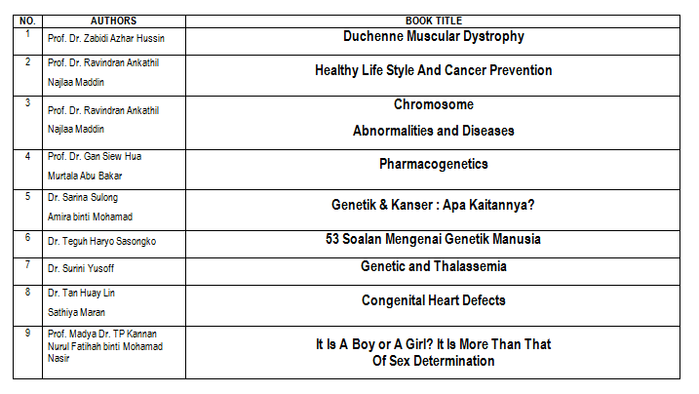
Notes:
As a results, drafts of nine books were produced. These are currently undergoing review. We project to publish them in October this year and distribute them for free.

Slide 20


Thank you
Dr. Teguh Haryo Sasongko
Human Genome Center
USM School of Medical Sciences
Ext. 6794; HP. 0129874175
Email : tghsasongko@gmail.com
Notes:
Well, things have been done and are ongoing as response to the concern of lack of knowledge and awareness. Yet, we still have to see the impact, if all of these have made any difference in our community. Thank you.

