Slide 1


The legal and ethical dilemma of embryonic stem cells: an impediment to translation in medicine?
E. Rial-Sebbag, A. Mahalatchimy, A.M. Duguet

Slide 2
Outline
Talking about hESC.
Talking about patenting hESC:
Brustle Case
Isco Case
Impact on research pathways.
Impact on research strategies.

Slide 3
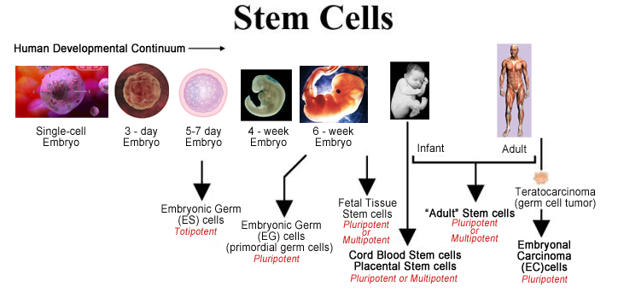
http://www.medexpressrx.com/research/treatments-of-diseases.aspx

Slide 4
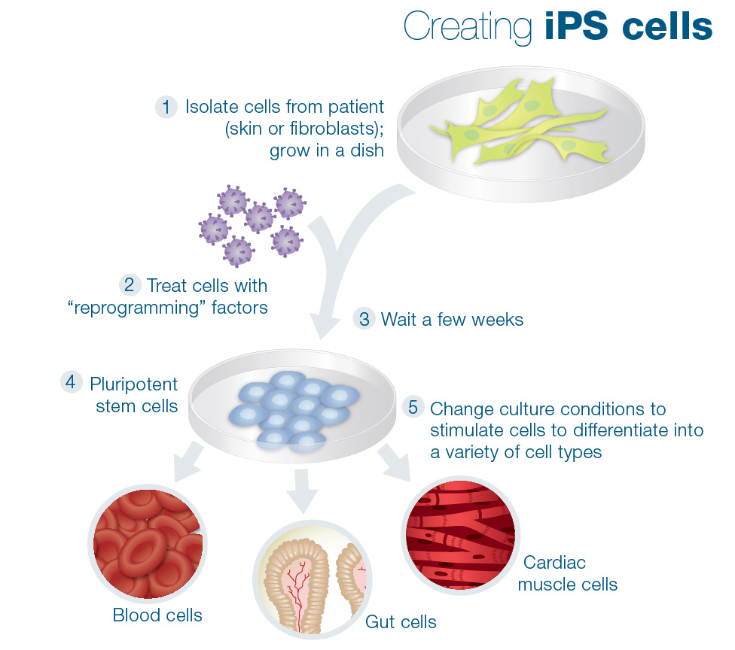
Induced Pluripotent Stem cells
http://learn.genetics.utah.edu/content/stemcells/quickref/

Slide 5
Regenerative medicine
“Regenerative medicine is an interdisciplinary field of research and clinical applications focused on the repair, replacement or regeneration of cells, tissues or organs to resort impaired function resulting from any cause, including congenital defects, disease, trauma and ageing. It uses a combination of several converging technological approaches, both existing and newly emerging, that moves it beyond traditional transplantation and replacement therapies. The approaches often stimulate and support the body’s own self‐healing capacity” [Daar AS, Greenwood HL, 2007].

Slide 6
Why Human embryonic stem cells are so important?
Immature cells.
High capacity of diferenciation.
Accessible since progress in fertilization (IVF).

Slide 7
Why using hESC is so problematic?
Shared ethical principles
Cells of human origin (anthropological approach) ;
Research on hESC implies the destruction of the embryo or the impossibility to reimplant the embryo;
Infringement of the Right to Life (European Convention on Human Rights, article 2) ;
Sometimes it is considered as immoral.
Notes:
Heterogeinity is leading to confusions on what can be possible where and have conseqsuences on the development of research activities

Slide 8
But….
Heterogeneous legal responses in Europe
Research is banned (Germany, Italy)
Research is authorised under conditions (France, UK)
Research is banned but with exemptions (France before 2011)
How to translate knowledge in hESC to clinics and to the market ?

Slide 9
hESC Research
Is increasing in Europe ;
Is limited by enforceable regulations ;
Is challenged by the public opinion in the various countries.

Slide 10
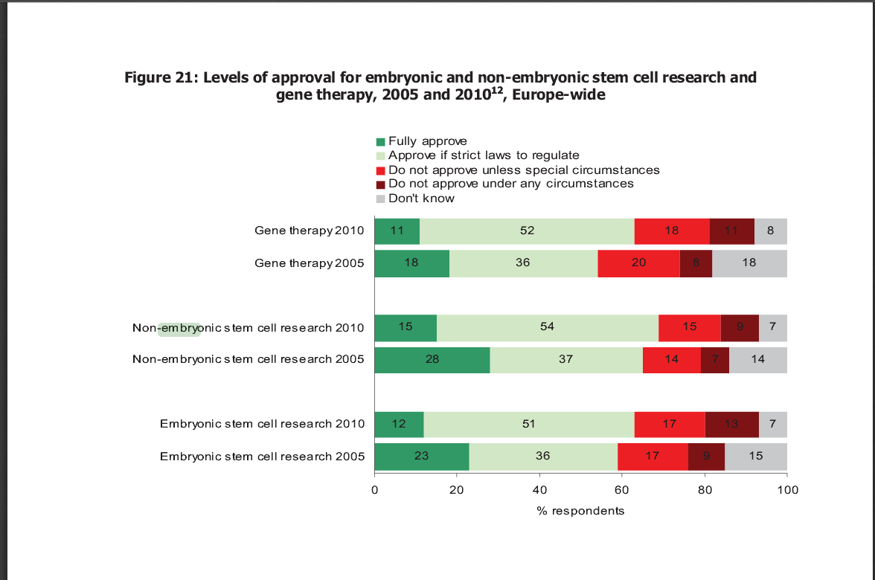
Europeans and Biotechnology in 2010 Winds of change?

Slide 11
Patentability Directive 98/44/EC
Protection of the innovation through patentability (Confer the right to exclude others from making, using, or selling the claimed invention).
Patentability criteria: novelty of the invention, inventive step, industrial application, respect ordre public or morality.

Slide 12
Industrial and commercial use of human embryos
CJEU: Case law Oliver Brüstle / Greenpeace Ev ( C-34/10), 18 October 2011
Mr Oliver Brüstle: holder of a patent on precursor cells produced from ESC to treat neurological diseases
On application by Greenpeace Ev, the German Federal Patent Court ruled: invalid patent as it covers processes for obtaining precursor cells from human ESC
Mr Brüstle’s appeal
German Federal Court of Justice refers questions to the CJEU on the interpretation of Directive 98/44/EC

Slide 13
CJEU: Case law Oliver Brüstle 18 October 2011
Three questions referred for a preliminary ruling:
1) What is meant by the term « human embryo »?
2) What is meant by the expression “uses of human embryos for industrial or commercial purposes”?
3) No patentability because of prior destruction of human embryos, or because of their use as base material?

Slide 14
CJEU: Case law Oliver Brüstle 18 October 2011
1) What is meant by the term « human embryo »?
Wide meaning: « any human ovum after fertilisation, any non-fertilised human ovum into which the cell nucleus from a mature human cell has been transplanted and any non-fertilised human ovum whose division and further development have been stimulated by parthenogenesis”
Return to the referring court: “to ascertain, in the light of scientific developments, whether a stem cell obtained from a human embryo at the blastocyst stage constitutes a ‘human embryo’”

Slide 15
CJEU: Case law Oliver Brüstle 18 October 2011
2) What is meant by the expression “uses of human embryos for industrial or commercial purposes”?
The exclusion of patentability covers use for purposes of scientific research

Slide 16
CJEU: Case law Oliver Brüstle 18 October 2011
3) No patentability because of prior destruction of human embryos, or because of their use as base material?
Both
an invention is excluded from patentability “where the technical teaching which is the subject-matter of the patent application requires the prior destruction of human embryos or their use as base material”

Slide 17
JUDGMENT OF THE COURT (Grand Chamber)
18 December 2014
International Stem Cell Corporation

Slide 18
The legal question
Article 6(2)(c) of Directive 98/44 must be interpreted as meaning that an unfertilised human ovum whose division and development to a certain stage have been stimulated by parthenogenesis constitutes a ‘human embryo’ within the meaning of that provision?

Slide 19
The decision
an unfertilised human ovum whose division and further development have been stimulated by parthenogenesis does not constitute a ‘human embryo’, within the meaning of that provision, if, in the light of current scientific knowledge, it does not, in itself, have the inherent capacity of developing into a human being, this being a matter for the national court to determine.
Notes:
Change in the croteria Potentially patentable

Slide 20
Criteria for patenting
Does the patent suggest or refer to the use of a “human embryo”?
the inherent capacity of developing into a human being.
Does the patent involve the destruction of a “human embryo”?

Slide 21
Consequences for research pathways
Sustainability of research if private companies can invest.
Reinforcement of public/private partnerships.
Collaborations enforced through Stem cell banks.

Slide 22
Consequences for research strategies
Companies will naturally go where they can protect their discoveries ;
Will impact on the choice to invest in one or another technique;
Will imply to make the information on the tecnhique used to derive cells lines (with or without destruction of the embryo) available in cell lines registries.

Slide 23
Mahalatchimy A. and al., The impact of European embryonic stem cell patent decisions on research strategies.

Slide 24
To conclude
Field of Stem cell is quite difficult to frame in a context of concurrent initiatives (elaboration of scenarios);
Part of the decision to invest in one or the other field is the “return of investment” mostly constituted by the protection offered by patents;
Change of the Court position will probably reassure the companies to develop new fertilisation methods but will lead to other forms of bioethical questioning on procreation.
It encourages companies to stay or to come to Europe to benefit from this patents 'regime.
Notes:
Which cells to choose ?

Slide 25
Further issues…
Node of confusion between patentability (property right) and commercialisation of the human body (Fundamental rights).
Still an effort to make for avoiding the “pollution” of the discourse around stem cells by the bioethical questions posed by hESC.
Use of IPS cell lines is seen as an alternative BUT the techniques are not scientifically equivalent and IPS should raise issues.
Notes:
The adoption of the new decision is leading to some confusion where patents could be offerd to protect some inventions wheras the commercialisation of such invention could be banned as an infringement of the non commercialisation principle.

Slide 26
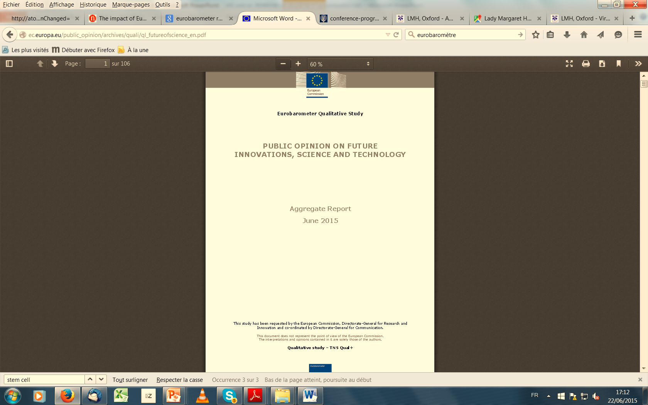
- In some countries stem cell research was not well understood by all (NL, CZ,
EE, PT, SK), but when it was understood most participants in all countries liked
the idea of stem cell therapy for organ repair. Reasons for liking it included
that this method will be able to cure many diseases.
- Reservations focused on ethical concerns (whether people should change nature
or let it run its course), cost and whether people will become careless with their
health because they know they can be cured with stem cell therapy.
http://ec.europa.eu/public_opinion/archives/quali/ql_futureofscience_en.pdf
Notes:
Nevertheless stem cell research will probably be supported in the future as it has been shown in the last report produced by Eurobarometer a few days ago

Slide 27

THANK YOU
Emmanuelle.rial@univ-tlse3.fr
This work has been partly supported by the EUceLEX project (FP7, GA: NO: 601806)

