Slide 1
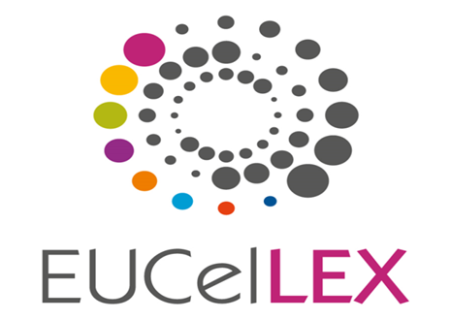

Translation of Stem Cells therapies: How to Balance Hope and Uncertainties?
E. Rial-Sebbag and A. Blasimme

Slide 2
Outline
Presentation of cells therapies and of the legal and ethical tensions in using them.
Presentation of the Durisotto case
Discussion on the ruling of the European Court of Human Rights
Conclusion

Slide 3
Outline
Presentation of cells therapies and of the legal and ethical tensions in using them.
Presentation of the Durisotto case
Discussion on the ruling of the European Court of Human Rights
Conclusion

Slide 4
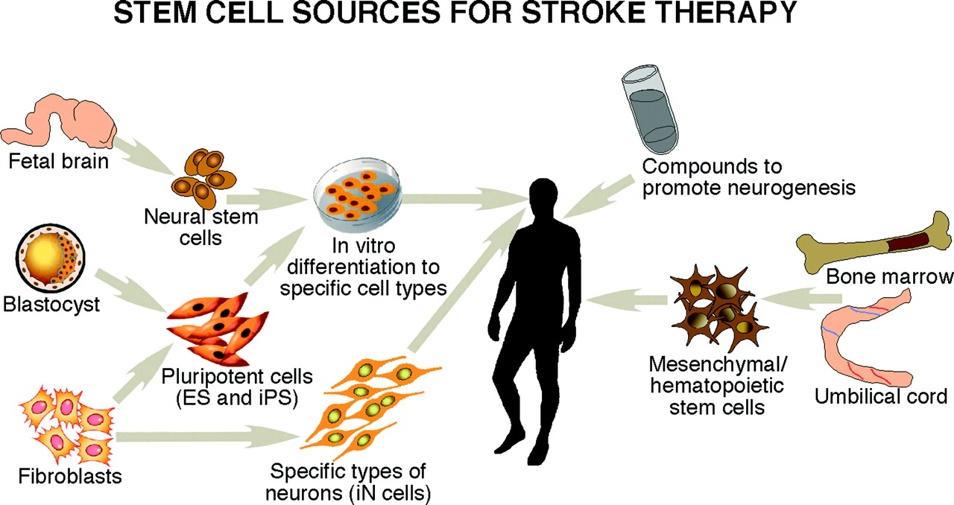
Stem cells sources

Slide 5
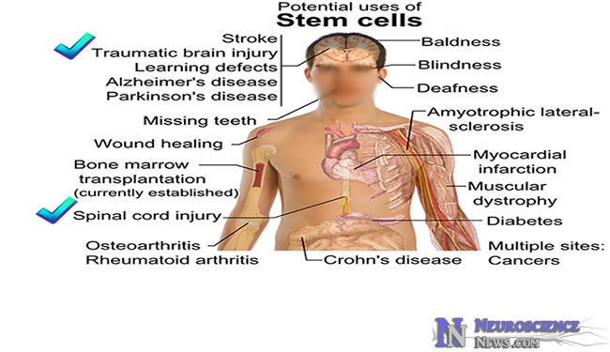
What are Stem cells therapies for ?

Slide 6
Stem Cell therapies regime
Are considered as new medicinal products in the context of regenerative medicine.
Are legally defined as innovative therapies (Regulation EC/2007)
Are subject to a strict evaluation process by regulatory agencies at the European level and the national level.
Are aiming at being commercialised.

Slide 7
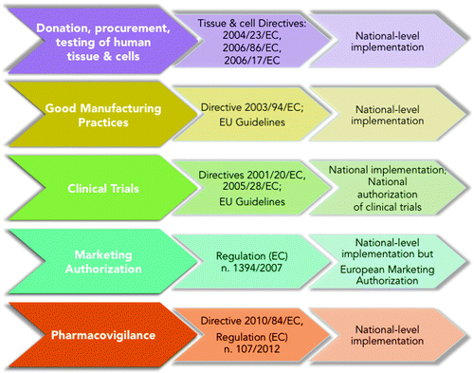
A complex regulation
Blasimme Alessandro and Rial-Sebbag Emmanuelle. Stem Cells and Development. December 2013, 22(S1): 14-19. doi:10.1089/scd.2013.0352.

Slide 8
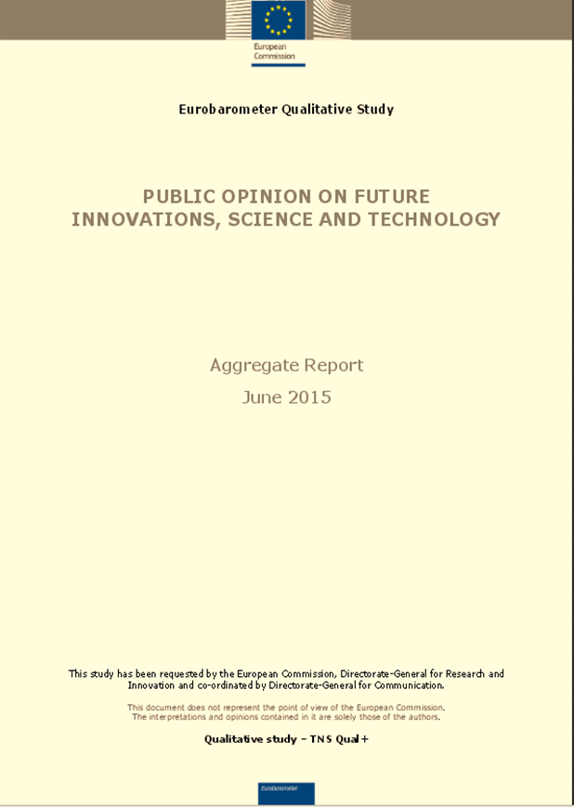
Public expectations
- In some countries stem cell research was not well understood by all (NL, CZ,
EE, PT, SK), but when it was understood most participants in all countries liked the idea of stem cell therapy for organ repair. Reasons for liking it included that this method will be able to cure many diseases.
- Reservations focused on ethical concerns (whether people should change nature or let it run its course), cost and whether people will become careless with their health because they know they can be cured with stem cell therapy.

Slide 9
Paradox
Gap between the time required by regulatory agencies for the evaluation (in terms of safety and efficacy) of these new products which are considered as innovative therapies and the expectations of certain groups of patients
STRONG IMPACT OF TRANSLATION

Slide 10
Outline
Presentation of cells therapies and of the legal and ethical tensions in using them.
Presentation of the Durisotto case
Discussion on the ruling of the European Court of Human Rights
Conclusion

Slide 11
The case
European court of human rights
Durisotto v. Italy, appeal n. 62804/13
May 6, 2014
Rial-Sebbag E, Blasimme A. The European Court of Human Rights' ruling on unproven stem cell therapies: a missed opportunity? Stem Cells Dev. 2014 Dec;23 Suppl 1:39-43

Slide 12
The facts
Mr Durisotto, acting as the guardian of his daughter, has been refused by an Italian hospital to get access to the Stamina method, a cell therapy intended to treat a variety of serious disorders.
He is asking the ECHR if this refusal to access to a stem cell treatment is against the principles of the European Convention of Human Rights ?

Slide 13
The law
Can access to a stem cell treatment be granted according to the principles of the European Convention of Human Rights and in particular:
  Right to life (European Convention of Human Rights: Article 2),
  Right to respect for private life (Article 8),
  Prohibition of discrimination (Article 14)

Slide 14
Outline
Presentation of cells therapies and of the legal and ethical tensions in using them.
Presentation of the Durisotto case
Discussion on the ruling of the European Court of Human Rights
Conclusion

Slide 15
Discussion on legal categories
Unproven therapies
Versus
Compassionate therapies
Although the ECHR has confirmed the Italian court ruling, the court implicitly endorses the possibility that totally unproven therapies that are neither undergoing marketing authorization nor were ever properly tested in a clinical trial could be legitimately considered as compassionate treatments.

Slide 16
Impact of the decision
Is leading to more confusion on what is authorised or not;
Is creating expectations for desperate patients;
Is confusing in guiding judges for future similar cases.

Slide 17
Discussion on acceleration of evaluation process
Paradox since the adoption of this decision
  Proposal for acceleration of the evaluation process through “adaptive licensing” (EMA, FDA, Japan).
  Can be considered as a huge shift in the evaluation process of innovative therapies.
The main questions are why? For which interests? For which consequences?

Slide 18
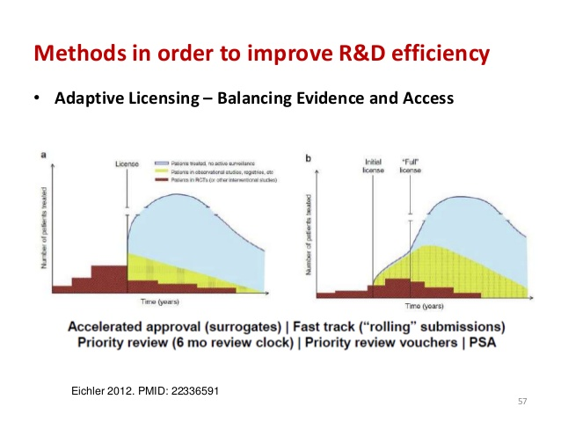

Slide 19
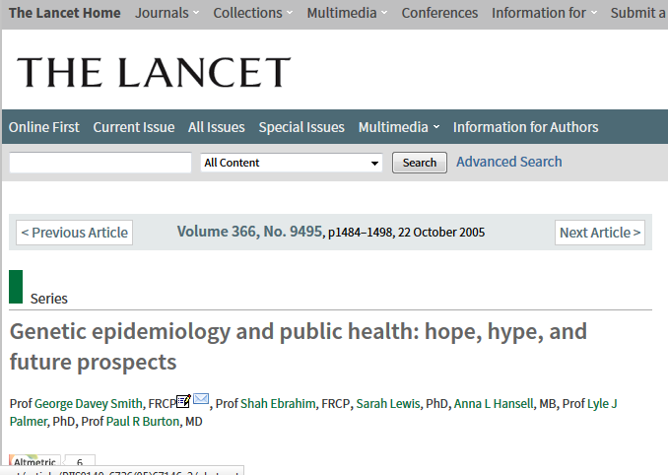
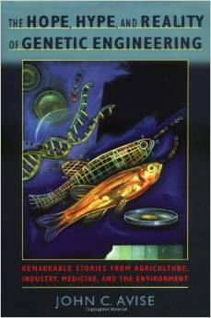
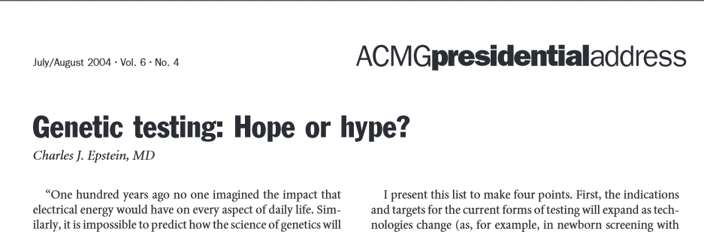
Risks of reuse of the “Genetic discourse”

Slide 20
Outline
Presentation of cells therapies and of the legal and ethical tensions in using them.
Presentation of the Durisotto case
Discussion on the ruling of the European Court of Human Rights
Conclusion

Slide 21
Conclusion
It is never a good idea to regulate under the pressure of a group (the public, the laboratories etc.);
The duty of information should prevail;
This information is due by:
  Scientists (exploring new ways of communication: publications for scientific community and other forms to the public);
  States and regulatory agencies in their role of promoting and protecting healthcare (constitutionnal duty).

Slide 22


Slide 23

THANK YOU
Emmanuelle.rial@univ-tlse3.fr
This work has been partly supported by the EUceLEX project (FP7, GA: NO: 601806)

