Slide 1
Psycho-socio-economic challenges on Thalassemia patients: Sharing from Peripheral Region (Purwokerto, Indonesia)
Lestari, DWD., Faiza, D., Rujito L, Setyono,J., Suparno, AA

Slide 2
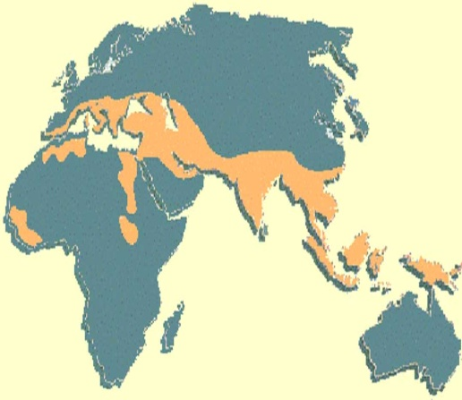
Thalasemia
THALASEMIA
Red Blood Cell Disorder
Hemolitic anemia
Have a systematic effect on human body
Recesive mendelian inheritance
Before : Thalassemia Belt Region
Now : Spread all over the
world
6-10% of population in Indonesia are predicted to be genetically thalassemia carrier
→ Banyumas Region : 8 %
Therapy
Montly Blood Transfusion
Chelation Therapy
Prevention
Genetic Screening/Preconception Screening
Genetic Counselling
Prenatal Screening/Amniosintesis
Notes:
Mr. L slide

Slide 3
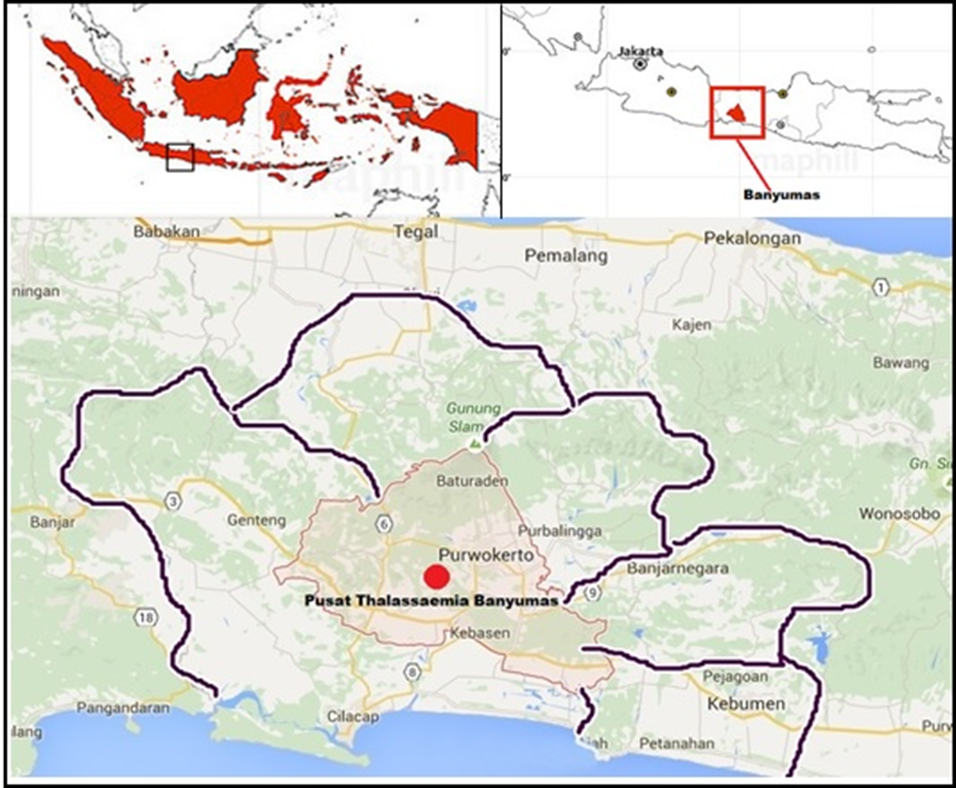
Our Region
Notes:
Mr. L slide

Slide 4
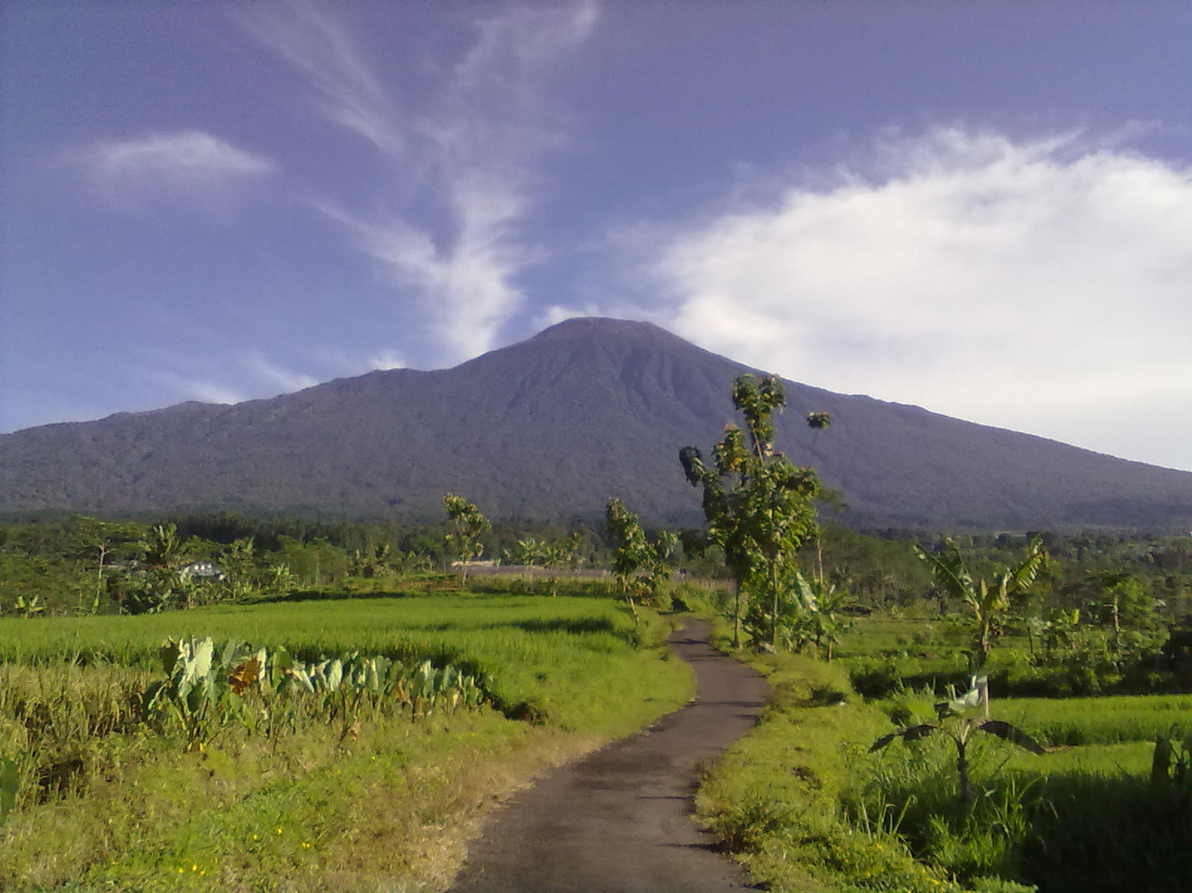

Slide 5
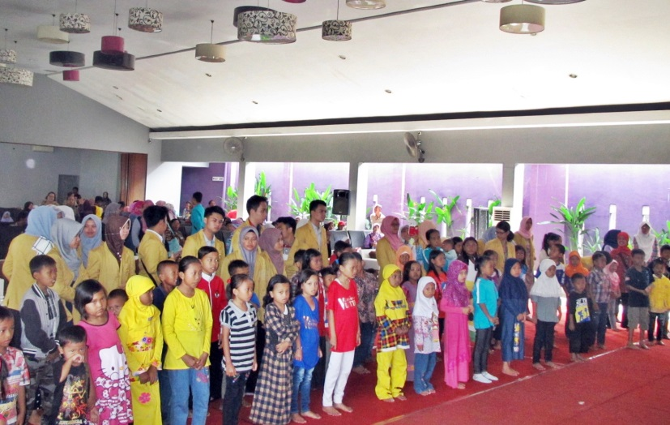
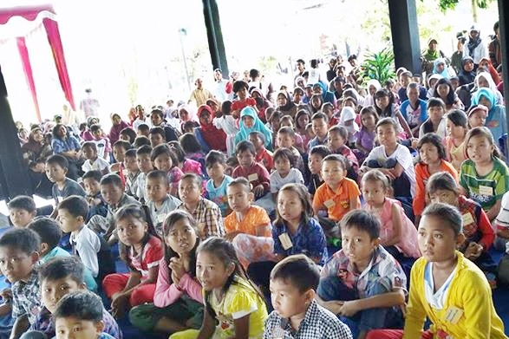
Thalassaemia in Banyumas Region
Total : ± 420 patients
± 100 Adolescences and adults
Included other regions like Cilacap, Purbalingga, Banjarnegara, Kebumen, Brebes, Tegal
Notes:
Mr. L slide

Slide 6
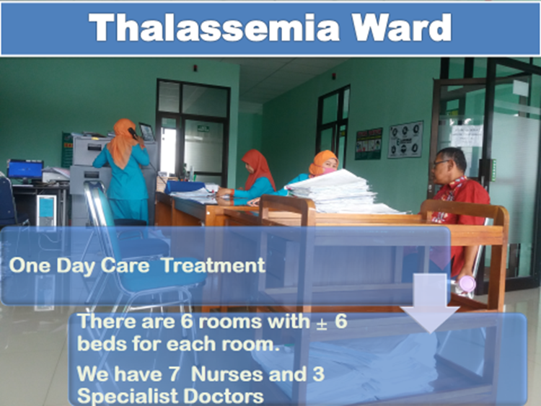
Notes:
Mr. L

Slide 7
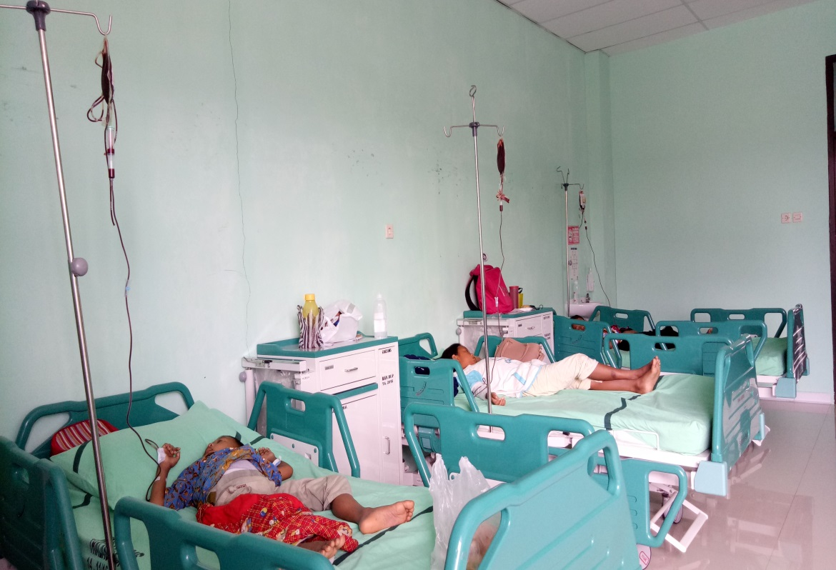
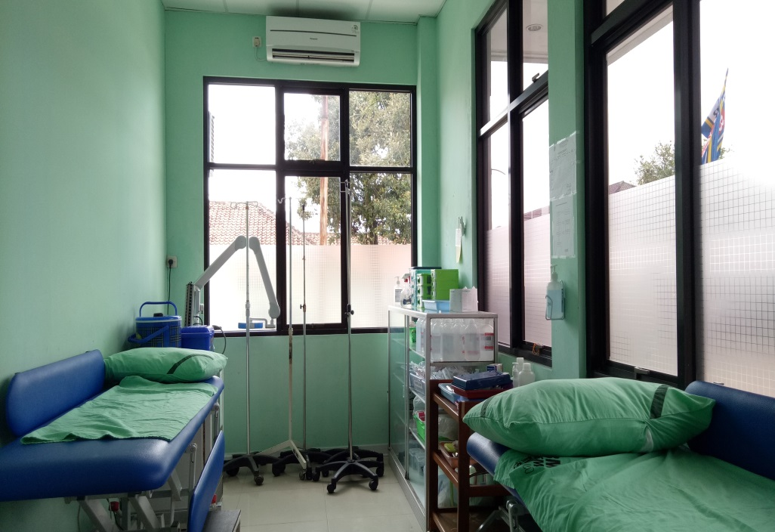
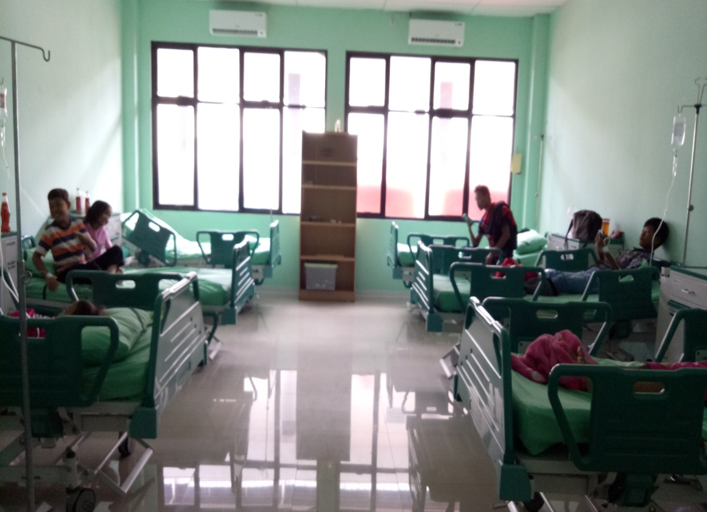
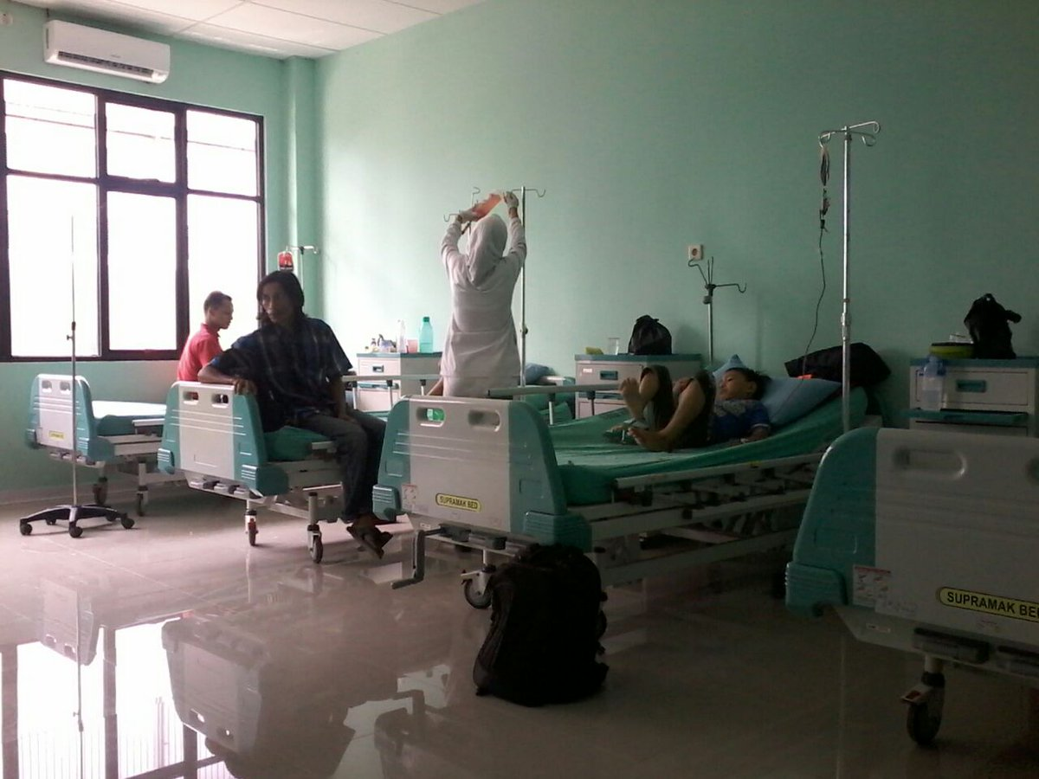
Transfussion
Notes:
Mr. L

Slide 8
Clinical management
All patients are covered by National Health Insurance
Supporting treatments :
Regular Transfusion
Iron chelator : Deferiprone (Feriprox)
Vitamins : E, C, B
Management of complications :
DM
Hepatitis
Infections
Notes:
Mr. L Slide

Slide 9
Molecular aspect
Notes:
Mr. L

Slide 10
Psycho-social issues
Disorder and Therapy
Thalassemia disorder has effect on physical apperances (shorter, darker skin, particular facial shapes).
Common therapy are montly blood transfussion and chelation therapy
Both condition affecting the Self Esteem of individual living with thalassemia, expecially those who entering the adolescence age.
Relationship between health practitioner – Patient during therapy
Banyumas has the centre of Thalassemia located in Government Hospital.
Parents and relatives
Some of the children/teenager who lives with thalassemia are labeled as “sick child”
Parenting style of Individual living with Thalasemia
Some parent worried about the child physical condition and tend to be more permissive to the child (case of child who want to quit school when he was in elementary school and the parents agree)
Notes:
Woro

Slide 11
Psycho-social Issues
Sosio-cultural
Issue of Marriage and Negative Label toward “Inheritance Disorder”
The Issue of Inheritance disorder related with “javanesse culture issue in choosing mates”.
Over-reaction from community toward individuals living with Thalasemia
There are cases of individual living with thalassemia treated differently (there are not allowed to participate in activity which need “strenght” due to their condition, eg : sport in school )
Hardiness of Individual living with Thalasemia as positive factor in coping
Notes:
Woro

Slide 12
What can be done?
Individuals living with Thalasemia
Strenghten the role of thalasemia community to empowering individual living with thalasemia
Community in general
Find the best way possible to educate the community about thalasemia with the cultural issue of inheritance disorder as important aspect to be considered.
Notes:
Woro

Slide 13
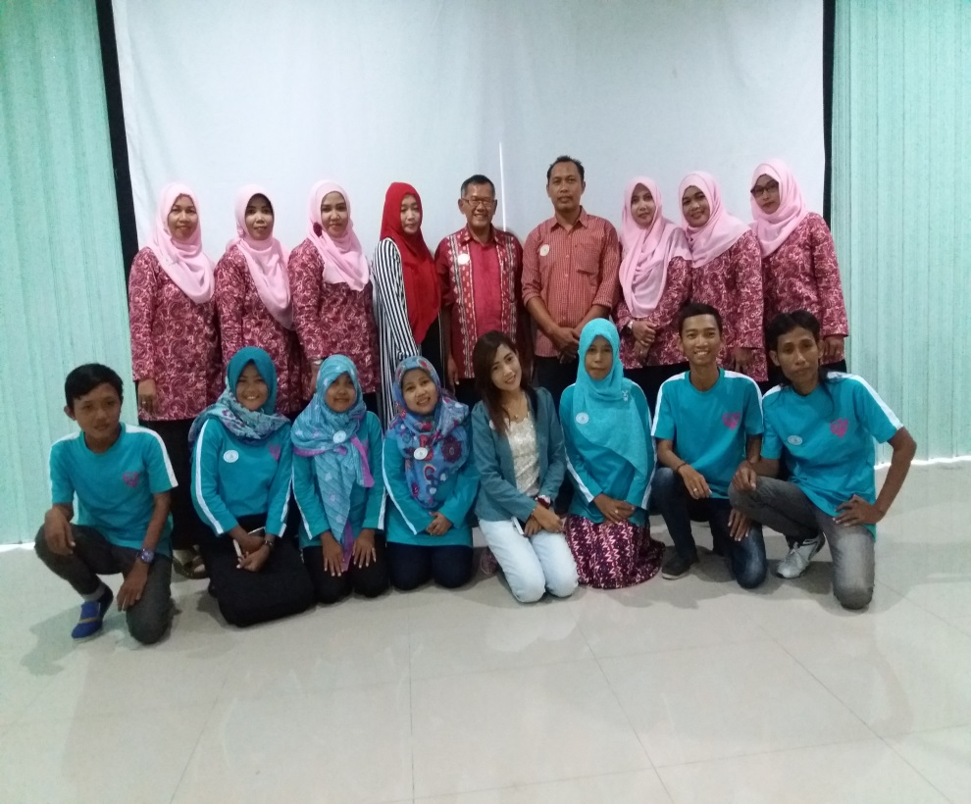
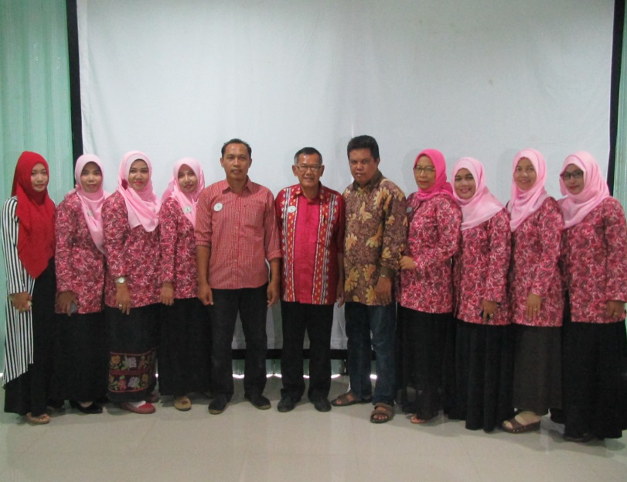
Organisasi Thalassaemia Banyumas
Thalassaemia Community in Banyumas
POPTI [The Parents Association of Thalassaemia Patients]
YTI [Thalassaemia Indonesia Foundation]
PPTI [The Association of Thalassaemia Patients]
Notes:
Diterangkan bahwa ketiga organisasi ini levelnya nasional tapi kita punya organisasi di tingkat daerah yang selalu berkoordinasi dengan organisasi di pusat
Dinar

Slide 14
POPTI BANYUMAS
Before 1995
Thalassemia Treatment was spread on many hospitals
It’s difficult to have coordination & talk about problems between the fellow patient
It was the beginning of other advancement of thalassemia community empowerment in Banyumas Region
1995
There was still lack of knowledge and information about thalassemia treatment
The group parents of Thalassemia Patients established POPTI in 1995
They started to share their hardships, talk their problems, give support & motivation and exchange the knowledge and information
Notes:
Dinar

Slide 15
YTI BANYUMAS
Established on March 4, 2009
The purpose:
Help to support treatment, patient services, research
Give information, education, campaign to attract public awareness about thalassemia
Notes:
Dinar

Slide 16
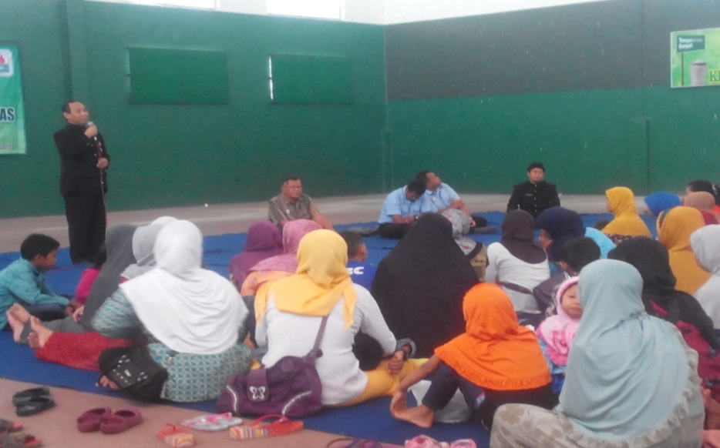
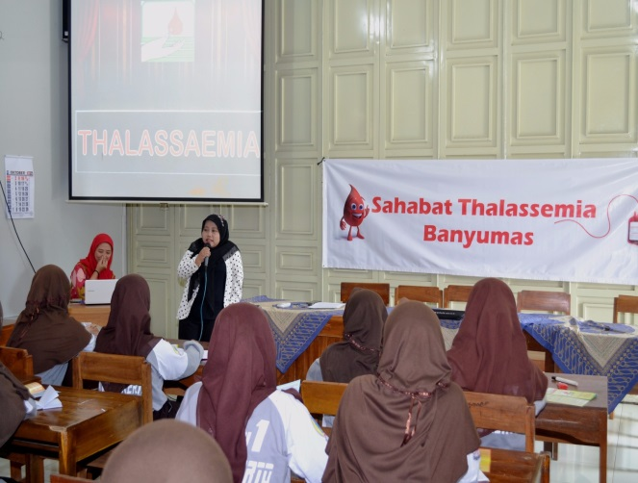
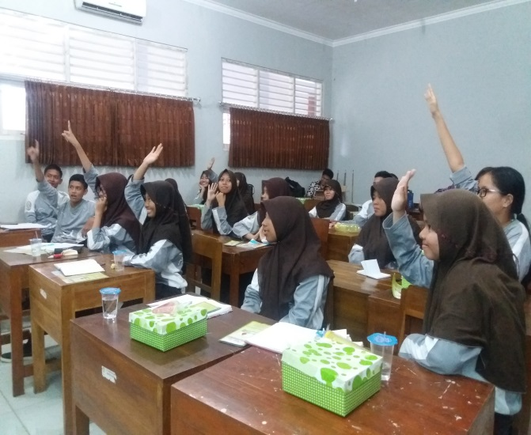
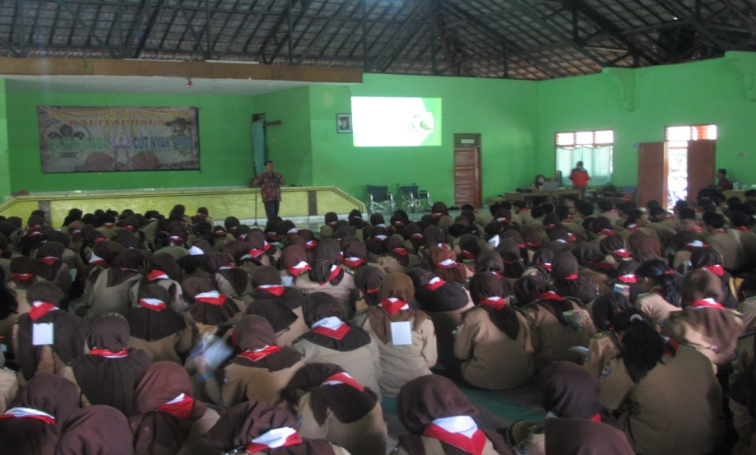
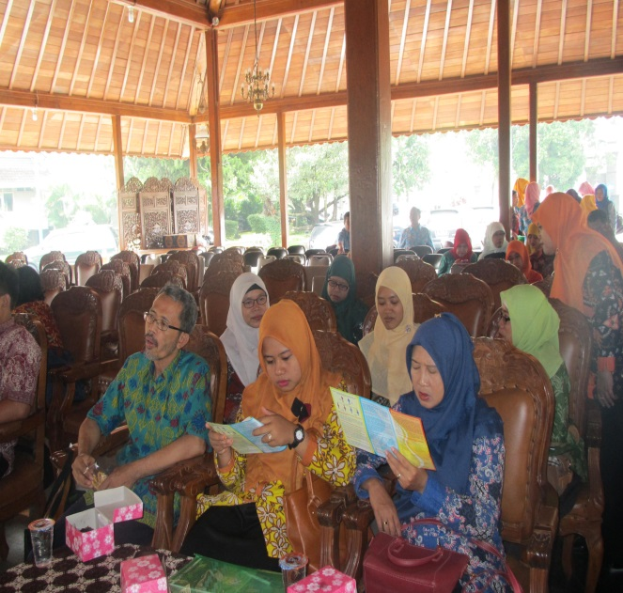
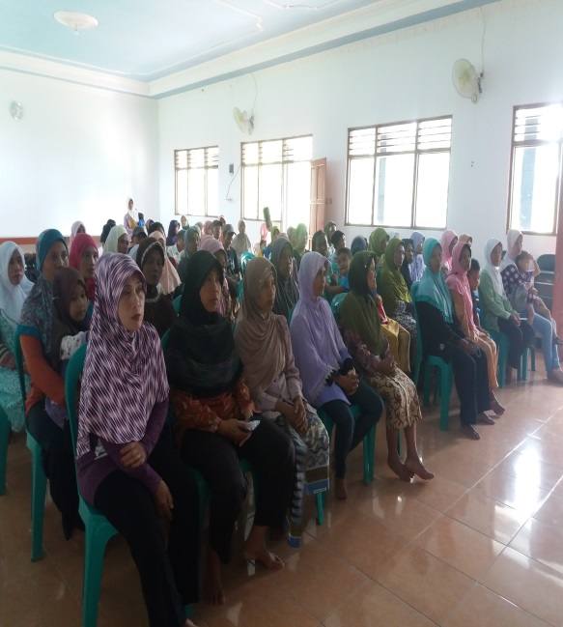
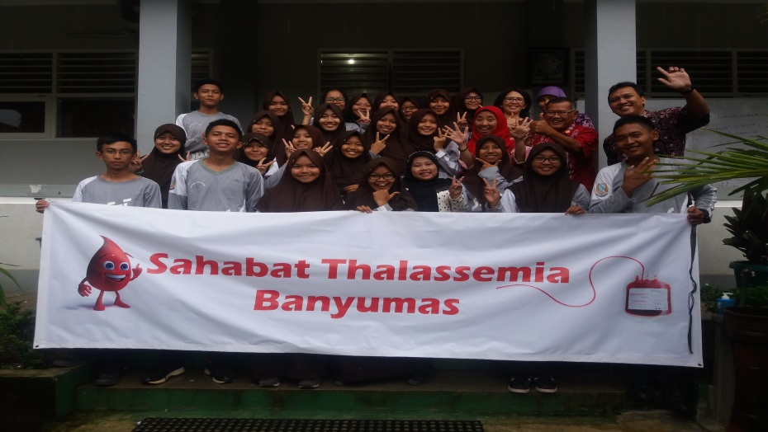
Education, Seminar to Parents and Public
Notes:
Dinar or woro

Slide 17
PPTI BANYUMAS
Established on April 15, 2015
Activities :
Sharing motivation, support, problems, pains to build self-confidence & self-acceptance as Thalassemia patient
Help POPTI & YTI to support their activities n held events like campaign, seminar to raise public awareness bout thalassemia
Doing many fun activities & gathering as self-therapy to build positive character like group transfusion for teenagers & adult patients
Approaching fellow thalassemia patients who are introvert, lack of confidence, still locked themselves from others
Challenges :
Still many Individu living with Thalassemia unable to fully accept their condition, tend to stay away from others and lack of confidence,
Many Individu living with thalassemia are worried and hopeless about their futures, mainly about occupation, getting marriage, build family etc.
Notes:
Slidenya dibuat putih aja ya dek, biar tulisannya jelas
Dinar

Slide 18
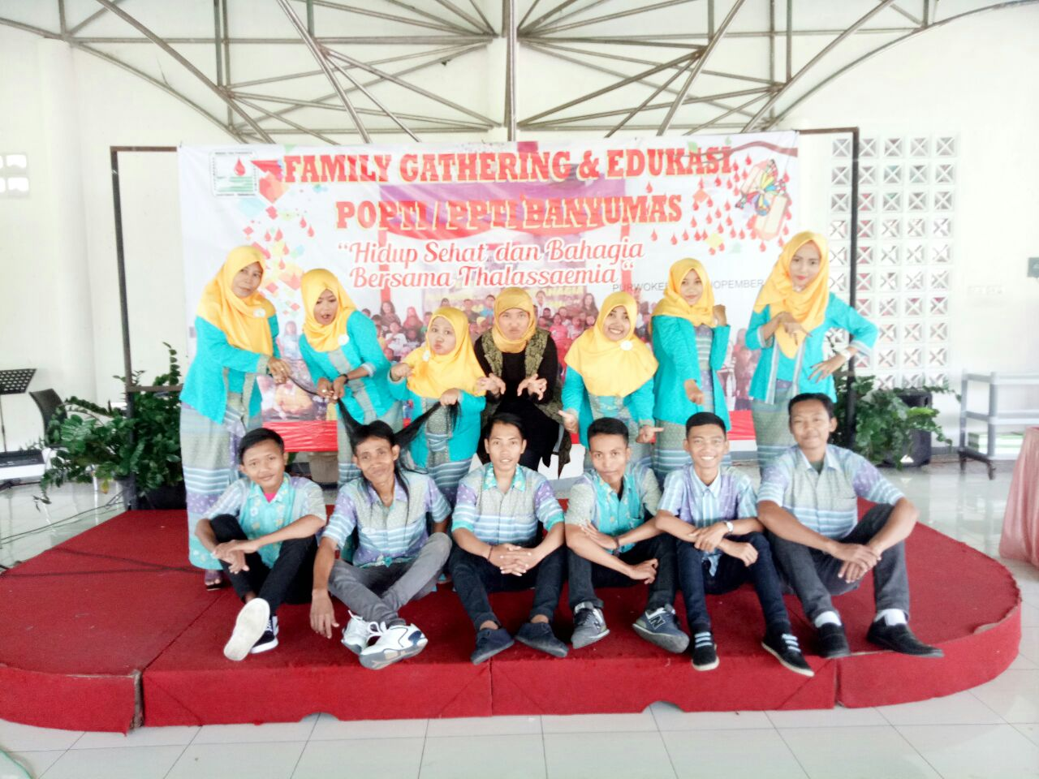
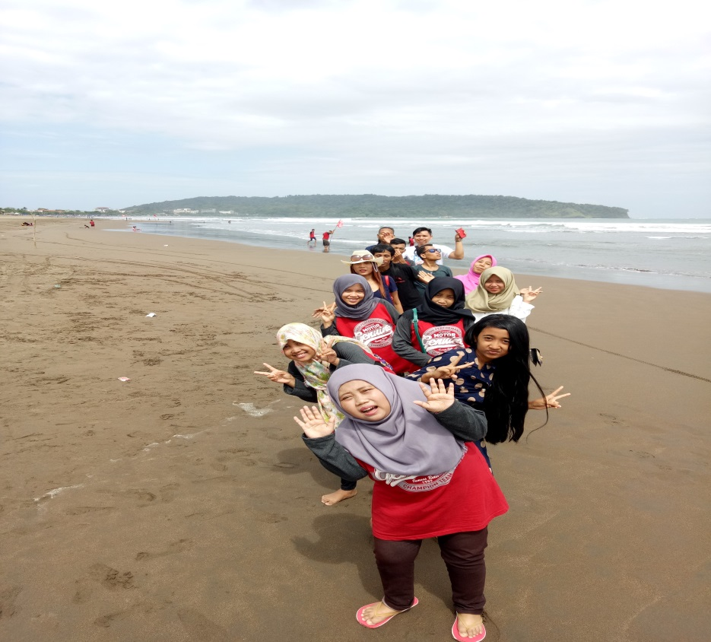
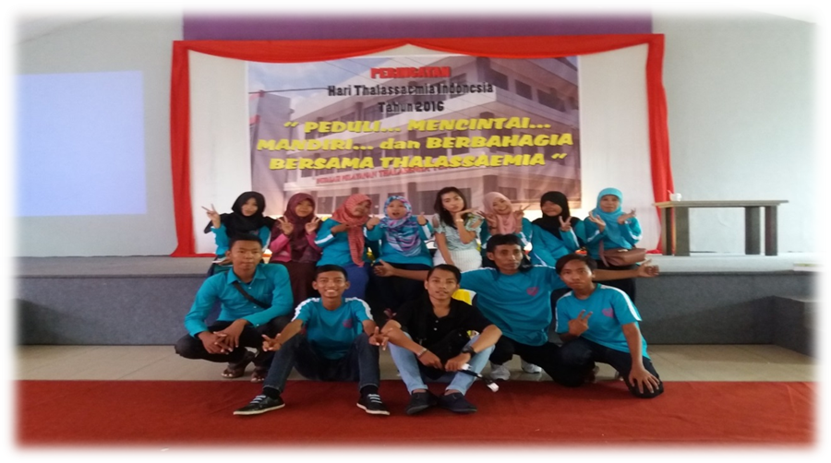
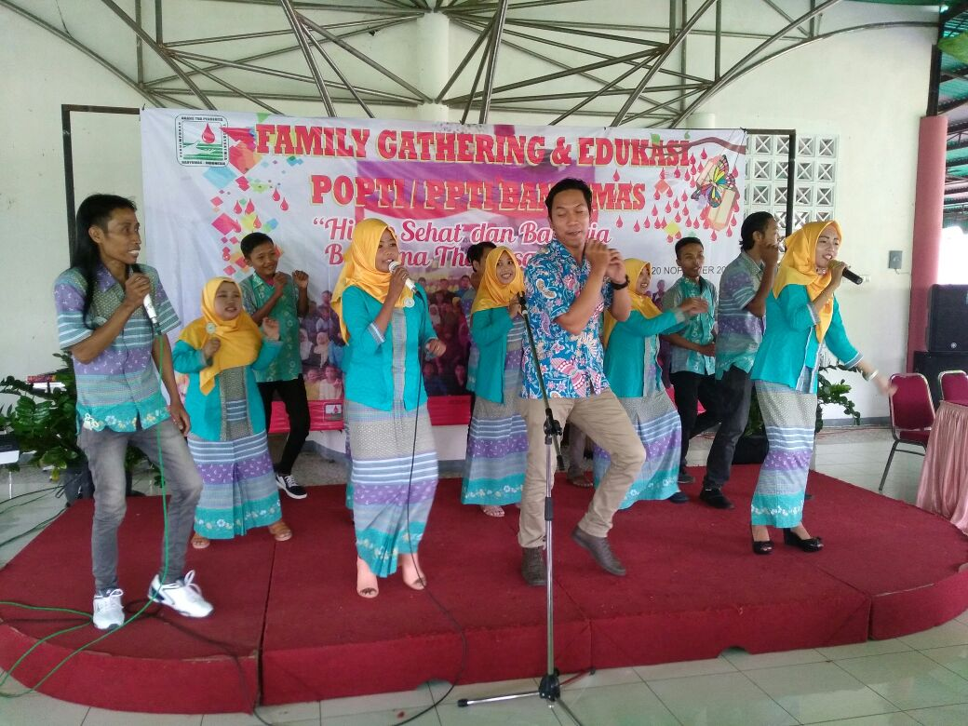
PPTI
Notes:
Dinar : menerangkan beberapa kegiatan ppti

