Slide 1
Mutations are our Currency: The Value of Genomic Data in the Information Economy
Stacey Pereira, PhD
Baylor College of Medicine
Houston, TX USA

Slide 2

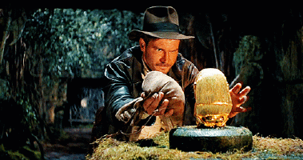

Slide 3
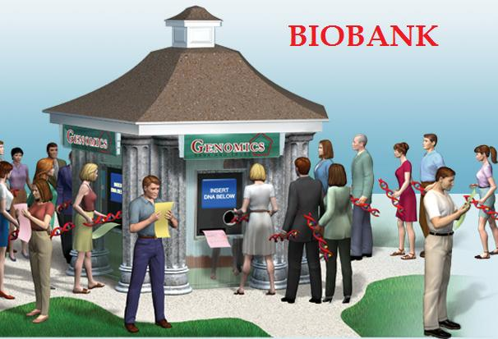

Slide 4

Why are the tissues so valuable?

Slide 5


Slide 6
“If you discover something that will end up in a cure, or […] the management of how people are treated, it’s very valuable. You cannot put—how do you evaluate the cost of your life? It’s about that. If you can find a cure, I mean, what is the cost of a human life?”
-Geneticist

Slide 7

Biovalue

Slide 8
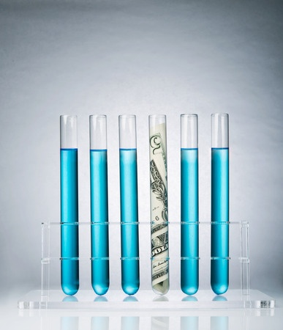
Bayh-Dole Act

Slide 9

Diamond v. Chakrabarty

Slide 10
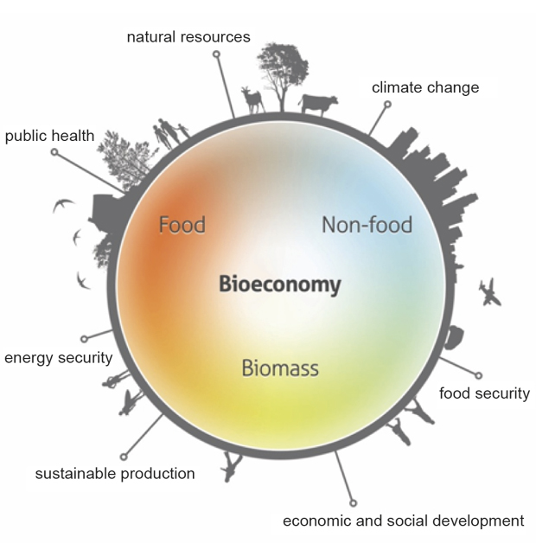

Slide 11
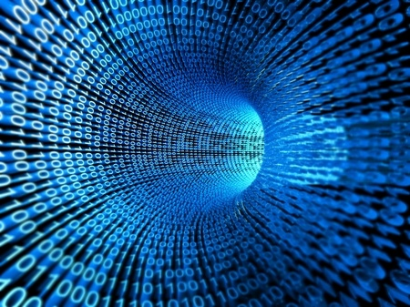
Information Economy

Slide 12
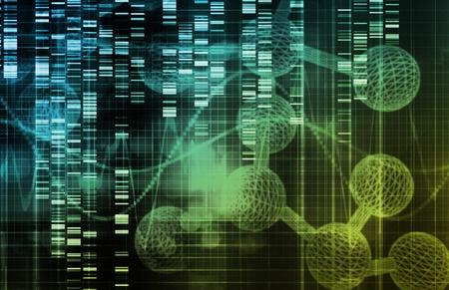
Genes as Information

Slide 13
“DNA is information, and genetics is information technology.”
-Geneticist

Slide 14

Genetic Information = Source of Value

Slide 15
“The molecular information from the samples is what is valuable.”
-Geneticist

Slide 16
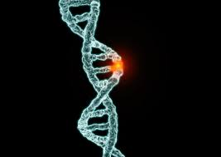
Cancer Mutations
are
Valuable

Slide 17
“Mutations are our currency.”
“For medical sequencing […], the currency is identifying candidate mutations that might be involved in the disease process of whatever disease that you’re looking at.”
-Genetics Project Manager

Slide 18

Morbidity as Space of Value Creation

Slide 19
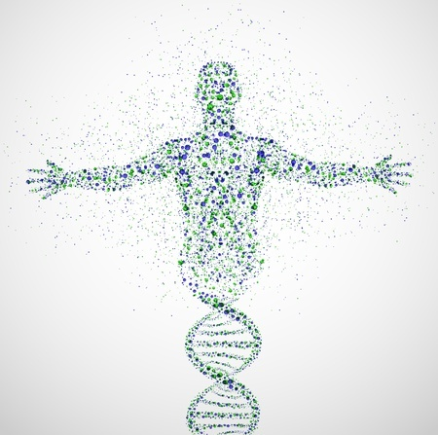
Translation to Goals of Vitality

Slide 20
“Oh dear. They are potentially worth millions and millions of dollars. If from ten tissues you could say, ‘I can take normal breast tissue from an 18-year-old woman and predict whether she’ll get breast cancer or not,’ how much is that worth? How much do you think that test is worth? Every woman in the western world would get that test.”
-Geneticist

