Slide 1

The Duty of Care in Next Generation Sequencing: Who owes a legal duty?
To whom and to do what?
Colin Mitchell
HeLEX, University of Oxford

Slide 2

The Legal Duty of Care
Area of uncertainty for NGS
Increased volume and uncertainty of results
Projects like 100,000 Genomes Project underway

Slide 3

The LEGAL Duty of Care
Part of judge made common law
Negligence and reasonableness
Duties and liability can shape or overtake practice

Slide 4
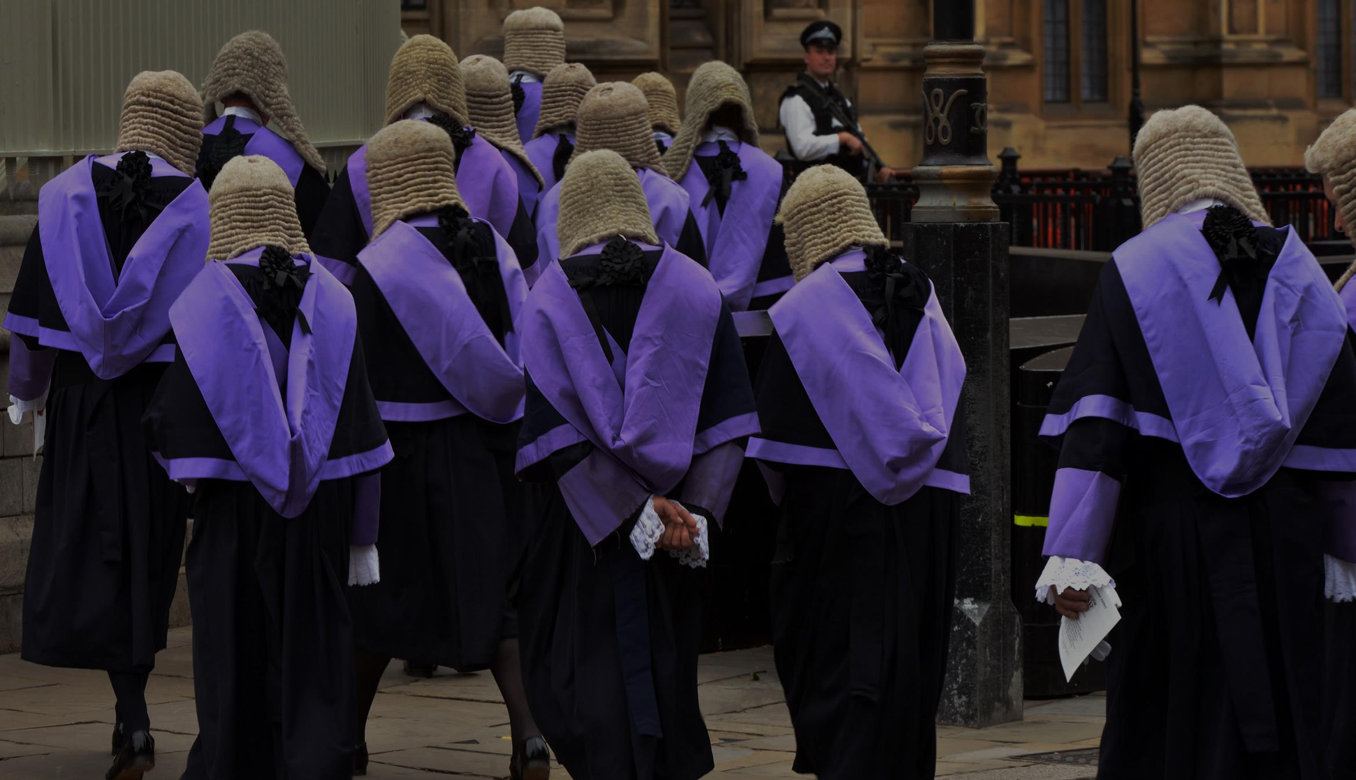
Research Aims
To identify the areas of uncertainty for the duty of care in clinical NGS, and;
To identify the relevant factors that would be considered by the courts in addressing them.

Slide 5
Who owes a duty?
Do non-clinical professionals?
To whom are duties owed?
A duty to genetic relatives?
To do what?
Which results should be sought, investigated and communicated?

Slide 6
The Caparo test and a new duty of care
Is the harm forseeable?
Is there a relationship of proximity?
Would a duty be fair, just and reasonable?
Caparo Industries plc v Dickman [1990] UKHL 2

Slide 7
Who owes a duty?

Slide 8
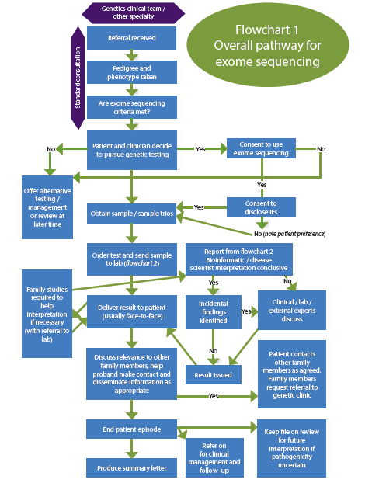
The ‘Hybrid’ model of NGS
Clinicians
Lab Scientists
Bioinformaticians
Flowcharts taken from ‘Realising Genomics in Clinical Practice’, PHG Foundation

Slide 9
Do non-clinical professionals owe a legal duty?
CJD Litigation suggests this may be the case
Factors that will be considered by courts
    Proximity?
    Partly clinical?
‘Fair, just and reasonable’?
    Identifiability of participants
    Any professional standards or guidelines
    Human Rights and ‘soft law’
The Creutzfeldt-Jakob Disease Litigation (1997) QB 41 BMLR 157, 164

Slide 10
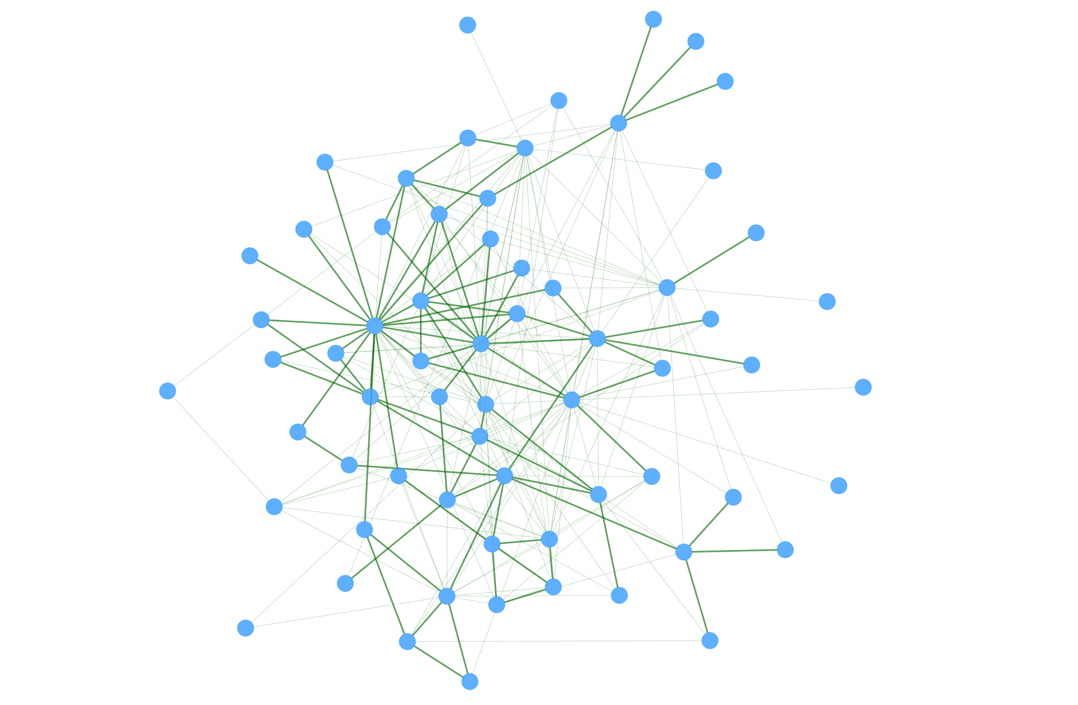
Do non-clinical professionals owe a legal duty?
Further analysis of the precise roles of all professionals involved
Therapeutic roles?

Slide 11
To whom are duties owed?

Slide 12

Is a duty of care owed to relatives
A duty to warn them of risk?
To do so without consent and in breach of confidence?

Slide 13
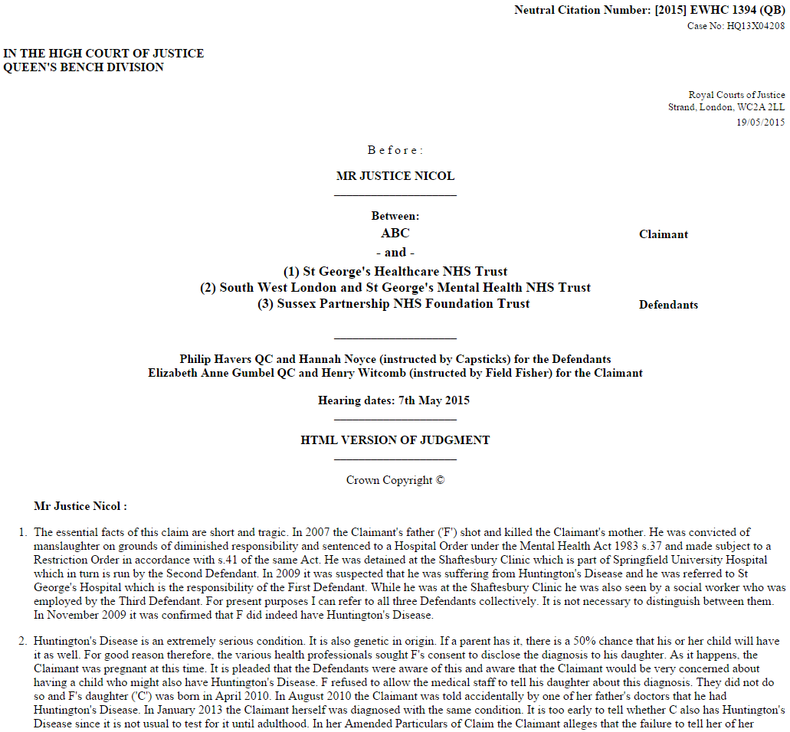

Slide 14
ABC v St George’s Healthcare NHS Trust & Others (May 2015)
Claimed she should have been warned of risk of Huntington’s Disease
Application to ‘strike out’
Agreed forseeablity of harm and proximity
The duty was not even ‘arguable’ as ‘fair, just and reasonable’
‘Giant leap’ for law
Conflict with confidentiality
Professional duties and legal duties
ABC v St George’s Healthcare NHS Trust & Ors [2015] EWHC 1394 (QB) (n 8)

Slide 15
ABC v St George’s Healthcare NHS Trust & Others (May 2015)
Not even arguable?
Maliciously with-held consent?
Best practice can be overlaid with legal duties (Montgomery)
Limitation no longer logically or socially justified? (Lord Toulson in Michael)
Positive obligation to provide a legal framework to resolve conflict between duty of confidence and another’s rights? (Colak & Tsakiridis v Germany)
International comparison? (Safer v Estate of Pack – New Jersey)

Slide 16
A ‘weaker’ duty?
A legal duty to encourage patients to inform relatives of risk?
‘Third party’ legal problems still apply
Some form of a duty seems likely

Slide 17
A duty to do what?

Slide 18
Could there be a duty to:
Look for certain findings?
  Actionable and serious or of interest to the patient?
To evaluate all ‘incidental findings’?
To feedback results-
  Clinically actionable?
  Reproductive risk?
  Carrier status?
Re-evaluate results in the future?

Slide 19
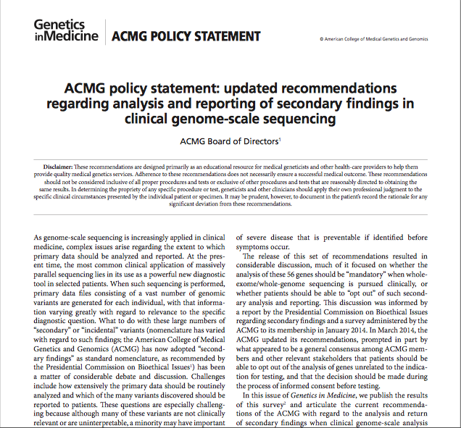
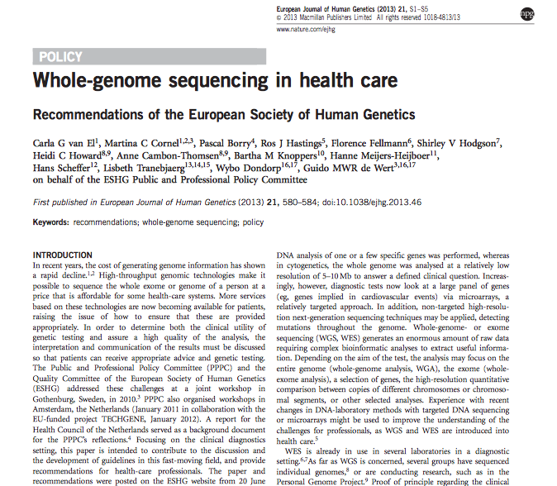
Reasonable decisions
Standard of care and technical competence
  ‘practice accepted as proper by a responsible body of medical opinion’
  Bolam v Friern Hospital Management Committee [1957] 1 WLR 582
Guidelines and best practice

Slide 20
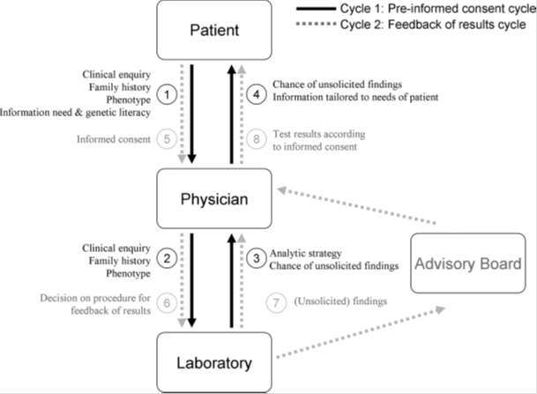
Reasonable decisions
Tessel Rigter and others, ‘Reflecting on Earlier Experiences with Unsolicited Findings: Points to Consider for Next-Generation Sequencing and Informed Consent in Diagnostics’ (2013) 34 Human Mutation 1322

Slide 21
Information Disclosure
Montgomery v Lanarkshire Health Board

Slide 22
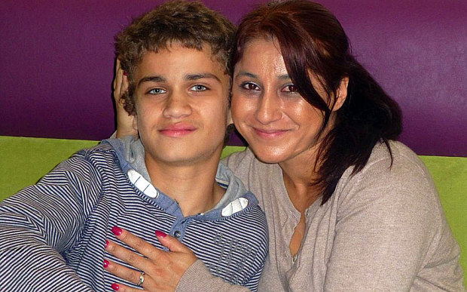
Montgomery v Lanarkshire Health Board
Already applied in Mrs A v East Kent University NHS Foundation Trust (March 2015)
Supreme Court decision that small risks of serious harm should be disclosed to the patient if significant to that patient or any reasonable person.
Consent to genetic sequencing requires careful consideration of which risks are ‘material’ and potentially significant to an individual patient.

Slide 23
Information Disclosure
Montgomery and it’s relevance to diagnostic disclosure
  Does a reasonable patient standard apply to diagnostic disclosure?
  Does this suggest a reasonable patient could require more information than the results the clinician/professionals have decided to disclose?
    Material and ‘Significant risks’?

Slide 24
Conclusions on the Duty of Care
Under-explored topic
Breaks down traditional divides
Montgomery and influence on disclosure?
Danger of legal developments shaping practice
Guidance should be aware of legal possibilities
Further legal issues; causation, actionable harm…

Slide 25
Acknowledgements
HeLEX team
Jane Kaye and Jessica Bell
Oxford HICF2 Clinical WGS Project
Jenny Taylor, Mike Parker, Liz Ormondroyd
The Wellcome Trust
Katherine Littler
Helex and Wellcome Trust; Workshop on the duty of care in clinical NGS, 24th March 2015
Deirdre Goodwin
Alison Hall
Michael Fay
Rachael Mulheron
Vicky Chico
Mark Taylor
Kathryn Leask
Susan Wallace
Simon Philips
Jonathan Sellors
Sheelagh McGuinness
Katherine Littler
Liz Ormondroyd

