Slide 1

One genome is not enough
Gil McVean
The Oxford Big Data Institute

Slide 2
The Gene X hypothesis

Slide 3
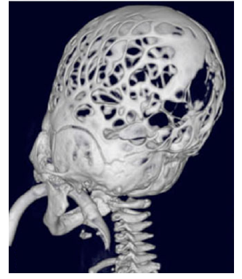
N = 1

Slide 4
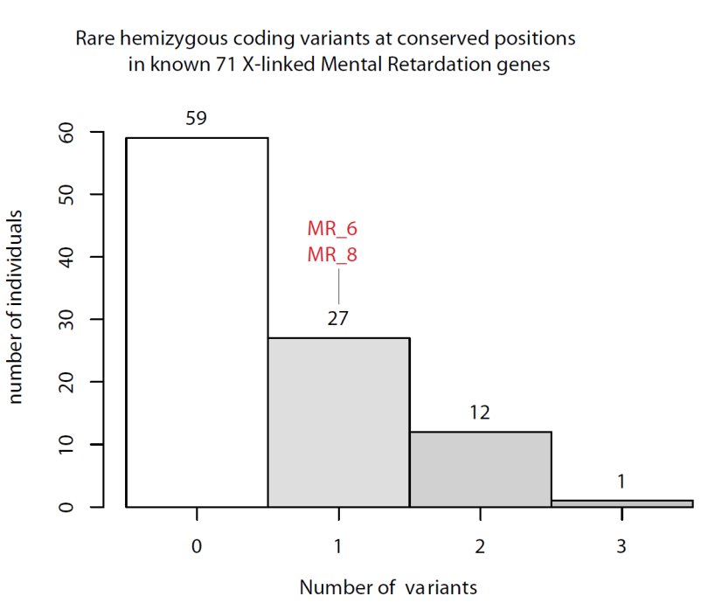
Do 40% of males have mental retardation?

Slide 5
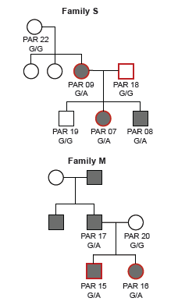
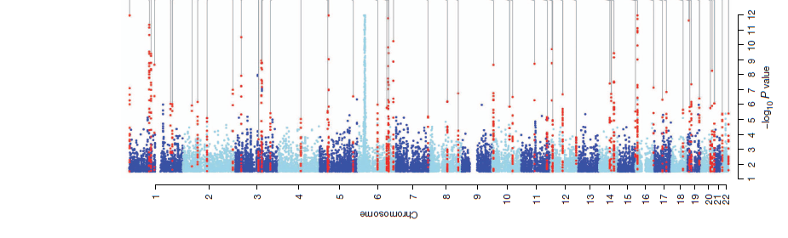
What constitutes evidence?
Class B – Functional relevance
Class A – Statistical association
  Transmission within pedigree
  Association within population

Slide 6
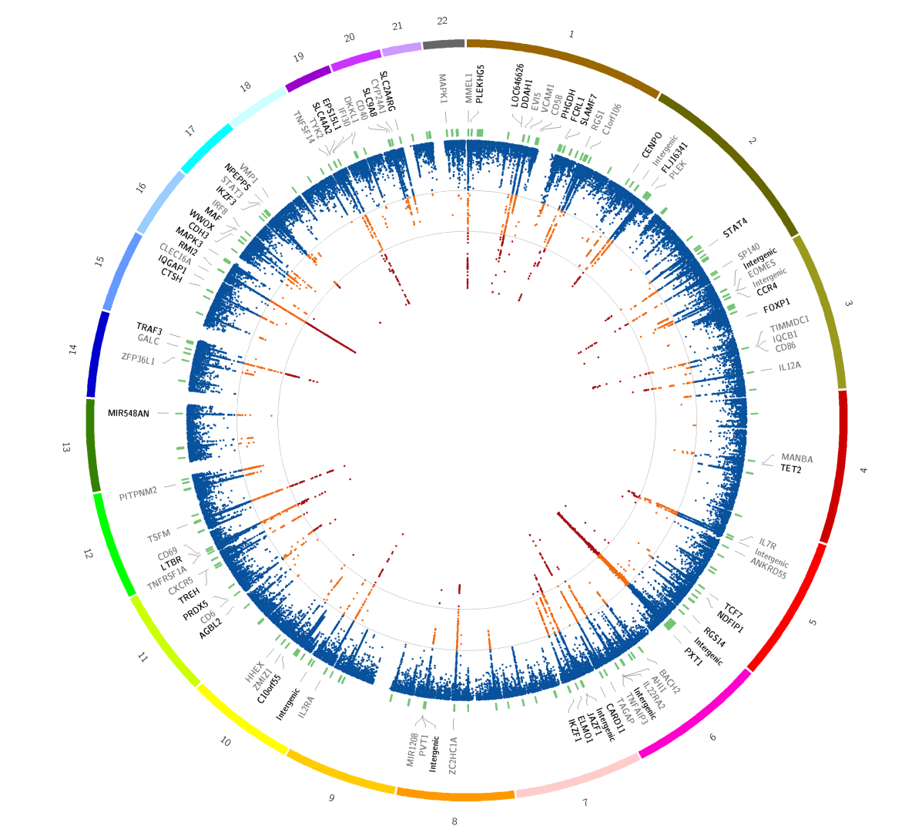
Precision comes from numbers: Multiple sclerosis at 50,000

Slide 7
The value of large numbers: Ischaemic heart disease and systolic blood pressure
5000 people
50 000 people
500 000 people
Age at risk:
Age at risk:
256
256
256
80-89
80-89
128
128
128
70-79
Age at risk:
70-79
64
64
64
60-69
80-89
32
32
60-69
32
50-59
70-79
16
60-69
16
50-59
16
Hazard Ratio (95% CI)
40-49
8
50-59
8
40-49
8
4
40-49
4
4
2
2
2
1
1
1
120
140
160
180
120
140
160
180
120
140
160
180
Usual SBP (mmHg)
Usual SBP (mmHg)
Usual SBP (mmHg)
Courtesy of Prospective Studies Collaboration, unpublished

Slide 8
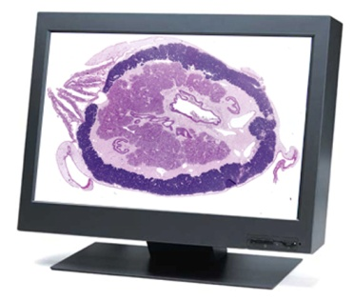
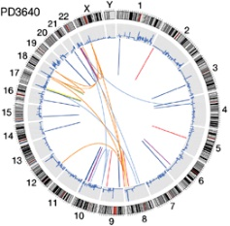
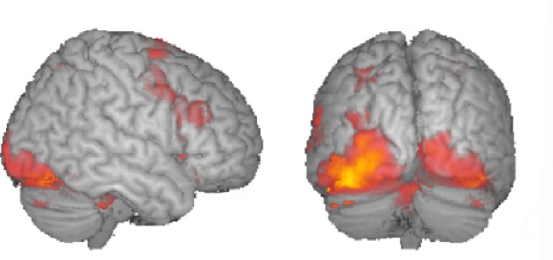

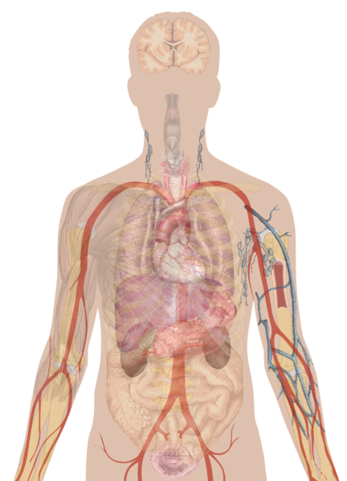


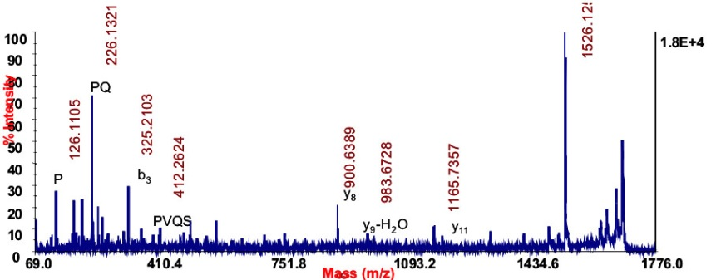
Medical data is big and growing…
Genome sequence
Imaging
Electronic medical records
Mobile health
High dimensional profiling

Slide 9







…at a population scale
500,000
100,000
100,000
500,000
1,000,000

Slide 10
Challenges of data sharing
Volume
  How do we cope with the computational and analytical scale?
Heterogeneity
  How do we ensure we are measuring the same thing?
Privacy
  Do we have to share individual level data to achieve power?
Security
  How can we ensure that data are used appropriately?
Engagement
  How do we get people excited about sharing their data?

Slide 11
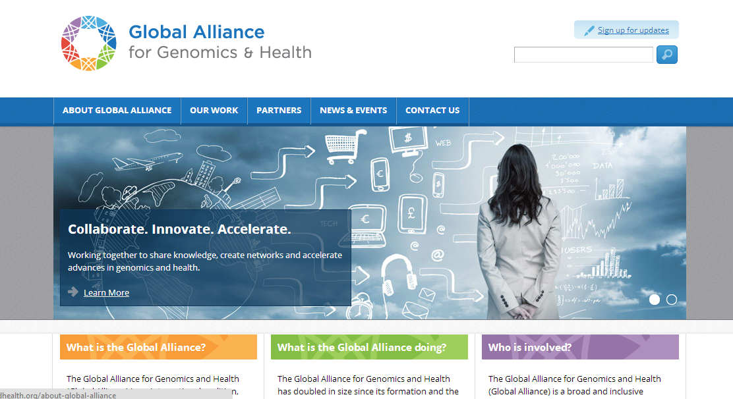
An international partnership is needed

Slide 12
Challenges of data sharing
Volume
  How do we cope with the computational and analytical scale?
Heterogeneity
  How do we ensure we are measuring the same thing?
Privacy
  Do we have to share individual level data to achieve power?
Security
  How can we ensure that data are used appropriately?
Engagement
  How do we get people excited about sharing their data?

Slide 13
N = 1 | N > 100,000

