Slide 1
Translating Science into Meaning
Amy McGuire, JD, PhD
Notes:
We have heard many perspectives this afternoon on what translation is and what the biggest challenges are to translational science.

Slide 2
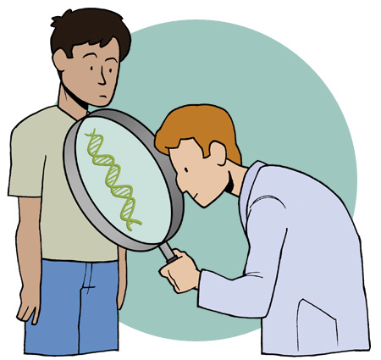
Translation = To Make Meaning
Notes:
I am going to be very literal. To translate is to make meaning of something and to make meaning of something is to translate it. So I am going to talk about translation as the act of making meaning. And, I am going to suggest that the biggest challenge to translational science is in making meaning of the science.
Now I am going to talk about this from two different perspectives: the challenge of making meaning scientifically or from the scientists or clinicians perspective, and the challenge of making meaning personally, or from the patient’s perspective.

Slide 3
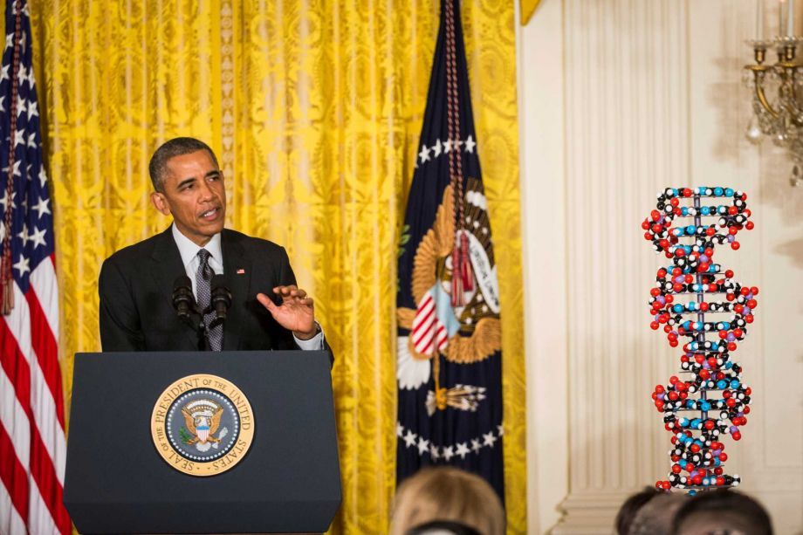
The Future of Translational Science
  Goal: medical care based on individual genetic, environment, and lifestyle difference that enable more precise ways to prevent and treat disease
Notes:
I think President Obama summed up nicely what a lot of people consider the goal of translational science today, which is to achieve medical care based on our knowledge of individual genetic, environmental, and lifestyle differences so that we can more precisely prevent and treat disease. From a scientific and a clinical perspective, I believe that the single biggest challenge to achieving this goal is our ability to make meaning of the vast amount of information that we are generating.

Slide 4
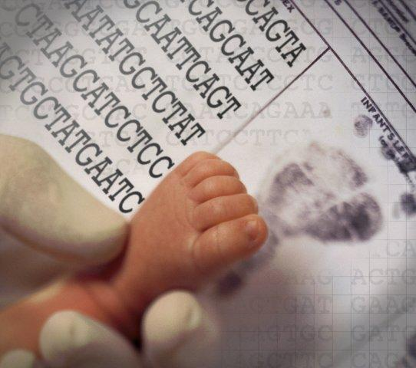
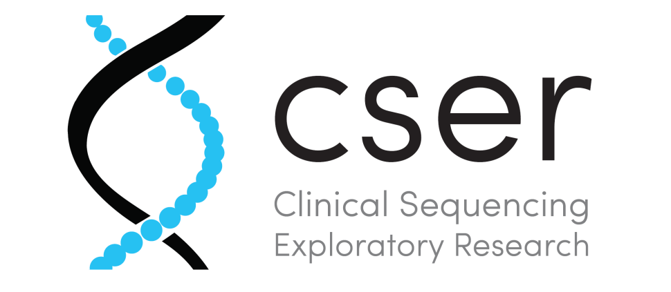
Clinical Translational Projects
Newborn Sequencing Program
Adult Only
DFCI/Broad
BWH
UW
U Mich
Seattle/Kaiser
Pediatric Only
CHOP
Baylor
Louisville/Alpha Hudson
BWH/Boston Children’s
Children’s Mercy
UCSF
UNC
Both
UNC
Notes:
I work on several clinical translational projects in the United States and we are currently sequencing hundreds of individuals in each of these projects for relatively low cost. But the real challenge is figuring out what each of the variants that we discover means for that particular patient.

Slide 5
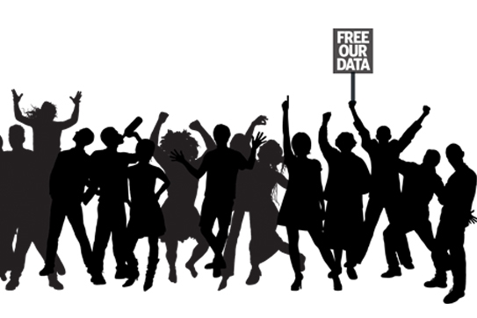
Notes:
And the only way that I think we will be able to make meaning of large amounts of genomic and even epigenomic information is if we work collaboratively and share data broadly so that, as an international community, we can translate the very individual language of our own genomes into a more generalizable dialect. So that we can make meaning of meaning of our collective biology.

Slide 6
Medical Information Commons
HC Systems & Clinical Labs
Baylor Miraca Genetics Laboratory
Geisinger Health System
Kaiser Permanente
Tech Companies
23andMe
Amazon, DNAnexus
Google, Google Genomics
Govt Programs
CDC, National Center for Health Statistics
NIH, BD2K
NIH, ClinVar
NGOs
Genetic Alliance
Genome Bridge
Global Alliance for Genomics and Health
Research Consortia
eMERGE Network
CHARGE Consortium
Lung Genomics Research Consortium
McGuire, Cook-Deegan, Deverka, Majumder, Koenig
Notes:
The solution to this, I believe, will be in the creation of a medical information commons, a networked environment between public and private organizations, both national and international. This will require collaboration on an unprecedented scale, but it is only through the medical information commons that we will be able to make meaning of the data we are generating. And through that process, we will be collectively translating the data into a new language. From an ELSI perspective, I think the biggest challenge for us will be in helping to create innovative governance structures for this large networked environment, with is a project that Barbara Koenig, who is here, Bob Cook-Deegan and few others of us are working on.

Slide 7
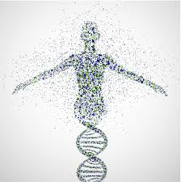
“We know what we are, but know not what we may be”
William Shakespeare
Notes:
But making meaning of, or translating data from a scientific and clinical perspective is not enough. Because when that information reaches the patient, there is whole other dimension of translation that occurs. About a year and a half ago I was invited by one of my colleagues to participate in a translational genomic study in which I would get my genome sequenced and learn the results. And as I considered whether or not I wanted to participate in the study, I was faced with uncertainty about how I would translate the information they gave back to me. How would I interpret what it meant for me? What it meant about me? About who I am as a person and what I may become?

Slide 8

Notes:
We went through the informed consent process and my colleagues explained to me the potential risks and benefits of participating. And I can say pretty confidently that I understood. Especially since I helped them write the consent form. I really got it. I might have been one of the most informed participants they had. I got, probably better than most people, that even though I have a family history of neurodegenerative disease – my grandfather had Alzheimer Disease and my mom has Parkinson’s disease – I got that those are complex disorders. That even if they found a variant that suggested I was at increased risk of developing one of those disorders, it doesn’t mean that I would necessarily get it, especially because they hadn’t tested my grandfather or my mother. And I also understood that even if they didn’t find a genetic variant known to be associated with those disorders, it didn’t mean that I wouldn’t get them. But knowing that intellectually and knowing that emotionally are two very different things.
And in that moment it occurred to me, that although informed consent is important, and although I think it is essential that we do a better job of educating patients and the public about the scientific facts, our natural human tendency towards genetic determinism, the overly simplistic ways in which we translate information and make meaning of what it says about who we are are and what will be become of us, is the biggest challenge to translational genomics.

Slide 9
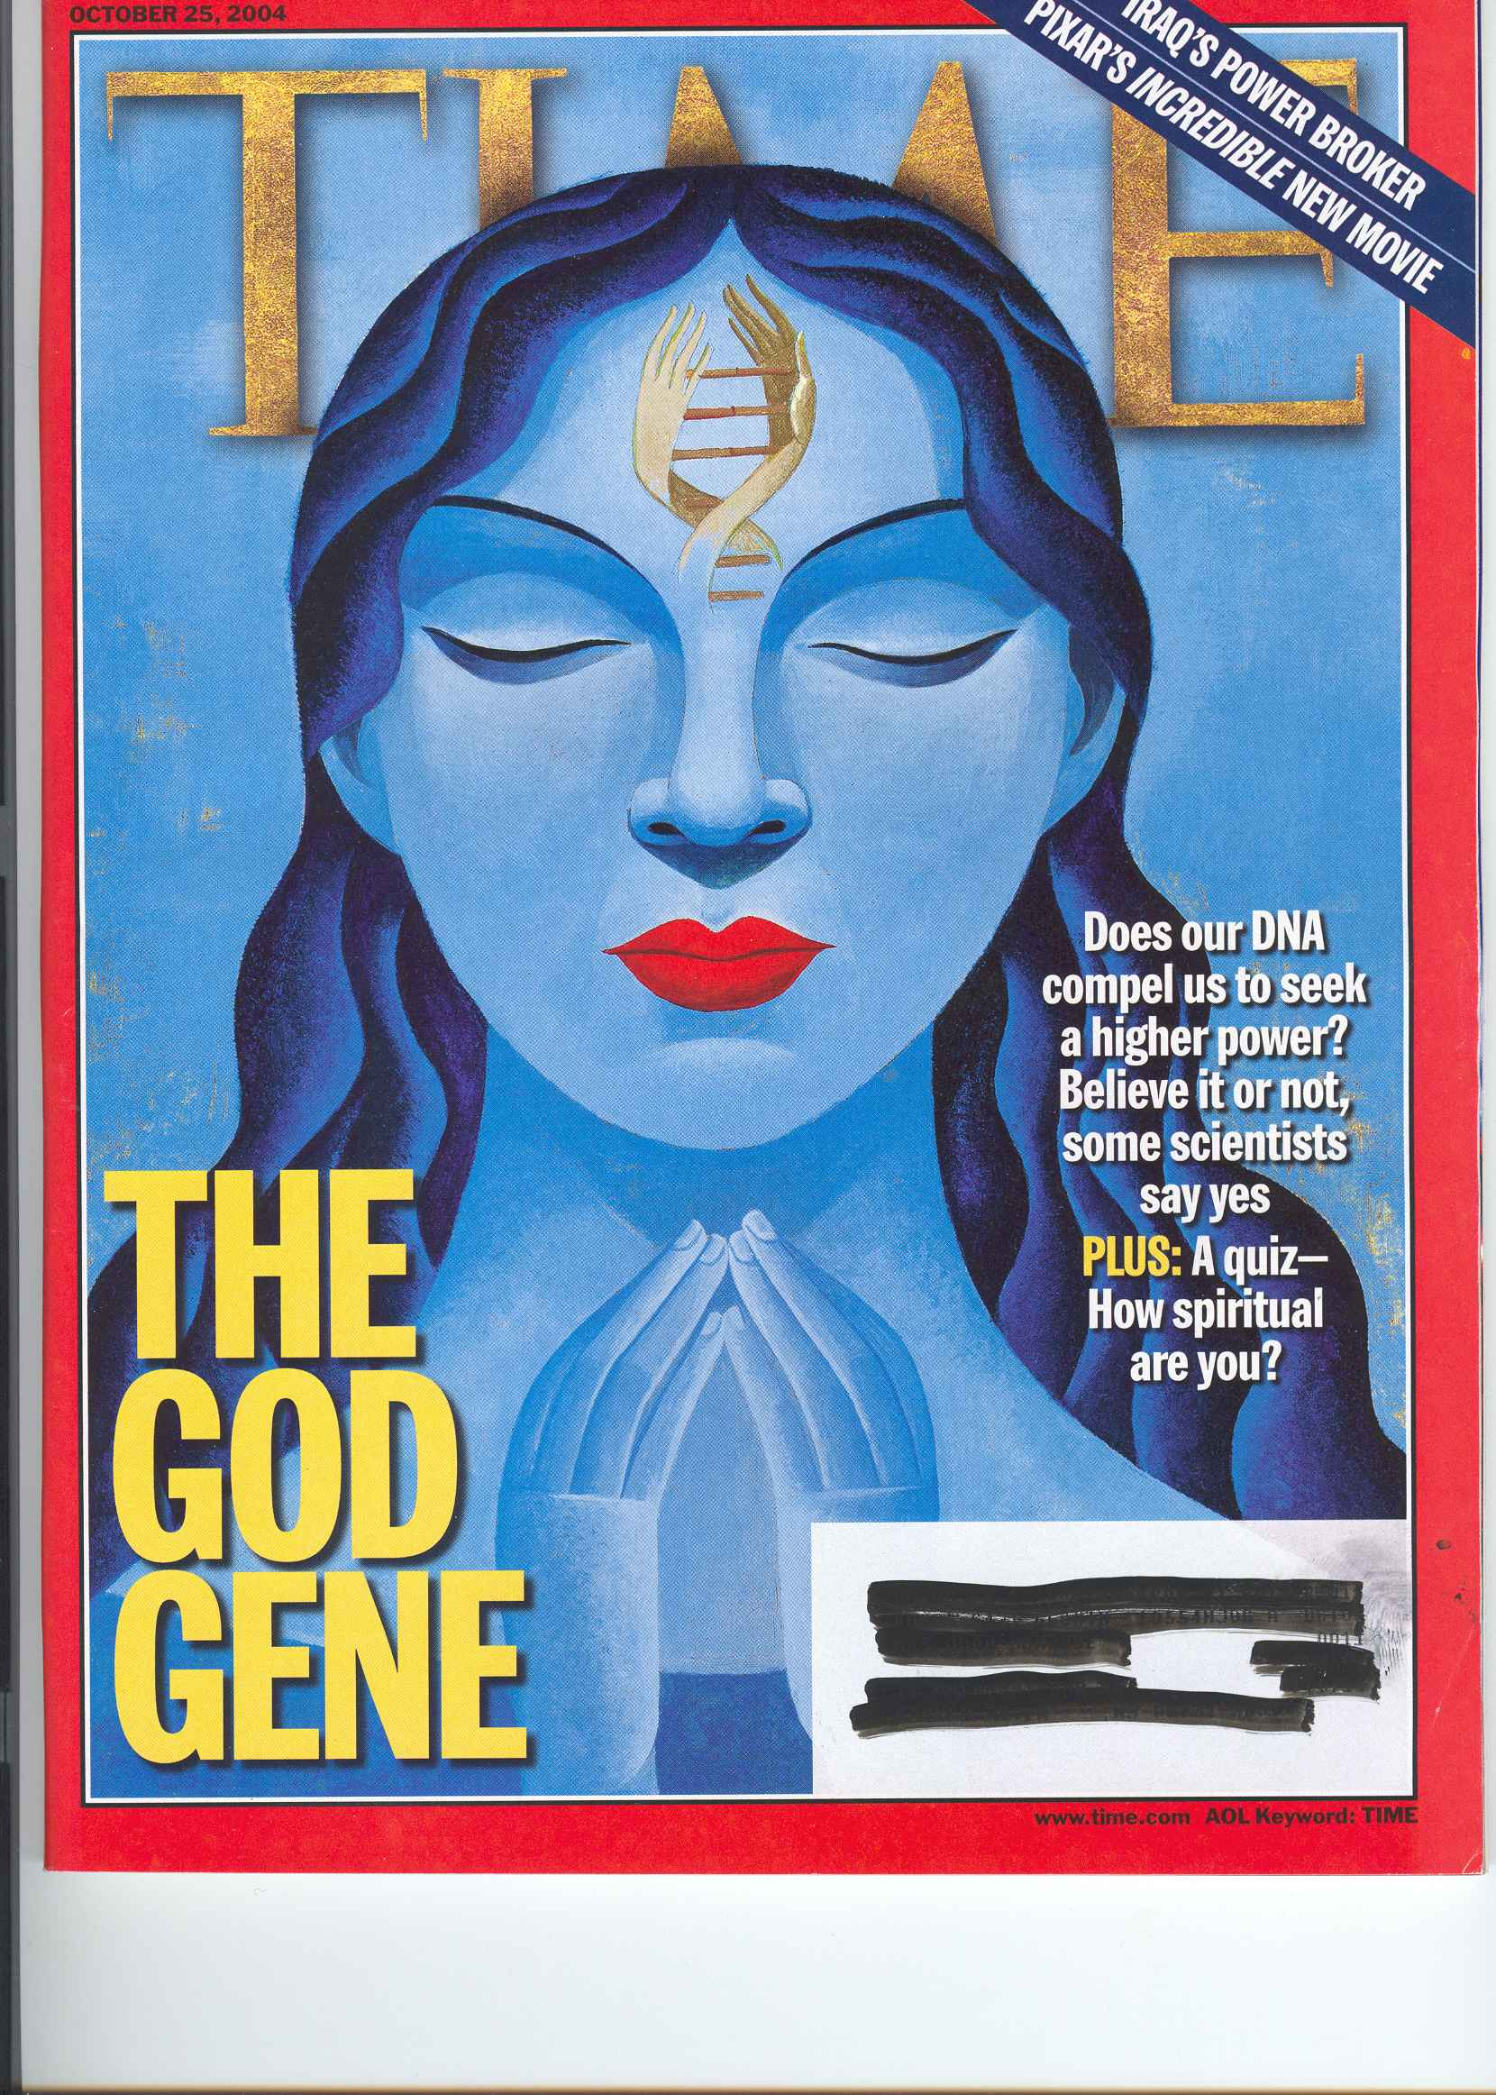
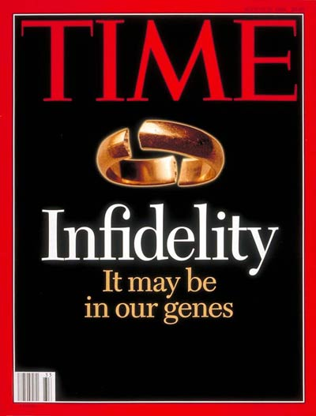
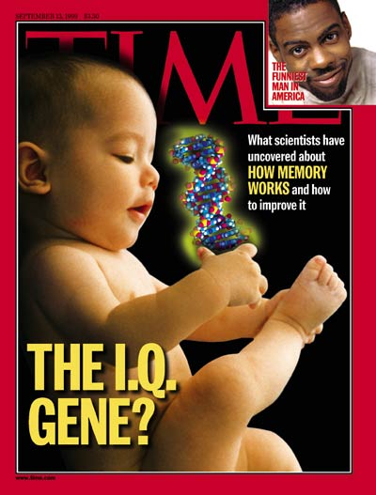
Notes:
Too often, we are seduced by the tendency to simplify the complex relationship between our genes and our environment and to reduce the mysterious nature of the human spirit, of who we are, of our personal identity, to our biological or genetic make-up.
As you all know, the vast majority of human diseases, traits, and behaviors are complex and multifactorial. They cannot be reduced to a single gene, or even to genetics alone. Yet popular media reinforces the fallacy of genetic determinism, and in doing so, biases our interpretation of the information we receive. Time magazine covers…

Slide 10
Example of Genetic Determinism
Later that week, I get an email addressed to my daughter, whom I had just tucked in for the night. Her [23andMe] results are ready, and I approach them with an even greater ravenousness [than my own results]. At first glance, everything looks great…
And there it is, screaming out at me from my computer screen. My daughter, who is learning to read and tie her shoes, has two copies of the APOE-4 variant, the strongest genetic risk factor for Alzheimer's. According to her 23and­Me results, she has a 55% chance of contracting the disease between the ages of 65 and 79.
My husband, who is out of town on business, texts that he will call me at 8:30. "Everything okay?" he adds. "All good," I write back, "except our daughter is going to get Alzheimer's."
From: Inside 23andMe Founder Anne Wojcicki’s $99 DNA Revolution
Notes:
This to me is the perfect example of how this plays out. Of how someone who can understand the meaning and complexity of genetic information, and yet it can still get lost in translation by knowing something intellectually but interpreting it to mean something different emotionally.

Slide 11
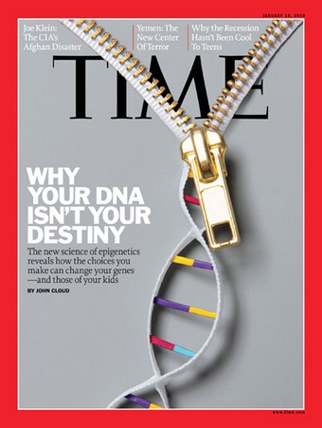
Notes:
So what is the solution? Well, I think it starts will public education. Explain complexity of genetic information. Change the dialogue.

Slide 12
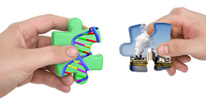

Notes:
But it is more than that. It is not just about translating the science and understanding its complexity. It is a much larger public dialogue about who we are and what becomes of us. *It is about translating science into the language of the spirit. Deciding whether or not get my own genomic information back has been, as corny as it may sound (and I know Tim is going to love this), for me, a spiritual journey. And I believe that translation requires a collective spiritual journey as we make meaning of the science in the context of what it means to be human. And that, I think, is the biggest challenge that we face.

