Slide 1
When Opportunity Knocks ? A European perspective on the use of WGS in the clinic
Samantha Leonard, Alexandra Soulier, Anne Cambon-Thomsen

Slide 2
Outline
Introduction to whole genome sequencing – what does it change for clinical medicine?
What ethical challenges are involved in WGS?
Views of professionals
Proposals for clinical use of WGS

Slide 3
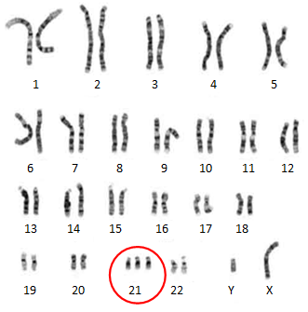
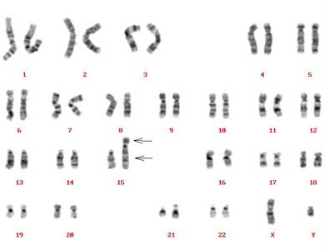
Progress of Genetics in Medicine- then
Clinical diagnosis – Downs syndrome
Chromosomes

Slide 4
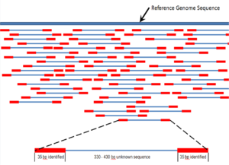
Progress of Genetics in Medicine- now
Single gene tests eg Cystic Fibrosis (CFTR)
Investigation of intellectual deficit – chromosomes – telomeres – aCGH
Future: whole genome sequencing

Slide 5
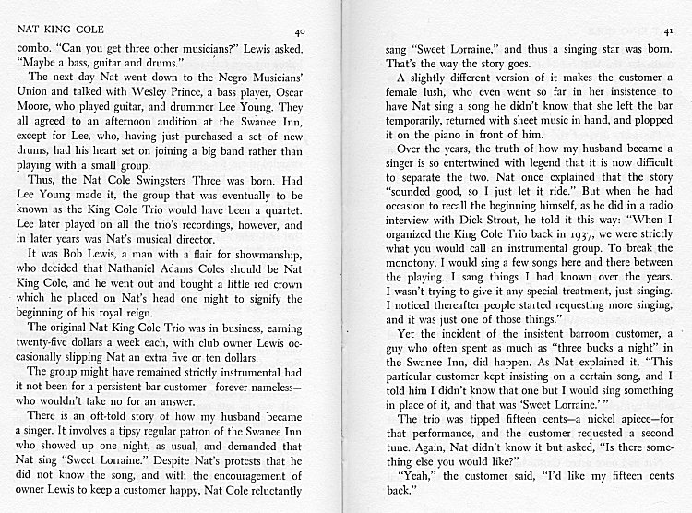
More detailed tests
Caryotype
Array- CGH
Whole exome/ genome sequencing

Slide 6
Whole genome sequencing
Changes the paradigm of clinical genetic testing (phenotype – genetic test)
Offers greater diagnostic capacity – speed, lower costs, higher pick-up rate
Disadvantages – uncertainty, data management, unwanted results

Slide 7
Issues identified through literature search and study of related technologies
Testing children
Prenatal testing
Incidental findings
Informed consent
Storage of data and recontact
Solidarity and equity

Slide 8
Key ethical principles
Right to decide to accept or refuse tests
Maximising patient benefit
Minimising harm
Equality of care and access to care

Slide 9
The ethical challenges
The big one:
- is this new?
- is this unique?
INCIDENTAL FINDINGS

Slide 10
A big challenge: incidental findings
You go to the doctor to find out why your child has learning difficulties.
You find out that you carry a high-risk susceptibility gene for breast cancer.

Slide 11
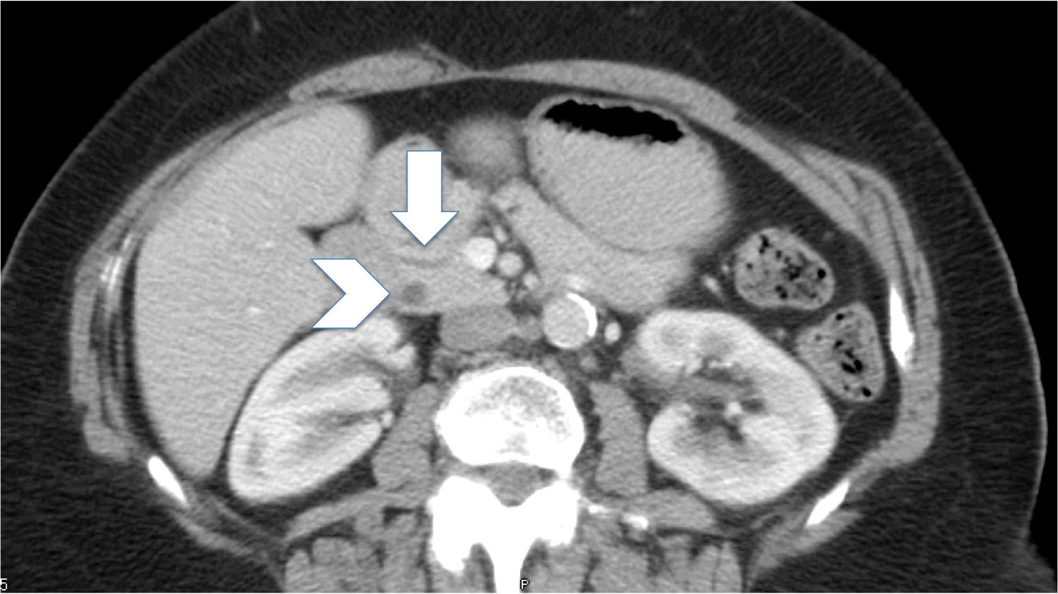
Incidental findings in other areas
Is there a difference?

Slide 12
No there isn’t:
Incidental findings occur in all areas of medicine
They are difficult to avoid
Dilemma about sharing, especially if significance unknown
‘Side effect’ of clinical care – forms part of investigation and treatment

Slide 13
Yes there is
Increased frequency of IFs in genetics
Predictive nature
Indirect nature
Radiology= visualising a tumour or other lesion
Genetics = studying a gene which may or may not lead to a particular effect now or in future

Slide 14
Sharing adult-onset results with parents of c children having WGS
For:
If such results are not shared they may be lost/ forgotten
IFs may have implications for one of the parents, - it is in the child’s best interests to have a healthy parent
Against :
Sharing IF results of adult-onset conditions does not directly benefit the child.
They should be able to participate in the decision-making

Slide 15
Informed consent

Slide 16
Informed consent
Large amount of information to cover
Understanding of issues
Spend hours obtaining specific consent or opt for ‘broad’ consent?

Slide 17
Return of results
Categories:
IFs – clinically actionable in adulthood
IFs – clinically actionable in childhood
IFs – clinically significant but not actionable
? Give choice about category of results
Timing
Give all results asap?
Staged return?
Patient held records?

Slide 18
New models of consent
Broad consent sufficient?
A number of issues to cover,
categories of IFs
Uncertain results
Sharing of results
Re-contact
Database participation
? Use of web tools

Slide 19
Data storage and Recontact

Slide 20
Storage of data and recontact
High volume of unknown variants expected
Technical and ethical problems
Guardianship of interpretable data
1 approach (dept in Netherlands): ask patients to recontact department after 2 years or if new personal or medical history or if feel WGS information may be of benefit

Slide 21
Recontact
Information changes over time
Significance of information for an individual may change over time
Duty of recontact – patient or genetics service?
Recontact or resequence?
Storage of data?
Security and privacy

Slide 22
Equity and solidarity

Slide 23
Paradigm shift

Slide 24
New landscape: solidarity and equity
Move away from patient-centred medicine to communal shared approach
Encouragement/ mandatory sharing within families
Creation of databases for variants
Necessity of populating databases

Slide 25
Challenge
Harness the diagnostic benefits of this technology
Minimise the harms

Slide 26
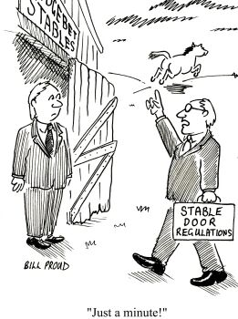
The challenge of developing ethical guidelines

Slide 27
Consequences
Guidelines too proscriptive/ not well adapted
Guidelines too general (guidelines about research needed to formulate guidelines).

Slide 28
Views of genetics health professionals towards diagnostic use of NGS

Slide 29
Incidental findings
Area of convergence: maximising benefit, minimising harm
Area of divergence: how this should be accomplished

Slide 30
Area of divergence: maximising benefit/ minimising harm
ACMG: opportunistic screening
ESHG: targeted screening
But – evidence that members are less divergent than the recommendations committees

Slide 31
Return of incidental findings to adult patients
Emerging consensus that patient preference should be taken into account
Divergence on issue of what options should be offered
96% would return clinically actionable findings
52% of clinical genetics professionals would disclose adult onset conditions that are not clinically actionable (Lemke et al 2013).

Slide 32
Return of results to parents of children undergoing WGS
Consensus regarding return of clinically actionable childhood illness
Divergence regarding adult onset clinically actionable disorders
Traditional stance: Don’t test child for adult onset disorders
Strong arguments that context and avoidable harms in WGS may warrant a different approach

Slide 33
Recontact
Empirical evidence that most patients value being recontacted
Most authors consider recontact to be ethically desirable but practically unfeasible
Otten et al Genetics in Medicine 2014

Slide 34
Survey of European professional stakeholders
147 respondants from 21 countries
54.7% female
28.3% clinical geneticists, 4.1% counsellors
33.1% clinical laboratory
6.2% students/ trainees

Slide 35
Do you agree that all competent adult patients undergoing WGS should have screening of a predetermined panel of genes for clinically actionable disorders?

Slide 36
Regarding incidental findings, which of the following result options should be offered to the competent adult patient?:

Slide 37
In addition to results related to the indication for testing, options for return of a child's results to their parents should include the following:

Slide 38
Do you think that WGS in the clinic requires a more in-depth consent procedure than array CGH?

Slide 39
Does the clinical service ordering WGS have a duty to review previous results in light of new information and re-contact patients (assuming consent has been obtained)?

Slide 40
Areas of convergence
Requirement for longer consent process for WGS
86.1%
Sharing of IF results of preventable/ treatable disorders
For adults: 96.5%
For children: 96.5%

Slide 41
Areas of divergence
Return of other IFs for children and adults (untreatable disorders)
Duty to recontact
Use of opportunistic screening

Slide 42
A way forward?
Divergence may be less marked when seen in light of common goal of maximising benefit and minimising harm
Need for exploration of practical options for return of incidental findings (when/ how)
More work to come to a consensus view
Regular revision of guidelines

Slide 43
Proposals: Opportunistic screening
Tests should be targeted wherever possible-opportunistic screening should not be offered at this time.
Justification:
difficulties of interpretation
lack of an infrastructure for long-term follow up of healthy patients with predictions of future disease
in such healthy patients without a family history penetrance of the known pathogenic mutations may well be decreased owing to selection bias of initial cases)

Slide 44
Proposal: Return of incidental findings results
Each laboratory and clinical department will need to decide (if there are no national guidelines) which results will be offered.
If more than just the “results related to clinical indication” will be given, the patient should be given options for which categories they would like to receive

Slide 45
Proposal: children and WGS
Until such time as the ability to interpret variants and to prevent adult onset conditions advances significantly, results for genes known to be associated with adult-onset conditions but unrelated to the condition being tested for should be masked.

Slide 46
Proposal: Recontact
Laboratories should not be expected to issue new reports related to variants outside of the indication for testing.
If the change is related to a variant reported in connection with the indication for testing then the laboratory could potentially be considered to have a duty to update the report.
The patient must be informed at the time of testing whether their result is a ‘snapshot’ or an ongoing, evolving process liable to give rise to changing interpretations as knowledge advances.

Slide 47
A final thought
“There is no terra incognita any more, at least geographically speaking. Our life is secured and fulfilled with guarantees and contracts. Maybe this is our last chance to live something we do not expect or something the science cannot interpret yet. (…) Maybe we do need this part of adventure as human beings” (LS1)

