Slide 1
Liminality and the limits of law in health research regulation
Graeme Laurie,
School of Law, University of Edinburgh

Slide 2
Overview
The metaphors and processes of regulatory ‘space’ and ‘translation’
Regulation and transition : the value of liminality
care.data : where is the human in human health research?
Health research as a transformative experience
Who, or what, experiences liminality? (and so what?)
Imagining liminal regulatory spaces

Slide 3
Regulatory space(s) in human health research
Regulated ‘objects’: ‘data’/ ‘tissue’/ ‘embryos’ / ‘devices’ / ‘ATMPs’/ ‘clinical trials’
Bounded by law and regulatory silos
The ‘consent or anonymise’ paradigm
‘Interests’ » ‘inter’ + ‘esse’: between beings…
More public engagement, more ethics, and more law
And yet…

Slide 4
care.data : an exercise in regulatory failure?
Health and Social Care Act 2012
Individual level patient data from GPs for six purposes, including commissioning and research
The ‘consent or anonymise’ paradigm » anonymise
Leaflets to 26.5 million households
Suspended in February 2014 for want of social licence
Legal authority does not command social legitimacy
But what is the experience for citizens and GPs?

Slide 5
Regulation and transition: liminality
Humans in translation…
childhood » adulthood
single » married
death » burial
3-stage process and the crucial value of ritual

Slide 6
Van Gennep’s 3 stages
» » Transition » »
STATE
STATE
Rites of separation LIMINALITY Rites of incorporation

Slide 7
Stenner and Moreno-Gabriel
“Moments of ‘becoming’ are literally formative experiences in which subjectivity itself acquires a new pattern…
…the more important and emotionally real the event, the greater the need for a carefully staged structure to ‘occasion’ the experiences.
In the absence of such patterning devices, liminality can be chaotic, messy, dangerous and destructive. Instead of being a formative experience, emotional transitions can be de-forming.”
Liminality and affectivity: The case of deceased organ donation (2013)

Slide 8
Turner and anti-structure
“Liminal entities are neither here nor there; they are betwixt and between the positions assigned and arrayed by law, custom, convention, and ceremonial.” (1969)

Slide 9
The mature minor
Gillick v. West Norfolk & Wisbeck Area Health Authority (1986)
Lord Fraser’s five-point test: autonomy and best interests
Consent v refusal: neither child nor adult
The temporary and transitory passing through
The role of health care professional as Representative of Order
Law’s attempt to give effect to the liminal experience feels unsatisfactory for its uncertainty and instability (at least to lawyers!)

Slide 10
Liminality and (ill) health
Becoming ill (entry into liminality)
Being ill (permanent liminality?)
Surviving illness (reincorporation)
Donating organs (asking relatives in a narrow window: time)
Hospices (somewhere outside the healthcare system: space)
Patient groups (liminality can generate camaraderie: communitas)

Slide 12
Liminality, community and crisis
Wars
Pandemics?
Moral and medical panics? – Bristol & Alder Hey
Law as the Representative of Order?

Slide 13
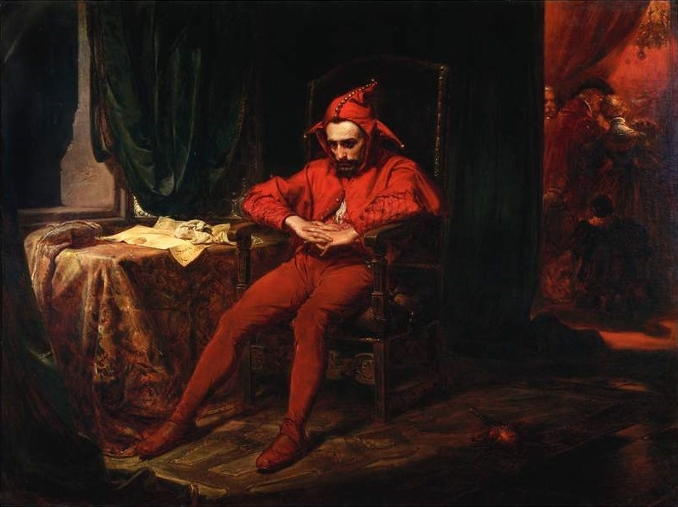

Slide 14
Who, or what, can experience liminality (and so what?)
Liminality is:
Experiential
Transformative and, normally, transitory
Processual, with both spatial and temporal dimensions
Characterised by uncertainty and it is anti-structural
Rites of passage therefore have value
Independent actors have a role as guides through liminality
Where rituals & actors absent = greater risk of chaos and permanent liminality
To pass through liminality is often to experience a change of status; (communitas?)
Both challenging and empowering but not easily amenable to influence or control

Slide 15
So what does liminality suggest about the experience of becoming a participant in health research?

Slide 16
care.data : an exercise in liminality?
Health and Social Care Act 2012 created the liminal space
Liminality was experienced by citizens and GPs alike
“Actualising a new cross-domain identity” (Ladge et al, (2012)
Who, or what, was the Representative of Order?
Crisis without suitable rituals or rites of passage
Was there a Trickster here?
Law as Trickster?

Slide 17
Liminality and the limits of consent
Consent as process
“Liminality is not just a matter of knowledge and cannot be ‘informed away’, as it is germane to socio-cultural processes and structures.”
Ladge et al. (2012)

Slide 18
Liminality and the Representative of Order
Contrast:
Health Research Authority: Applications Managers for ‘complex’ cases
Farr Institute (data linkage): Research Coordinators
RECs/IRBs: gatekeepers - who is the “shaman of the liminal”?

Slide 19
Liminality and the limits of law
Challenging the ‘bounded object’ approach of law
Challenging the ‘consent or anonymise’ paradigm
Considering law as Representative of Order or Trickster?
Imagining liminal regulatory spaces:
Allowing or creating spaces to share experiences
Accepting and embracing uncertainty and supporting transitions
Contrasting ceremonial liminality v spontaneous liminality
Capturing and reflecting how health research is experienced

Slide 20
Thank you
Wellcome Trust Senior Investigator Award, Confronting the Liminal Spaces of Health Research Regulation, WT103360MA
Liminal Spaces team: Edward Dove, Agomoni Ganguli-Mittra, Catriona McMillan and Samuel Alexander-Taylor
Niamh Nic Shuibhne and Mark Taylor for continued support

