Slide 1


Clinical Decision-Making and Secondary Findings
in Systems Medicine
T. Fischer¹, M. Langanke², P. Erdmann², K. Brothers³
¹ University Medicine Greifswald, Greifswald, Germany
² Greifswald University, Faculty of Theology, Greifswald, Germany
³ University of Louisville, School of Medicine, Louisville KY, United States
Oxford, 24 June 2015

Slide 2
I
II
III
IV
Agenda
I | Systems Medicine – one label for different methodologies
II | Systems Medicine and clinical decision-making – epistemological considerations
III | Translation of scoring systems into clinical practice – the Riyadh-algorithm as a case study
IV | Unsolicited findings in a future Systems Medicine
 | Contact details
Notes:
If we define “systems medicine” as the application of systems biology to clinical practice, then a question of great – even urgent – interest is how we move from systems biology to systems medicine. What additional work is needed before we can begin applying scientific findings generated in systems biology research to medical applications?

Slide 3
I
II
III
IV
Systems Medicine – one label for different methodologies
Simulation of processes in
sub-systems of organisms using tools from bioinformatics
Systems biology
“Big data medicine“
using methods from
biostatistics and biomathematics
Personalized Medicine/4P Medicine
“minus“ mechanistic reasoning (Association studies with -omics data)
Systems Medicine
Streamlining clinical workflows
using tools from
biomedical informatics
e.g. debate on
Electronic Health Records (EHRs)
Notes:
If we define “systems medicine” as the application of systems biology to clinical practice, then a question of great – even urgent – interest is how we move from systems biology to systems medicine. What additional work is needed before we can begin applying scientific findings generated in systems biology research to medical applications?

Slide 4
I
II
III
IV
Systems Medicine – one label for different methodologies
Simulation of processes in
sub-systems of organisms using tools from bioinformatics
Systems biology
“Big data medicine“
using methods from
biostatistics and biomathematics
Personalized Medicine/4P Medicine
“minus“ mechanistic reasoning
(Association studies with -omics data)
Systems Medicine
Streamlining clinical workflows
using tools from
biomedical informatics
e.g. debate on
Electronic Health Records (EHRs)
Notes:
If we define “systems medicine” as the application of systems biology to clinical practice, then a question of great – even urgent – interest is how we move from systems biology to systems medicine. What additional work is needed before we can begin applying scientific findings generated in systems biology research to medical applications?

Slide 5
I
II
III
IV
Systems Medicine – one label for different methodologies
Basic research
“Big data medicine“
using methods from
biostatistics and biomathematics
Personalized Medicine/4P Medicine
“minus“ machanistic reasoning
(Association studies with -omics data)
Systems Medicine
Streamlining clinical workflows
using tools from
biomedical informatics
e.g. debate on
Electronic Health Records (EHRs)
Notes:
If we define “systems medicine” as the application of systems biology to clinical practice, then a question of great – even urgent – interest is how we move from systems biology to systems medicine. What additional work is needed before we can begin applying scientific findings generated in systems biology research to medical applications?

Slide 6
I
II
III
IV
Systems Medicine and clinical decision-making –
epistemological considerations
Personalized Medicine
“Big data”-medicine
Rooted in scientific disciplines with mechanistic methodologies (e.g. Pharmacology)
Focuses (at least in part) on molecular mechanisms
Depends on big data
Rooted in information science and biostatistics/biomathematics
Agnostic to (molecular) biochemical mechanisms
Depends on bigger data
Notes:
Another way to frame this problem is to ask whether Systems Biology should be treated as a basic science or a translational science. If it is a basic science, we will utilize its findings as a new source of knowledge that may lead, with additional research, to improvements in clinical practice. If it is a translational science, then we will view its findings as directly applicable to clinical practice. Can we begin using computer-based algorithms developed using clinical “big data” sources directly in clinical care, or are other types of research needed prior to that use?

Slide 7
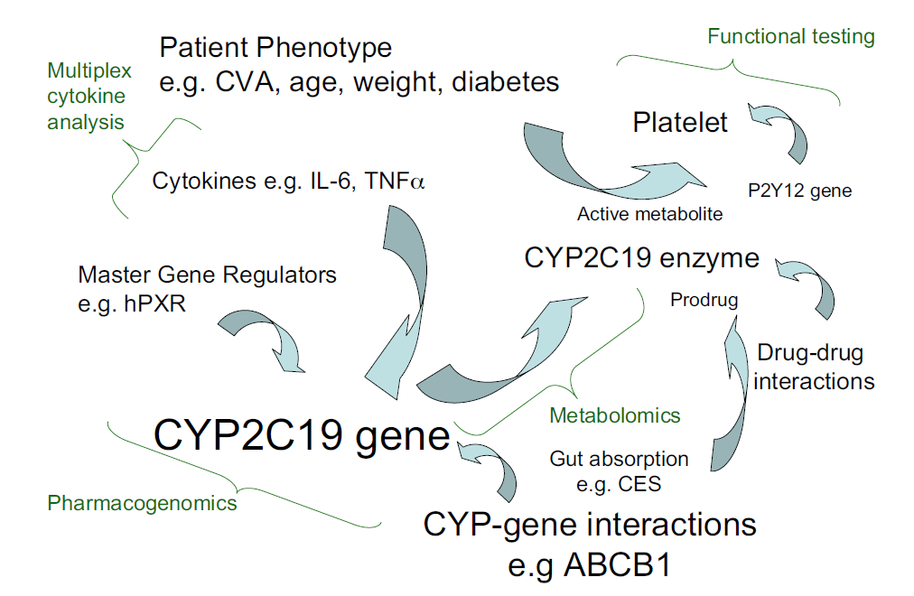
I
II
III
IV
Systems Medicine and clinical decision-making –
epistemological considerations
Mechanistic thinking in Personalized Medicine – Clopidogrel as a pharmacological example
Clopidogrel
CYP2C19
Active Drug
Gladding et al. “Clopidogrel Pharmacogenomics: Next Steps A Clinical Algorithm, Gene–Gene Interactions, and an Elusive Outcomes Trial.” JACC: Cardiovascular Interventions
Notes:
Another way to frame this problem is to ask whether Systems Biology should be treated as a basic science or a translational science. If it is a basic science, we will utilize its findings as a new source of knowledge that may lead, with additional research, to improvements in clinical practice. If it is a translational science, then we will view its findings as directly applicable to clinical practice. Can we begin using computer-based algorithms developed using clinical “big data” sources directly in clinical care, or are other types of research needed prior to that use?

Slide 8
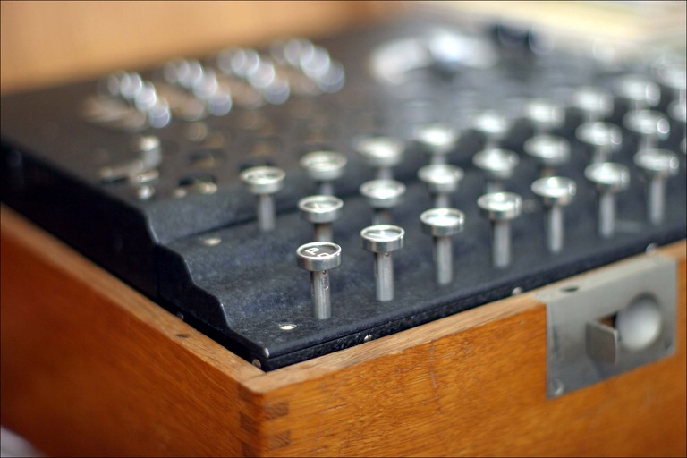
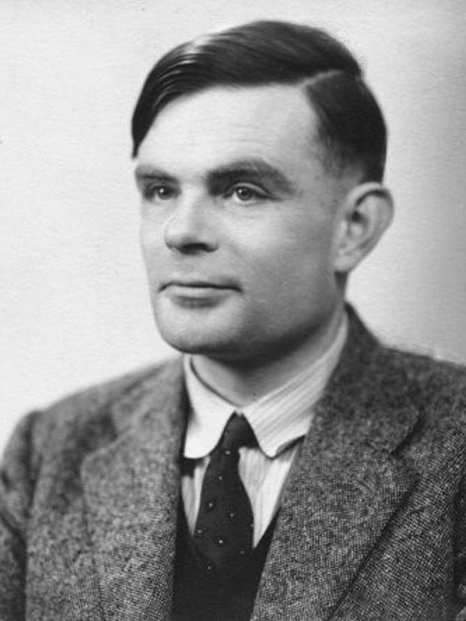
I
II
III
IV
Systems Medicine and clinical decision-making –
epistemological considerations
Notes:
Another way to frame this problem is to ask whether Systems Biology should be treated as a basic science or a translational science. If it is a basic science, we will utilize its findings as a new source of knowledge that may lead, with additional research, to improvements in clinical practice. If it is a translational science, then we will view its findings as directly applicable to clinical practice. Can we begin using computer-based algorithms developed using clinical “big data” sources directly in clinical care, or are other types of research needed prior to that use?

Slide 9
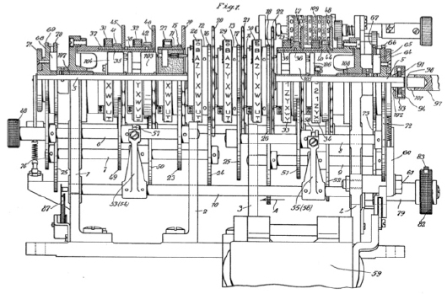
I
II
III
IV
Systems Medicine and clinical decision-making –
epistemological considerations
Input
(Original Message)
Enigma
Output
(Encrypted Message)
Notes:
Turing and his team were tasked with decrypting messages that had been encrypted using Enigma. That is, he wanted to make the Enigma machine run backwards – to recover the unknown input that had been used to generated the known output.
Although this proved to be an extraordinarily difficult challenge in a world with no digital computers, Turing proved that it was possible. Put simply, he took the “mechanistic approach”. Because British intelligence had managed to recover an enigma machine, he was able to literally “open the box” and see how it worked. Based on this understanding of how the mechanism worked, he was eventually able to build a type of computer that simulated the enigma machine running in reverse.

Slide 10
I
II
III
IV
Systems Medicine and clinical decision-making –
epistemological considerations
Input
Human Body
Output
Notes:
Turing and his team were tasked with decrypting messages that had been encrypted using Enigma. That is, he wanted to make the Enigma machine run backwards – to recover the unknown input that had been used to generated the known output.
Although this proved to be an extraordinarily difficult challenge in a world with no digital computers, Turing proved that it was possible. Put simply, he took the “mechanistic approach”. Because British intelligence had managed to recover an enigma machine, he was able to literally “open the box” and see how it worked. Based on this understanding of how the mechanism worked, he was eventually able to build a type of computer that simulated the enigma machine running in reverse.

Slide 11
I
II
III
IV
Systems Medicine and clinical decision-making –
epistemological considerations
Input
(Big Data)
Output
(Data, Scores, Prediction)
Notes:
Turing and his team were tasked with decrypting messages that had been encrypted using Enigma. That is, he wanted to make the Enigma machine run backwards – to recover the unknown input that had been used to generated the known output.
Although this proved to be an extraordinarily difficult challenge in a world with no digital computers, Turing proved that it was possible. Put simply, he took the “mechanistic approach”. Because British intelligence had managed to recover an enigma machine, he was able to literally “open the box” and see how it worked. Based on this understanding of how the mechanism worked, he was eventually able to build a type of computer that simulated the enigma machine running in reverse.

Slide 12
I
II
III
IV
Systems Medicine and clinical decision-making –
epistemological considerations
Patient-Specific
Knowledge
Clinical
Decision-Making
Clinical
Plan
Basic principle
General (Scientific)
Knowledge
Notes:
This tendency to treat the body as a “black box” lies at the heart of the challenge of incorporating systems medicine into clinical medicine. We have here a schematic demonstrating how clinical decisions are typically made. The clinician combines expert knowledge of the general or scientific variety to specific knowledge about the circumstances of a patient. We call this process “clinical decision-making”, and it results in the development of a clinical plan.

Slide 13
I
II
III
IV
Systems Medicine and clinical decision-making –
epistemological considerations
Patient
Characteristics
Evidence-Based Decision-Making
Clinical
Plan
Evidence-Based Medicine
Comparative Effectiveness Research
Notes:
This tendency to treat the body as a “black box” lies at the heart of the challenge of incorporating systems medicine into clinical medicine. We have here a schematic demonstrating how clinical decisions are typically made. The clinician combines expert knowledge of the general or scientific variety to specific knowledge about the circumstances of a patient. We call this process “clinical decision-making”, and it results in the development of a clinical plan.

Slide 14
I
II
III
IV
Systems Medicine and clinical decision-making –
epistemological considerations
Patient
Physiological Markers
Mechanistic Reasoning
Clinical
Plan
Experimental Medicine
Mechanistic Understanding
Notes:
This tendency to treat the body as a “black box” lies at the heart of the challenge of incorporating systems medicine into clinical medicine. We have here a schematic demonstrating how clinical decisions are typically made. The clinician combines expert knowledge of the general or scientific variety to specific knowledge about the circumstances of a patient. We call this process “clinical decision-making”, and it results in the development of a clinical plan.

Slide 15
I
II
III
IV
Systems Medicine and clinical decision-making –
epistemological considerations
Patient
Data
Algorithm based
Decision-Making
Clinical
Plan
Systems Medicine
Computer Algorithms
Notes:
This tendency to treat the body as a “black box” lies at the heart of the challenge of incorporating systems medicine into clinical medicine. We have here a schematic demonstrating how clinical decisions are typically made. The clinician combines expert knowledge of the general or scientific variety to specific knowledge about the circumstances of a patient. We call this process “clinical decision-making”, and it results in the development of a clinical plan.

Slide 16
I
II
III
IV
Systems Medicine and clinical decision-making –
epistemological considerations
Basic research
“Big data medicine“
using methods from
biostatistics and biomathematics
Personalized Medicine/4P Medicine
“minus“ mechanistic reasoning
(Association studies with -omics data)
Systems Medicine
Streamlining clinical workflows
using tools from
biomedical informatics
e.g. debate on
Electronic Health Records (EHRs)
Notes:
If we define “systems medicine” as the application of systems biology to clinical practice, then a question of great – even urgent – interest is how we move from systems biology to systems medicine. What additional work is needed before we can begin applying scientific findings generated in systems biology research to medical applications?

Slide 17
I
II
III
IV
Systems Medicine and clinical decision-making –
epistemological considerations
Basic research
Basic research
Systems Medicine
Streamlining clinical workflows
using tools from
biomedical informatics
e.g. debate on
Electronic Health Records (EHRs)
Notes:
If we define “systems medicine” as the application of systems biology to clinical practice, then a question of great – even urgent – interest is how we move from systems biology to systems medicine. What additional work is needed before we can begin applying scientific findings generated in systems biology research to medical applications?

Slide 18
I
II
III
IV
Translation of scoring systems into clinical practice – the Riyadh- algorithm as a case study
But even if we could have functional scoring systems from the “big data“-approach…
Systems Medicine
Notes:
With this in mind, we can begin to see the deep challenge that Systems Medicine poses. In this model, we only have a computer algorithm, but that algorithm is a black box. It is not based on mechanistic science, and it is not based on clinical research. It just takes the patient’s data, generates an output. Neither clinicians nor patients have a way to evaluate its predictions. We are faced with following its predictions, or ignoring them. This choice is arbitrary, and based purely on confidence in the black box.
We find this way of applying systems biology to medical practice to be untenable. Medical practice must be based on clinical decisions rooted in scientific knowledge, not on the capricious predictions of a black box. Based on this analysis, then, we argue that Systems Biology must be viewed as a basic science – as a hypothesis generator. We believe firmly in its potential, but fear the arbitrariness of its premature application to clinical care.

Slide 19
I
II
III
IV
Translation of scoring systems into clinical practice – the Riyadh- algorithm as a case study
Scoring systems (ICU) – APACHE II as an example
APACHE II was designed to measure the severity of disease for adult patients admitted to intensive care units.
Calculation:
The point score is calculated from a patient's age and 12 routine physiological measurements (i.e. temperature, mean arterial pressure, heart rate, respiratory rate, creatinine, hematocrit)
The calculation method results in a predicted mortality that is purely statistical.
Notes:
With this in mind, we can begin to see the deep challenge that Systems Medicine poses. In this model, we only have a computer algorithm, but that algorithm is a black box. It is not based on mechanistic science, and it is not based on clinical research. It just takes the patient’s data, generates an output. Neither clinicians nor patients have a way to evaluate its predictions. We are faced with following its predictions, or ignoring them. This choice is arbitrary, and based purely on confidence in the black box.
We find this way of applying systems biology to medical practice to be untenable. Medical practice must be based on clinical decisions rooted in scientific knowledge, not on the capricious predictions of a black box. Based on this analysis, then, we argue that Systems Biology must be viewed as a basic science – as a hypothesis generator. We believe firmly in its potential, but fear the arbitrariness of its premature application to clinical care.

Slide 20
I
II
III
IV
Translation of scoring systems into clinical practice – the Riyadh- algorithm as a case study
Use of scoring systems
Yes
No
Scores can be used to describe the morbidity of a patient when comparing the outcome with other patients.
Predicted mortalities are averaged for groups of patients in order to specify the group's morbidity.
It does not tell the individual patient's chance of survival.
No matter on how much data a projection is based: scoring systems are not intended to estimate the individual prognosis, but to assess a particular group.
Notes:
With this in mind, we can begin to see the deep challenge that Systems Medicine poses. In this model, we only have a computer algorithm, but that algorithm is a black box. It is not based on mechanistic science, and it is not based on clinical research. It just takes the patient’s data, generates an output. Neither clinicians nor patients have a way to evaluate its predictions. We are faced with following its predictions, or ignoring them. This choice is arbitrary, and based purely on confidence in the black box.
We find this way of applying systems biology to medical practice to be untenable. Medical practice must be based on clinical decisions rooted in scientific knowledge, not on the capricious predictions of a black box. Based on this analysis, then, we argue that Systems Biology must be viewed as a basic science – as a hypothesis generator. We believe firmly in its potential, but fear the arbitrariness of its premature application to clinical care.

Slide 21
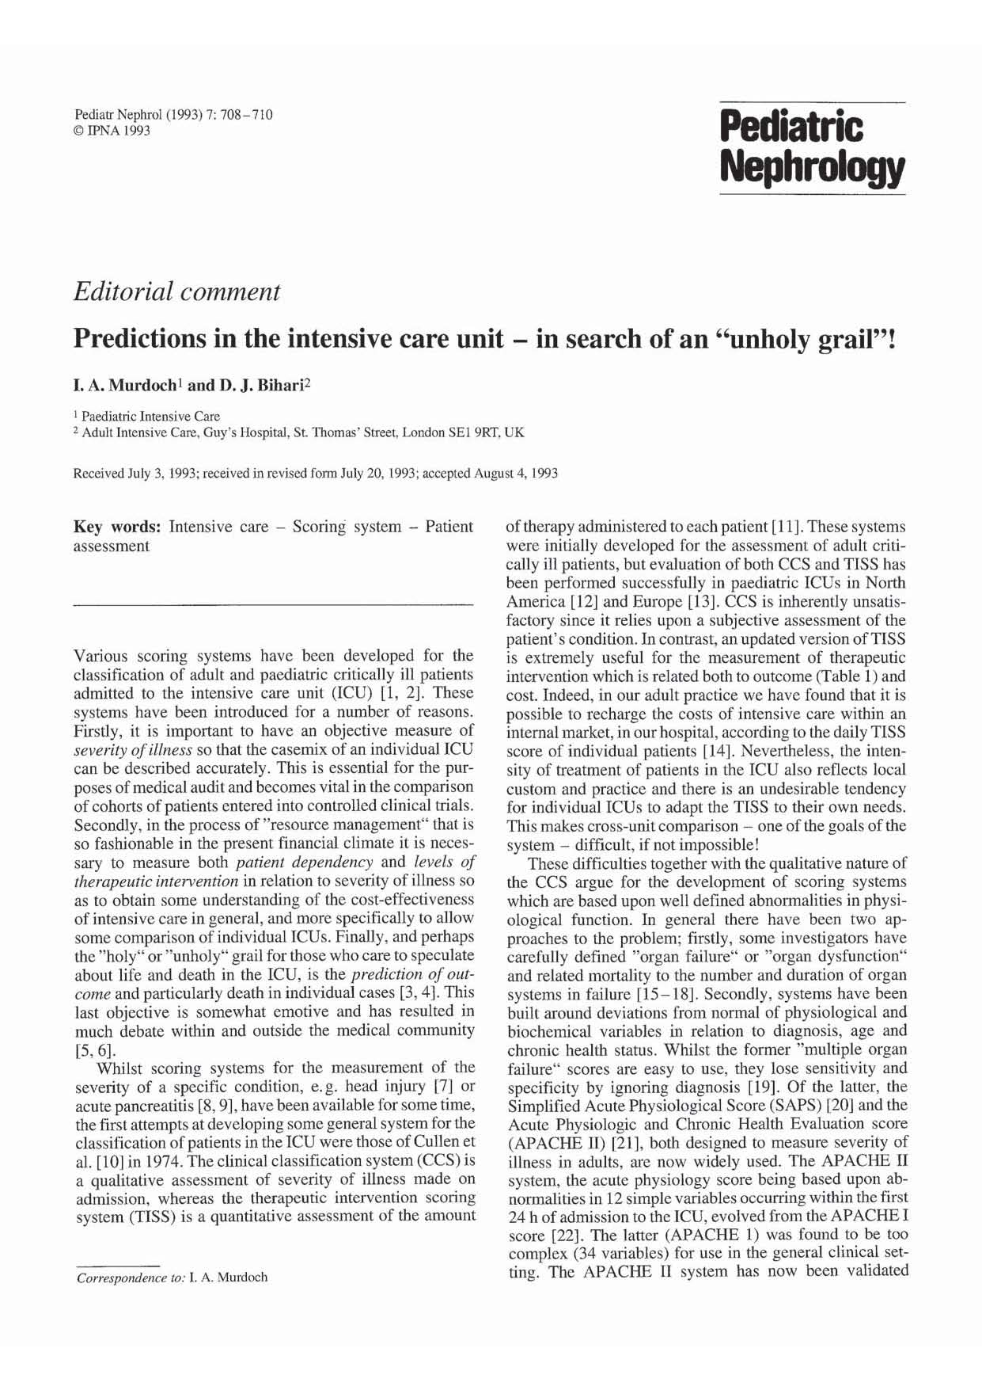
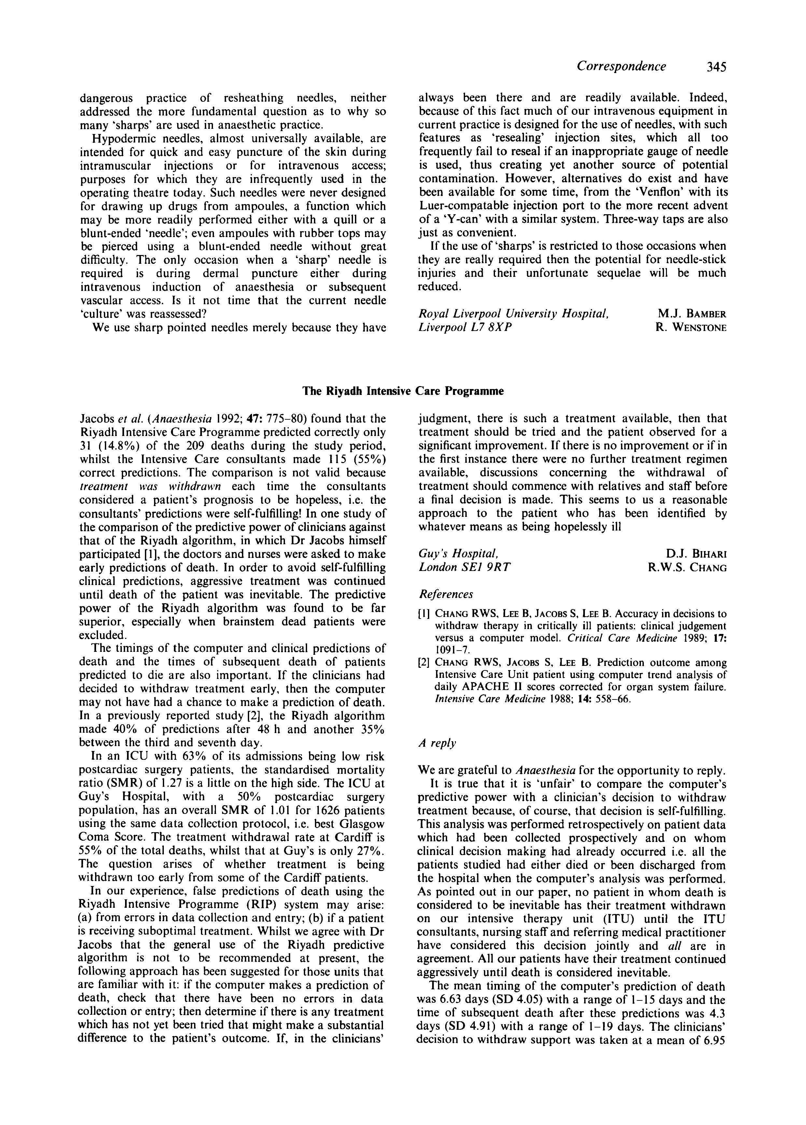
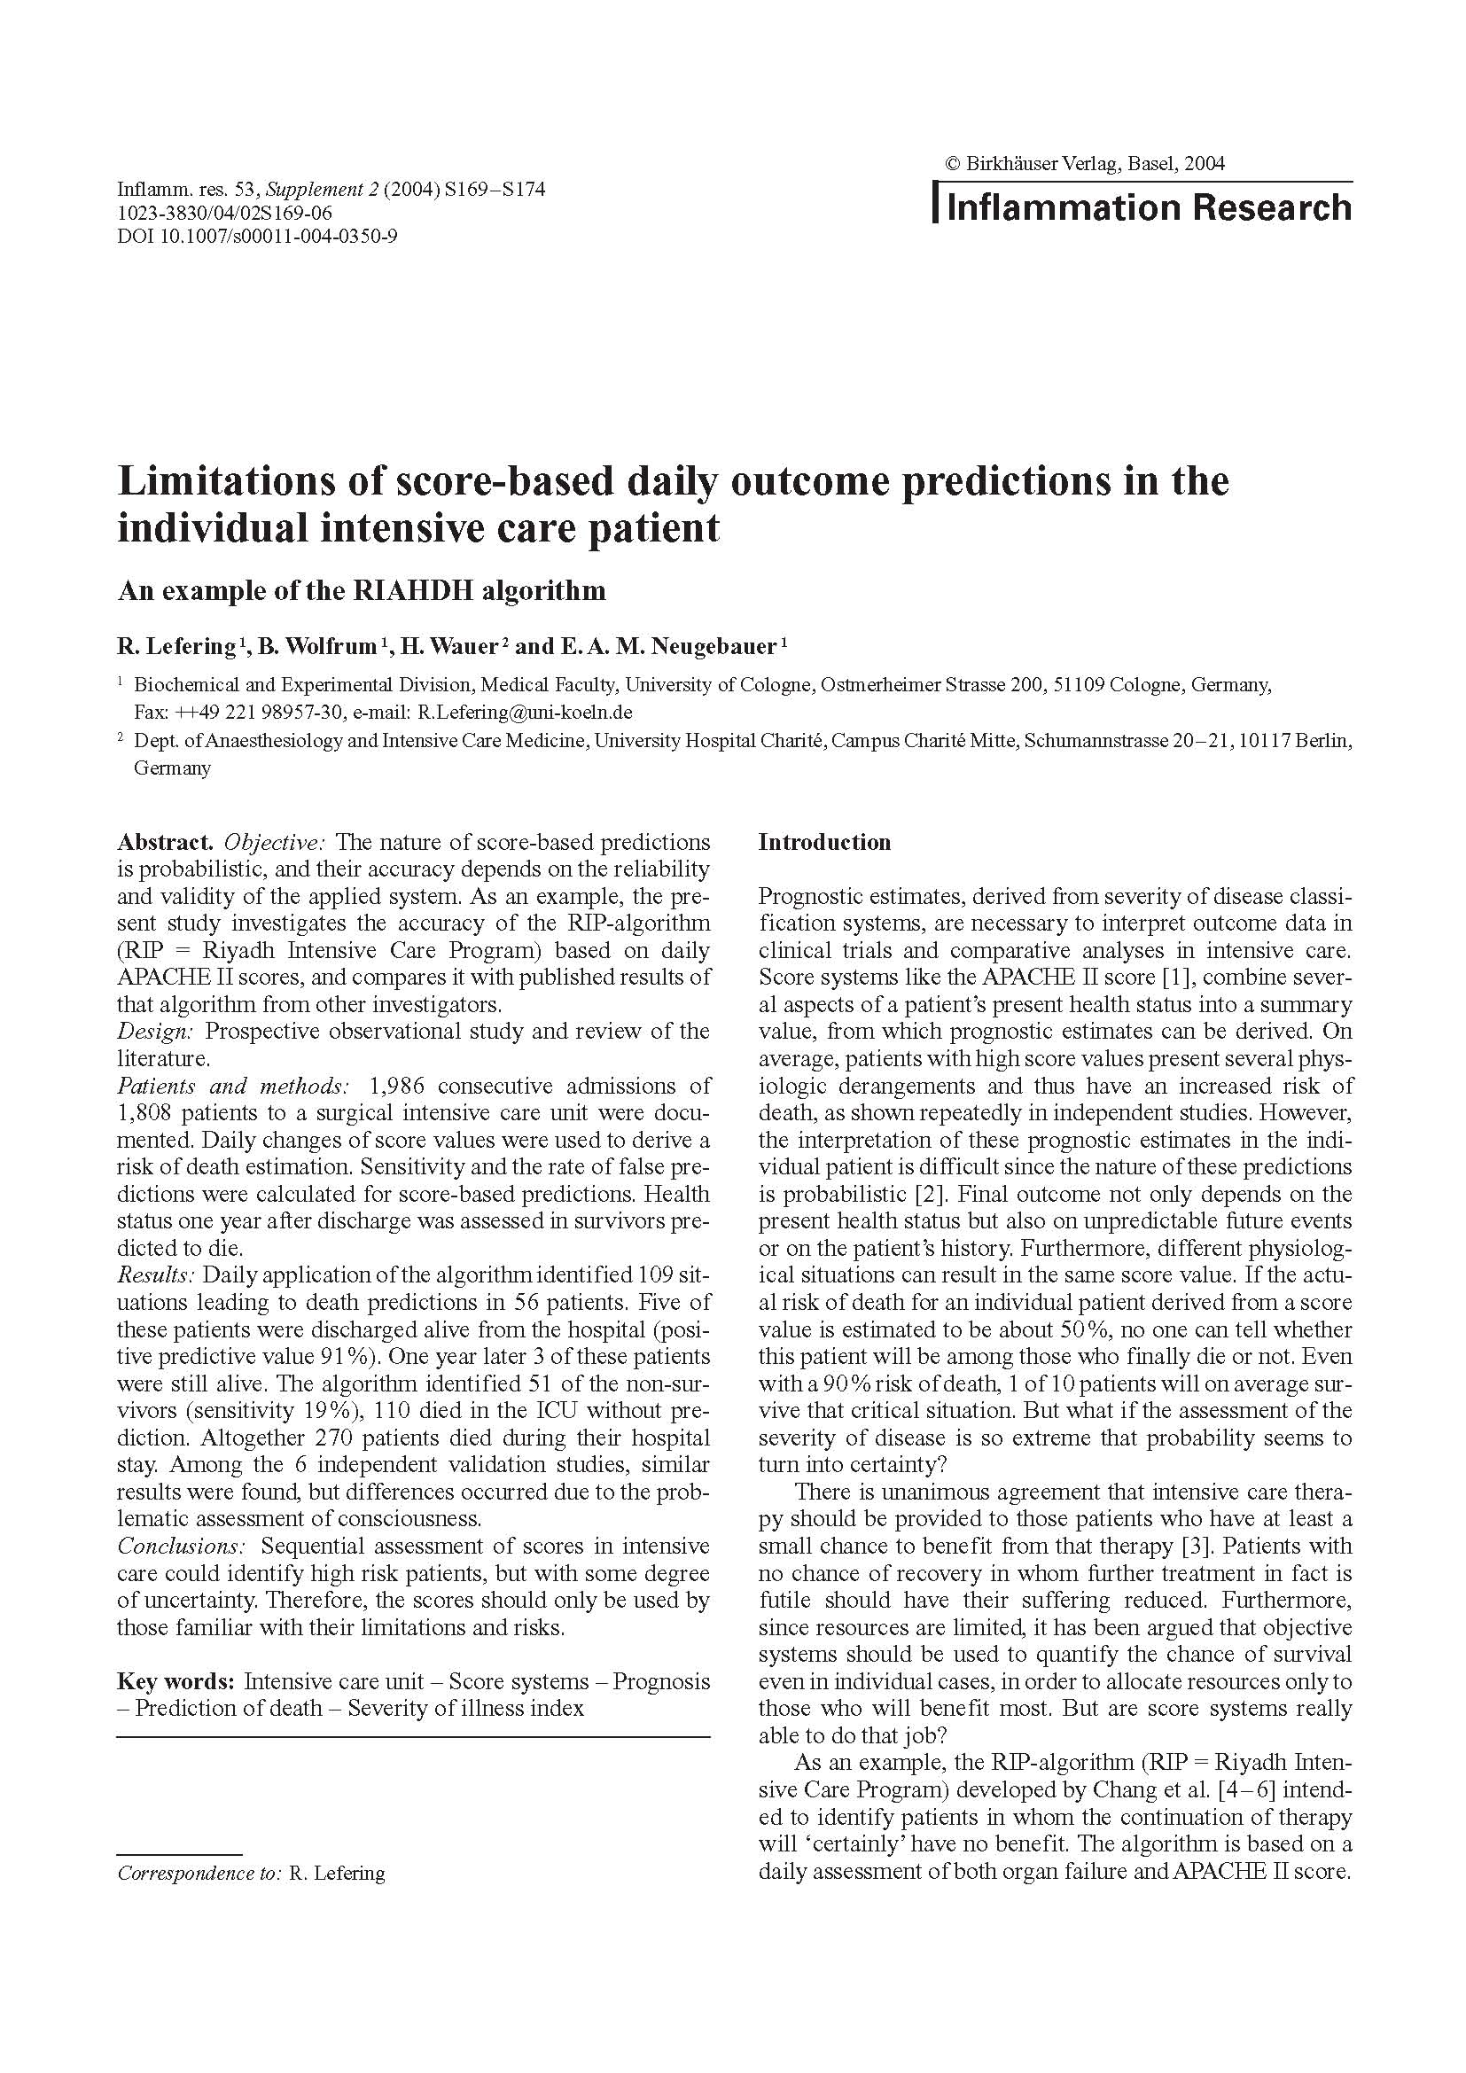
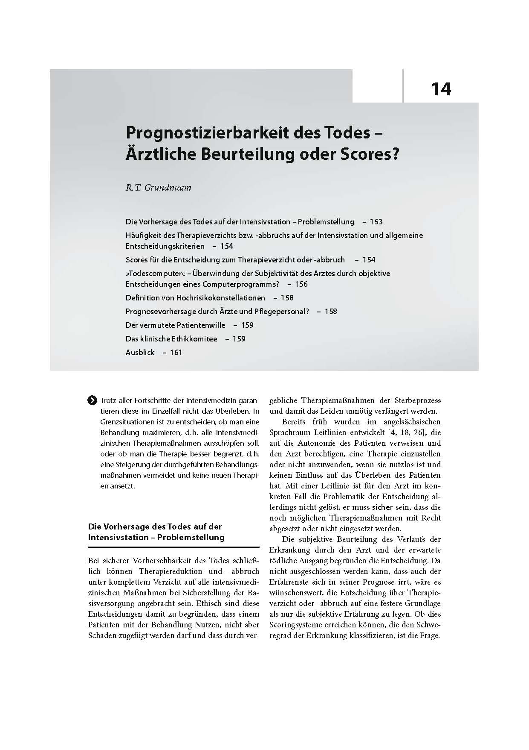
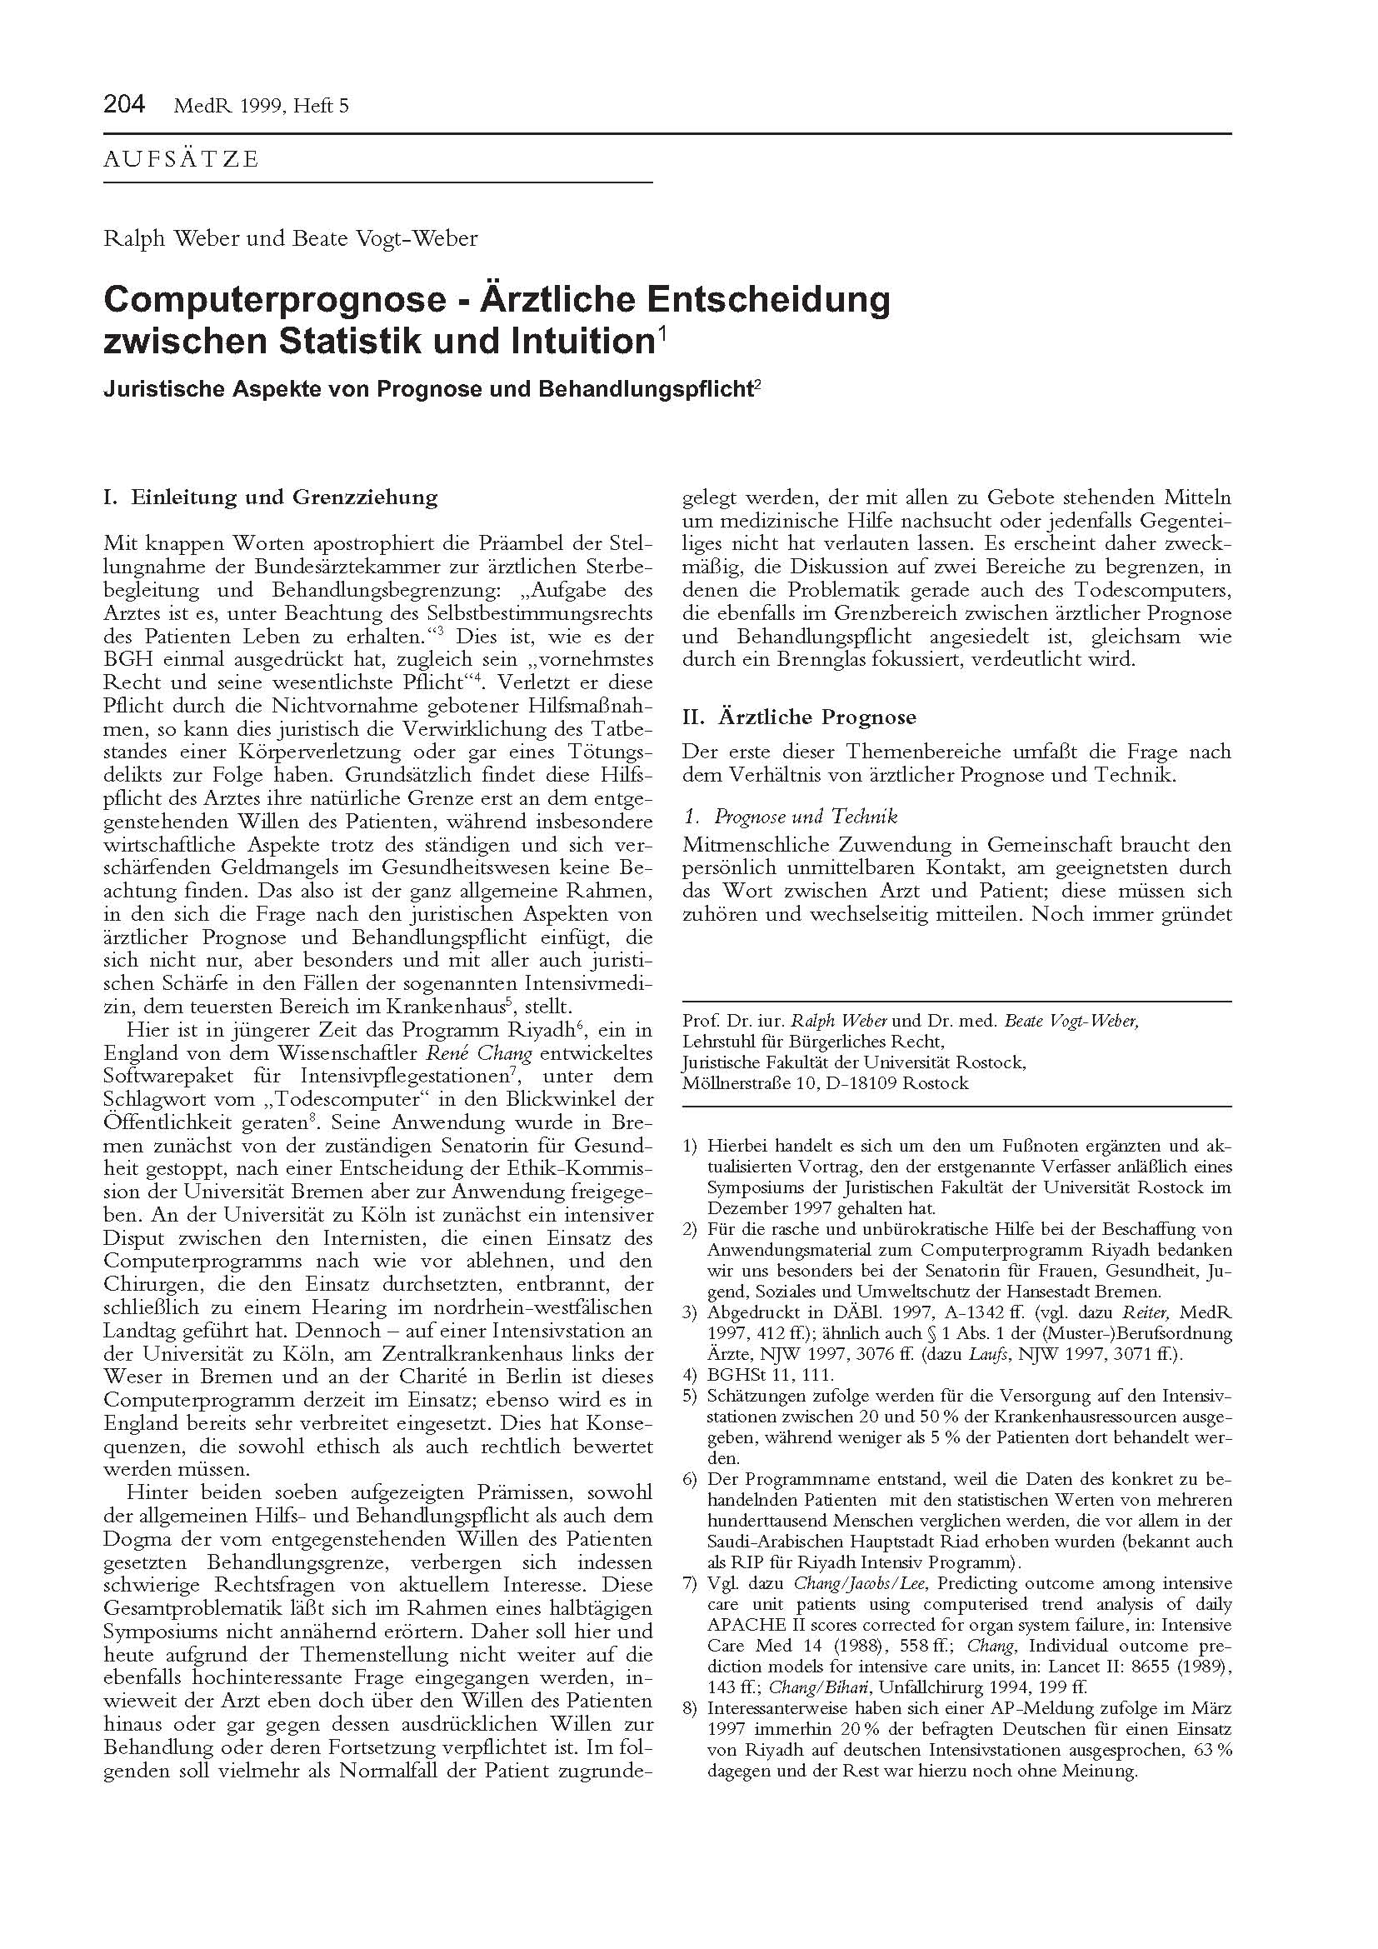
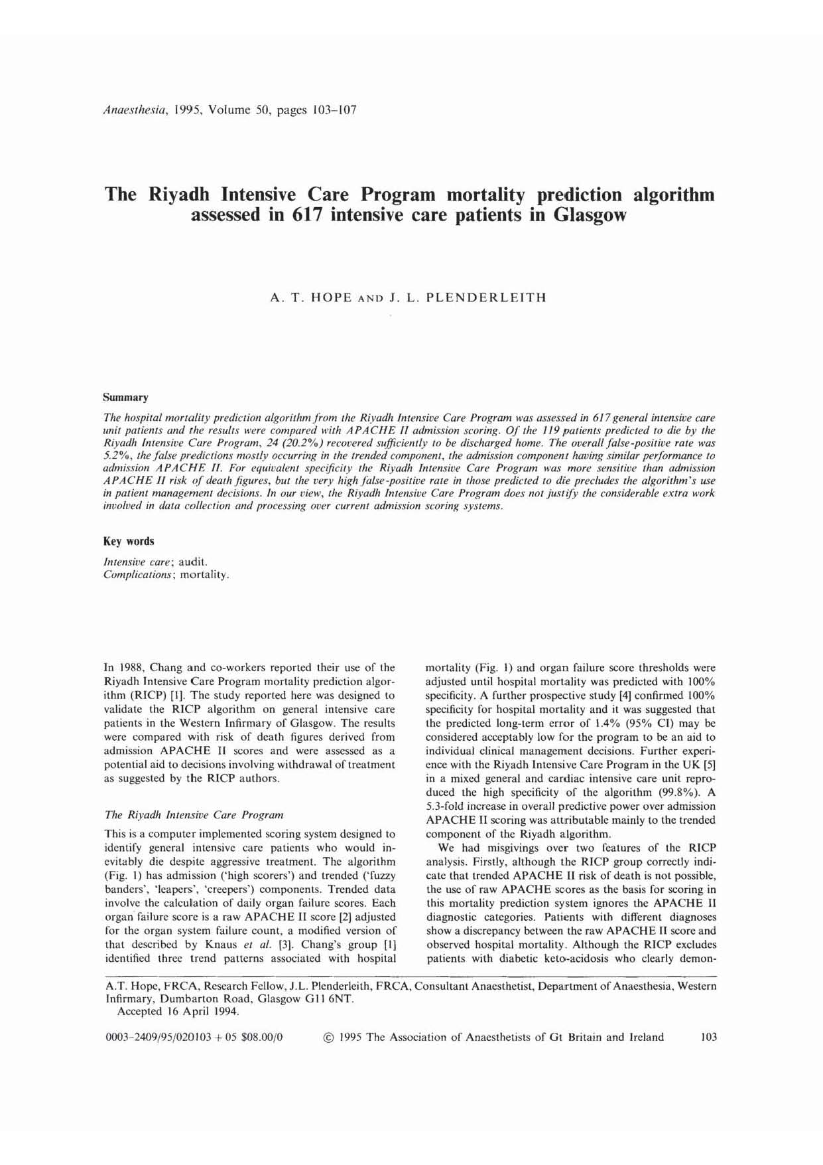
I
II
III
IV
Translation of scoring systems into clinical practice – the Riyadh- algorithm as a case study
Notes:
With this in mind, we can begin to see the deep challenge that Systems Medicine poses. In this model, we only have a computer algorithm, but that algorithm is a black box. It is not based on mechanistic science, and it is not based on clinical research. It just takes the patient’s data, generates an output. Neither clinicians nor patients have a way to evaluate its predictions. We are faced with following its predictions, or ignoring them. This choice is arbitrary, and based purely on confidence in the black box.
We find this way of applying systems biology to medical practice to be untenable. Medical practice must be based on clinical decisions rooted in scientific knowledge, not on the capricious predictions of a black box. Based on this analysis, then, we argue that Systems Biology must be viewed as a basic science – as a hypothesis generator. We believe firmly in its potential, but fear the arbitrariness of its premature application to clinical care.

Slide 22
I
II
III
IV
Translation of scoring systems into clinical practice – the Riyadh- algorithm as a case study
Riyadh – Intensive Care Unit Program
The Riyadh program converted the daily therapeutic effort based on the Therapeutic Intervention Scoring System (TISS) into so-called "cost-performance profile".
Not only the performance overhead can be documented, but the cost can be determined in relation to the “outcome".
By the inclusion of non-medical data, Riyadh becomes a cost-benefit analysis
Riyadh
should reliably predict the course of a disease and at the same time make a prediction about the cost of treatment and
was said to be highly correct with its outcome-predictions (99,9%).
Notes:
With this in mind, we can begin to see the deep challenge that Systems Medicine poses. In this model, we only have a computer algorithm, but that algorithm is a black box. It is not based on mechanistic science, and it is not based on clinical research. It just takes the patient’s data, generates an output. Neither clinicians nor patients have a way to evaluate its predictions. We are faced with following its predictions, or ignoring them. This choice is arbitrary, and based purely on confidence in the black box.
We find this way of applying systems biology to medical practice to be untenable. Medical practice must be based on clinical decisions rooted in scientific knowledge, not on the capricious predictions of a black box. Based on this analysis, then, we argue that Systems Biology must be viewed as a basic science – as a hypothesis generator. We believe firmly in its potential, but fear the arbitrariness of its premature application to clinical care.

Slide 23
I
II
III
IV
Translation of scoring systems into clinical practice – the Riyadh- algorithm as a case study
Fear
Reality
Based on the premise that Riyadh is a 99,9% reliable scoring system:
“Big data“: Integrating economic data allows the abuse or at least the merging of medical and non-medical reasons for a decision.
Should a (expensive) therapy be withheld from patients with low survival rates?
Should a computer/algorithm determine or at least influence the fate of the critically ill?
Riyadh has never achieved the 99.9% reliability which gave it the name "Death Computer”.
One study has shown that the prognosis of experienced clinicians is at least as good as the Riyadh prognosis
Another study has shown: of 53 patients with high probability of death 1/3 survived
Show stopper
Notes:
With this in mind, we can begin to see the deep challenge that Systems Medicine poses. In this model, we only have a computer algorithm, but that algorithm is a black box. It is not based on mechanistic science, and it is not based on clinical research. It just takes the patient’s data, generates an output. Neither clinicians nor patients have a way to evaluate its predictions. We are faced with following its predictions, or ignoring them. This choice is arbitrary, and based purely on confidence in the black box.
We find this way of applying systems biology to medical practice to be untenable. Medical practice must be based on clinical decisions rooted in scientific knowledge, not on the capricious predictions of a black box. Based on this analysis, then, we argue that Systems Biology must be viewed as a basic science – as a hypothesis generator. We believe firmly in its potential, but fear the arbitrariness of its premature application to clinical care.

Slide 24
I
II
III
IV
Translation of scoring systems into clinical practice – the Riyadh- algorithm as a case study
The big excitement was: When it was,
believed that Riyadh would work super accurately and
(2) all usable data (including economic) was processed
ethical problems arose.
Once a scoring system based on “big data” works as well as promised for Riyadh, these ethical issues will arise again.
Notes:
With this in mind, we can begin to see the deep challenge that Systems Medicine poses. In this model, we only have a computer algorithm, but that algorithm is a black box. It is not based on mechanistic science, and it is not based on clinical research. It just takes the patient’s data, generates an output. Neither clinicians nor patients have a way to evaluate its predictions. We are faced with following its predictions, or ignoring them. This choice is arbitrary, and based purely on confidence in the black box.
We find this way of applying systems biology to medical practice to be untenable. Medical practice must be based on clinical decisions rooted in scientific knowledge, not on the capricious predictions of a black box. Based on this analysis, then, we argue that Systems Biology must be viewed as a basic science – as a hypothesis generator. We believe firmly in its potential, but fear the arbitrariness of its premature application to clinical care.

Slide 25
I
II
III
IV
Translation of scoring systems into clinical practice – the Riyadh- algorithm as a case study
Old (and new) problems/questions
Patient wishes
Respect for the individuality of the dying life
Weighing up process of quality of life
Psychological factors
If the chance of survival is 2% - that means 2 of 100 will survive
Doctor-patient relationship
Justification pressure when deciding against the “objective” prediction
Call for discontinuation of therapy, if the score supposes a good chance of survivability?
Notes:
With this in mind, we can begin to see the deep challenge that Systems Medicine poses. In this model, we only have a computer algorithm, but that algorithm is a black box. It is not based on mechanistic science, and it is not based on clinical research. It just takes the patient’s data, generates an output. Neither clinicians nor patients have a way to evaluate its predictions. We are faced with following its predictions, or ignoring them. This choice is arbitrary, and based purely on confidence in the black box.
We find this way of applying systems biology to medical practice to be untenable. Medical practice must be based on clinical decisions rooted in scientific knowledge, not on the capricious predictions of a black box. Based on this analysis, then, we argue that Systems Biology must be viewed as a basic science – as a hypothesis generator. We believe firmly in its potential, but fear the arbitrariness of its premature application to clinical care.

Slide 26
I
II
III
IV
Translation of scoring systems into clinical practice – the Riyadh- algorithm as a case study
The bigger the data and the better the score…, the stronger the argument not to use it as a sole or prominent predictor?
Notes:
With this in mind, we can begin to see the deep challenge that Systems Medicine poses. In this model, we only have a computer algorithm, but that algorithm is a black box. It is not based on mechanistic science, and it is not based on clinical research. It just takes the patient’s data, generates an output. Neither clinicians nor patients have a way to evaluate its predictions. We are faced with following its predictions, or ignoring them. This choice is arbitrary, and based purely on confidence in the black box.
We find this way of applying systems biology to medical practice to be untenable. Medical practice must be based on clinical decisions rooted in scientific knowledge, not on the capricious predictions of a black box. Based on this analysis, then, we argue that Systems Biology must be viewed as a basic science – as a hypothesis generator. We believe firmly in its potential, but fear the arbitrariness of its premature application to clinical care.

Slide 27
I
II
III
IV
Unsolicited findings in a future Systems Medicine
Basic research
Basic research
Systems Medicine
Streamlining clinical workflows
using tools from
biomedical informatics
e.g. debate on implementation of
Electronic Health Records (EHRs)
Notes:
If we define “systems medicine” as the application of systems biology to clinical practice, then a question of great – even urgent – interest is how we move from systems biology to systems medicine. What additional work is needed before we can begin applying scientific findings generated in systems biology research to medical applications?

Slide 28
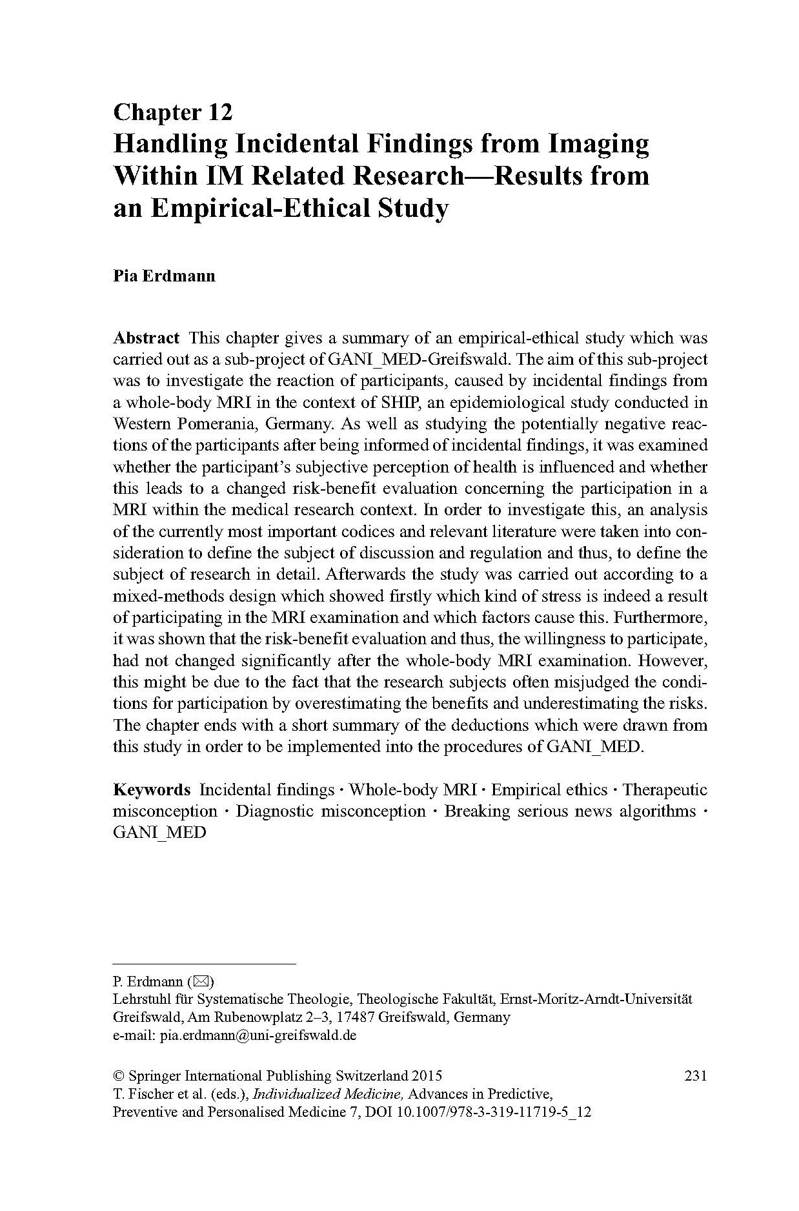
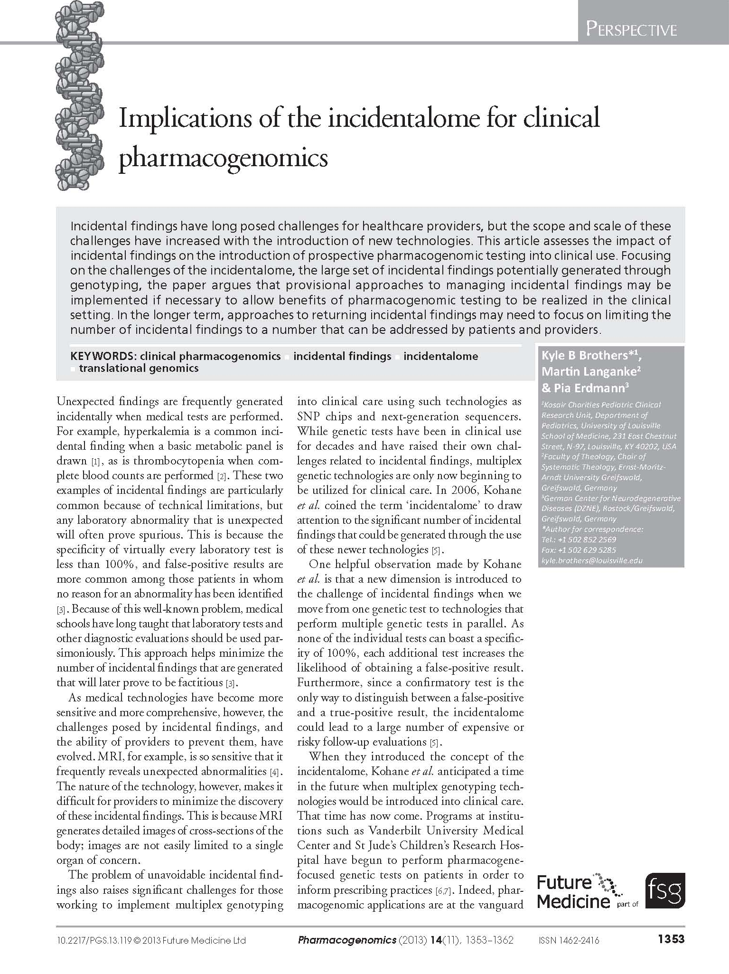
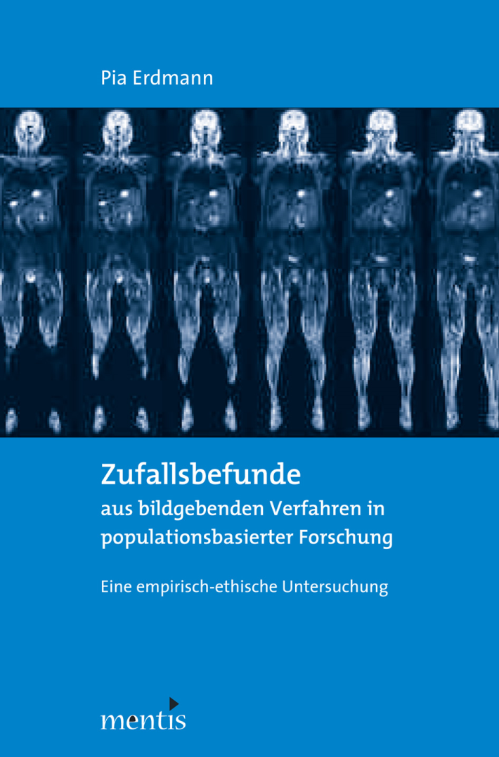
I
II
III
IV
Unsolicited findings in a future Systems Medicine
Research Award of the Association of the
German Ethics Commission 2015
Notes:
With this in mind, we can begin to see the deep challenge that Systems Medicine poses. In this model, we only have a computer algorithm, but that algorithm is a black box. It is not based on mechanistic science, and it is not based on clinical research. It just takes the patient’s data, generates an output. Neither clinicians nor patients have a way to evaluate its predictions. We are faced with following its predictions, or ignoring them. This choice is arbitrary, and based purely on confidence in the black box.
We find this way of applying systems biology to medical practice to be untenable. Medical practice must be based on clinical decisions rooted in scientific knowledge, not on the capricious predictions of a black box. Based on this analysis, then, we argue that Systems Biology must be viewed as a basic science – as a hypothesis generator. We believe firmly in its potential, but fear the arbitrariness of its premature application to clinical care.

Slide 29
I
II
III
IV
Unsolicited findings in a future Systems Medicine
WB MRI and Whole Exome Sequencing as sources for unsolicited and/or secondary findings
WB MRI
Direct-to-comsumer
Research context
Whole Exome Sequencing
(Health care context)
Notes:
With this in mind, we can begin to see the deep challenge that Systems Medicine poses. In this model, we only have a computer algorithm, but that algorithm is a black box. It is not based on mechanistic science, and it is not based on clinical research. It just takes the patient’s data, generates an output. Neither clinicians nor patients have a way to evaluate its predictions. We are faced with following its predictions, or ignoring them. This choice is arbitrary, and based purely on confidence in the black box.
We find this way of applying systems biology to medical practice to be untenable. Medical practice must be based on clinical decisions rooted in scientific knowledge, not on the capricious predictions of a black box. Based on this analysis, then, we argue that Systems Biology must be viewed as a basic science – as a hypothesis generator. We believe firmly in its potential, but fear the arbitrariness of its premature application to clinical care.

Slide 30
I
II
III
IV
Unsolicited findings in a future Systems Medicine
WB MRI and Whole Exome Sequencing as sources for unsolicited and/or secondary findings
WB MRI
Direct-to-comsumer
Research context
Whole Exome Sequencing
(Health care context)
Notes:
With this in mind, we can begin to see the deep challenge that Systems Medicine poses. In this model, we only have a computer algorithm, but that algorithm is a black box. It is not based on mechanistic science, and it is not based on clinical research. It just takes the patient’s data, generates an output. Neither clinicians nor patients have a way to evaluate its predictions. We are faced with following its predictions, or ignoring them. This choice is arbitrary, and based purely on confidence in the black box.
We find this way of applying systems biology to medical practice to be untenable. Medical practice must be based on clinical decisions rooted in scientific knowledge, not on the capricious predictions of a black box. Based on this analysis, then, we argue that Systems Biology must be viewed as a basic science – as a hypothesis generator. We believe firmly in its potential, but fear the arbitrariness of its premature application to clinical care.

Slide 31
I
II
III
IV
Unsolicited findings in a future Systems Medicine
Unsolicited findings can cause stress (figures from the research context)
Looking back, recieving test results was emotionally stressful…
~ 18 %
n = 131
Erdmann P et al.: Incidental Findings – Risk awareness of test persons and research ethical consequences, Linköping [Linköping University Electronic Press] 2013
Notes:
With this in mind, we can begin to see the deep challenge that Systems Medicine poses. In this model, we only have a computer algorithm, but that algorithm is a black box. It is not based on mechanistic science, and it is not based on clinical research. It just takes the patient’s data, generates an output. Neither clinicians nor patients have a way to evaluate its predictions. We are faced with following its predictions, or ignoring them. This choice is arbitrary, and based purely on confidence in the black box.
We find this way of applying systems biology to medical practice to be untenable. Medical practice must be based on clinical decisions rooted in scientific knowledge, not on the capricious predictions of a black box. Based on this analysis, then, we argue that Systems Biology must be viewed as a basic science – as a hypothesis generator. We believe firmly in its potential, but fear the arbitrariness of its premature application to clinical care.

Slide 32
I
II
III
IV
Unsolicited findings in a future Systems Medicine
Minimization of unsolicited findings in the medical research context through implementation of sophisticated disclosure algorithms – the SHIP-WB-MRI as an example
In addition:
No disclosure of unclear orthopedic findings in SHIP
Nevertheless:
~ 30 % patients have findings that require further clarification
Erdmann P et al.: Incidental Findings – Risk awareness of test persons and research ethical consequences, Linköping [Linköping University Electronic Press] 2013
Notes:
With this in mind, we can begin to see the deep challenge that Systems Medicine poses. In this model, we only have a computer algorithm, but that algorithm is a black box. It is not based on mechanistic science, and it is not based on clinical research. It just takes the patient’s data, generates an output. Neither clinicians nor patients have a way to evaluate its predictions. We are faced with following its predictions, or ignoring them. This choice is arbitrary, and based purely on confidence in the black box.
We find this way of applying systems biology to medical practice to be untenable. Medical practice must be based on clinical decisions rooted in scientific knowledge, not on the capricious predictions of a black box. Based on this analysis, then, we argue that Systems Biology must be viewed as a basic science – as a hypothesis generator. We believe firmly in its potential, but fear the arbitrariness of its premature application to clinical care.

Slide 33
I
II
III
IV
Unsolicited findings in a future Systems Medicine
EHRs as electronic “memories”
T₁
T₂
T₃
T₄
T_{n}
T₁
T₂
T₃
T₄
T_{n}
Patient‘s medical history
Patient‘s medical history
loss of information
loss of information
loss of information
loss of information
loss of information
saving
saving
saving
saving
saving
t
t
MENON hypothesis:
“Increase of available health-related information from patient‘s medical history causes continuous increase of (unsolicited and/or secondary) findings.“
Available health-related Information
Available health-related Information
t
t
Health care in the era of “paper files”
Health care in the era of EHRs
Notes:
With this in mind, we can begin to see the deep challenge that Systems Medicine poses. In this model, we only have a computer algorithm, but that algorithm is a black box. It is not based on mechanistic science, and it is not based on clinical research. It just takes the patient’s data, generates an output. Neither clinicians nor patients have a way to evaluate its predictions. We are faced with following its predictions, or ignoring them. This choice is arbitrary, and based purely on confidence in the black box.
We find this way of applying systems biology to medical practice to be untenable. Medical practice must be based on clinical decisions rooted in scientific knowledge, not on the capricious predictions of a black box. Based on this analysis, then, we argue that Systems Biology must be viewed as a basic science – as a hypothesis generator. We believe firmly in its potential, but fear the arbitrariness of its premature application to clinical care.

Slide 34
I
II
III
IV
Unsolicited findings in a future Systems Medicine
Potential sources for unsolicited and/or secondary findings
Physicians
“Quantified self“ applications
Patient‘s EHR
Clinics
Direct-to-consumer-genetics
Other health care providers
Direct-to-consumer-imaging
.
.
.
.
.
.
Notes:
With this in mind, we can begin to see the deep challenge that Systems Medicine poses. In this model, we only have a computer algorithm, but that algorithm is a black box. It is not based on mechanistic science, and it is not based on clinical research. It just takes the patient’s data, generates an output. Neither clinicians nor patients have a way to evaluate its predictions. We are faced with following its predictions, or ignoring them. This choice is arbitrary, and based purely on confidence in the black box.
We find this way of applying systems biology to medical practice to be untenable. Medical practice must be based on clinical decisions rooted in scientific knowledge, not on the capricious predictions of a black box. Based on this analysis, then, we argue that Systems Biology must be viewed as a basic science – as a hypothesis generator. We believe firmly in its potential, but fear the arbitrariness of its premature application to clinical care.

Slide 35
I
II
III
IV
Unsolicited findings in a future Systems Medicine
Types of data containing health related information
Medication data
Data from interviews
Imaging data
Pathological relevant
associations
Pathological relevant
associations
-omics data
Pathological relevant
associations
Data from special clinical examinations
Data from genetics
Data from
clinical chemistry
Notes:
With this in mind, we can begin to see the deep challenge that Systems Medicine poses. In this model, we only have a computer algorithm, but that algorithm is a black box. It is not based on mechanistic science, and it is not based on clinical research. It just takes the patient’s data, generates an output. Neither clinicians nor patients have a way to evaluate its predictions. We are faced with following its predictions, or ignoring them. This choice is arbitrary, and based purely on confidence in the black box.
We find this way of applying systems biology to medical practice to be untenable. Medical practice must be based on clinical decisions rooted in scientific knowledge, not on the capricious predictions of a black box. Based on this analysis, then, we argue that Systems Biology must be viewed as a basic science – as a hypothesis generator. We believe firmly in its potential, but fear the arbitrariness of its premature application to clinical care.

Slide 36
I
II
III
IV
Unsolicited findings in a future Systems Medicine
If our MENON hypothesis is true…, health care utilization could change…
MENON hypothesis:
“Increase of available health-related information from patient‘s medical history causes continuous increase of (unsolicited and/or secundary) findings.“
Patients with limited knowledge and sporadic health care utilization
“big data”-enriched EHRs
Early multimorbid
risk-burdened
“knowers”
?
Notes:
With this in mind, we can begin to see the deep challenge that Systems Medicine poses. In this model, we only have a computer algorithm, but that algorithm is a black box. It is not based on mechanistic science, and it is not based on clinical research. It just takes the patient’s data, generates an output. Neither clinicians nor patients have a way to evaluate its predictions. We are faced with following its predictions, or ignoring them. This choice is arbitrary, and based purely on confidence in the black box.
We find this way of applying systems biology to medical practice to be untenable. Medical practice must be based on clinical decisions rooted in scientific knowledge, not on the capricious predictions of a black box. Based on this analysis, then, we argue that Systems Biology must be viewed as a basic science – as a hypothesis generator. We believe firmly in its potential, but fear the arbitrariness of its premature application to clinical care.

Slide 37
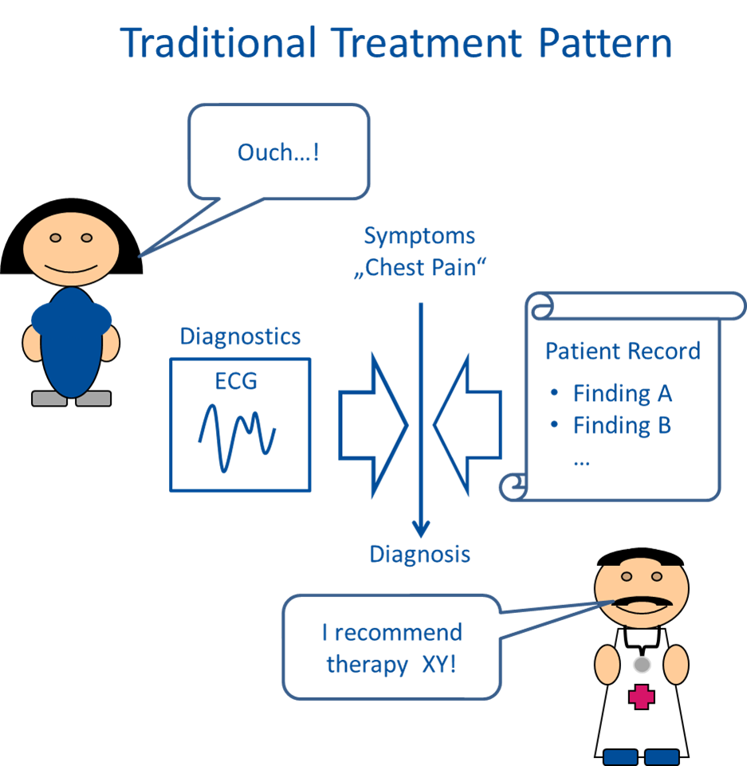
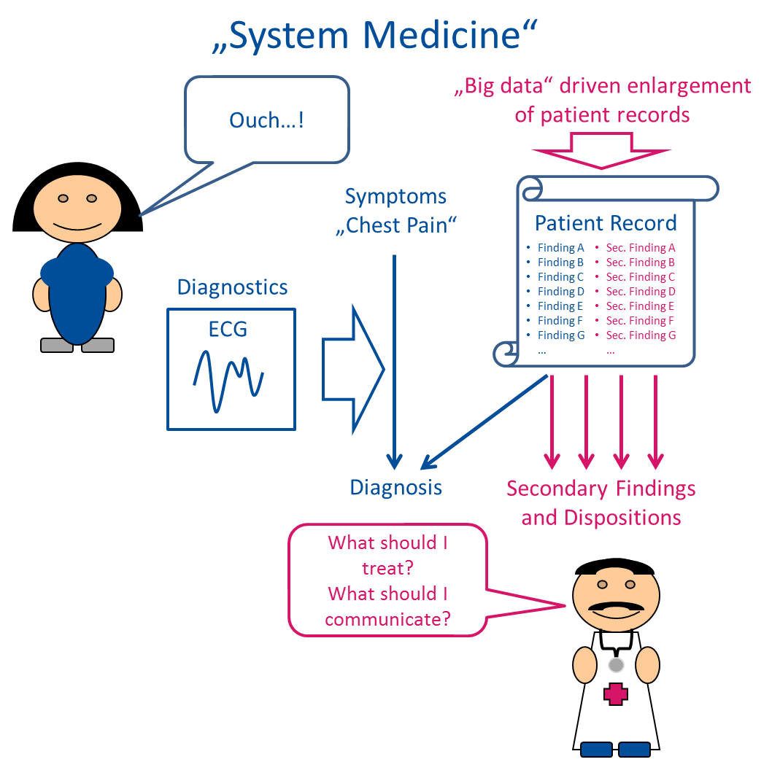
I
II
III
IV
Unsolicited findings in a future Systems Medicine
If our MENON hypothesis is true…, workflows in clinical treatment must be eventually adapted…
Traditional Treatment Pattern
?
Systems Medicine
Notes:
With this in mind, we can begin to see the deep challenge that Systems Medicine poses. In this model, we only have a computer algorithm, but that algorithm is a black box. It is not based on mechanistic science, and it is not based on clinical research. It just takes the patient’s data, generates an output. Neither clinicians nor patients have a way to evaluate its predictions. We are faced with following its predictions, or ignoring them. This choice is arbitrary, and based purely on confidence in the black box.
We find this way of applying systems biology to medical practice to be untenable. Medical practice must be based on clinical decisions rooted in scientific knowledge, not on the capricious predictions of a black box. Based on this analysis, then, we argue that Systems Biology must be viewed as a basic science – as a hypothesis generator. We believe firmly in its potential, but fear the arbitrariness of its premature application to clinical care.

Slide 38
I
II
III
IV
Unsolicited findings in a future Systems Medicine
But maybe nothing changes, because the anticipated effects of EHRs are absorbed by …
Non-compliance of patients
Economical constraints
Patients with limited knowledge and sporadic health care utilization
“big data”-enriched EHRs
Concept of “watchful waiting“
Patients with limited knowledge and sporadic health care utilization
Pragmatic neglect of findings
Other factors…
Concept of “leading“ diagnosis
Pragmatic paternalism of doctors
Notes:
With this in mind, we can begin to see the deep challenge that Systems Medicine poses. In this model, we only have a computer algorithm, but that algorithm is a black box. It is not based on mechanistic science, and it is not based on clinical research. It just takes the patient’s data, generates an output. Neither clinicians nor patients have a way to evaluate its predictions. We are faced with following its predictions, or ignoring them. This choice is arbitrary, and based purely on confidence in the black box.
We find this way of applying systems biology to medical practice to be untenable. Medical practice must be based on clinical decisions rooted in scientific knowledge, not on the capricious predictions of a black box. Based on this analysis, then, we argue that Systems Biology must be viewed as a basic science – as a hypothesis generator. We believe firmly in its potential, but fear the arbitrariness of its premature application to clinical care.

Slide 39
I
II
III
IV
Unsolicited findings in a future Systems Medicine
Or…, our hypothesis is false…
Patients with limited knowledge and sporadic health care utilization
“big data”-enriched EHRs
Patients with limited knowledge and sporadic health care utilization
Notes:
With this in mind, we can begin to see the deep challenge that Systems Medicine poses. In this model, we only have a computer algorithm, but that algorithm is a black box. It is not based on mechanistic science, and it is not based on clinical research. It just takes the patient’s data, generates an output. Neither clinicians nor patients have a way to evaluate its predictions. We are faced with following its predictions, or ignoring them. This choice is arbitrary, and based purely on confidence in the black box.
We find this way of applying systems biology to medical practice to be untenable. Medical practice must be based on clinical decisions rooted in scientific knowledge, not on the capricious predictions of a black box. Based on this analysis, then, we argue that Systems Biology must be viewed as a basic science – as a hypothesis generator. We believe firmly in its potential, but fear the arbitrariness of its premature application to clinical care.

Slide 40
I
II
III
IV
Unsolicited findings in a future Systems Medicine
Therefore:
Empirical research in MENON:
Interviews and Focus Groups
with German and US-American experts in the field of Systems Medicine
Notes:
With this in mind, we can begin to see the deep challenge that Systems Medicine poses. In this model, we only have a computer algorithm, but that algorithm is a black box. It is not based on mechanistic science, and it is not based on clinical research. It just takes the patient’s data, generates an output. Neither clinicians nor patients have a way to evaluate its predictions. We are faced with following its predictions, or ignoring them. This choice is arbitrary, and based purely on confidence in the black box.
We find this way of applying systems biology to medical practice to be untenable. Medical practice must be based on clinical decisions rooted in scientific knowledge, not on the capricious predictions of a black box. Based on this analysis, then, we argue that Systems Biology must be viewed as a basic science – as a hypothesis generator. We believe firmly in its potential, but fear the arbitrariness of its premature application to clinical care.

Slide 41
Contact details
Dr. Tobias Fischer, M.A.
University Medicine Greifswald
Department for Ethics Theory and History
in Life Sciences
Walther-Rathenau-Str. 48
17489 Greifswald, Germany
Dr. Martin Langanke, M.A.
Greifswald Universiity
Faculty of Theology
Chair of Systematic Theology
Am Rubenowplatz 2-3
17489 Greifswald, Germany
Dr. Pia Erdmann, M.A.
Greifswald Universiity
Faculty of Theology
Chair of Systematic Theology
Am Rubenowplatz 2-3
17489 Greifswald, Germany
Prof. Kyle B. Brothers MD, PhD
University of Louisville
School of Medicine
Kosair Charities Pediatric Clinical Research Unit
231 East Chestnut Street, N-97
40207 Louisville KY, United States
Notes:
With this in mind, we can begin to see the deep challenge that Systems Medicine poses. In this model, we only have a computer algorithm, but that algorithm is a black box. It is not based on mechanistic science, and it is not based on clinical research. It just takes the patient’s data, generates an output. Neither clinicians nor patients have a way to evaluate its predictions. We are faced with following its predictions, or ignoring them. This choice is arbitrary, and based purely on confidence in the black box.
We find this way of applying systems biology to medical practice to be untenable. Medical practice must be based on clinical decisions rooted in scientific knowledge, not on the capricious predictions of a black box. Based on this analysis, then, we argue that Systems Biology must be viewed as a basic science – as a hypothesis generator. We believe firmly in its potential, but fear the arbitrariness of its premature application to clinical care.

