Slide 1

IMPACT Observatory of Clinical Research Regarding Data Sharing
Karmela Krleža-Jerić
On behalf of IMPACT Observatory
Ottawa Group -IMPACT- Dpt of Research in Biomedicine and Health, University of Split School of Medicine

Slide 2
Karmela Krleža-Jerić
No conflict of interest
but
interest in research &
public disclosure of research data

Slide 3

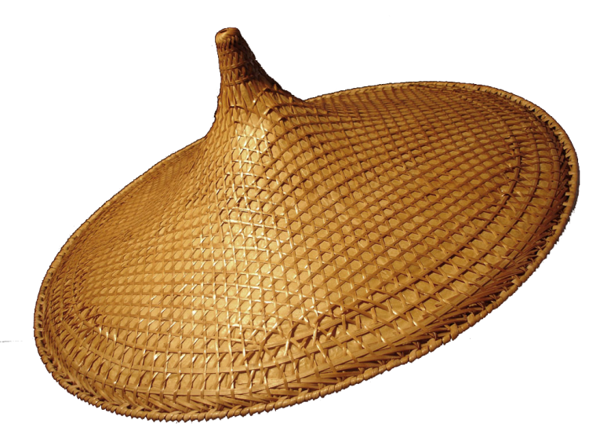

Open trial data
Public health aspect; ultimate user and beneficiary aspects
International aspect: dialogue, initiatives, actions, standards, IMPACT
Clinical trial aspect – transition regarding changes in data sharing ;shift of paradigm

Slide 4
outline
Clinical trials
Data sharing
IMPACT
IMPACT Observatory
IMPACT observatory issues

Slide 5
IMPACT
IMProving Access to Clinical Trial data
http://ottawagroup.ohri.ca/disclosure.html

Slide 6
CLINICAL TRIAL and RCT
“clinical trial” is a prospective (research) study evaluating the effects of one or more health-related interventions assigned to human participants.
RCT (randomized controlled/clinical trial) is using random allocation, determining whether
an intervention is effective or harmful.
or
an innovative intervention leads to improved health.

Slide 7
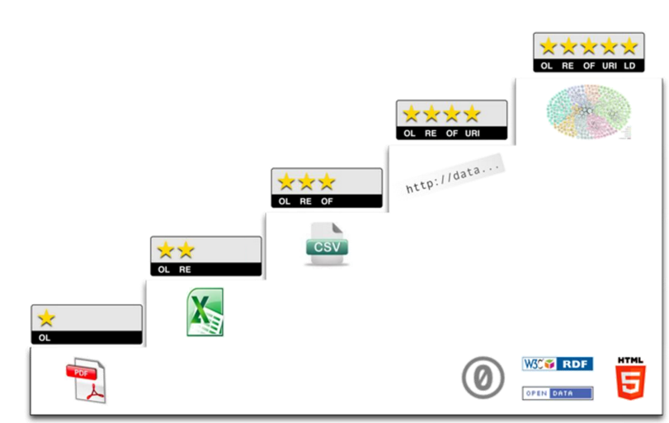
5 Open Data
Tim Berners-Lee, the inventor of the Web and Linked Data initiator, suggested a 5 star deployment scheme for Open Data.
Link your data to other data to provide context
Use URI to denote things so people can point on your stuff
Non-proprietary formats (CSV instead of excel)
 Structured data (excel instead of image scan of table)
Available on web under open licence

Slide 8
Why do we want to open CT data?
to
increase reliability of evidence for evidence informed decision making

Slide 9
Why do we want to open CT data?
to
speed up knowledge creation and
development of better diagnostics & therapies

Slide 10
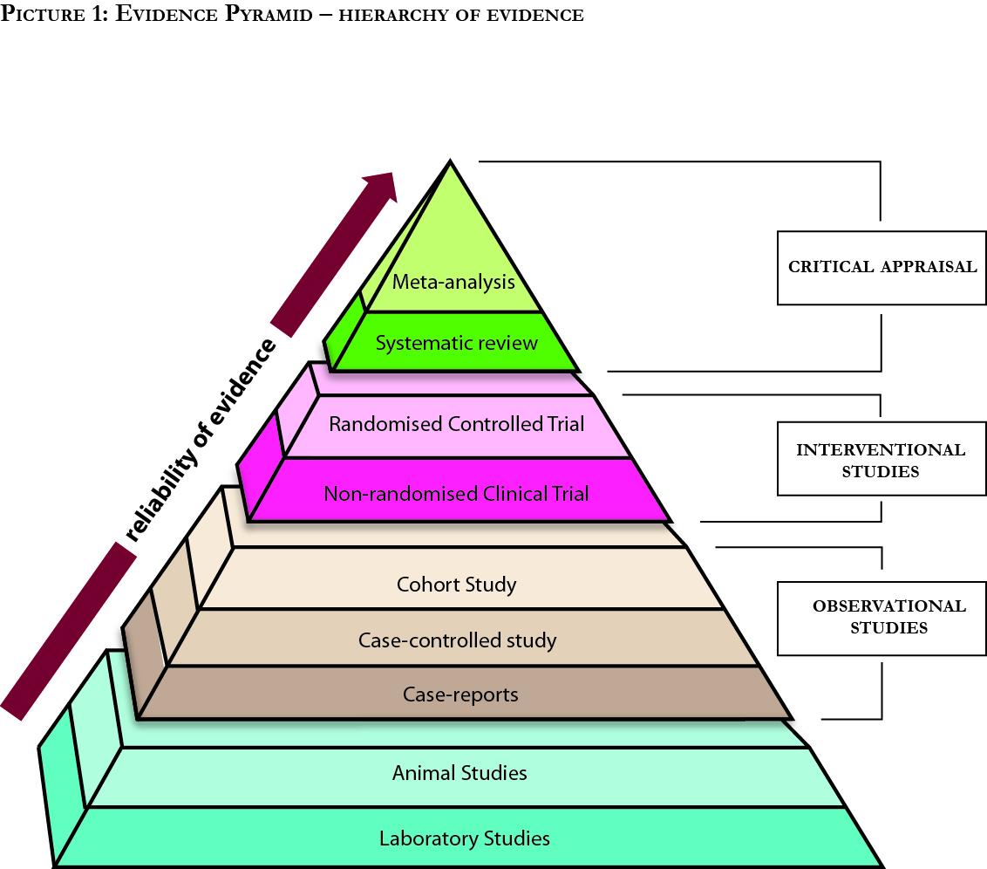
Pooled analysis

Slide 11
data- knowledge-innovation pyramid
Data – findings
Information - results
Knowledge - evidence
Wisdom know how & what to do
New therapies

Slide 12
And if we do not share data?
Lack of information
biased clinician
biased researcher & sponsor
inefficient and irresponsible research
impact on patients

Slide 13









Slide 14








Slide 15



Slide 16


IMPACT Observatory story
Planning Meeting IMPACT Ottawa (British High Commission, University of Ottawa, participants)
Ottawa Statement
PROCTOR
Ottawa (CIHR-IRSC)
2004
2006
2008
2012
2013
2014
IMPACT Observatory NewFelPro Fellowship
WHO
Trial registration standards
Environmental Scan of Repositories of Clinical Research Data

Slide 17
IDEA
ID#
PROTOCOL ID#
TRIAL ID#

Slide 18



Ottawa Statement
OTTAWA STATEMENT 1 (2004)
• ID • Protocol • Results
OTTAWA STATEMENT 3
Results Disclosure 2
Individual participant level dataset
Systematic review after the trial
DATA
DATA
DATA
DATA
TRIAL ID#
OTTAWA STATEMENT 2
Register 20 WHO items plus
• consent form • details of design • ethics approval • countries & sites • key dates • full protocol • contract/ financial agreements • systematic review
DATA
DATA
DATA
DATA
OTTAWA STATEMENT 3
Results Disclosure 1
Content: CONSORT + OS2 items
Sites / Countries
Any independent validation of results
List of any publications
DATA
DATA
OTTAWA STATEMENT 1&2
Amendments
Recruitment status
Adverse events
Interim analyses
Early stopping (if applicable)

Slide 19
Results reporting PROCTOR 2008
Build research on all knowledge, not just partial
Current system is suboptimal and inefficient in the Internet era
Without results reporting trial registration is an unfulfilled promise
Perform secondary analysis
PROCTOR 2008: Public Reporting Of Clinical Trials Outcomes and Results

Slide 20



Trial Registry
Trial Data Repository
cross-reference
Results Database
Aggregate Data
Final Update
Raw Data- IPD
Protocol Elements
All Trial Documentation
Updates
Results and Findings
Design
Conduct
Analysis

Slide 21
Excitement
Hesitation

Slide 22

Repositories and
data exchange standards
Barriers
data format standards
accuracy
quality
Privacy
anonymization
Citability
Availability
Prepublication
Academic credit
Resources
Road to Public Disclosure
Intellectual
property, TRIPS

Slide 23
Publication reporting standards (CONSORT)
Protocol standards (SPIRIT)
Trial registration (WHO/international) standards
Public Disclosure of Results Standards (to be developed)
Better & more efficient trials

Slide 24
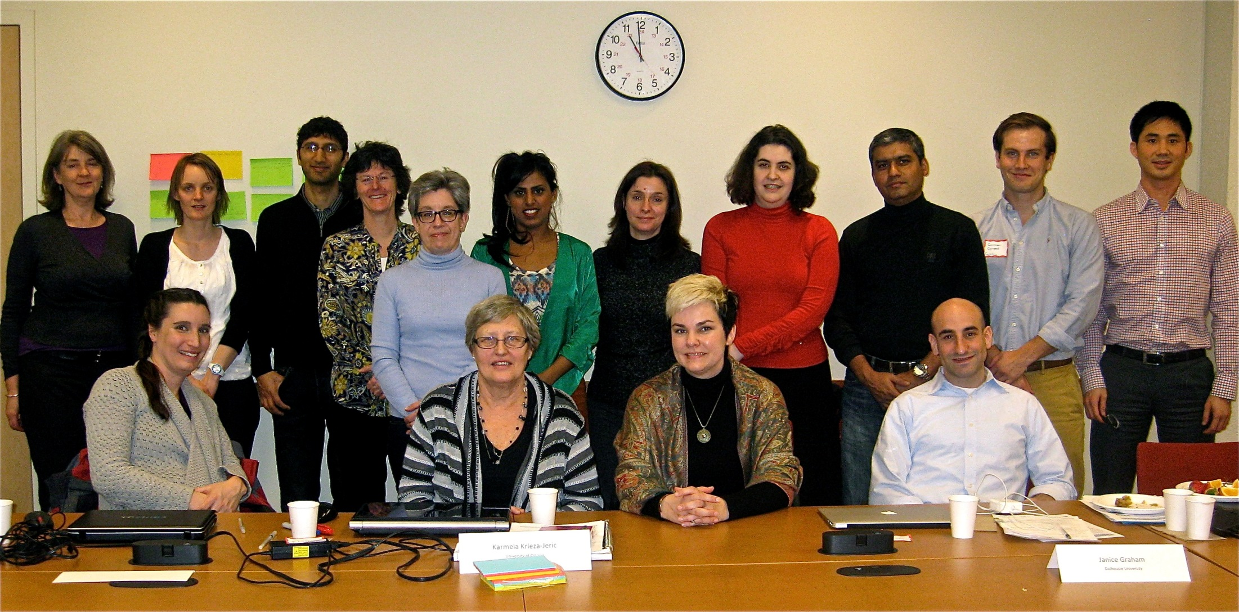

Slide 25
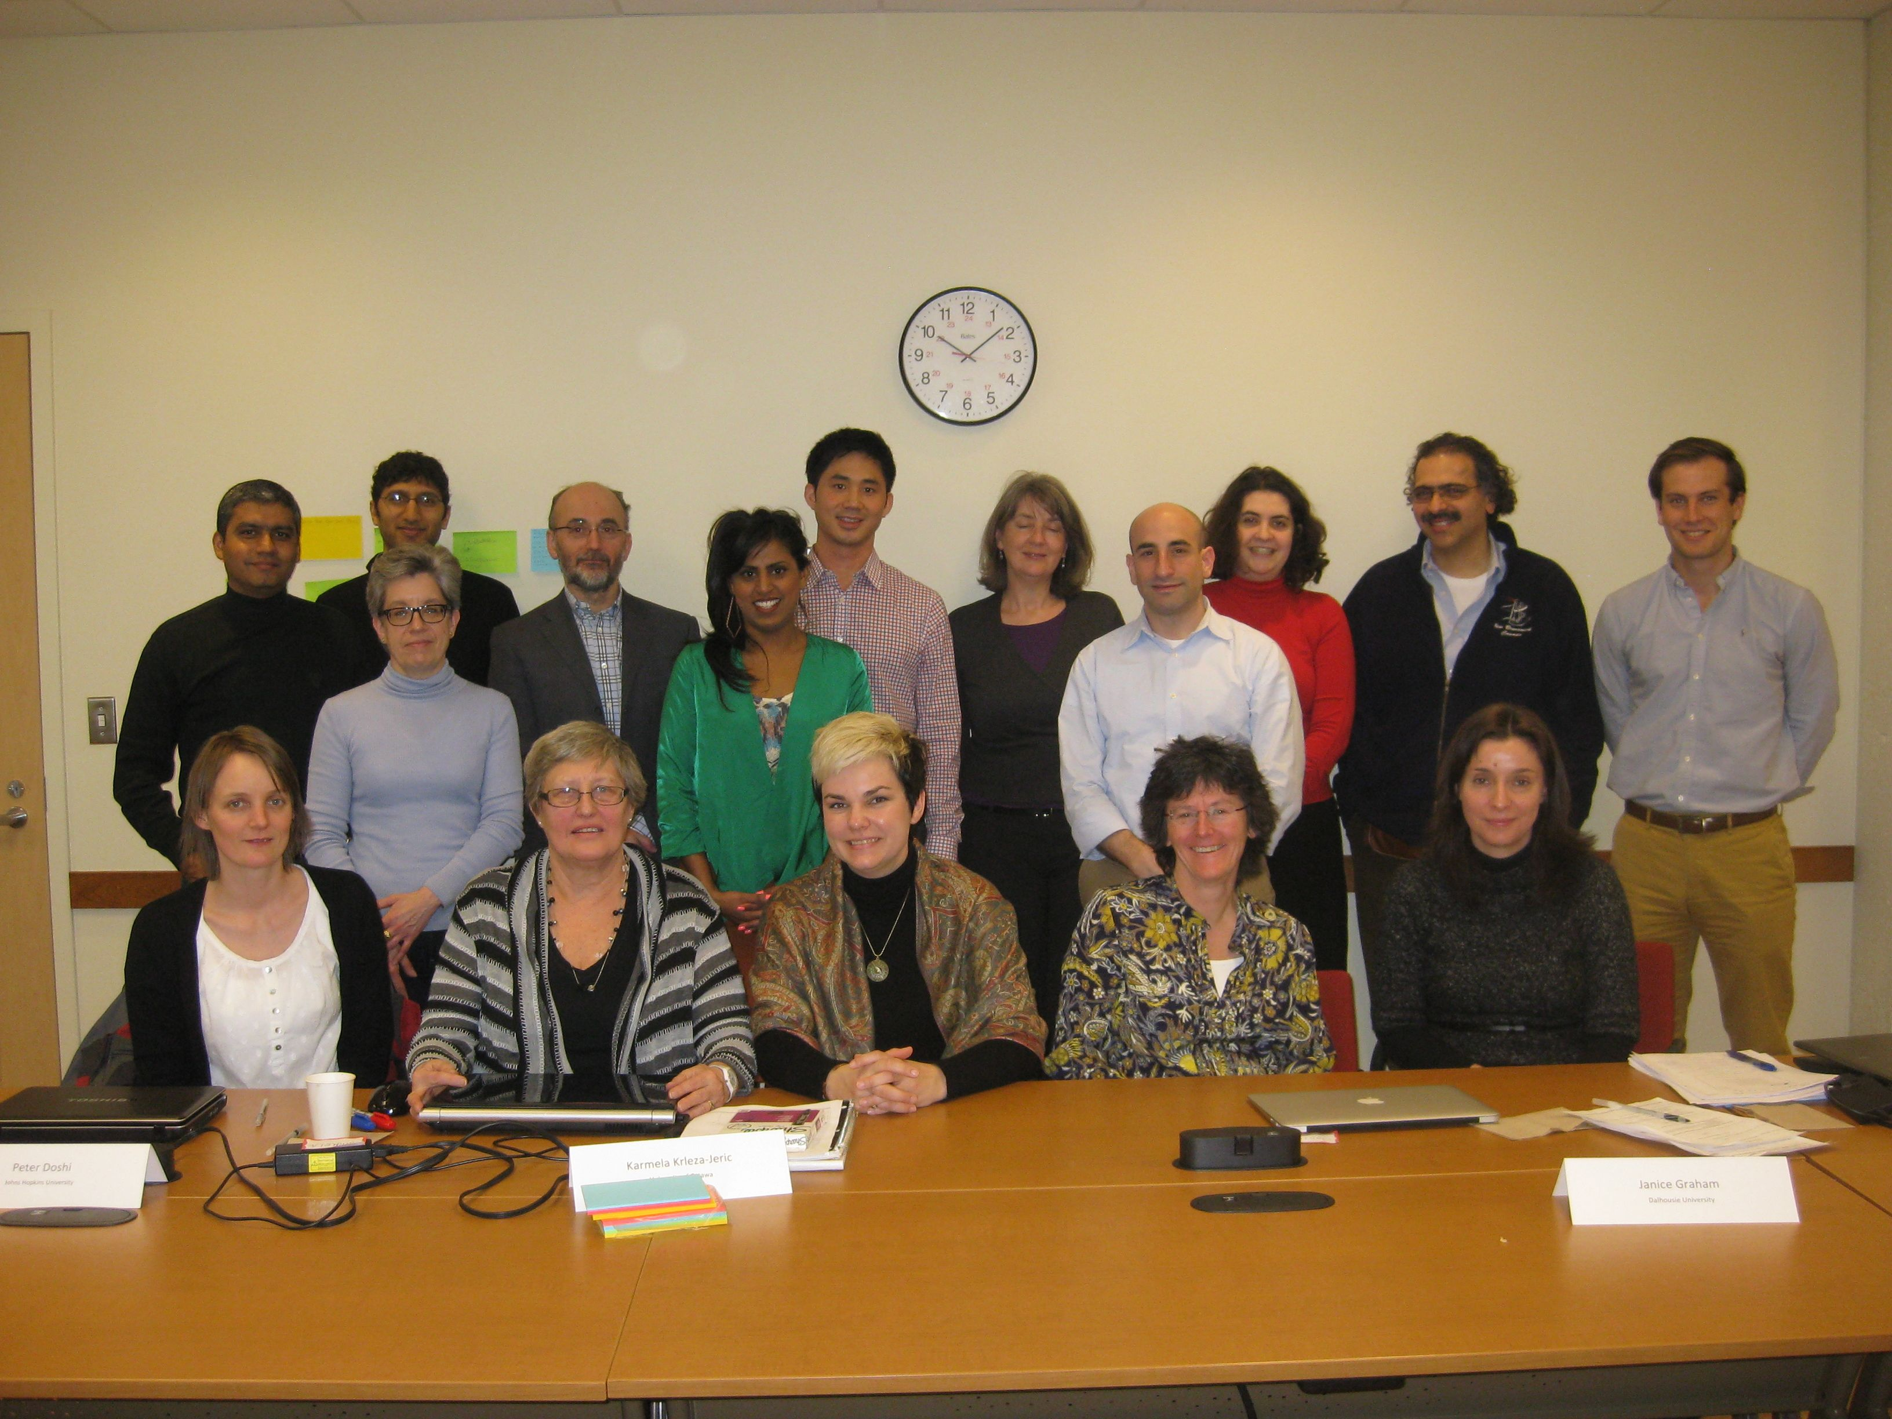

Slide 26
IMPACT (2013) (IMProve Access to Clinical Trial data)
Explore
definitions of raw data, meta-data
data formats, privacy
repositories, access to data for re-analysis and pooled analysis
Develop
methodologies, standards, guidelines
Inform
operationalisation, implementation
http://ottawagroup.ohri.ca/disclosure.html

Slide 27

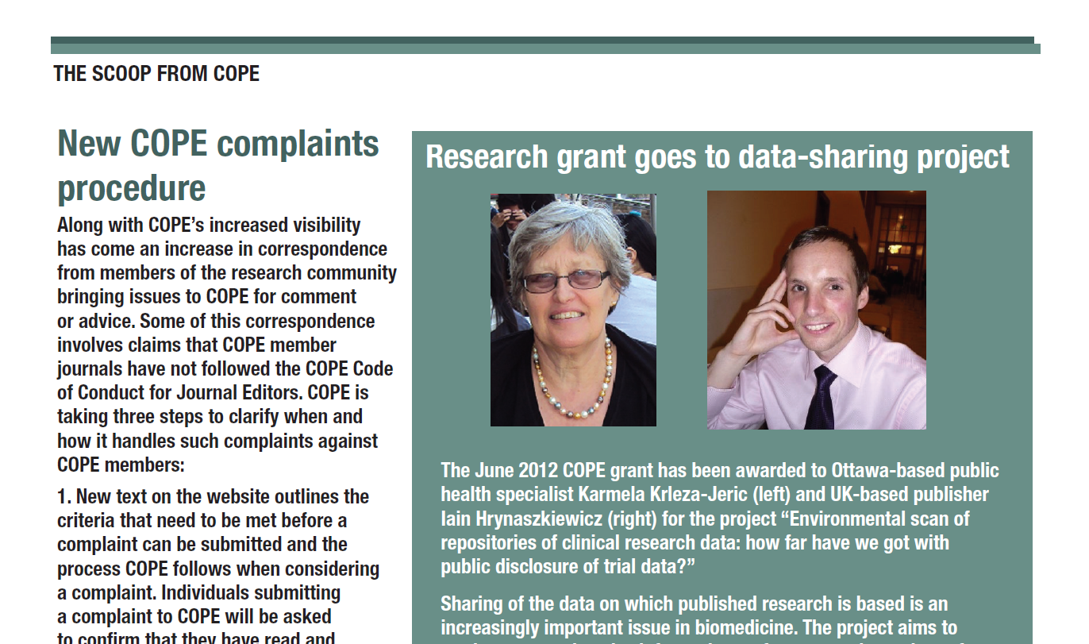

Slide 28
Environmental scan of repositories
Objective
Identify and explore essential features and practices of repositories that
accept clinical trial data including IPD
facilitate their public disclosure
Use/ KT
Inform IMPACT (IMProve Access to Clinical Trial data)
Raise awareness
Help plan the future
Funded by the COPE grant

Slide 29
Methodology
Selection/inclusion criteria
Search
Data collection
Repositories that harvest clinical trial raw data with a goal of enabling sharing and public disclosure
Define features-develop headings
Extract data from websites; Interview managers
Literature search (a)repositories
(b) methodologies
Internet
Registries of data repositories
Literature
Other sources

Slide 30
Data repositories
provide access to data
archive
store and maintain data
share, reuse
necessary to achieve the full transparency of research
open data

Slide 31
Databib n+598
re3data n=608
Manual search n=3
Repositories that accept human data
n=93
Repositories that accept clinical research
n=11
Repositories that accept clinical trials
n=5
Repositories derived from search
Repositories excluded
Duplicates
Inclusion criteria not met
Repositories that accept raw data from clinical trials
n=4+5 (?)

Slide 32
Selected repositories
• Dryad • Figshare
• MMMP • Databox
• ICPSR • YODA
• Res Data Australia • Zenodo
• Edinburgh DataShare

Slide 33
CONTROL OF QUALITY
PARTNERSHIP
SECONDARY USE ACCESS
DATA FORMATS AND STANDARDS
SCIENTIFIC AREA
WHO CAN UPLOAD
CITABILITY OF DATA
ARCHITECTURE
TYPE OF RESEARCH DATA
Open
free to download & no legal barriers to reuse
Limited /Restricted
upon request
qualified researcher
Conditions
data use agreement
no sharing
Closed
responsible organisation only
Combination
No universal standards
Leave to submitter and journal
Range of standards:
Defined
No specific
No specific fields
Any
As is
Formats:
as is
multiple formats to enable accessibility
Journals /publishers
Dryad- BMJ
Figshare- PLoS, Faculty 1000
ORCID- 37 partners
Funding agencies
Governments
Consortia
Pharma
Yoda-Medtronic
publications
any standard file
images, graphs, video
multimedia & audiovisual
datasets
outcome data
summary data
raw data
individual data elements for each participant
Anyone
Limited (by application)
Closed (no outside institutions)
Certain scientific area (malignant melanoma)
Only if published
Extensively curated
To certain extend
As is
GUI - rare
Online analysis
Report templates
Social notification
Social commentary
clinical trials
any research
DOI
URN
ARK
Handle
PURL
Persistent identifier system HDL
ORCID
cite the repository
none
API - APPLICATION PROGRAMMING INTERFACE
URL
REPOSITORY NAME
ETHICS GUIDELINES
SCIENTIFIC AREA
CONTROL OF QUALITY
TYPE OF REPOSITORY
TYPE OF RESEARCH DATA
DATA FORMATS AND STANDARDS
TYPE OF OWNERSHIP
REQUIREMENTS TO FACILITATE MULTIPLE SECONDARY USES
NETWORKING
ACCEPTABLE SIZE
GOVERNANCE MODELS
GEO-COVERAGE
DE-IDENTIFICATION PRACTICES
PARTNERSHIP
COST AND FINANCIAL STRUCTURE
POLICIES
ARCHITECTURE
WHO CAN UPLOAD
CITABILITY OF DATA
DEFINITION OF RAW DATA
SECONDARY USE ACCESS
ONLINE HELP
UPDATES (ARCHIVE VS. OVERWRITE)
PRIVACY
SOCIAL NOTIFICATION SYSTEM
GRAPHICAL USER INTERFACE (GUI)
CURATED
SERVICE LEVEL AGREEMENT (SLA)

Slide 34
Repositories
Directories/Registries of research data repositories re3data , Databib
DataCite
Repositories that take clinical trial data are
General
Country/region
Institutional
Topic
No universally accepted standards

Slide 35
Barriers, opportunities, trends 2013
Improvement and development needed
Directories/Registries of repositories | Repositories
Description / categorisation of repositories | Features
Search engine | Policies
Duplication: same repositories in R3data and Databib | Standards
Coordination btw re3data and Databib | No domain repository for CT data

Slide 36
Barriers, opportunities, trends 2015
Number of data repositories increase from 600 in May 2013 to 1275 in June 2015.
but
No new repository hosts clinical trial raw data
No domain repository for clinical trial data
re3data, DataCite and Databib partner in 2014
re3data & Databib merged in March 2015
DataCite assigns persistent identifiers -DOI
DataCite manages re3data from May 2015
RDA –Research Data Alliance

Slide 37
Barriers, opportunities, trends 2015
Improvement and development needed
Directories/ registries of repositories | Repositories
Description / categorisation of repositories | Features
Search engine | Policies
 | Standards
 | No domain repository for CT data

Slide 38
IMPACT Observatory
IMPACT-IMProving Access to Clinical Trials data; Observatory of ongoing transition in clinical research regarding data sharing, opportunities and barriers

Slide 39
Observatory or natural experiment
Experiment is not controlled by researcher
No intervention by researcher
Identifies changes/ transition
Points to barriers and facilitators of …
Measures the impact of changes on…
Informs and thus indicates trends

Slide 40
IMPACT Observatory
explore development in the past
measure the impact of changes on clinical research
examine ongoing changes of transparency of CT data
establish potential future development

Slide 41
Methodology
Scoping review
Websites & literature
barriers opportunities gaps
Surveys & Interviews
Public release of findings
Indicate trends
Initiatives
Impact transition
Repositories

Slide 42
Issues
no specific MESH terms
no domain repository
no standards for public disclosure and reuse of data.
Observatory: complex; numerous players

Slide 43
Complexity of observatory
Preservation
Data Repositories
Access
Funders
Infrastructure
Researchers
Media
Knowhow
Consumer Advocates
Publishers
Journals
Academia
Policy
Culture
Pharmaceutical Industry
Regulators

Slide 44
Initiative related issues and how we deal with them
Initiatives
Not much published
Internet, contacts

Slide 45
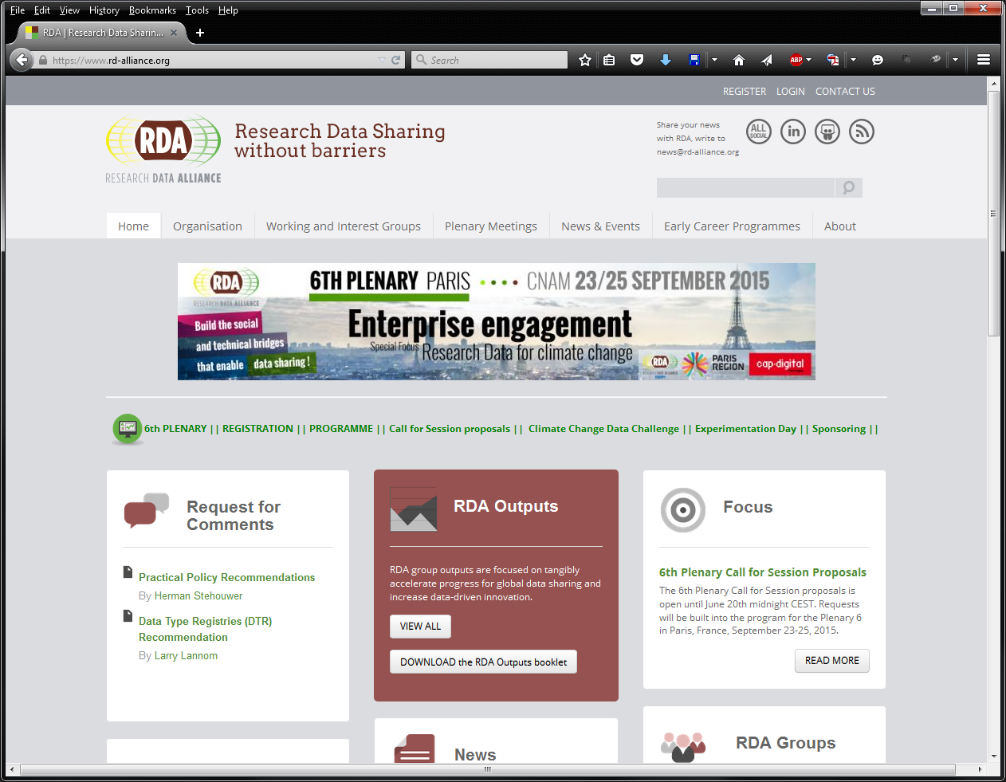
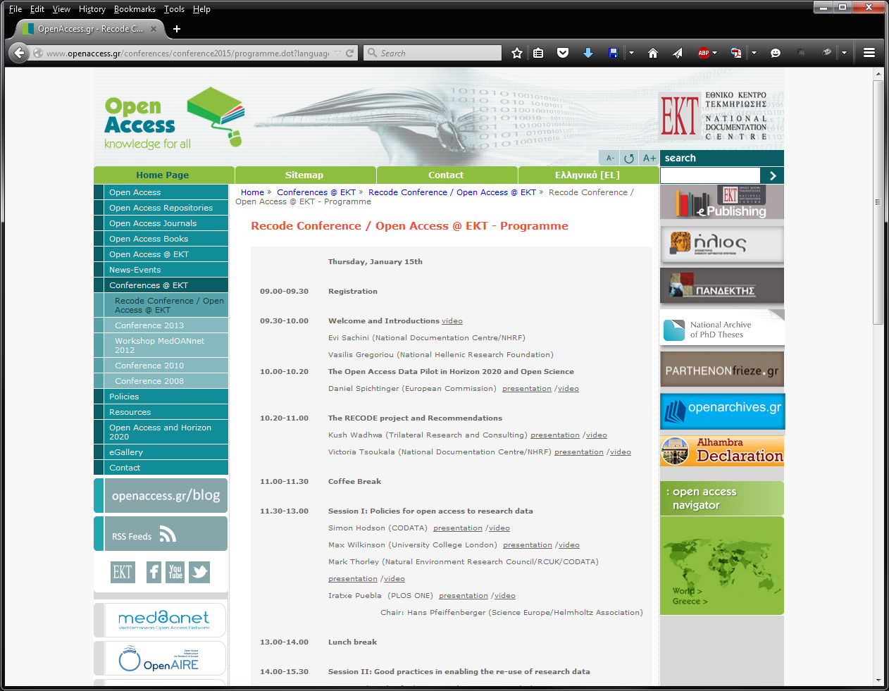
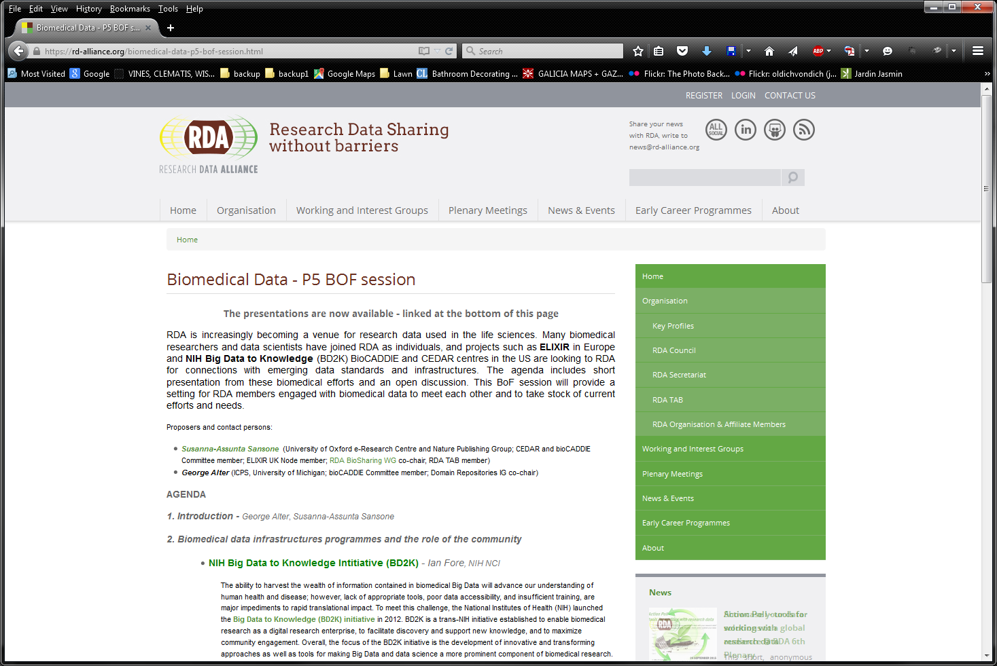

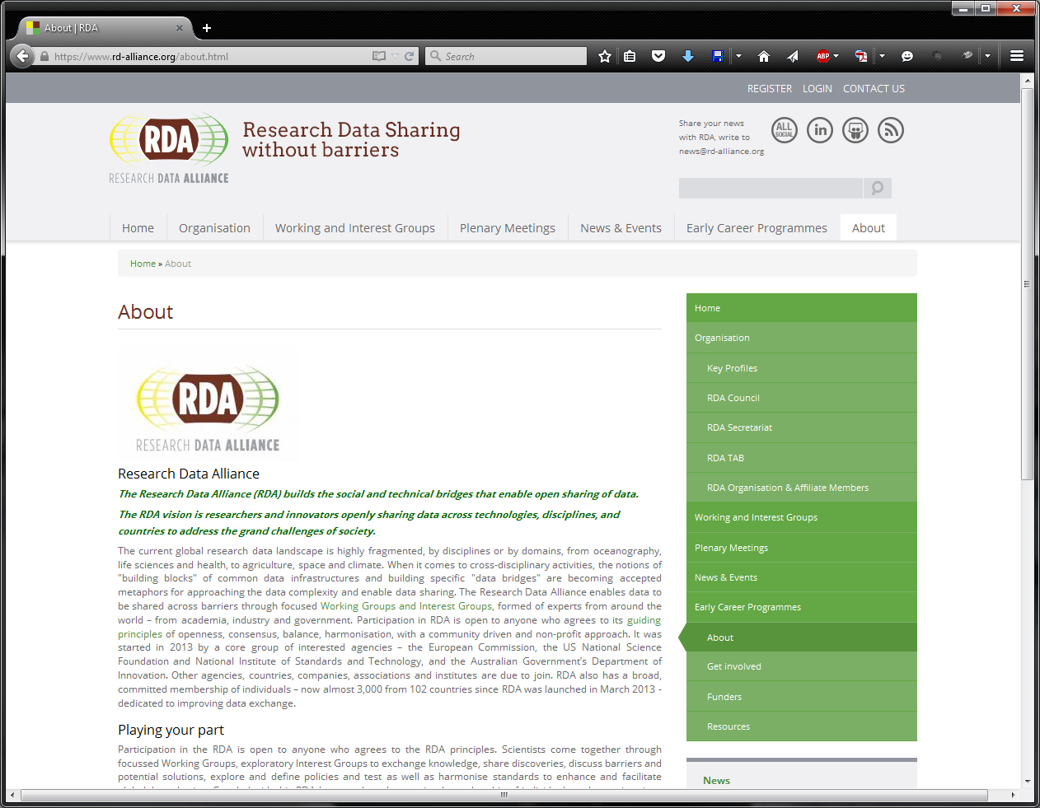
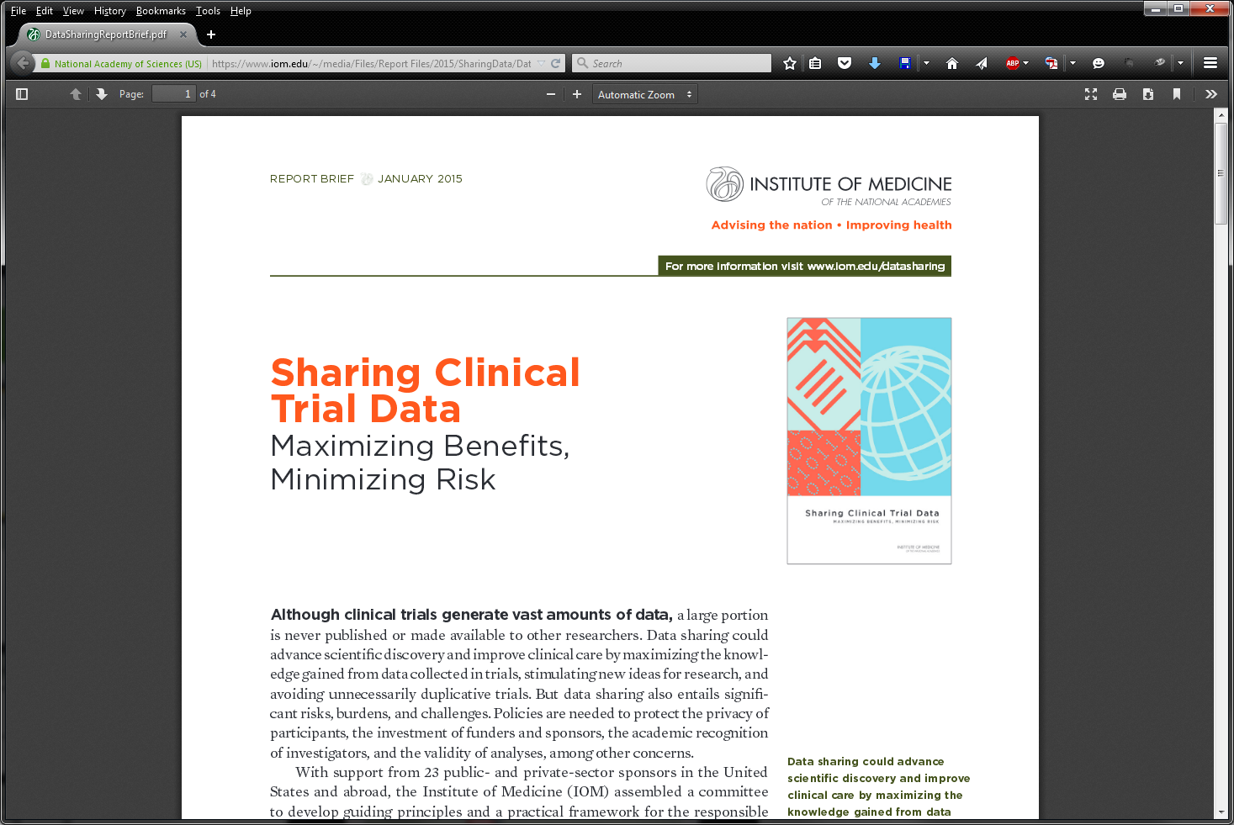
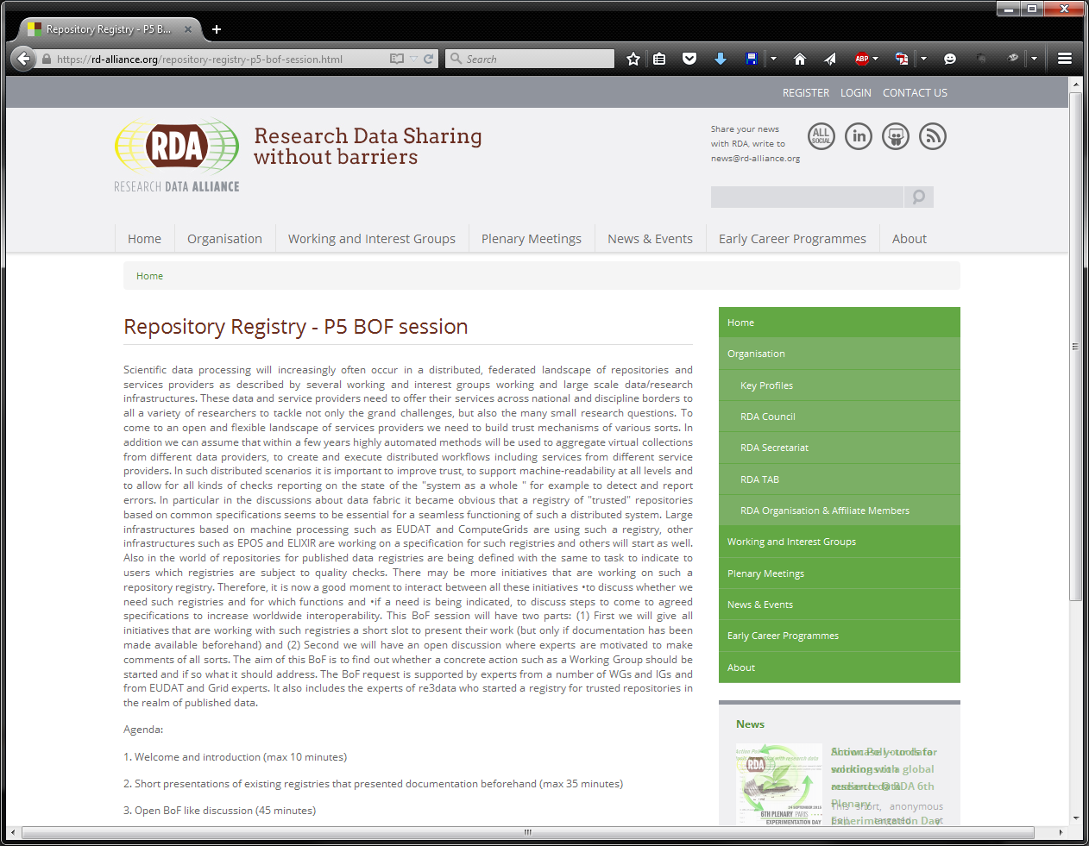
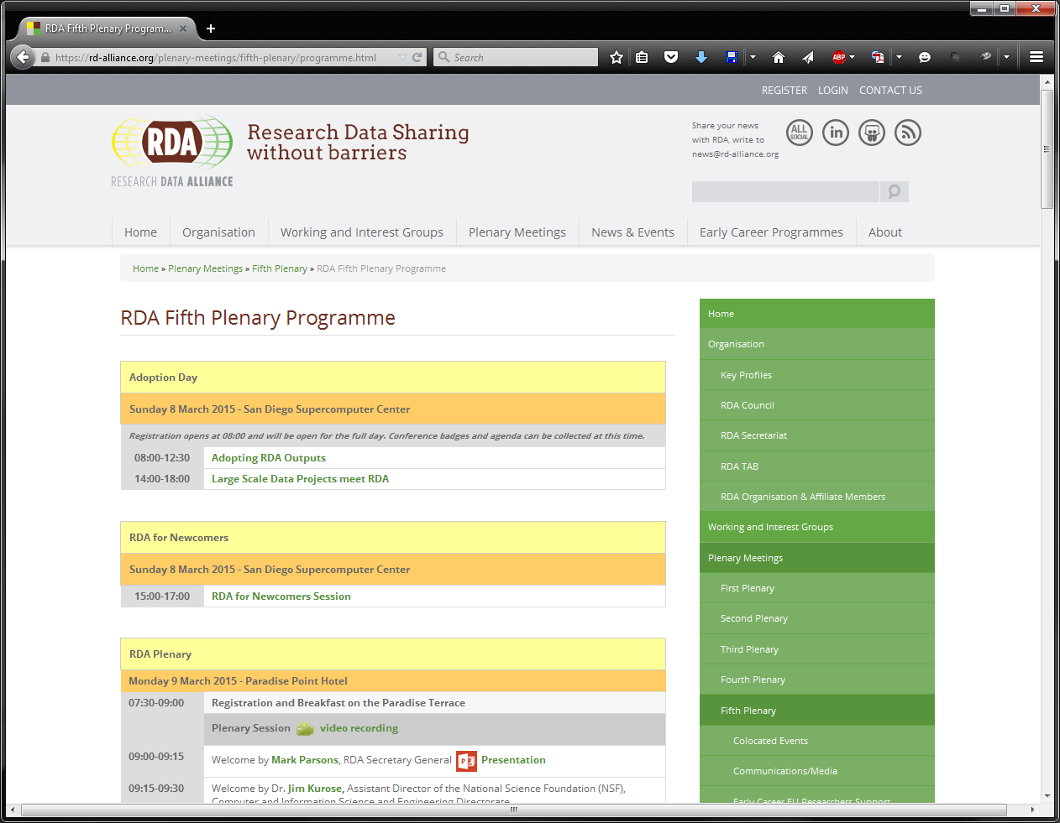
Selected Initiatives
IOM Report
RECODE Conference- Athens
BioCADDIE- BD2K
RDA
BioCaDDIE Group at RDA
Repository group at RDA

Slide 46
Survey
Monkey survey
Sample: corresponding authors of CTs published in 2013
Responded: 2250
Limitation: -low response rate although high number
Peek into some preliminary Results

Slide 47
Peek into some preliminary results
Trial registration: 60 +8% registered/ 22% did not/ 7% did not know
Published studies
Summary results: 21% public….but
Data sets from published studies
last : 58% my computer/43% org web/ 4% sent to journal
earlier: 11% yes/ 35% upon request /53%no

Slide 48
Expected results
impact the transition
indicate potential trends
identify barriers, gaps and opportunities of opening clinical trial data
identify tendencies of transitions, dynamics and roles of different players

Slide 49
Potential long term outcomes
IMPACT Observatory is established as a longitudinal study/ tool to measure the
Impact of interventions by many players on clinical trial research
How it is done
How it is reported
How data are shared
How secondary analysis is done
Indicate trends
Establish future developments

Slide 50
Who is IMPACT Observatory
We are - anyone interested
IMPACT Observatory team
Everything we do depends on collaboration
Multi nodal network
Network of people/groups of people with good ideas: OG, PROCTOR, IMPACT, Cochrane, RDA, ECRIN

Slide 51
IMPACT Observatory team 2015
Karmela Krleža-Jerić, NEWFELPRO, Dpt on Research in Biomedicine and Health, Univ of Split School of Medicine, Split, Croatia
Nevena Jeric
Apropomedia
Mirko Gabelica
ENT, Head and Neck Surgery, Uni of Split Hospital Center
Ana Jerončić
Statistics, Dpt on Research in Biomedicine and Health
Davor Lukšić IT Dpt, Uni of Split School of Medicine
Mersiha Mahnic-Kaknjo
Dpt of Clinical Pharmacology, Cantonal Hospital Zenica, BiH
Mario Malički Dpt on Research in Biomedicine and Health, MF, Split
Ana Marušić, Head
Dpt on Research in Biomedicine and Health, MF Split
Andelka Phillips
Oxford University, UK
Ludovic Reveiz PAHO, Washingto, USA
Ana Utrobičić Medical Library, Uni of Split School of Medicine
Josip Šimic Medical Library, Mostar, BiH

Slide 52
IMPACT Observatory
Thank you
http://ottawagroup.ohri.ca

Slide 53
IMPACT Observatory
explore development in the past
measure the impact of changes on quality/ knowledge management
examine ongoing changes of transparency of PR data
establish potential future development

Slide 54
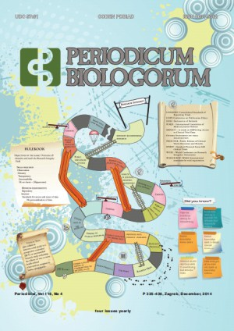

Slide 56
What did you do with datasets of last published trial

Slide 57
PROCTOR
PROCTOR: Public Reporting Of Clinical Trials Outcomes and Results
An international meeting held by CIHR in Ottawa in March 2008
Wide range of constituencies
No consensus building but identified issues and challenges
Identified a need to develop international standards for public disclosure of trial results

Slide 58
Participating constituencies
Clinicians
Researchers
Systematic reviewers
Consumers
Ottawa Group
Policy makers
Trial registries
Industry
Ethicists
Medical journal editors
Public Funders
Methodologists
CONSORT
WHO – PAHO

Slide 59
PROCTOR discussion topics
why
for whom
when
which trials
how much detail
what format
responsibility
monitoring quality
accountability
website features
funding
who should run websites
barriers

Slide 60
Regain public trust
kkj-CIHR May 2008
Provide global open access to information
Reduce unnecessary duplication
Prevent harmful trials to be repeated
Enable monitoring of adherence to ethical principles
Provide practical benchmark for accountability

Slide 61
WHO International Standards
Primary Register and Trial ID #
Date of Registration in Primary Register
Secondary ID#s
Source(s) of Monetary or Material Support
Primary Sponsor
Secondary Sponsor(s)
Contact for Public Queries
Contact for Scientific Queries
Public Title
Scientific Title
Countries of Recruitment
Health Condition(s) or Problem(s)
Intervention(s)
Key Inclusion & Exclusion Criteria
Study Type
Date of First Enrollment
Target Sample Size
Recruitment Status
Primary Outcome(s)
Key Secondary Outcomes

Slide 62
PROCTOR discussion topics
why
for whom
when
which trials
how much detail
what format
responsibility
monitoring quality
accountability
website features
who should/not fund
who should/not run websites
barriers
What we need to do to achieve the universal results reporting?
kkj- March 2009

Slide 63
Changes
culture of researchers regarding
data sharing
research of existing data
policies of
regulators
funders
journals
pharmaceutical industry (pharma)
academia
data repositories
features
policies
standards for data accepting, curatorship and sharing

Slide 64
BENEFITS OF DATA SHARING
Build on all knowledge, not just partial
Use opportunities offered by the Internet
Overcome publication, and outcome reporting bias, selective reporting
Minimize unnecessary duplication of research
Enable re-analysis, meta and pooled analysis
Speed up knowledge creation
6
5
4
3
2
1
Efficient and responsible research

Slide 65
Data repositories
store and maintain data
provide access to data
archive
share, reuse
necessary to achieve the full transparency of research; open data;

Slide 66
Ottawa statement: general time-line for trial registration process (2004)
Protocol
Ethics approval
Recruitment
Results
Publication
Unique ID
Protocol registration
Public release of protocol
Recording of amendments
Registration of results
Public release of results

Slide 67
(i) to analyse peer review in different scientific areas by integrating quantitative and qualitative research and incorporating recent experimental and computational findings;
(ii) to evaluate implications of different models of peer review and to explore new incentive structures, rules and measures to improve collaboration in all stages of the peer review process;
(iii) to involve science stakeholders in data sharing and testing initiatives,
(iv) to define collaboratively a joint research agenda that points to an evidence-based peer review reform.

Slide 68
How
baseline
ongoing tendencies
Public sharing of findings
potential development in the future (trends)

