Slide 1


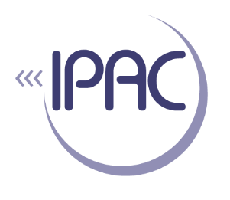


Data Sharing: An Issue of Human Rights?
Prof. Bartha M. Knoppers
Canada Research Chair in Law and Medicine

Slide 2
(GA4GH)
Mission
To accelerate progress in human health by helping to establish a common framework of harmonized approaches to enable effective and responsible sharing of genomic and clinical data, and by catalyzing data sharing projects that drive and demonstrate the value of data sharing

Slide 3
Framework for Responsible Sharing of Genomic and Health-Related Data
Current frameworks are founded on principle of protection from harm. In contrast,
GA4GH Framework founded on Article 27 of the 1948 Universal Declaration of Human Rights. (ratified in the International Covenant on Economic, Social and Cultural Rights, by 164 countries) , which includes:
the right of everyone “to share in scientific advancement and its benefits,” including to freely engage in responsible scientific inquiry, and “to the protection of the moral and material interests resulting from any scientific […] production” of which he or she is the author.
Framework aims to activate these human rights by promoting responsible data sharing.
Notes:
WHY? There was an absence of universal and enforceable guiding norms for data sharing, ethical and legal hurdles, and cultural hurdles.
This Framework provides guidance for the responsible sharing of human genomic and health-related data, including personal health data and other types of data that may have predictive power in relation to health. In particular, it highlights, and is guided by, Article 27 of the 1948 Universal Declaration of Human Rights.
Article 27 guarantees the rights of every individual in the world “to share in scientific advancement and its benefits” (including to freely engage in responsible scientific inquiry), and at the same time “to the protection of the moral and material interests resulting from any scientific…production of which [a person] is the author.”
This Framework is guided by the human rights of privacy, non-discrimination and procedural fairness. At the same time, it considers all human rights principles relevant, complementary and interrelated, founded as they are on respect for human dignity.
In addition to being founded on the right of all citizens in all countries to the benefits of the advancements of science, and on the right of attribution of scientists, it also reinforces the right of scientific freedom.
Article 27 made legally binding under article 15(1)(b) of the 1966 International Covenant on Economic, Social and Cultural Rights.
Ratified by 164 countries.
Framework aims to move away from protectionism towards sharing based in legally binding human rights.

Slide 4
Renewed Interest
The right to science “has acquired an increased importance in today’s globalized world.”
(UNESCO, Venice Statement, (2009)).
“The scope, normative content and obligations of the State under … ‘the right to science’, remain underdeveloped while scientific innovations are changing human existence in ways … inconceivable a few decades ago.”
(UN Special Rapporteur, A/HRC/20/26 (2012)).
Notes:
UNESCO, Venice Statement (2009)
Rapid sci/tech development → drastic changes for individuals and the societies.
Access improves socio-economic situation + opportunity to participate in local, national or international community.
Address negative effects of globalization + eradicate poverty (at 4-5)
UN Special Rapporteur – Interested Because:
Vital to the realization of other human rights (right to health, education, adequate standard of living)
Addressing the negative effects of globalization and eradicating poverty.
Encapsulates traditional human rights issues: benefit sharing, ethical conduct of science, protection of scientific freedom.
Science and technology may create social problems or be misused to violate human rights.
Closely related to ‘right to take part in cultural life’ and the freedom for scientific activity.

Slide 5
Content of the Right to Science
access by everyone without discrimination to the benefits of science and its applications;
opportunities for all to contribute to the scientific enterprise
the freedom indispensable for scientific research;
participation of individuals and communities in decision-making;
conservation, development and diffusion of science and technology.
(UNESCO, Venice Statement 2009)
Notes:
Content was the focus of the UNESCO Venice Statement, 2009; and UN Special Reporter Report, 2012.
http://www.ohchr.org/Documents/HRBodies/HRCouncil/RegularSession/Session20/A-HRC-20-26_en.pdf
‘Core content’ echoed by AAAS, 2010:
(a) Take legislative and any other necessary steps to guarantee non-discrimination and gender equality in the enactment of the right to enjoy the benefits of scientific progress and its applications, both individually and collectively;
(b) Take legislative and any other necessary steps to prohibit OR prevent the violation of human rights by scientific progress and its applications;
(c) Adopt the measures necessary to protect and address the needs of marginalized and vulnerable populations, including with regard to funding, determining research priorities and the conduct of science;
(d) Create a participatory environment for the conservation, development and diffusion of science and technology, including equal access and participation for all, as well as capacity-building and education;
(e) Take steps to protect scientific freedom, including freedom of expression and opinion, freedom of association, freedom of movement, and freedom from economic, religious and other influences;
(f) Eliminate barriers or obstacles to international cooperation in science and adopt measures to facilitate international scientific exchange and technology transfer.

Slide 6
Framework for Responsible Sharing of Genomic and Health-Related Data
Aims
Foster responsible data sharing;
Protect and promote the welfare, rights, and interests of groups and individuals who donate their data;
Provide benchmarks for accountability;
Establish a framework for greater international data sharing cooperation, collaboration, and good governance; and,
Serve as a dynamic instrument.
Foundational Principles
Respect Individuals, Families and Communities;
Advance Research and Scientific Knowledge;
Promote Health, Wellbeing and the Fair Distribution of Benefits; and,
Foster Trust, Integrity and Reciprocity.
Notes:
This Framework establishes a set of foundational principles for responsible research conduct and oversight of research data systems in the realm of genomic and health-related data sharing.
It interprets the right of all people to share in the benefits of scientific progress and its applications as being the duty of data producers and users to engage in responsible scientific inquiry and to access and share genomic and health-related data across the translation continuum, from basic research through practical applications.
It recognizes the rights of data producers and users to be recognized for their contributions to research, balanced by the rights of those who donate their data.

Slide 7
Framework for Responsible Sharing of Genomic and Health-Related Data
Core Elements for Responsible Data Sharing
Transparency
Accountability
Engagement
Data Quality and Security
Privacy, Data Protection and Confidentiality
Risk-Benefit Analysis
Recognition and Attribution
Sustainability
Education and Training
Accessibility and Dissemination

Slide 8
Framework for Responsible Sharing of Genomic and Health-Related Data
Benefits of the Framework
offers political and legal dimensions that reach beyond the moral appeals of bioethics and provides a more robust governance framework for genomic and health-related data sharing
speaks to groups and institutions, not just individuals
stresses the progressive realization of duties
urges action by governments, industry, funders, publishers, and researchers to create an international environment for responsibly sharing data
Notes:
Challenges:
Objections to a human rights framework: 1- minimalist/vague claims, imperialist ideological construct; 2- accountability, monitoring and enforcement problems
Its adoption (translation, policy, UNESCO…)

Slide 9
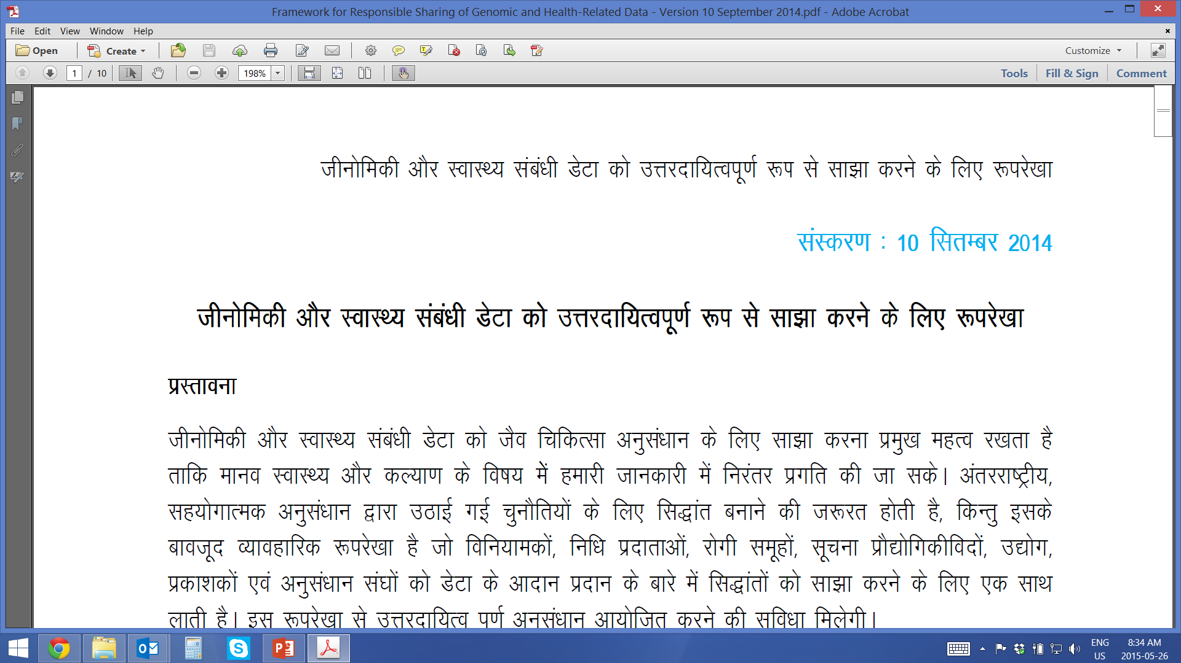
Framework for Responsible Sharing of Genomic and Health-Related Data
To date, the Framework has been translated into 9 languages (all freely available on the GA4GH website). Thank you to all for the time and work involved to translate and validate the Framework!
Arabic
Chinese
French
Greek
Japanese
Portuguese
Spanish
German
Hindi
إطار لتبادل مسؤول للمعلومات الجینومیة والمتصلة بالصحة
基因组学与健康相关数据负责任的共享框架
Cadre pour un partage responsable des données génomiques et des données de santé
Πλαίσιο για την Υπεύθυνη Κοινοχρησία Γονιδιωματικών και άλλων Ιατρικών Δεδομένων
ゲノム及び健康関連データの責任ある共有に関する枠組み
Framework para Compartilhamento Responsável de Dados Genômicos e Relacionados à Saúde
Marco de actuación para el uso compartido responsable de datos genómicos y relativos a la salud
Rahmenkonzept für die den verantwortungsvollen Datenaustausch genomischer und gesundheitsbezogener Daten

Slide 10
Strategies for Global Adoption
Policies pursuant to the Framework:
Consent Policy (complete)
Privacy and Security Policy (complete)
Accountability Policy
Paediatric Policy
Ethics Review Equivalency Policy
Machine Readable Consent
Demonstration Projects:
Beacon Project
BRCA Challenge
Matchmaker Exchange …
Tools to promote international interoperability
…and more to come!

Slide 11
UNESCO
Explore possibility of a formal UNESCO IBC support for the Framework
Twin rights: “to benefit from” and “to be recognized for” that support scientific, intellectual freedom
Respect, protect and fulfill these rights
“respect the freedom of the scientific community and its individual members to collaborate with others both within and across the country’s borders, including the free exchange of information, research ideas and results.” (UNESCO Venice Statement on the right to enjoy the benefits of scientific progress and its applications 2009)
Notes:
Important to balance discussions of ethical and legal risk (privacy, autonomy) with discourse on benefits of sharing.
Respect: UNESCO Venice statement on the right to enjoy the benefits of scientific progress and its applications (2009) – “respect the freedom of the scientific community and its individual members to collaborate with others both within and across the country’s borders, including the free exchange of information, research ideas and results.”
Protect: pass laws or regulations that ensure parties do not violate the rights
Fulfill: progressively make the rights a reality
Audrey Chapman: UN Committee on Economic, Social and Cultural Rights to adopt an official statement on application, steps for gvt implementation

Slide 12

