Slide 1
From Benchtop to Bedside to Population.
Challenges and Opportunities in e-Health
Translation in Healthcare Conference. Fred Kemp, 25th June 2015

Slide 2
What is e-Health?
Health services and information
delivered or enhanced through
the Internet and related technologies.
Notes:
So, what I do I mean by eHealth.

Slide 3
What is e-Health?
The intersection of
medical informatics, public health and business.
Notes:
Also described as….
And advances in gene sequencing, biomedical imaging, and informatics have resulted in a huge explosion of digital data available to researchers and clinicians

Slide 4
What is e-Health?
Not just technology.
Also a state-of-mind, a way of thinking, an attitude,
a commitment for networked, global thinking
to improve healthcare locally, regionally, and worldwide by using ICT.
Notes:
But it’s more than that. It’s not just technology, it’s

Slide 5
The rise and rise of e-Health
Current market estimated to be $5.7B
Huge growth in mobile technologies
“Consumer” Perspective - Personal Health tracking.
Opportunity for a more patient-centric approach.
Driving Individual and societal change
Notes:
The market in e-Health is…
*
The growth in the eHealth market is a direct result of the explosion in digital technology, particularly mobile technology and the internet.
Creating the opportunity for data to be delivered – or captured – in real time, wherever you are.
Obviously this has fantastic benefits to clinicians and researchers, being able to access digitised data and services from around the world.
*
But it has also sparked a huge interest from the healthcare “consumer” perspective.
Question: How many people have a smart phone with them right now?
How many people have used a fitness tracker, or a calorie counter?
So pretty much all of you are already, or have the capacity to be e-Health consumers.
Whether it’s logging how many chocolate biscuits you ate or how many miles you ran last week.
This ability to easily collect information about ourselves, aligns with our desire for self-improvement.
And it can be very empowering: if you can quantify it, you can measure change and track improvement
Unsurprisingly then, there are many new companies entering the market as well as existing healthcare solution providers.
Over 65 million users of myfitnesspal alone.
*
But I think this is just the beginning of a shift that will put the patient back at the centre,
And allow them to actively participate in shaping their own personal healthcare.
*
Linking this type of data to clinical records could allow new insights and drive lifestyle and behavioural changes that will improve our health and wellbeing both as individuals and as a society.

Slide 6
Creating Innovation in Healthcare
Several approaches:
  Technology transfer
    Developing or finding a use for new technologies.
  Entrepreneurial approach
    Find technologies to solve specific problems.
  Big Data approach
    New insights from large scale data (making good use of the things that we find.)

Slide 7
Adopting Innovation in Healthcare
Several(!) challenges:
  Funding for translational work
  Clinical validation
  Regulatory hurdles
  Proving the Health Economic Case
  Integration into care pathways
  Ethics and Privacy issues.
  Fragmented nature of healthcare system.
  Commercial interest.

Slide 8
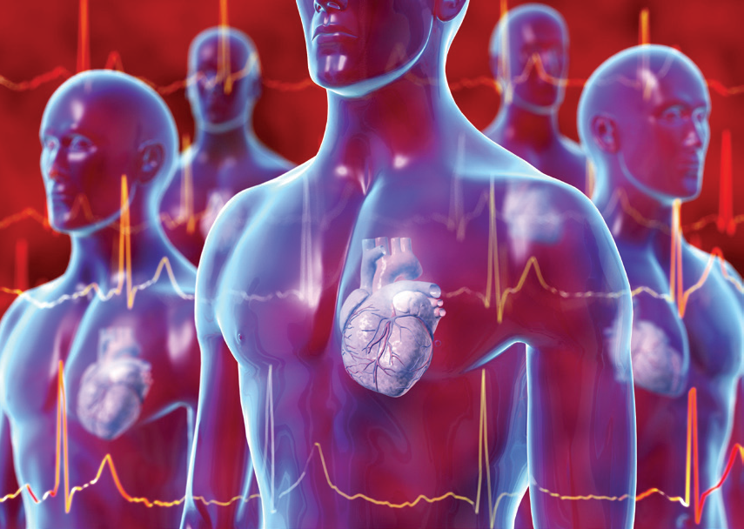
Virtual Assay – Personalised medicine for the population
A population-based approach to in silico drug screening for safety and efficacy.
  Uses well established cardiac models
    50% drugs removed from market are for unexpected cardiac effects.
  Calibrated against experimental data.
Why is this important?
  Everyone is different, challenge of identifying all risks without testing everyone.
  Esp. important where drugs might be prescribed as a prophylactic on a population level.
Translation challenge
  putting the application in the hands of the “non-expert” user.
UK ICT Pioneer Finalist 2014
National NC3R winner 2014.
Next steps: FDA approval for pre-clinical screening.

Slide 9
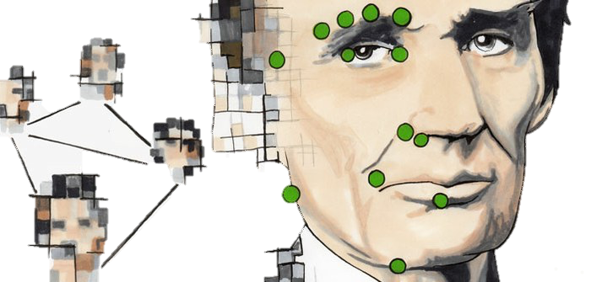
Diagnosing rare diseases - Facial phenotype from snapshots
“A clinician should in future be able to take a smartphone picture of a patient and query Clinical Face Phenotype Space to quickly find out which genetic disease the person might have.” Dr Chris Nellåker.
Application of computer vision and machine learning research has trained an algorithm to cluster patients by phenotype using only ordinary photos.
One person in 17 has a rare genetic disorder
Most fail to receive a genetic diagnosis.
Genetic screening is expensive.
Not all genetic markers are known.

Slide 10
“Solving Healthcare” – An entrepreneurial approach
What is the main challenge in healthcare?
  better healthcare = people living longer
  ageing population = more disease
  more disease = more expense
  limited resource = restricted treatment choices.
  restricted treatments ≠ better healthcare…
How to reduce costs?
  Make treatments more efficient/cheaper.
  Less time in hospitals
    lower direct cost, reduced hospital acquired infections, faster recovery times, etc.
  Make the population more healthy
    e.g. reduce “lifestyle” conditions (obesity, type II diabetes, COPD, etc)

Slide 11
Remote/Self-Monitoring – it’s all about the patient
Reducing hospital time:
  Oxehealth (vital sign monitoring using just webcam/mobile phone)
Increasing Patient engagement:
  True Colours (self-monitoring for mental health)
Early detection of health conditions:
  Clinical Face Phenotype Space
  Gait analysis for early detection of Parkinson’s using accelerometer in phone
Promoting behavioural change:
  Gamification of health through activity trackers.

Slide 12

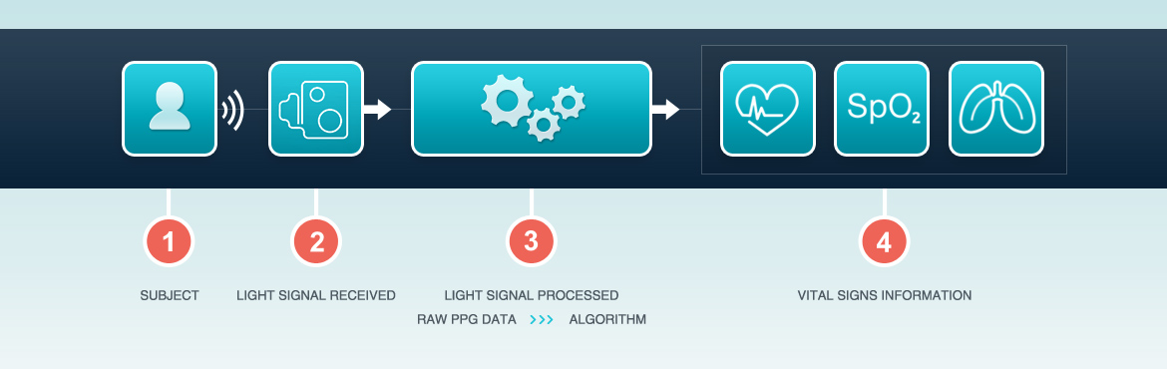
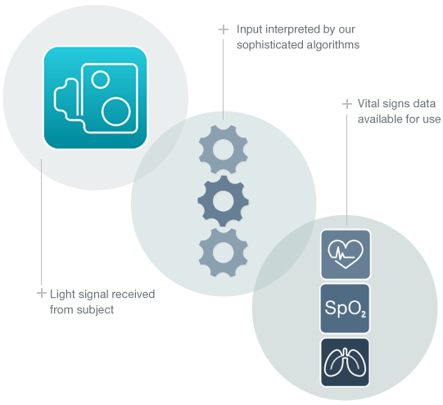
  System can read vital signs with only a camera.
  Allows monitoring for extended periods, avoiding the physical limitations and discomfort of ‘wired’ solutions (e.g. in NICU)
  Enables remote monitoring of long-term conditions (“Health Skype”) and optimisation of treatment without hospital admission
Notes:
Spun out in 2012 with approximately £500k seed funding. In May 2014 Oxehealth completed a further £2m investment round.
Academic Founders: Prof Lionel Tarassenko and Prof Christopher Pugh
Based on photoplethysmography (PPG); through the use of sophisticated algorithms produced a medical technology which can read vital signs with a camera in a wide range of real world situations.
Advantages include:
Allows monitoring for extended periods, avoiding the physical limitations and discomfort of ‘wired’ solutions (e.g. in NICU)
Enables remote monitoring of long-term conditions (“Health Skype”) and optimisation of treatment without hospital admission

Slide 13
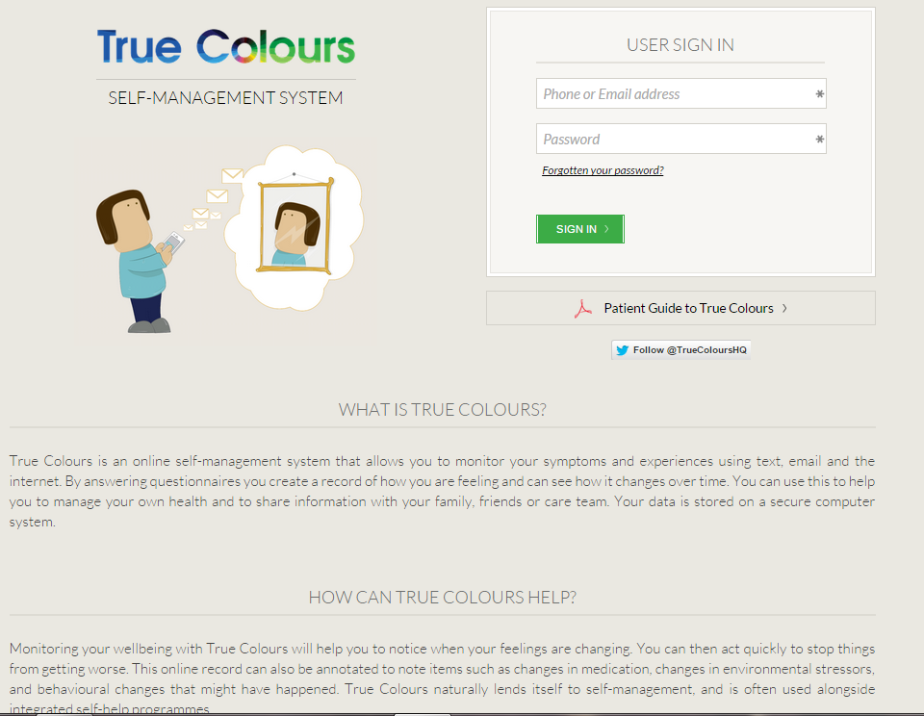
A patient-centric approach
Oxihealth (vital signs using just webcam/mobile phone)
True Colours (self-monitoring for mental health)
Gait Analysis (early detection of Parkinson’s using accelerometer in phone)
Fitness devices…

Slide 14
Gamification of health -Individual Incentives, Population Reward.
  Competition, community and rewards.
  Better patient engagement
    Bounts reward scheme resulted in better adherence to weight-loss programme
    True Colours allows patients to feel in control of condition
  Competing with friends increases activity
    Fitbit daily/weekly challenges
  Rewards increase motivation:
    Private healthcare scheme –
      points awarded for healthy lifestyle
      points convert into discounts/cashback.
    Should NHS adopt same approach?

Slide 15
How do we make it happen?
The toolkit:
  Consumer technology more powerful than ever.
  Everyone/everything is connected
  Data being captured at exponential rate
  Tremendous advances in medical technologies
The team:
  Academic rigour
  Clinical insight
  Industry partnerships
  Patient engagement
Never stop saying “Wouldn’t it be good if…”

Slide 16


Please join us on 30th June for our Technology Showcase
  http://isis-innovation.com/news/events/isis-technology-showcases/

