Slide 1
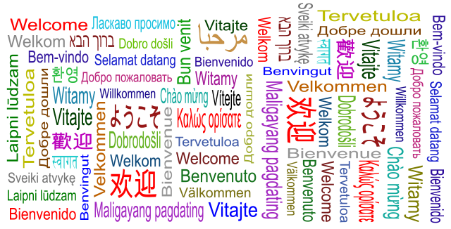
Welcome!

Slide 2


Slide 3
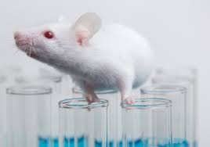




T0 Basic and applied research | T1 Translation to Humans | T2 Translation to Patients | T3 Translation to Practice | T4 Translation to Communities
Preclinical and Animal Studies | Proof of Concept Phase I Clinical Trials | Phase II and Phase III Clinical Trials | Phase IV Clinical Trials and clinical outcomes research | Population level outcomes and research
Defining Mechanisms and lead molecules | New methods of diagnosis, treatment and prevention | Controlled studies leading to effective care | Delivery or recommended and timely care to the right patient | Population Health benefits Blumberg et.al. Nat Med 2012

Slide 4


Slide 5


Slide 6


Slide 7


Slide 8


Slide 9


Slide 11


Slide 12



Slide 13


Slide 14


Slide 15


Slide 16


Slide 17


Slide 18
ELSI 2.0 Objectives
To provide opportunities for students and early career researchers to enable capacity building
To use 2.0 technology to support global research and interactions
To develop methods for global policy acceleration

Slide 19


Slide 20



#Transhealth2015
#Transhealth2015
Translation in Healthcare Conference Oxford 2015

Slide 21

Talking wall

Slide 22

Selfies
helexselfies@gmail.com

Slide 23
Haiku Poem
What is the Structure?
A Haiku consists of 3 lines and 17 syllables
Each line has a set number of syllables see below:
Line 1 – 5 syllables Line 2 – 7 syllables Line 3 – 5 syllables
An Example of a Haiku Poem
(5) The sky is so blue. (7) The sun is so warm up high. (5) I love the summer.

Slide 24
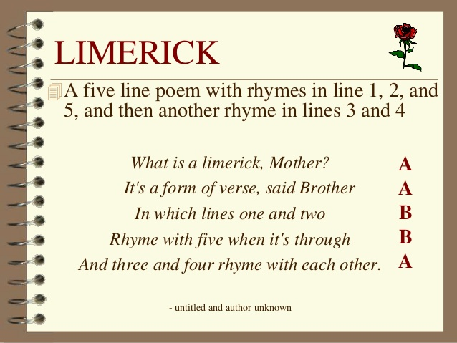
Limerick

Slide 25


Wifi Login

Slide 26

BMC Medical Ethics Special Issue
Translation in Healthcare: Ethical, Legal and Social Implications
Expressions of Interest due:
Friday 17th July
Helex@dph.ox.ac.uk

Slide 27







With many thanks to

Slide 28


Slide 29

People
Notes:
Traditionally, the term ‘governance’ has been associated with government and the exercise of power held by political leaders. For example, some commentators have understood governance as ‘the capacity of government to make and implement policy, in other words, to steer society’. These understandings—referred to as ‘old governance’ approaches—see national governments steering from the top down, and concentrate on the degree of control the government is able to exert over social and economic activities. However, the term has developed a new and broader meaning in modern times to extend to processes and actors outside the narrow realm of government. Mette Kjær, A., Governance (Polity, Oxford 2004) 1.
Ibid 10.
Ibid 11.
Ibid 1.

