Slide 1

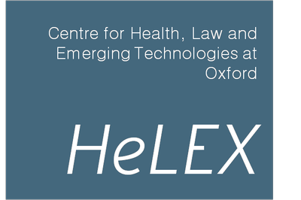


“DNA a click away” Workshop on ‘agreements’ in DTCGT
Andelka Phillips and Teresa Finlay
HeLEX and CESAGenE
Notes:
Good morning ladies and gentlemen. Thank you for coming to this workshop in which we will be discussing the current nature of agreements (by which we mean Terms and Conditions, Privacy Policies and Consent forms) between companies and consumers of direct-to-consumer genetic testing.
The workshop will be facilitated by … (happy to do this – TF) and will work as follows:
TF will start the ball rolling with a brief presentation from her study on Early Adopters and Genetics Clinicians’ experiences of DTCGT in the UK. Specifically she will share data that relates to users’ experiences of purchasing SNP genotyping and their understanding of what they had agreed to in doing so, and their thoughts on regulation of DTCGT. …..(expand this bit as required)
AP will follow this with a short presentation of her analysis of the legal issues that DTCGT companies’ contractual agreements present……. (expand as required)
Please feel free to ask questions for clarification during these presentations if needed.
These two opening parts of the workshop are deliberately juxtaposed to illustrate some of the problems with contractual “agreements” in DTCGT in relation to how agreements are framed and understood differently by the parties involved.
Having used our respective research findings to set the scene we shall use a series of questions to prompt discussion about about how the regulatory grey-area that DTCGT occupies could be addressed in the future, bearing in mind the opposing views of the various stakeholders.
We also welcome Jan Charbonneau to the workshop panel; Jan’s work on DTCGT encompasses…..

Slide 2
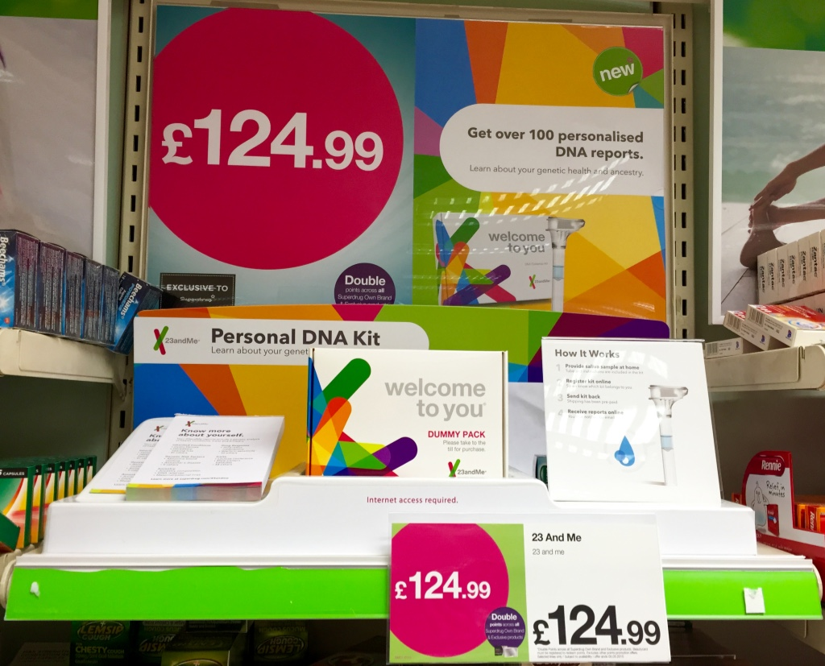
Notes:
This is an illustration of the kind of DTCGT we are researching, and which this workshop is about. 23andMe recently launched in the UK and their product is available both online and in Superdrug (though as you can see from the photograph, internet access is required regardless of the mode of acquisition). Whilst not the only company involved in our research, it figures prominently, unsurprisingly as the market leader in this area, and is the company with whom all of TF’s User participants tested (in addition to some others in the multi-test people).

Slide 3
UK Users’ experiences of DTCGT
17 interviews with early adopters
15 educated to degree level
6 PhDs
8 scientists, 5 of these in genetics
5 ISOGG members
All were ‘curious’
Notes:
I’m going to share excerpts from interviews with 17 users who largely fall into the category of early adopters being well-informed, educated people involved in genetics or genetic genealogy or something related. Aspects of DTCGT that we discussed included consent, privacy, confidentiality and regulation. I am going to share excerpts from the data that I think best illustrate this group of users’ experiences of DTCGT in respect of what they thought they were agreeing to and how they feel about the availability of SNP genotyping more broadly. Clearly single quotations do not indicate generalisable conclusions, but I have chosen excerpts that represent common themes amongst most of this group.
The names attributed to each excerpt are pseudonyms to preserve confidentiality.
Ann gives a great representation of the group of users’ characteristics.

Slide 4
Testers
“are people who are genealogists, progressed from ordinary testing, geeky people who like to get involved in research and play with their own data” Ann
Notes:
Though she is referring to genetic genealogists these characteristics could be broadly applied to most of the people who volunteered for my study.

Slide 5
Preparation
“I went through the website before I bought the kit to see how it worked, the security in place, the anonymity of the data and all that stuff” Carol
“I did read the clauses from 23andMe and worried slightly about it especially in the beginning before I did it, I did worry about who would get it but there’s so many hundreds of thousands of millions of people doing it now and that information is so valuable, the more people that do it the more we’re going to discover and more truth we’ll find out from it; I’d rather be part of that than worrying about insurance companies so I just don’t think about it. . I didn’t really think about it all that deeply.” Keith
Notes:
Thinking about testing and preparing to decide to buy was an area into which people fell roughly into one of two camps. These excerpts illustrate them
REVEAL Carol thought about it and did her research into the company
though the reasons for “just clicking” as Andelka puts it vary.
REVEAL. Keith also read the company information but decided not to think about it too deeply and “Just click” as Andelka puts it.

Slide 6
Trust
“I think they (23andMe) are very professional. They know what they are doing, especially the healthcare, uhmm. There’s clearly lots of clued up people behind deciding which aspects to test and information to give to consumers, it’s all very professional, impressive … it gave me confidence that they knew what they were doing and I could rely on it … there’s lots of information, and forums and a community where aspects are discussed if you want to know more.” David
I’ve been very impressed by the way they show it; they show it graphically, they show both absolute risks and odds ratios, which most statisticians would say you need both of those to interpret the risks effectively” Kirsten
Notes:
Trust in the company appeared to be an important aspect of users decisions to buy a test from them. The presentation of information was important in conveying a professional, trustworthy service.

Slide 7
Consent
“I suspect they don’t give people very much information but I’m not sure whether giving people more information would actually improve people’s understanding of what they were doing… because most of the time when you’re given a long electronic document most of us read the top few lines and then don’t look at the rest of it anyway Because I’d already somewhat made up my mind I never really looked into how well they communicate before you’re going to make the decision” Fiona
“Well there was written information but like a lot of people you don’t always go through all the small print. I understand contracts but when so many demands are made on you to go through a contract like that and to read all the small print, it’s hard to take it all in … So, I think that to read the small print and really consider it and understand it, you have to be a very unusual person.” Jane
Notes:
In relation to consenting to test there were again two themes around which people’s views clustered, and they were not aligned to their level of genetics knowledge
The first theme relates to reading long documents.
Fiona and Jane both refer to this. Fiona is explicit about the fact that she had already decided to test and didn’t look at the “agreements” in detail as she wasn’t going to change her mind.
REVEAL
Jane was honest about reading the detail comparing this to her work experiences which involve a lot of contracts.

Slide 8
Consent
“23andMe did that (let people know what they are letting themselves in for) very well on their consent form. …they did make it sound more scary than it actually is, so I think anyone who actually …test(s) would be fully aware of what it could tell them” Ann
“I think because I didn’t really value the information they were producing I felt very comfortable about that. I probably came at it from a fairly informed point of view. I was impressed by the list of things they gave you to consider about what the implications of doing this might be. You know they talk about increase in anxiety, not being able to forget or un-know what you find out, fairly obvious things on the list and it did make even me take a step back and think. I think that’s quite important.” Kirsten
Notes:
These two excerpts give a different view – of researching the T and Cs and being clear that what they convey is appropriate for the situation. Again, one scientist, one genealogist.

Slide 9
Curation
“The little fine print, that was unusual because if they sell the company then your database would be shared … so I had the sample destroyed. Because I don’t have family (children) it doesn’t really matter but at least they had that there for other people so I thought that was quite credible and reliable… you agree an accept clause on it. Yes, I was happy to do that because in the back of my mind I knew from family that wasn’t an issue so much.” Christine
“You don’t want to be storing your own personal data somewhere unsafe really and I agree with that so I‘m quite happy for them to look after it. I make assumptions that they [23andMe] are also careful about storing data and I assume it would be a downfall for the company if they mucked it up.” Laura
Notes:
At this point I should re-emphasise the timing of these interviews which was in 2012, just before the takeovers of Navigenics and DECODE and the publicity around 23andMe’s dealings with biotech and big pharma. I say this because people’s awareness of the business model on which 23andMe operates was not as publicly evident then as it has become.
These excerpts show contrasting views about how people thought about their samples and data. One does not leave her sample with the company (though of course this doesn’t encompass data)
REVEAL
The other thinks this is a preferable option
REVEAL

Slide 10
Regulation
“I think the current set up probably works quite well in that it’s relatively unregulated. I would be more interested in what the sellers of these tests can do with an individual’s data rather than how easy it is for a consumer to get the test. I would be less against regulation that stated these things couldn’t test for things that had serious health consequences like the BRCA genes.” Fiona
“Well, they can try … but I got my kit from the States, it’s out of the box really. I think it’s up to the individual if they want to do it or not. “ Keith
Notes:
Regulation was discussed by everyone and often in quite heated terms. People were largely unanimous in thinking that DTCGT not be prohibited, but they did have varying ideas of what regulation could achieve and its feasibility. But as I have indicated, as early adopters this group are well-informed and supportive of the prodemocracy arguments in relation to personalised health information.
Fiona thought that the vague information SNP genotyping provides did not need regulation unlike tests for genetic conditions with more serious consequences such as BRCA sequencing

Slide 11
Regulation
“It seems really odd to me that you want to regulate a test that has so little utility. It just seems a complete waste of time and using a sledgehammer to crack a nut sort of thing, so I’m aware of some of this and have been on the websites like some of the genetics associations in the States who say “You should not do a direct-to-consumer genetic test – that’s it”. And it’s like “What? Hang on, no conflict of interest here of course!” But I think the level of regulation should reflect the value of the information that they are providing. I would feel very strongly [about it being banned], that that’s not appropriate for them to do.” Kirsten
“I’d be pretty angry if they blocked it, possibly in the same way that I’m irritated about some of the stuff they’ve been doing with herbal medicines recently like blocking access to Echinacea and stuff. Why? I mean it just pushes people to buy stuff on the black market … Still I guess there are people out there who need protecting aren’t there? …[but] taking everything to the lowest common denominator is tiresome for the majority.” Helen

Slide 12
“The Public”
“But presumably those most likely to be badly affected are those who don’t understand what it means and are scared by it, and they are going to be the less educated who are less likely to come into this anyway … Because they are less likely to have found out about it and are less likely to be even interested in it” Helen
“I just wonder looking way into the future, when this kind of testing is integrated into medical testing, just knowing much more and having technology to check people, I’ve just got a feeling it will be a much better situation than currently, and also probably very open. The idea of having professionals who keep all the information and try to explain it, I don’t think that’s going to work any more. I know we can’t all understand everything but it’s amazing what people do understand” Ian
Notes:
Finally before we hear about Andelka’s work, many participants referred to the metaphorical “man on the street” in the context of their own understanding and views being different from the man on the street. When I asked them who they thought this person was/represented they found that difficult to answer. However Helen put it like this.
REVEAL
On the other hand REVEAL
Ian had a more democratic view about medical information that is more in keeping with the personalisation and autonomy arguments supporting the availability of personal genomic information.
It is important to state at this point that no-one was upset or took long-term life-style action on the basis of the health test results. One person was referred to an oncologist but no further intervention was arranged.
However their approaches to, and understanding of the legal aspects varied and were often influenced by their intentions in relation to DTCGT, by which I mean if they had decided to do it, they would do it anyway regardless of the information companies provided. So the “Hands off our genomes” argument is alive and well amongst early adopters of DTCGT and it does not appear to have had any major impact (negative or positive) on people’s lives.
for information on a variety of factors including ancestry, common complex disease risk, carrier status for genetic conditions, pharmacogenomics and physical traits. All the participants bought tests from 23andMe prior to the cease and desist order issued by the FDA in 2013
Hand over to AP.

Slide 13
DTCGT Industry
The DTCGT field is evolving rapidly
Lines between different categories of testing are increasing blurred
Ancestry.com has recently announced a move into health research.
Gene By Gene’s FamilyTreeDNA acquired DNA Heritage and DNA-Fingerprint
MyHeritage partnered with FamilyTreeDNA and 23andMe

Slide 14
“Agreements” in DTCGT
The websites of DTCGT companies in the health category (102 companies) were examined to identify those whose terms and conditions were available to the public (71 companies).
The online contracts and privacy policies of health-related DTCGT companies were saved as electronic documents (PDF files).
Where available the contracts and privacy policies were also saved for all other categories of testing and these will be examined in future research.

Slide 15
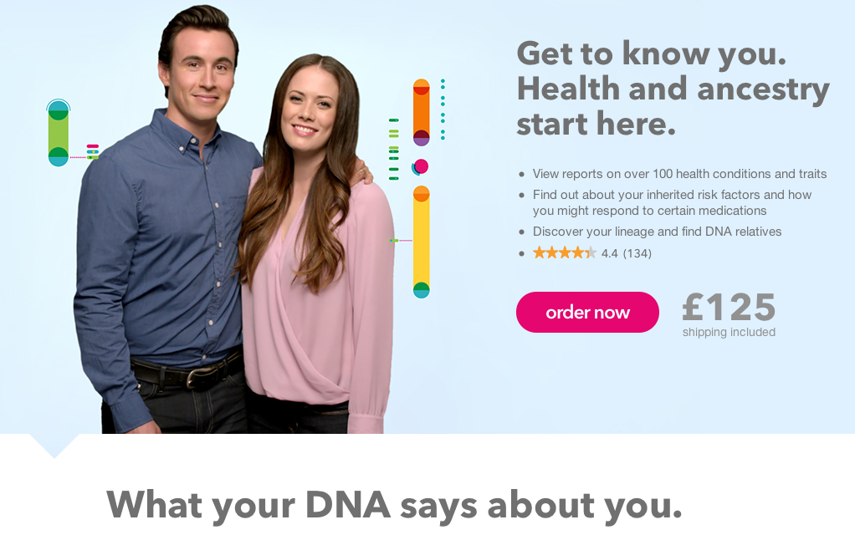
23andMe UK website June 2015

Slide 16
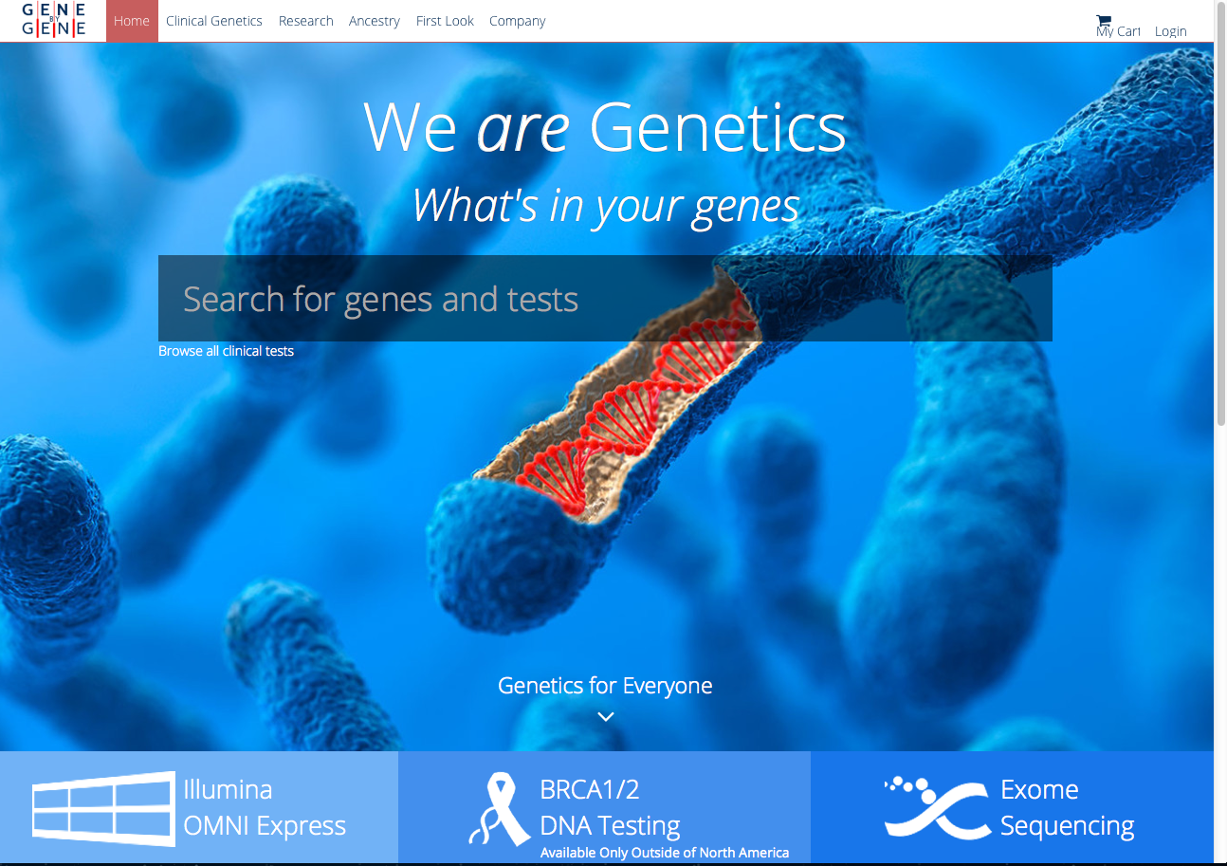
Gene By Gene

Slide 17
What is being agreed to?
Broad disclaimers of liability, including disclaiming fitness for purpose
Consent or acceptance of terms often deemed through use or viewing of the website
Company has right to change terms ‘at any time’ or from ‘time to time’ often without notice
Consumer to indemnify company
Privacy
Sharing of data?
Sale of data?
Destruction of data?
Giving up property rights and other rights
The jurisdiction that should govern disputes
Often terms could be deemed unfair under UK law
Notes:
Of the 102 DTCGT companies surveyed, 31 do not have a privacy policy or terms and conditions governing privacy.
Of the remaining 71 there is much variation amongst policies.
26 have clauses covering disclosure of data.
Only 32 address the issue of data sharing.
20 say that they will not sell data.
22 specifically mention ‘genetic information’ at some point in their policy.
Only 14 mention destruction of DNA samples.

Slide 18
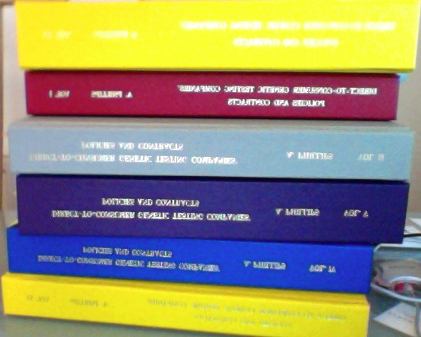
Examples of contract length:
Gene By Gene’s DNA DTC
Terms and Conditions = 3,645 words
Consent Document = 4,718 words
23andMe’s:
Terms of Service = 9,081 words
Privacy Statement = 15,807 words
Consent document = 2,051 words
DNA Spectrum’s
Terms of Service = 5,165 words

Slide 19
Unilateral change of terms
23andMe’s US clause
“26. Changes to the Terms of Service (US version)
23andMe may make changes to the TOS from time to time. When these changes are made, 23andMe will make a new copy of the TOS available on its website and any new additional terms will be made available to you from within, or through, the affected Services.
You acknowledge and agree that if you use the Services after the date on which the TOS have changed, 23andMe will treat your use as acceptance of the updated TOS.”
Notes:
S 62 of the Consumer Rights Act:
‘Requirement for contract terms and notices to be fair’
(4) A term is unfair if, contrary to the requirement of good faith, it causes a significant imbalance in the parties’ rights and obligations under the contract to the detriment of the consumer.
(5) Whether a term is fair is to be determined—
(a) taking into account the nature of the subject matter of the contract, and
(b) by reference to all the circumstances existing when the term was agreed and to all of the other terms of the contract or of any other contract on which it depends.

Slide 20
23andMe’s UK clause:
Terms of Service, section 30 Changes to the Terms of Service:
23andMe may make changes to the TOS from time to time to reflect
changes in our Service, technology, commercial practice, behaviors, our
business and the way users use our Service and applicable law and rules.
When these changes are made, 23andMe will make a new copy of the
TOS available on its Website and any new additional terms will be made
available to you from within, or through, the affected Services.
23andMe will use reasonable efforts to notify you of any significant
changes to the TOS.
You acknowledge and agree that if you use the Services after the date on
which the TOS have changed, 23andMe will treat your use as acceptance
of the updated TOS.

Slide 21
More examples
DNA Traits:
“DNATraits may revise these Terms and Conditions at any time and for any reason. Modifications may be posted on the website. By continuing use of the website and DNATraits services after such changes are made you will be accepting such changes.“
Asper Biotech:
“Asper Biotech may revise these Terms and Conditions at any time and for any reason. Modifications may be posted on the website. By continuing use of the website and Asper Biotech services after such changes are made you will be accepting such changes.”

Slide 22
Acceptance
International Biosciences, section 2:
“All information appearing on the pages of the INTERNATIONAL BIOSCIENCES website and supporting documentation is for information only. Persons entering the site have expressly accepted these terms and conditions.”
Indian Biosciences, Terms, section 2:
“…Persons entering the site have expressly accepted these terms and conditions.”
GTL
“By visiting www.gtldna.com, you are accepting the practices described in this Privacy Notice.”
Counsyl, section 23:
“By visiting this Site or using any of our Services, you are agreeing to them. If you cannot agree, please do not use the Services.”
Notes:
Of the 71 which do have terms and conditions available 22 do not have specific clauses addressing consent, meaning that 53 companies in total do not have specific clauses addressing what constitutes consent. The remaining 49 do have some clause addressing consent.
Of these 49, several deem assent to their terms merely through use of the website. 19 specify that either by ‘using the site’ or ‘using the services’, ‘you agree to’ either the privacy policy or the terms and conditions of the website. Three specify that by ‘visiting’ the site the consumer is bound by the site’s terms (ARUP, GTL, and the Makings of Me). One Privacy Policy states that ‘by visiting and using’ the website ‘you consent to the collection, use, and disclosure of information as described in this policy’ (ARUP). 6 specify that ‘continued use’ of the website after any changes to the terms and conditions or privacy policy, constitutes acceptance of those changes (Genepeeks, Genomic Health Inc, Inherent Health, Pathway Genomics, Perkin Elmer Genetics, and the Makings of Me). Only 10 companies mention ‘informed consent’ anywhere in their contracts and privacy policies (Counsyl, DeCODEme, DNA Spectrum, DNA Traits, easyDNA, Genepeeks, Gentle, Inherent Health, Map My Gene, and Navigenics). More up to a general review of the types of contracts and what they contain

Slide 23
Consent
Cancer Genetics Inc, Privacy Policy:
BY USING OUR SITE, YOU CONSENT TO THE COLLECTION, USE AND DISCLOSURE OF INFORMATION AS DESCRIBED IN THIS POLICY.
Gene By Gene’s DNADTC, Privacy Document:
By using the DNADTC websites and the services herein
you consent to the collection, use, storage and disclosure of your personal information by DNADTC in accordance with this Privacy Document. It should be read inconjunction with the DNADTC Terms of Use and DNADTC Consent Agreement

Slide 24
Example of indemnity clause
Gene By Gene’s DNADTC:
7. Indemnity
You agree to defend and hold DNA DTC, and its subsidiaries, affiliates, officers, agents, contractors, partners, employees, successors, and assigns harmless from any claim, or demand, including reasonable attorneys' fees, made by any third party due to or arising out of any information you submit, misuse of the results delivered to you, violation of the Terms and Conditions, or your violation of any rights of another party. If you have submitted a saliva sample or otherwise provided your own personal information, you will defend and hold harmless DNA DTC, its employees, contractors, successors, and assigns from any liability arising out of the use or disclosure of any information obtained from genotyping your saliva sample and/or analyzing your results, which is disclosed to you consistent with our Privacy Statement or results from any third-party add-ons to tools we provide. In addition, if you choose to provide your results and personal information to third parties - whether individuals to whom you facilitate access, intentionally or inadvertently, or to third parties for diagnostic or other purposes - you agree to defend and hold harmless DNA DTC, its employees, contractors, successors, and assigns from any and all liability arising from such disclosure or use of your results and personal information.
Notes:
44% of companies require the consumer to indemnify them

Slide 25
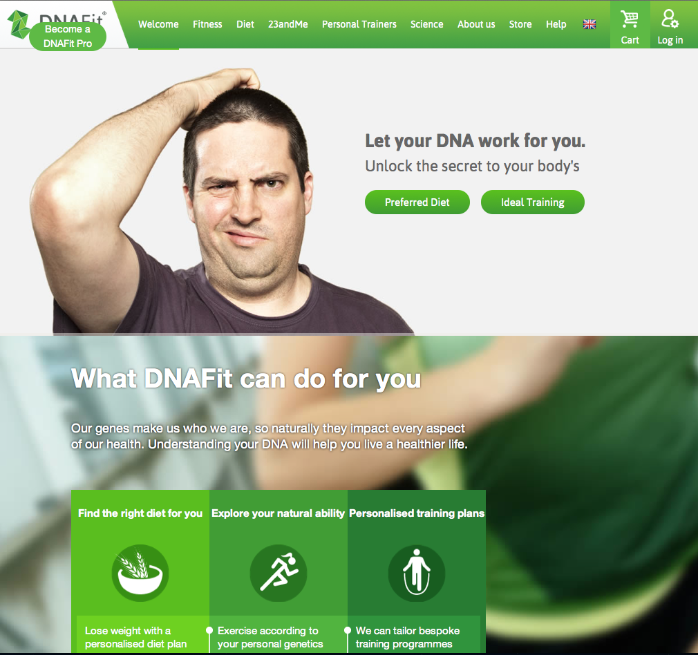

Slide 26
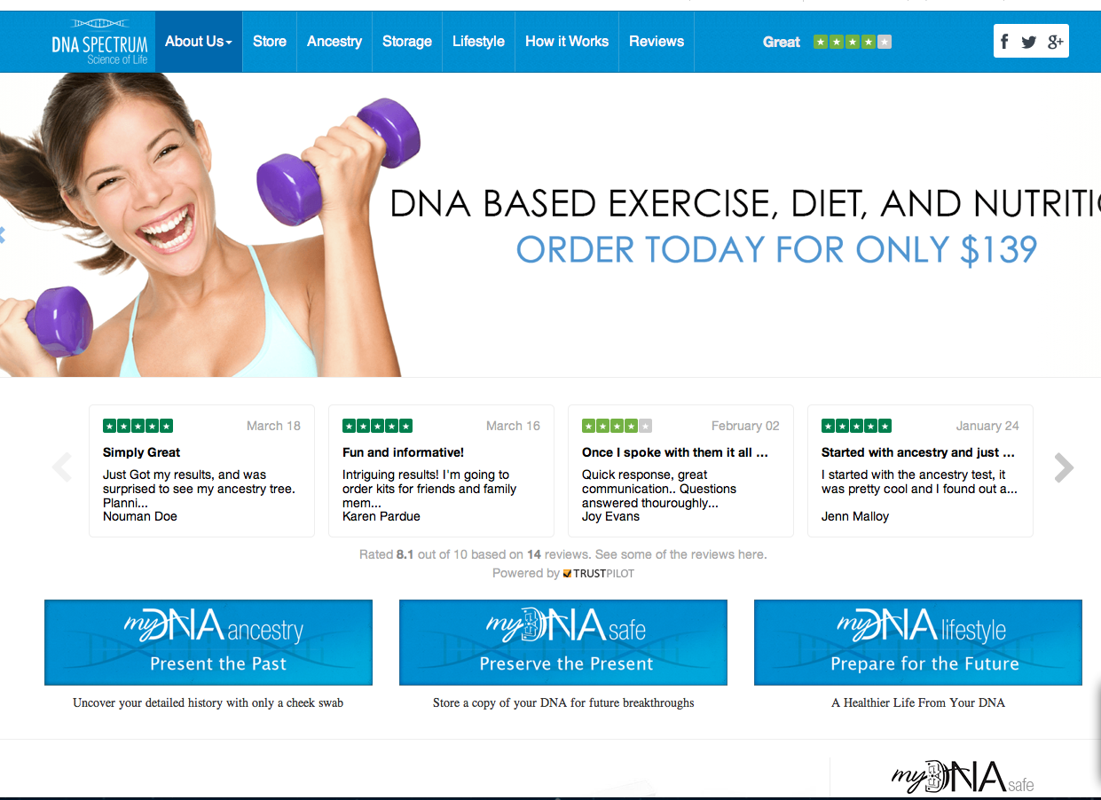

Slide 27
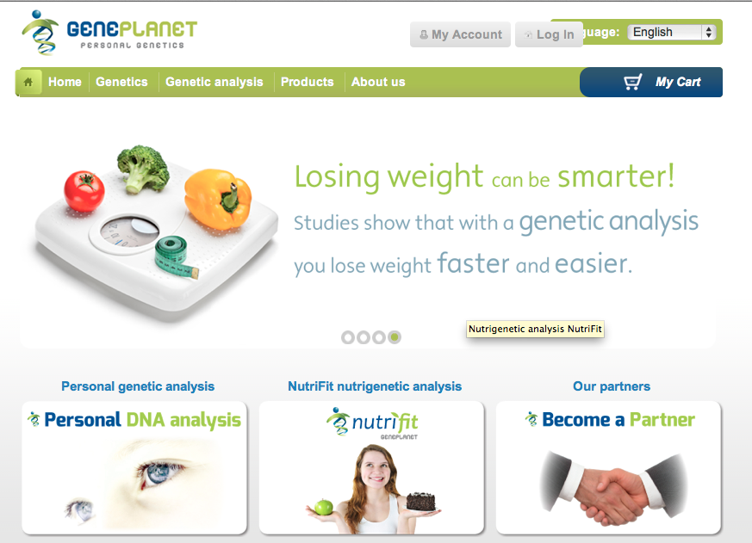

Slide 28
Questions for discussion
Are DTCGT contracts “fair”?
Is there a need to improve transparency?
Are the terms commonly included appropriate?
Is there an imbalance in the parties’ rights?
If so does it matter?
Should there be more specific contracts for commercial genomics?
Will the IVDMD be the most effective way to regulate this?
Notes:
OK – so on the basis of these presentations’ content we will now open the workshop up for discussion. To get discussion going we will start with these questions and we have more to consider as we go on. If the discussion gets taken in other directions that everyone is getting something from we will go with that but the questions should give us something to work with at the start.
(Invite Jan Charbonneau to join us on the panel if not already there)
REVEAL first questions and then take it as it comes.

