Slide 1
University-industry interaction in translational research: A survey of over 200 UK PIs receiving industry funding
Natasha Davie
Translation in Healthcare – Exploring the Impact of Emerging Technologies
Oxford
23 – 25 June 2015
Notes:
Hi Everyone, thank you for joining here today and thank you to the organisers for arranging such a… challenging but incredibly engaging presentation format.
I’m here today to talk about university-industry collaboration in translational medicine. So I’m sure that a day and a half into this conference you’re all completely au fait with translation, so instead I’m going to focus on collaboration. So who here thinks collaboration is important?

Slide 2

Photograph: Alamy
Notes:
When I first started out as an engineer looking at translation one of the issues that kept coming up was the valley of death. The phase between basic research and commercial product where lots of innovations fail due to gaps in funding, knowledge, resources, incentives. I thought it sounded dramatic, but then you start to understand it. So if we look at drug development we see that for every 10,000 compounds….

Slide 3
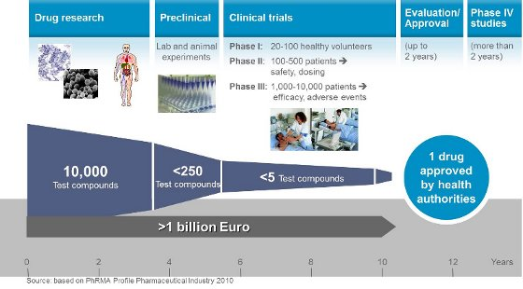
Notes:
From Bayer, who start with 10,000 compounds, then spend over a billion euros over 12 years to get one approved drug. (10th largest pharma company in the world, annual revenue of over $54bn.)
Even more complicated for healthcare and drug development as in addition to funding gap knowledge gap, skills gap, incentive gap
Simplified process, time scales, approximate costs, funding sources
Target validation, lead optimisation, process chemistry, preclinical development, phase 1 and 2 trials phase 3 trials, fda approval

Slide 4
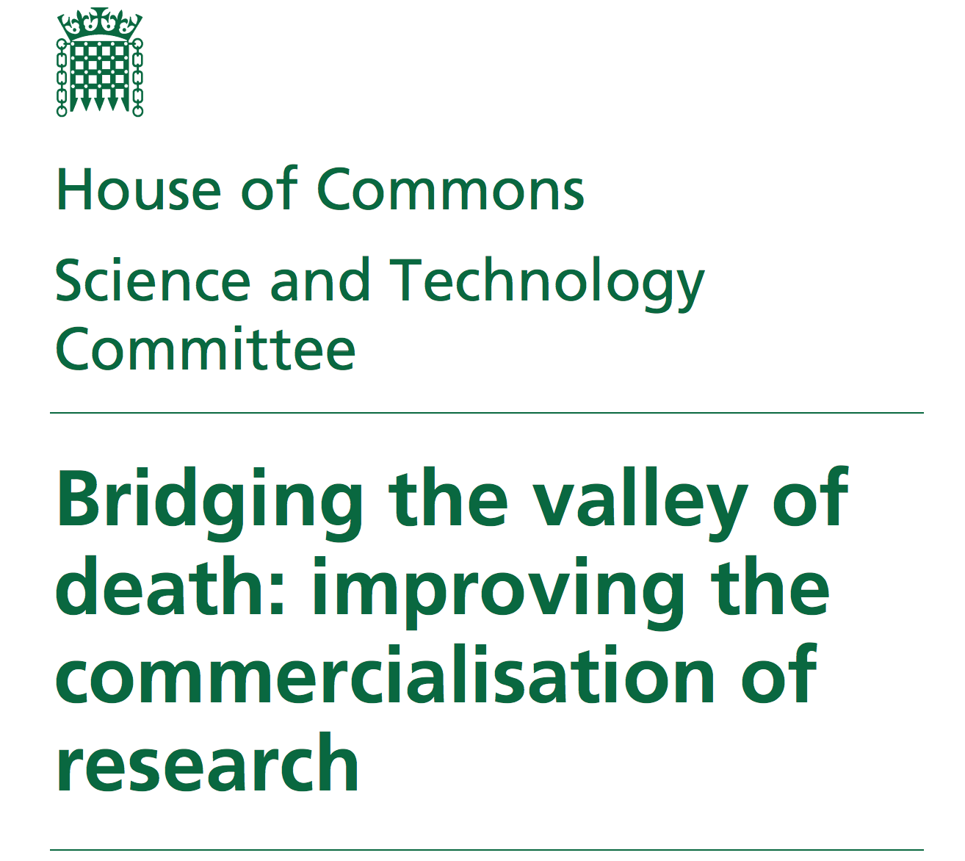
Notes:
That is worrying! It’s why drugs are so expensive and it’s why so many ‘me-too drugs’ exist.
There must be a better a way. Recently numerous government reports including cooksey, lambert, witty, wilson, recently commissioned dowling review a govt report called “Bridging the Valley of Death: Improving the commercialisation of research ” highlighted

Slide 5
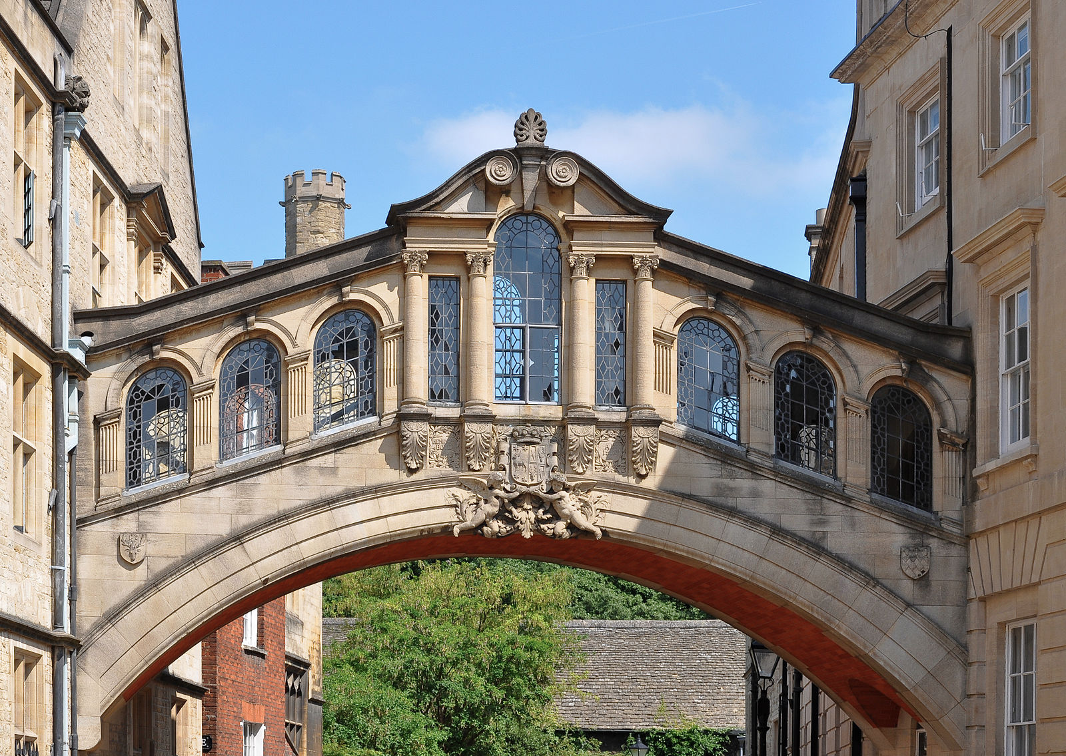
Universities
Industry
Notes:
Idea is academia can do the research and innovation part, and industry can do the scale up and commercialisation part. I wanted to see if this was true? Does U-I collaboration improve the translational process. Best way to examine this was to look at existing collaborations.

Slide 6

http://time.com/3774145/money-brain-mind/
Notes:
How do I assess the current state of collaborations in the UK? Isn’t really a consensus in the literature, some use patent licences, some use joint publications, but for several reasons I decided to look at industry investment into UK universities.
Do we look for press releases? How to we measure collaboration in a particular setting?
Number of patents or licenses is often used but doesn’t necessarily include collaboration (i.e. industry licenses patent, can sit on it or just have no input from the academic) Collaboration is different from technology transfer (Collaboration is two or more groups working together to produce something that could not have been otherwise realised (or not as quickly)”
journal articles don’t necessarily imply translation also a publication is often not the goal of a collaboration, funding was seen as a good metric (although it it worth mentioning that all these measures ignore hard to meature aspects of collaboration e.g. in kind donation of reagents and equipment)

Slide 7
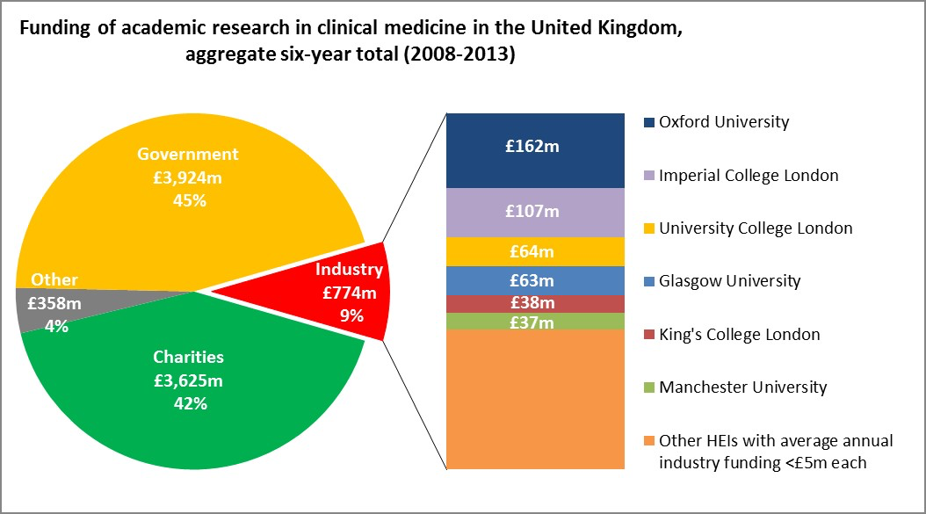
Data available online with registration at https://heidi.hesa.ac.uk/
Notes:
Looked into funding we found Oxford was really rather good, has about 50% more funding than the next most industry funded university. Raises other questions – Why does Oxford get more funding? Is it something about the system that encourages or facilitates that? Who is actually collaborating?
How many collaborations? How many academics? With this opportunity at my doorstep I decided this was worth exploring
Source : Hesa Higher education statistics agency

Slide 8
?
Notes:
Why is this? Why does Oxford get more funding? Is it something about the system that encourages or facilitates that? Who is actually collaborating?
Conducted a literature review, generated research questions to find out more about the people and the institution receiving industry funding
What are the barriers to university-industry collaboration in translational medicine at Oxford?
What types of projects are industry funding?
How mature or translated is the research?
What are the key motivations, advantages, disadvantages experienced by academics at Oxford?
Is collaboration good? If so, how can future collaboration be facilitated?

Slide 9
Survey covers 7 main areas
Motivations
Barriers to collaboration
Types of collaboration
Maturity/degree of translation of research
Advantages/Disadvantages of industry funding
Strategies to improve collaboration
Demographics
Notes:
To answer this designed, validated and piloted a survey covering 7 areas that address my initial research questions
How do I answer these questions? Ask those Pis who have experience of collaboration?

Slide 10
280
PIs who have received industry funding
229
Initially surveyed population
220
Final eligible survey population
169
Completed responses
38
Agreed to be interviewed
26
Completed interviews
26 Duplicates/Deceased
25 No longer at Oxford
5 Funded by BMA only
4 Misidentified as PIs
77% Response rate
22% of respondents
Notes:
280 Pis, 220 of whom met inclusion criteria, of whom 77% responded. Survey launched Nov 14

Slide 11
of 20

Slide 12
How are these barriers experienced?
Do barriers differ for different demographics?
Notes:
Most significant barriers were short-term industry research and extended contracting process.
Ethical issues and conflicts of interest were less problematic
Using demographic data on age, gender, professorial titles and whether or not they hold degrees.

Slide 13
Notes:
When we asked academics how much each activity made up of their TOTAL industry funding
The most common type of interaction funded by industry is investigator-led research.
Many academics also receiving funds for consultancy, although this tends to make up a smaller proportion of total funding. Couldn’t link it to actual funding amount or would unblind the study. Take through an example. Sum of ALL funding received, i.e. 3 grants, 700k, 250k, 50k, add them together, divide between money for consulting, investigator lead research and training.
80% received industry funding for investigator-led research
60% received industry funding for consulting
Consulting as a gateway activity?

Slide 15
Is consulting a gateway activity to more industry funding?
What are the features of investigator-led research?
Notes:
advantages, disadvantages and barriers Also got academics to suggest strategies

Slide 16
Create a database of all known industrial partners
Host targeted joint events
Streamline standard contracts
Use experienced academics to mentor junior researchers
Reduce the cost of overheads
Form an industrial collaboration group or department within the university
Increase exchange of personnel between academia and industry
Establish an incentive system
Notes:
Thematically analysed the data to identify these 8 strategies that I’ll be assessing the feasibility of. However, these are strategies from academics perspectives, and it’s important to note that collaboration is more than just the partners in academia and industry

Slide 17
PIs
Big Pharma
Research Services
BDO
Isis Innovations
SMEs
OUC
Collaboration
DA
Notes:
The bridge is same – that of collaboration, the people crucial to helping you get across are nuanced in their skill and understanding.
Secondary data analysis
Industry interviews
Repeat at different UK institution
Identify most feasible strategies
Write-up white paper

Slide 18
Next Steps…
Identify and test the most feasible strategies
Industry interviews
Secondary data analysis
Repeat at different UK institution
Write-up white paper

Slide 19
Notes:
85% agree collaboration should be improved or encouraged.
Qualitative data (that I don’t have time to show here) mentioned the satisfaction of seeing your work translated and used in real life. The value of this research

Slide 20
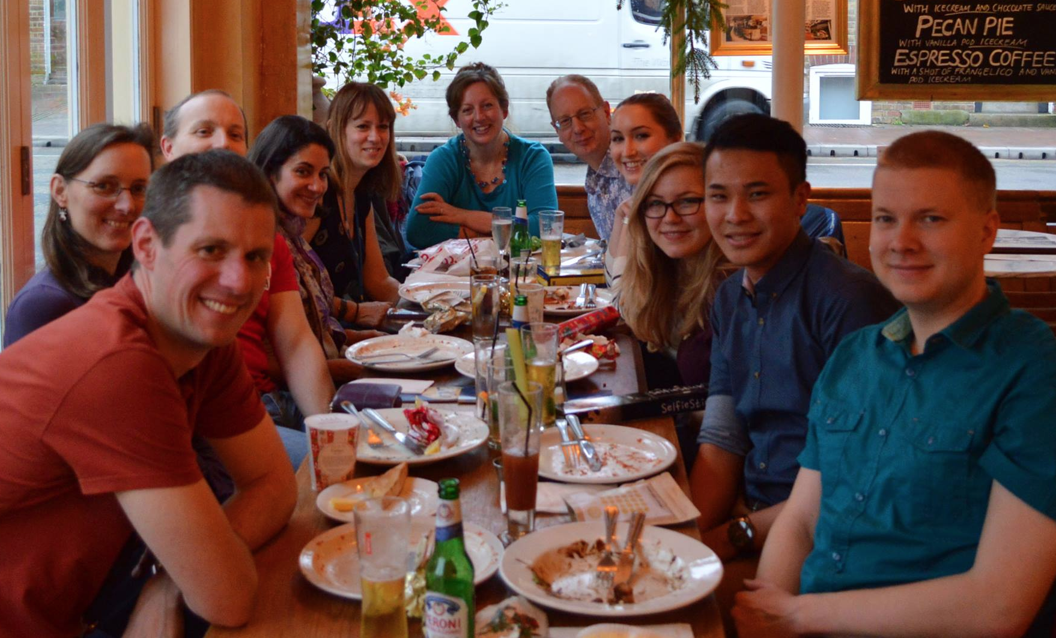


Acknowledgements
Deborah Gill
Richard Barker
Steve Hyde
Pavel Ovseiko
Megan Morys
Every participant in my survey and interviews!
Funding:
Notes:
Thank every PI, facilitator who helped in research.

