Slide 1

Epigenetics in Health Policy:
Ethical and legal considerations in the assessment of environmental harms
Ross D. Silverman, JD, MPH
Indiana University
Fairbanks School of Public Health & McKinney School of Law
rdsilver@iu.edu
@phlu
You
Are
Here
T1
T2
T3
T4

Slide 2
Outline
Some Pedagogical Context
The Question
Some attempts at formulating a solution

Slide 3
Law
Curriculum
Here
be
Complex,
Often Intractable, Questions
Here
be
Monsters
Ethics
Curriculum

Slide 4
Pedagogical Goal
Oxford Commas!
Developing policymakers, health
advocates, and scholars grounded in ethics, able to use ethical frameworks to analyze population health policies, programs, and problems
NOT
Philosophers who will argue with Mill & Rawls

Slide 5
Public Health Ethics Case Study
Question: How can we integrate genomics, as well as local public policy considerations, into a
graduate course on the ethics of public health?
Notes:
Local was of importance, as many of our students will end up working in city, county, or state public health agencies, as opposed to federal programs.
Also: didn’t want to focus on the more heavily traveled areas of public health genomics, such as newborn screening.

Slide 6
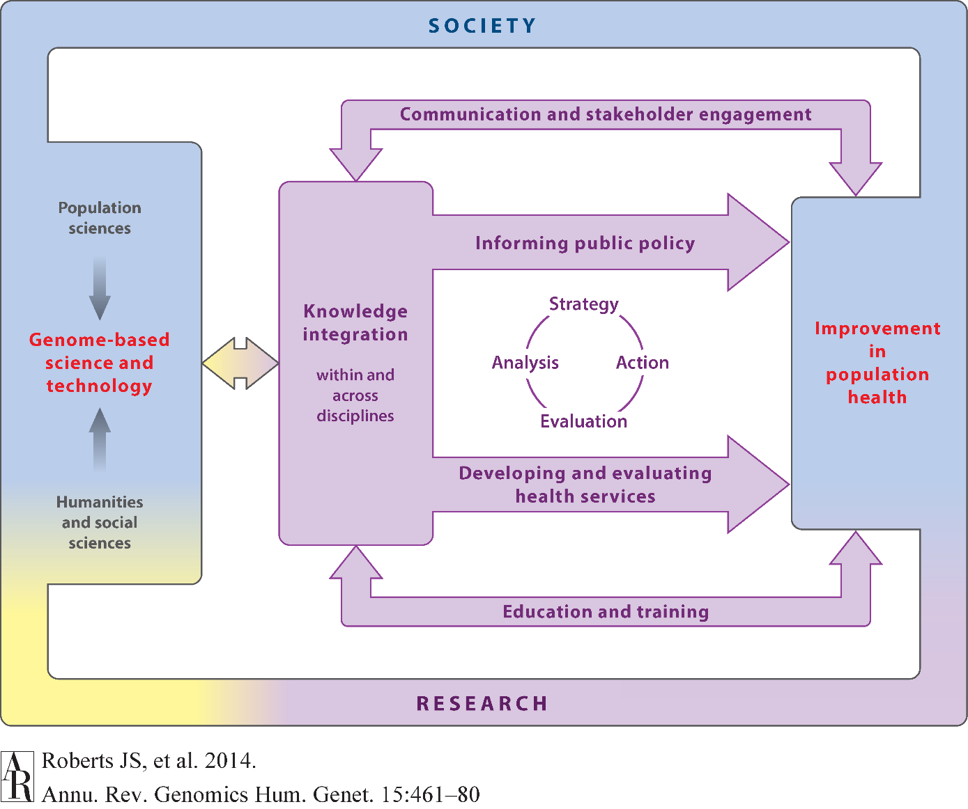
Notes:
Components of the public health genomics enterprise. Adapted from Burke W, Khoury M, Stewart A, Zimmern R. 2006. The path from genome-based research to population health: development of an international public health genomics network. Genet. Med. 8:451–58

Slide 7
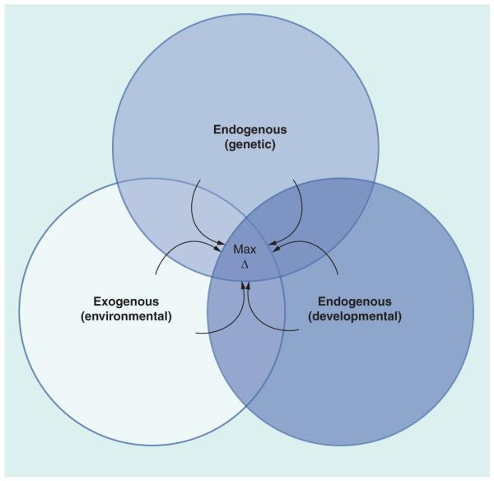
Social
Determinants
of
Health
Interaction of endogenous (genetic and developmental) and exogenous (environmental) factors in generating changes in the epigenome during an individual’s lifespan.
Latham et al 2012
Notes:
Figure 1
From Source:
Environmental factors include chemicals, toxins, physical agents and behavioral, dietary, social and other lifestyle factors. These exert effects preferentially at different times during development. Genetic variation affects developmental processes, responses to environmental factors and the molecular mechanisms that mediate epigenetic change. The arrows indicate that these three forces continue to interact throughout life to modify the epigenome. Maximum epigenetic change occurs when genotype, developmental stage and environmental exposure operate additively (exposure at sensitive stage in individual genetically predisposed to effect).
The epigenetic lorax: gene-environment interactions in human health
Epigenomics. 2012 August;4(4):383-402.

Slide 8
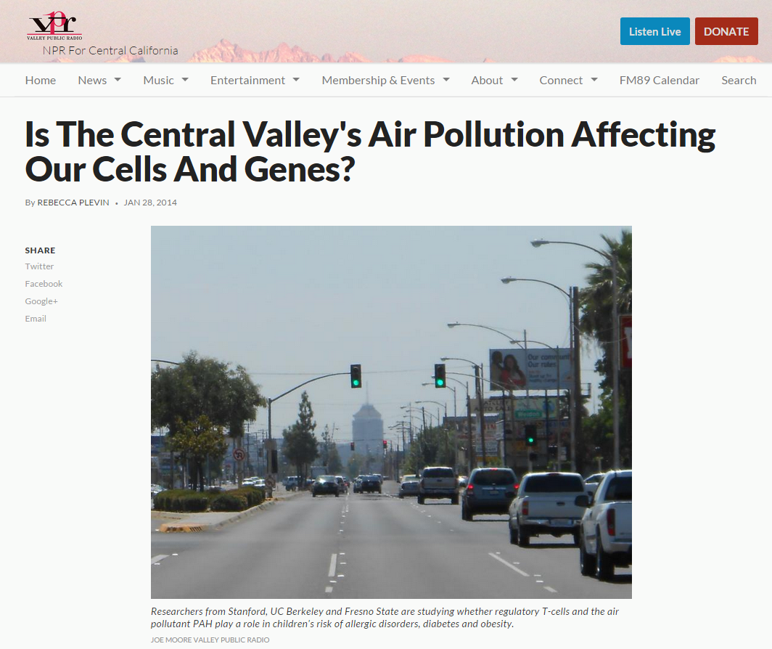

Slide 9
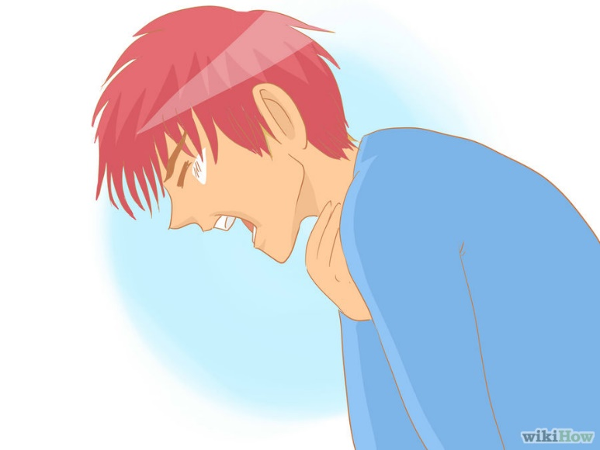
FOXP3
methylation
PAH
Notes:
T cells mediate the inflammatory responses observed in asthma among genetically susceptible individuals.
Higher exposure to polycyclic aromatic hydrocarbons (PAHs) – chemicals released from the burning of oil, coal, and gasoline - was significantly associated with impaired Treg function and increased methylation in the forkhead box protein 3 (FOXP3). This protein’s function has been associated with the development of asthma in children. More ambient PAH exposure was associated with adverse epigenetic modifications triggering asthma in children. Hew et al., Clin Exp Allergy. 2015 January; 45(1):238-248.
Asthma picture provided by wikiHow under a Creative Commons License.

Slide 10
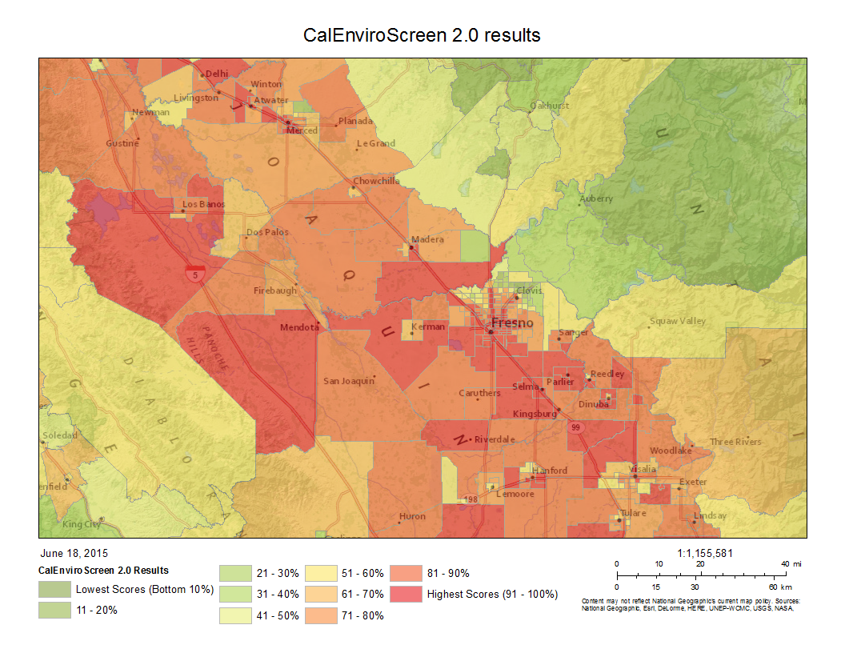

Slide 11
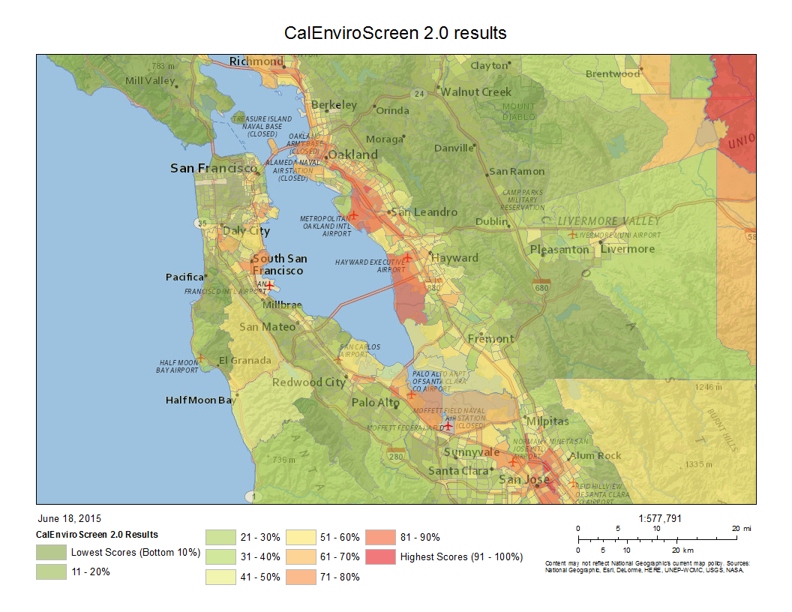

Slide 12
Case Study Question:
How could adverse epigenomic concerns find their way into public policy discussion?
  Include as part of a HiAP approach
  Raise a Question of Health Equity
    Possibly through engagement in Health Impact Assessment
of 20

Slide 13
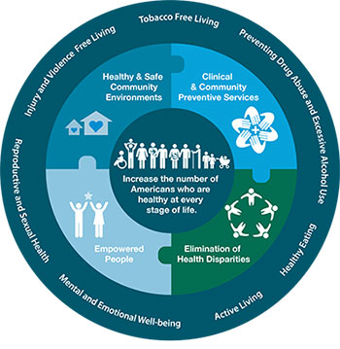
Health in All Policies
Health-Neutral
or Beneficial:
Public
policies
Plans
Projects
Programs
Notes:
National Association of County & City Health Officials (NACCHO) defines HiAP as “a change in the systems that determine how decisions are made and implemented by local, state, and federal governments to ensure that public policies, plans, projects and programs have neutral or beneficial impacts on the determinants of health…”
Source: National Association of County and City Health Officials. (2014). Health in All Policies. Retrieved October 21, 2014,
from http://www.naccho.org/topics/environmental/HiAP.
Image Source: CDC

Slide 14
Health in All Policies
Developing & structuring cross-sector relationships
Enhancing workforce capacity
Incorporating health into decision-making processes
Coordinating funding and investments
Implementing accountability structures
Integrating research, evaluation & data systems
Synchronizing communication & messaging
Notes:
“…HiAP emphasizes the need to collaborate across sectors to achieve common goals and innovatively tackle complex problems, such as health inequities and disparities in exposures to environmental toxicants.”
Source: Gase et al., “Health in All Policies”: Taking Stock of Emerging Practices to Incorporate Health in Decision Making in the United States, J Public Health Management Practice, 2013, 19(6), 529–540.

Slide 15
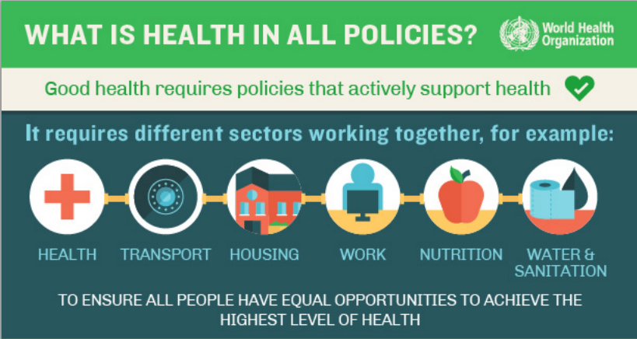
Notes:
Source: WHO
The World Health Organization defines Health in All Policies as referring to “taking health implications of decisions systemically into
account in public policies across sectors, seeking synergies, and avoiding harmful health impacts, in order to improve population health and health equity through assessing consequences of public policies on determinants of health and well-being and on health systems.” (WHO Training Manual)
Question: Where is academia?

Slide 16

Can
Health in HiAP
=
Regulating
to Protect
Genetic Health?
Notes:
Can the “Health” in “HiAP” accommodate questions of adverse epigenomic impacts? Is the science of epigenomics ready to play such a prominent role?
WHO defines “public health” as: “all organized efforts to prevent disease, promote health, and prolong life among the population as a whole?”
WHO says use HiAP if: * Problem or issue is of major public health importance, is amenable to change and change is feasible, and Potential solutions are politically and socially acceptable. (http://apps.who.int/iris/bitstream/10665/151788/1/9789241507981_eng.pdf?ua=1)
Spotted Owl? An indicator species signaling overall health of the ecosystem in which it lives (http://www.scu.edu/ethics/publications/iie/v4n1/)
Image source: https://share.america.gov/wildlife-at-risk/
Are these results inheritable, leading to an intergenerational effect of exposure?
This may be a challenge at this time to advance through HiAP approach.

Slide 17
Health Equity:
Health Differences that are
Unnecessary
Unfair
Unjust
Avoidable*
(Also Pervasive & Cumulative)
Whitehead 1992
Notes:
World Health Organization has set out the goal that every person have the chance to “attain his or her full health potential”
Health Equity promotes that every person have an equal chance to be healthy
Inequities are those social, economic, political, cultural and environmental conditions that cause disparities in health status that are unnecessary, unfair, unjust and avoidable*
And like social determinants of health, these problems are pervasive & cumulative
Health equity – Throwback to a classic public health philosophy of comprehensive concern about health, not merely the presence or absence of disease
Philosophy: Normative ethical concept founded on the principle of distributive justice. As noted later, you arguably can link issues of Health Equity to more than just justice as an ethical concept.

Slide 18
Health Equity in
Health Impact Assessment
A systemic, interdisciplinary process
Screening
Scoping
Assessing risks & benefits
Develop Rec’s
Reporting
Monitor & Evaluate
Notes:
Systemic process
Interdisciplinary
Data sources
Analytic methods
Stakeholder groups
Examines health effects of plans, policies, programs & projects on populations
Distribution of such effects within population

Slide 19
Health Equity & Epigenomic Impact
Links social determinants with disparity
Asks if alrady socially disadvantaged groups (e.g. poverty, gender, ethnicity) have the same opportunity to be healthy in a community
Notes:
P Braveman & S Gruskin, Defining equity in health.
J Epidemiol Community Health 2003;57:254-258
Systemic, or structural disparities, according to the World Bank, are conditions where “one category of people are attributed an unequal status in relation to other categories of people.” Looking at the normal operation of society, does a particular group of people consistently find itself at a disadvantage as far as “roles, functions, decisions, rights, and opportunities”?
Dani, Anis A., and Arjan De. Haan, eds. Inclusive States: Social Policy and Structural Inequalities. Washington, D.C: World Bank, 2008. 3.
Is the health disparity systematically associated with social disadvantage in a way that puts an already disadvantaged social group at further disadvantage?

Slide 20


Ross D. Silverman, JD, MPH
rdsilver@iu.edu
@phlu

