Slide 1



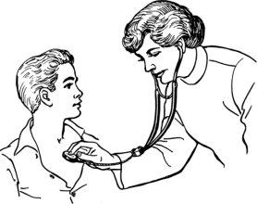





Translating novel technologies from bench to bedside: a legal perspective on the standard of care
Shahad Salman, Ma’n H. Zawati, Yann Joly
Centre of Genomics and Policy, McGill University
Montréal, Québec, Canada

Slide 2
Leucegene project:
Development of two genomic-based tests for patients with acute myeloid leukemia (AML)
Leucegene.ca

Slide 3



How to integrate the two novel genomic-based tests in the clinical setting?
Novel technologies need to be recognized as part of the medical standard of care

Slide 4

What is a standard of care?
What are the criteria and how are they proven?
What are the challenges for the recognition of a novel genomic based test as a standard of care?
How to facilitate a bench to bedside translational continuum?

Slide 5

Scientific meaning
What is a standard of care?
Medical discussions amongst physicians/researchers referring to medical and scientific best practices.

Slide 6
Legal meaning
The conduct of a prudent and diligent physician/researcher in the same circumstance.
Objective factors
Subjective factors

Slide 7
What are the criteria and how are they proven?
Objective factors
The average reasonable physician/researcher.

Slide 8
Subjective factors
            Considers specific circumstances;
            Qualification (education and experience) of the physician/researcher;
            Equipment, techniques and other resources available;
            Common use:

Slide 9





How to prove a standard of care?
Precedent
case law
legislation

Slide 10
Scientific meaning
Legal meaning
WHAT
Scientific & Medical Community
Courts & Legislators
WHO
Experts & Scientific Literature
HOW
Objective Factors
Subjective Factors

Slide 11





Slide 12

Challenges
  Continuous new scientific evidence arising from cancer research, especially in the context of genomic research.
Notes:
Dirk C Strauss & J Meirion Thomas, “What does the medical profession mean by ‘standard of care?’” (2009) 27:32 J Clin Oncol e192.
Lucy R Yates & Peter J Campbell, “Evolution of the cancer genome” (2012) 13:11 Nat Rev Genet 795.

Slide 13
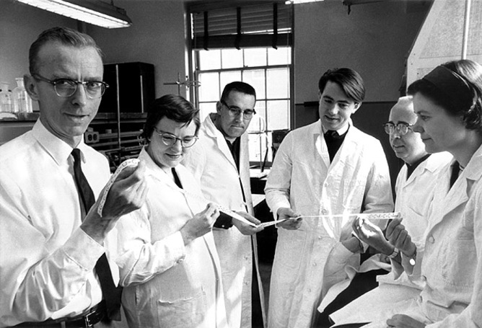
  The difficulty of reaching a scientific consensus (though consensus is not a necessity to establish the standard of care).
MaRS Discovery District/Flickr, https://www.flickr.com/photos/marsdd/2986989396
Notes:
Dirk C Strauss & J Meirion Thomas, “What does the medical profession mean by ‘standard of care?’” (2009) 27:32 J Clin Oncol e192.

Slide 14

  Lack of clinical data on novel tool, an absence of communication among various stakeholders and resistance among certain professionals.
Medscape, online : http://www.medscape.com/viewarticle/812258
  Genomic expertise is concentrated within specific type of scientific and medical specialties.
Notes:
Anick Dubois, Les enjeux de la translation des technologies: le cas des tests de pharmacogénétique au Québec (PhD Thesis, University of Montreal, Faculty of Pharmacy, 2010), online: <https://papyrus.bib.umontreal.ca>.

Slide 15

How to facilitate a bench to bedside translational continuum?
  The scientific use of the term standard of care on a medical test does not directly lead to its recognition as a legal standard of care.

Slide 16

  A good understanding of the legal concept of standard of care is key in facilitating integration of novel tool into clinical care.

Slide 17

  Dissemination of results and providing specific clinical guidelines and protocols are essential for the recognition of a novel technology as a standard of care.

Slide 18

  Implementation can require anticipating validation of their use from the medical community and other stakeholders.

Slide 19

Translational Advisory Board

Slide 20


THANK YOU!
  Me Ma’n H. Zawati
  Prof. Yann Joly
  Dr. Guy Sauvageau
  Dr. Josée Hébert

