Slide 1


Relations matter: A solidarity-based perspective on data-rich medicine
TRANSLATION IN HEALTHCARE-
EXPLORING THE IMPACT OF EMERGING TECHNOLOGIES University of Oxford 23-25 June 2015
Barbara Prainsack
Department of Social Science, Health & Medicine
King’s College London, UK

Slide 2
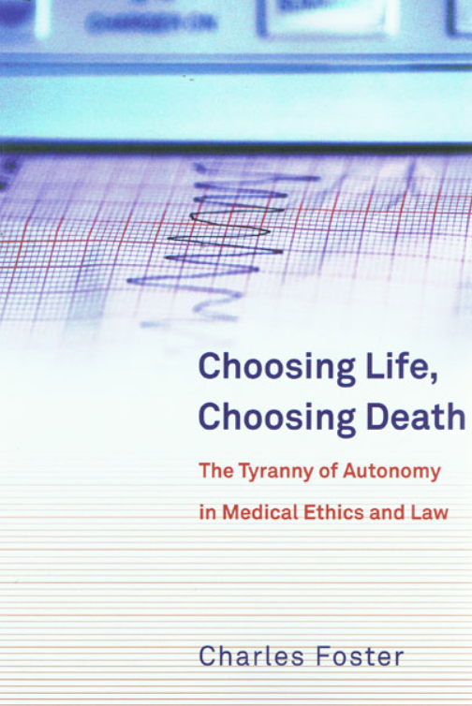
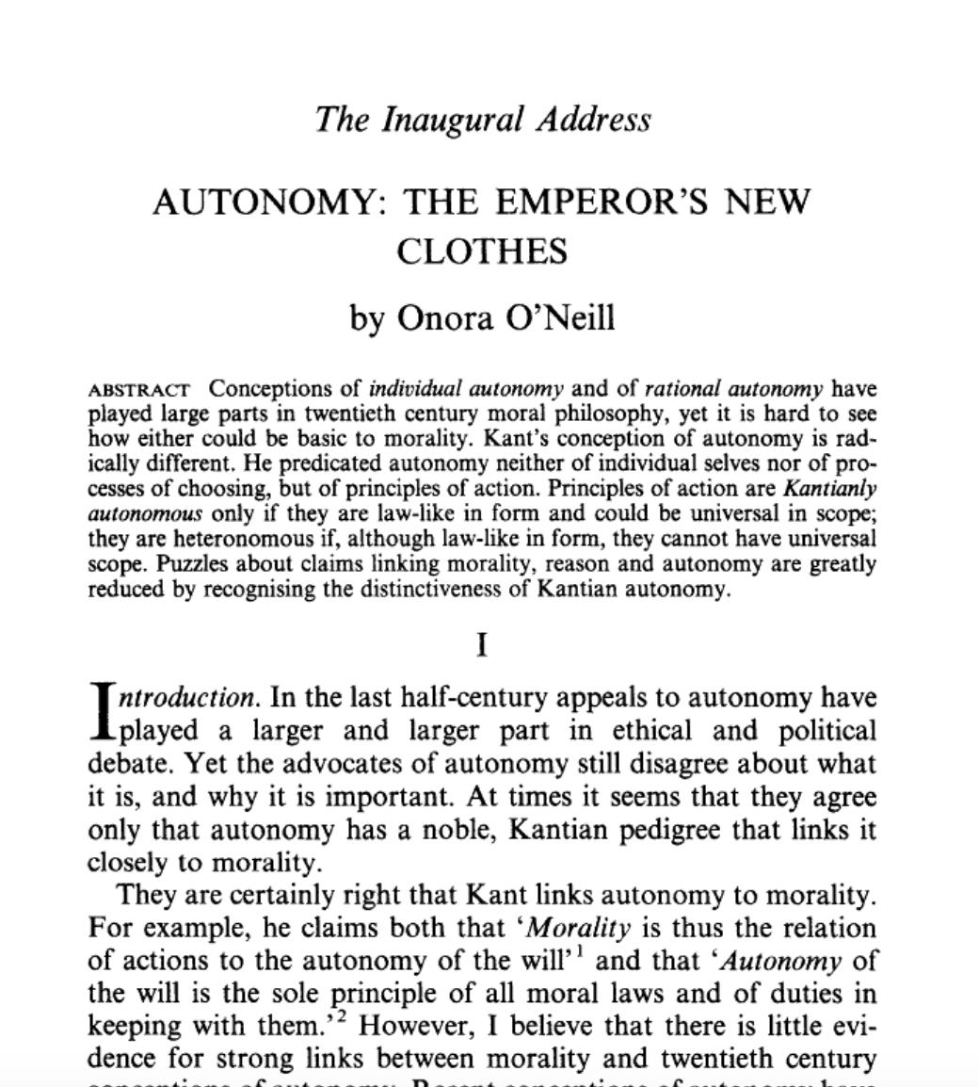

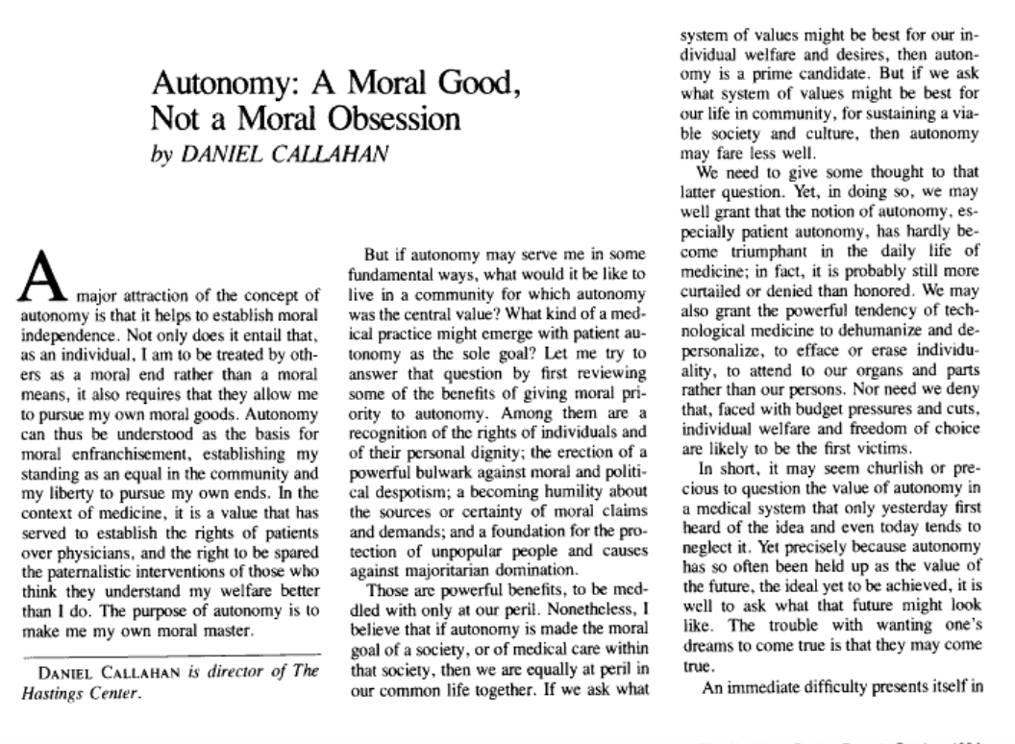
Critique of focus on individual autonomy

Slide 3

Ethical and legal instruments in the field of medicine regularly assume that
Decisions are taken by only one individual, and
Individual practices are typically motivated by self-interest
Reasons:
Methodological individualism in Western thought
Influence of “rational choice” paradigm

Slide 4
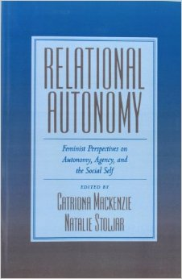
Overcoming methodological individualism - in theory
“porous boundaries of human beings”
[Gisli Palsson]

Slide 5

Overcoming methodological individualism in practice - Solidarity
Image: Jahn Henne

Slide 6
What is solidarity?
“acts carried out to support others”
(K. Bayertz 1996)
“non-calculating cooperation”
(M. Häyry 2005)
“a way of organising social institutions”
(D. Gunson 2009)
“the sort of intersubjective relations required to keep the fabric of modern society intact”
(R. Houtepen & R. Ter Meulen 2000)
Notes:
Bayertz: at least a disposition to help or assist

Slide 7



Our definition:
Solidarity signifies practices reflecting a commitment to carry “costs” (financial, social, emotional, or otherwise) to assist others with whom we recognise similarity in a relevant respect.
[Prainsack, B., & Buyx, A. (2011). Solidarity: Reflections on an emerging concept in bioethics. Nuffield Council on Bioethics.]
Notes:
Practice: 1. not merely an inner sentiment; 2. similarity in a relevant respect (‘community of fate’; ‘fellowship among equals’)
Self- and other-directedness
Persons are inseparable from their social relations
Fellowship: symmetrical relationship in the context of a particular practice (typically not symmetry in all respects)
Reciprocity is not a requirement

Slide 8
Three tiers of solidarity
Tier 3 (contractual level):
legal provisions and contractual norms
Reciprocity
Tier 2 (group practices): manifestations of collective commitment to carry costs to assist others; communities of risk
Tier 1 (interpersonal level):
manifestations of willingness to carry costs to assist others; similarity in relevant respect
blue: practices
grey: institutionalisation

Slide 9
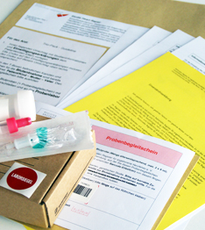
Biobank-based disease research
Genetic information is “personal” for more than one person (G Laurie, M Taylor, H Widdows)
specific consent is increasingly problematic
Privacy and confidentiality cannot be guaranteed (e.g. M Angrist, J Lunshof, G Church, D Vorhaus, etc.)
Research biobanks governance can be unduly bureaucratic and expensive (e.g. P Taylor)
Instrument: Solidarity

Slide 10
Biobanks: Possible solutions
Dynamic, online-mediated solutions: Kaye et al 2012; Saha & Hurlbut 2011. Emphasis on control and choice for individuals; Dove et al: Wiki governance (2012); “tiered consent”
Solidarity-based model: Moving away from individual control as the “gold standard”

Slide 11
Core elements of a solidarity-based approach:
Stronger emphasis on people’s willingness to accept “costs” to help others;
➔broad consent or even open consent
(in a situation where the possible harms are relatively small): Shifting emphasis from risk prevention to harm mitigation
➔e.g. “harm mitigation funds”
Privacy as a collective concern (Mittelstadt & Floridi Cassili) vis-a-vis “Big Brother & Company Man” (J. Kang et al.)

Slide 12
Does this conflict with autonomy?
Veracity (Lunshof et al. 2008) as a guiding principle (“mission statement” as part of the participation agreement; see also S. Cordell)
Reciprocity and transparency

Slide 13
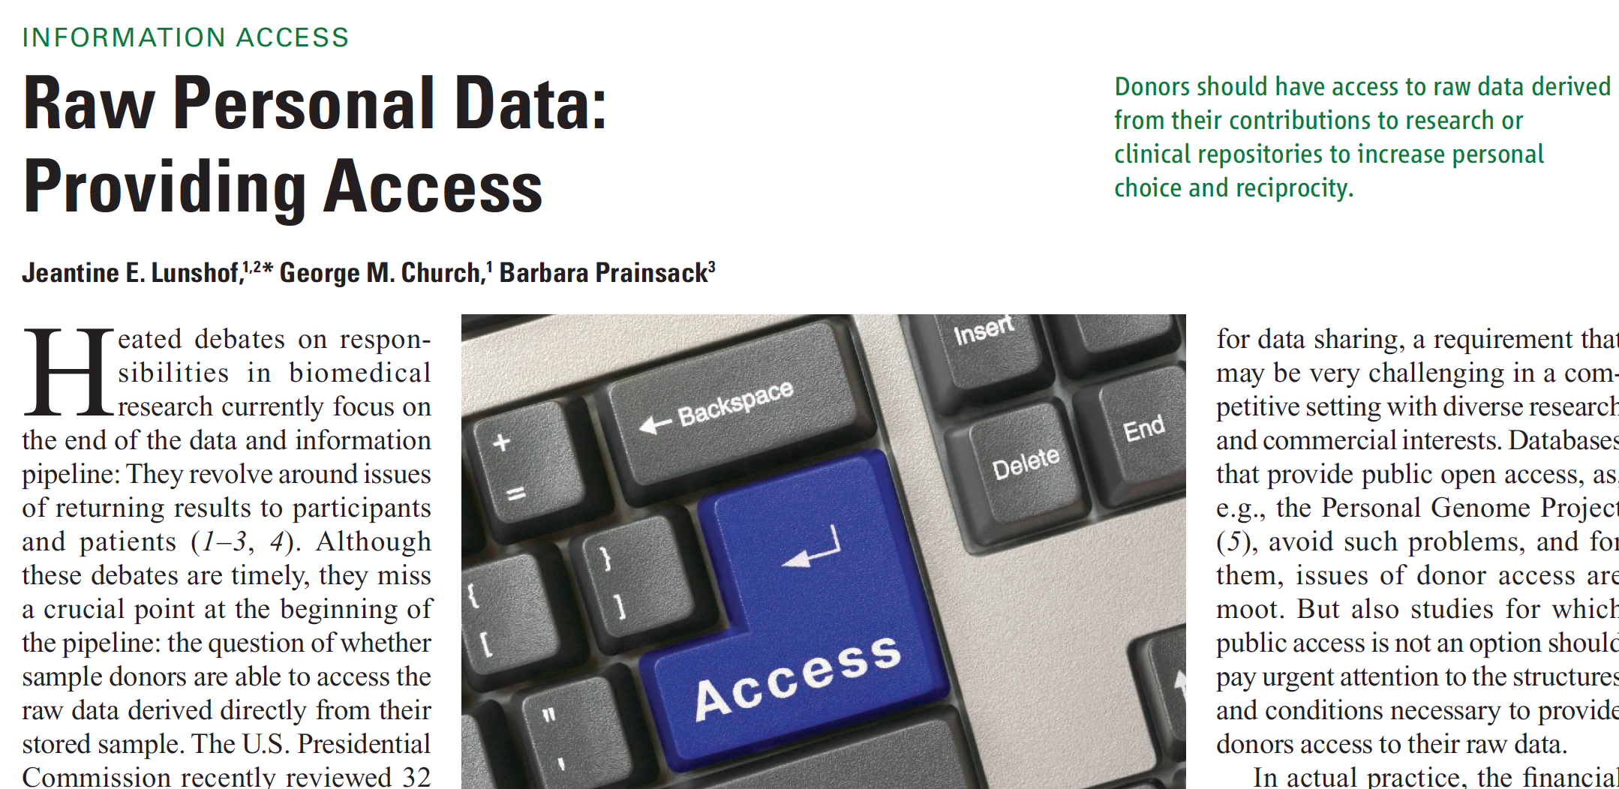
[Lunshof JE, Church GM, Prainsack B (2014). Raw Personal Data: Providing Access. Science 343/6169: 373-374.]

Slide 14
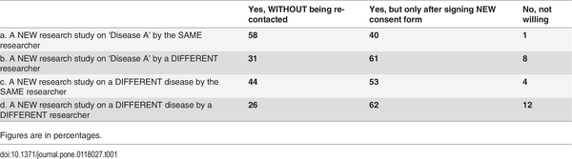

Table 1. Results for question: ‘Would you give your permission for your DNA to be used in…’.
Relations matter!
Kelly SE, Spector TD, Cherkas LF, Prainsack B, Harris JM (2015) Evaluating the Consent Preferences of UK Research Volunteers for Genetic and Clinical Studies. PLoS ONE 10(3): e0118027. doi:10.1371/journal.pone.0118027
http://127.0.0.1:8081/plosone/article?id=info:doi/10.1371/journal.pone.0118027

Slide 15
Conclusion: How does solidarity help?
non-dualist
Enacts “relational autonomy”
Treats privacy and benefit as personal and collective concerns
Foregrounds:
1. What people share in common and not what sets them apart
2. Relationships and meaning
3. Solidarity must not be an excuse for the retreat of public responsibility, or the exploitation or “guilt-tripping” of people

Slide 16

Thank you very much for your attention
Thank you also to:
Alena Buyx
Carrie Friese
Sarah Franklin
Gisli Palsson
Edward Dove
Hendrik Wagenaar
Bob Simpson
Noa Vaisman
NCOB, The Nuffield Foundation, AHRC, ESRC
Comments are very welcome: barbara.prainsack@kcl.ac.uk

Slide 17
Solidarity:
[Prainsack B, Buyx A (2011). Solidarity: Reflections on an emerging concept in bioethics. London: Nuffield Council on Bioethics]
[Prainsack B, Buyx A (2012). Solidarity in contemporary bioethics. Bioethics 26/7: 343-350.]
[Prainsack B, Buyx A (2012) . Understanding Solidarity (With a little help from your friends). A response to Dawson and Verweij. Public Health Ethics 5/2: 206-210.]
[Buyx A, Prainsack B (2012). Lifestyle-related diseases and individual responsibility through the prism of solidarity. Clinical Ethics 7/2: 79-85]
[Prainsack B, Buyx A (2013) A solidarity-based approach to the governance of research biobanks. Medical Law Review 21/1: 71-91]
[ Prainsack B, Buyx A (2014) Nudging and solidarity: Do they go together? Eurohealth 20/2: 14-17.
[ Prainsack B, Buyx A (in press) Ethics of healthcare policy and the concept of solidarity. In: Ellen Kuhlmann, Robert H. Blank, Ivy Lynn Bourgeault, and Claus Wendt (eds). The Palgrave International Handbook of Healthcare Policy and Governance. New York: Palgrave.
[ Prainsack B, Buyx A. Solidarity in bioethics and beyond. Cambridge, UK: Cambridge University Press (2016).

