Slide 1
Public input on priority setting and the high cost of cancer drugs results from a public deliberation event in Vancouver, Canada
Stuart Peacock^{1,2,3}, Colene Bentley ^{1,2}, Dean Regier ^{1,2,3} Helen McTaggart-Cowan^{1,2,3} Sarah Costa^{1,2,3}, Liz Wilcox³, Holly Longstaff⁴, Michael Burgess³
1Canadian Centre for Applied Research in Cancer Control (ARCC)
2Cancer Control Research, BC Cancer Agency
3 School of Population and Public Health, University of British Columbia
4Engage Associates

Slide 2
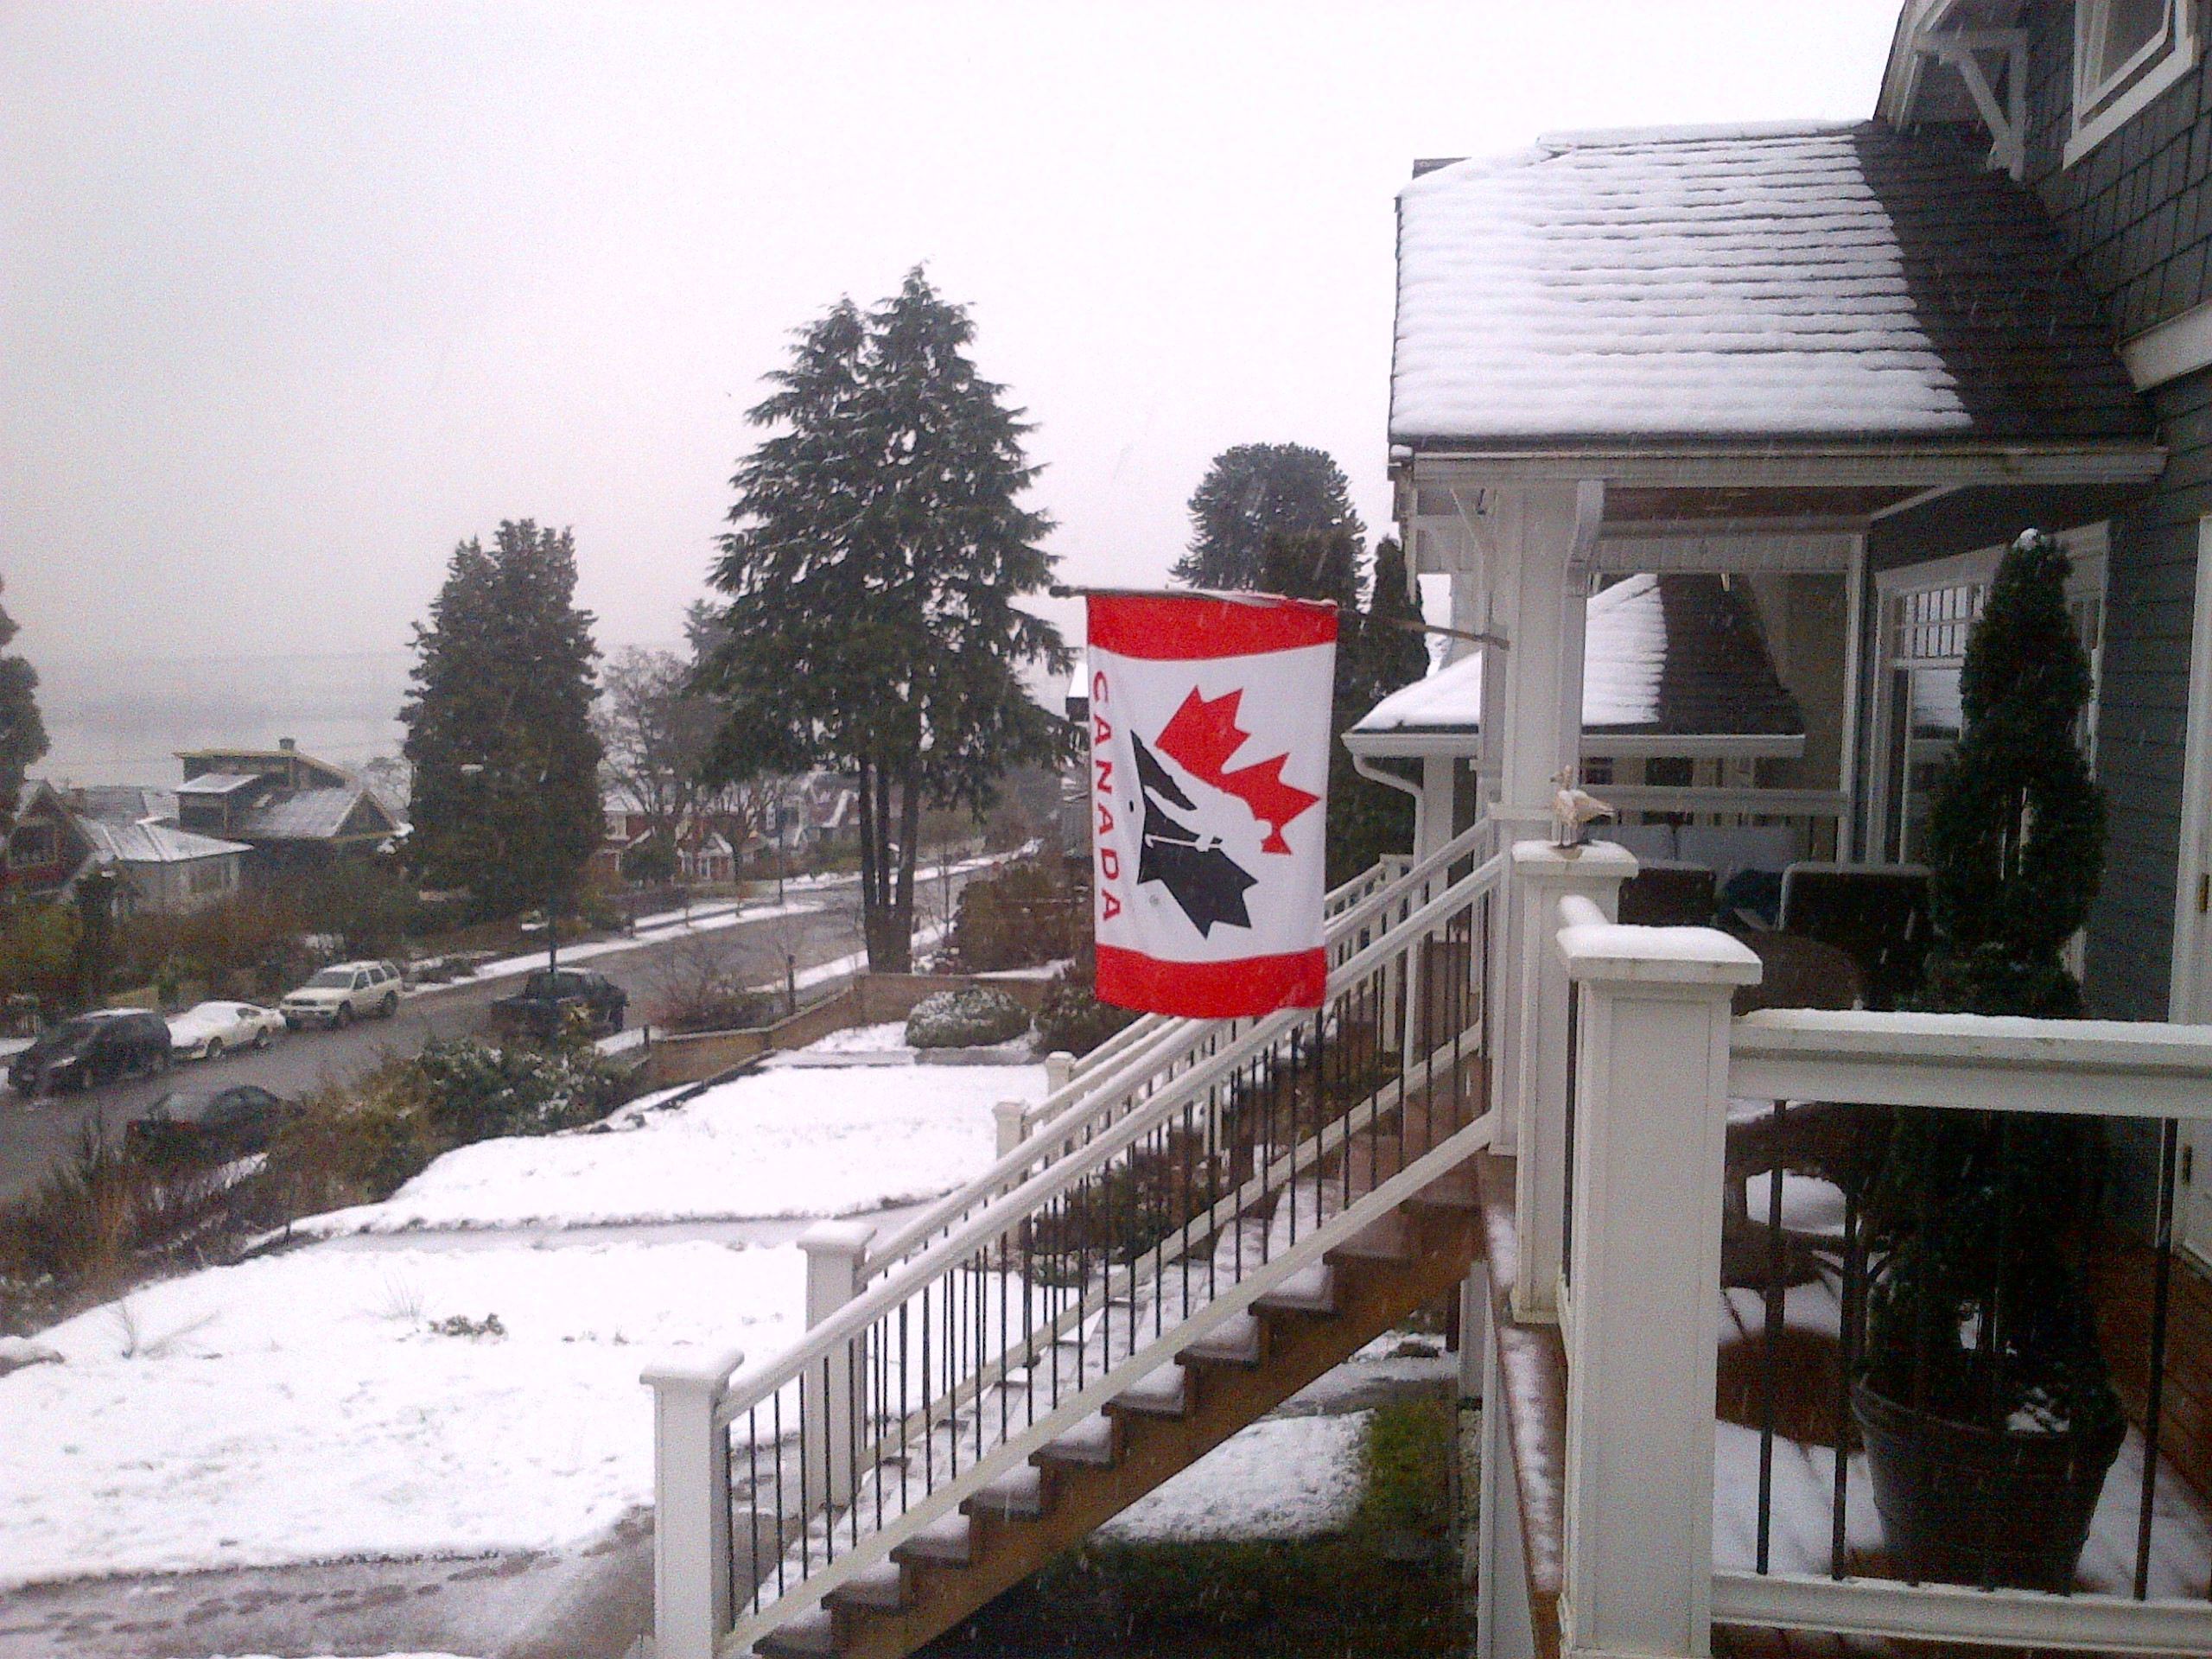

Slide 3




Event Team
Reka Pataky, Sonya Cressman, Emily McPherson, Lisa Scott, Kim van der Hoek
Funders
No conflicts of interest

Slide 4
Overview
Sustainability of cancer control systems
Some results from a public deliberation event in Vancouver, Canada

Slide 5

Cancer 'tidal wave' on horizon, warns WHO
Cancer is the leading cause of economic loss through premature death and disability worldwide - because of the vast sums spent on treatment, but also in lost economic and social activity. In 2010, WHO says the total annual economic cost of cancer was $1.16 trillion (£700bn).
"The global cancer burden is increasing and quite markedly ... If we look at the cost of treatment of cancers, it is spiralling out of control, even for the high-income countries ... Despite advances in the field of cancer research, treatments alone will not be enough to tackle the larger problem.” Dr Chris Wild, Director IARC

Slide 6


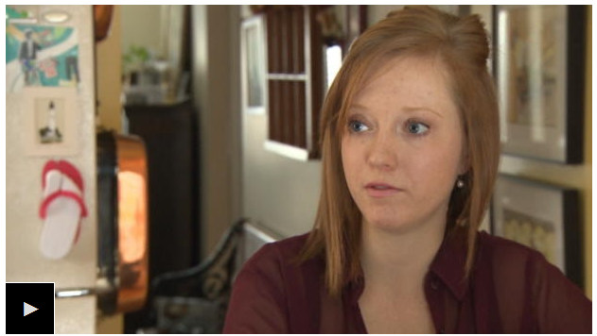
People in Ontario and Atlantic Canada face financial hardship that other Canadians don't when it comes to accessing cancer treatments taken orally, a coalition of more than 30 cancer organizations says.
The group CanCertainty, led by Kidney Cancer Canada, launched a campaign Monday calling for "equal and fair" cancer treatment for all Canadians, no matter what type of medication they're on.

Slide 7

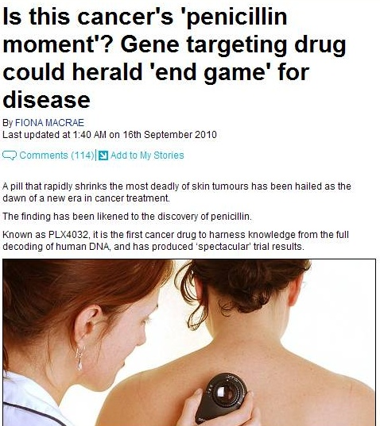

Slide 8
Rising community expectations
At the February 1, 2012 data cut-off, median follow-up was 12.5 months for vemurafenib and 9.5 months for dacarbazine. In patients not censored at crossover, median OS was 13.6 months for vemurafenib vs. 10.3 months for dacarbazine (HR 0.76; P<0.01 post-hoc). In those censored at crossover, OS was 13.6 months for vemurafenib and 9.7 months for dacarbazine (HR 0.76; P<0.001 post-hoc). (BRIM3 Trial presentation at ASCO 2012)

Slide 9

“Dr. Leonard Saltz’s remarks cited statistics showing that the median monthly price for new cancer drugs in the U.S. had more than doubled in inflation-adjusted dollars from $4,716 in the period from 2000 through 2004 to roughly $9,900 from 2010 through 2014. Dr. Saltz cited studies showing that the price increases haven’t corresponded to increases in the drugs’ effectiveness.”

Slide 10
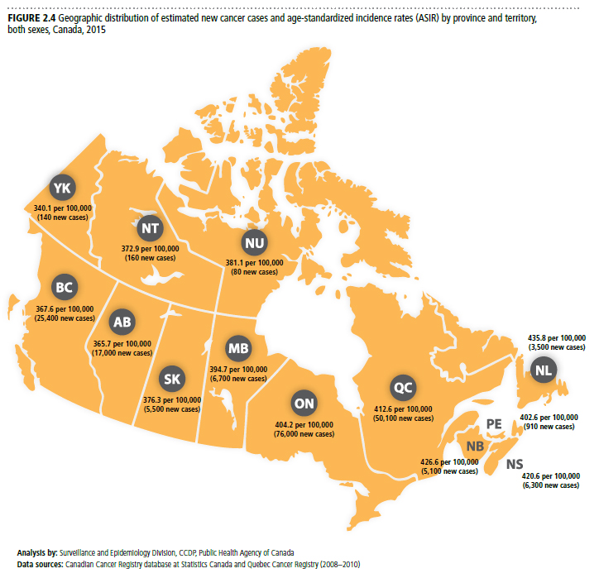
New Cancer Cases and Age-Standardized Incidence Rates 2015
Canadian Cancer Statistics 2015

Slide 11
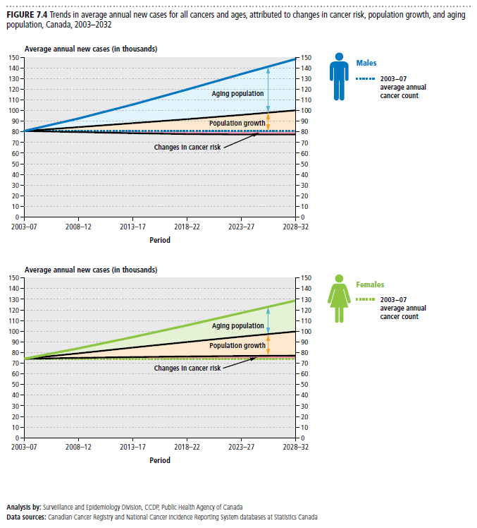
Canadian
Cancer
Statistics 2015

Slide 12
Population projections for BC
The BC population is both growing and aging
Cancer rates are highest in the seniors population (Age ≥ 65) and this population is growing fast in BC
 | Population Increase 2011 to 2027 | % Increase in Population
Non-seniors (Age < 65) | + ~400,000 | +10%
Seniors (Age ≥ 65) | + ~500,000 | +72%
Ryan Wood, Scientific Director, BC Cancer Registry

Slide 13
Projected Cancer Incidence to 2027

Slide 14
Projected Cancer Incidence to 2027
Cancer Site | Observed # of Cases 2011 | Projected # of Cases 2027 | % Increase
Breast (female) | 3467 | 4659 | 34
Prostate | 3397 | 4939 | 45
Colorectal | 2912 | 3994 | 37
Lung | 2842 | 3664 | 29
Lymphoma/Leukemia | 1730 | 2411 | 39
Melanoma | 1001 | 2137 | 113
Other GI | 1543 | 2107 | 37
All Other Cancers | 6937 | 10755 | 55
All Cancers | 23829 | 34666 | 45
Other GI = Liver, Pancreas, Stomach and Esophagus

Slide 15
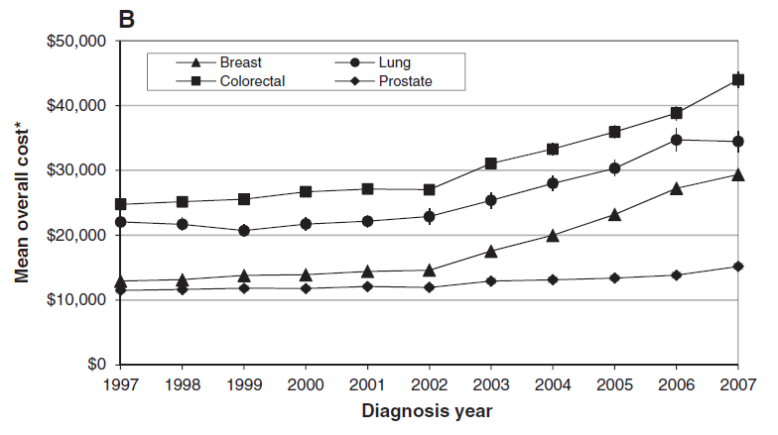
Mean cost after diagnosis
de Oliveira, et al CMAJ Open, 2013
Notes:
Data from Ontario
Health system cost – including hospitalization, ambulatory care, cancer-specific services (chemo, RT, surgery), physician visits, outpatient drugs, home and community care.
Mean cost per patient, for first year after diagnosis
Patients >45 years at diagnosis
Breast and colorectal cost almost doubled over 10-year period; 50% increase for prostate and lung

Slide 16
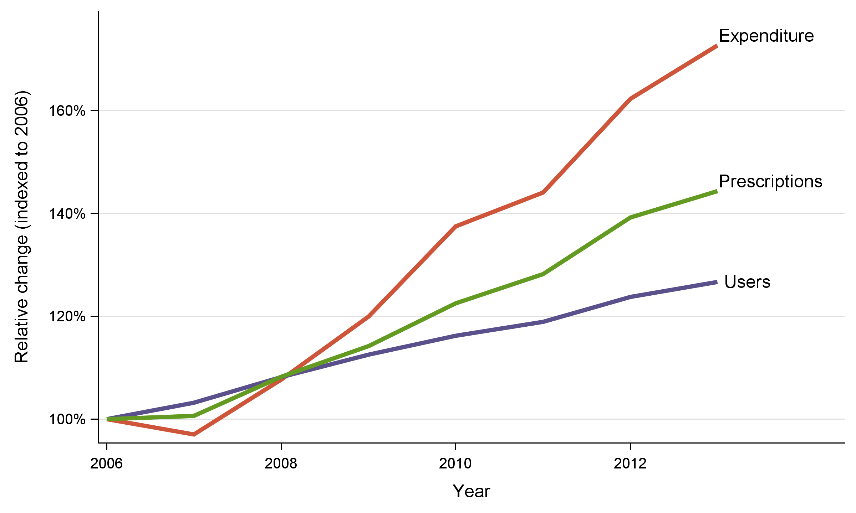
Growth in BC since 2006
73%
44%
27%
Notes:
73% increase in expenditure (constant dollars)
44% increase in prescription volume
27% increase in number of users
Overall expenditure is growing faster than we’d expect based on patient and prescription volume

Slide 17
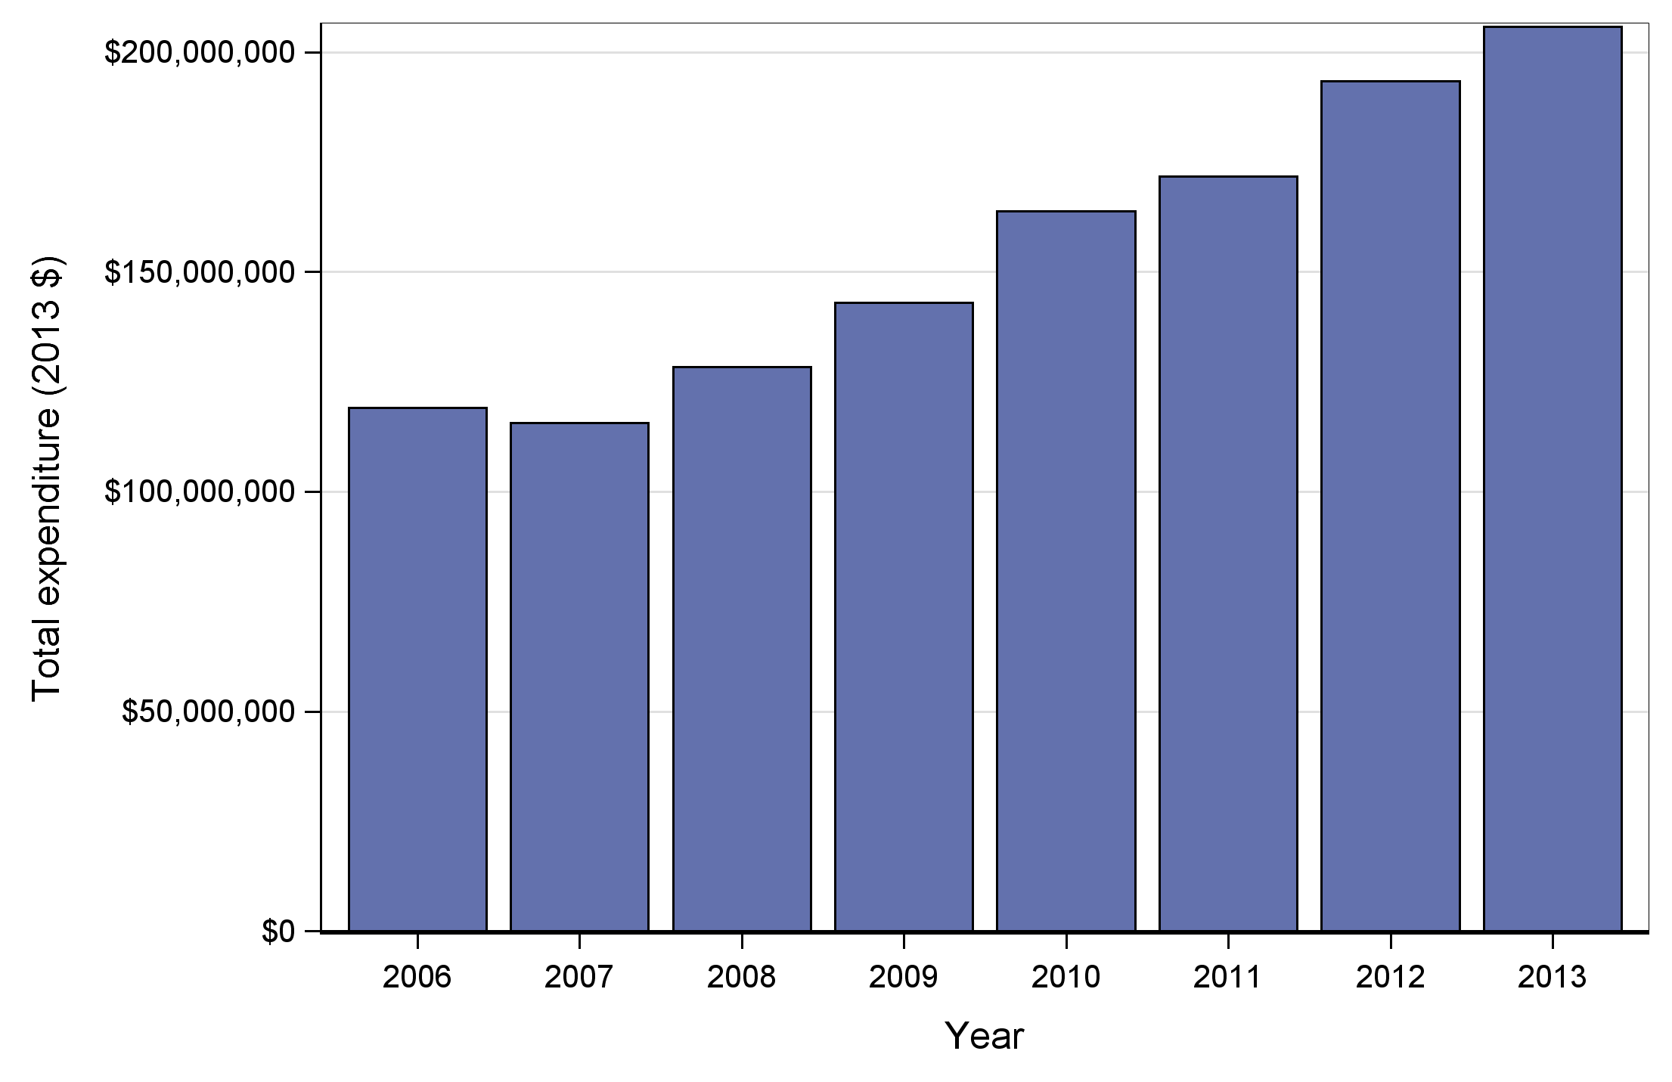
Growth in expenditure 2006-2013
$206m
$116m
Notes:
$206 M in 2013, up from a low of $116 M in 2007

Slide 18
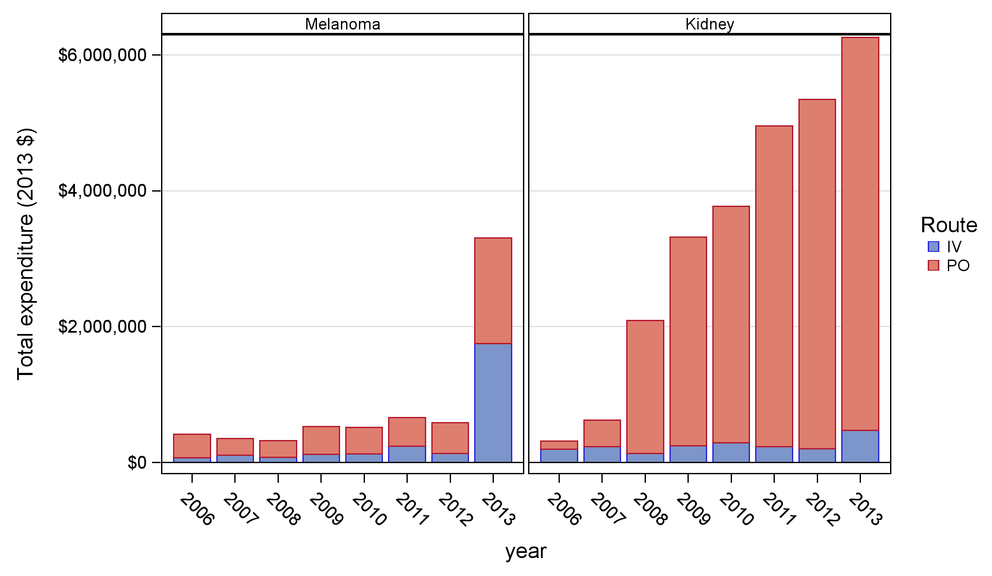
Total expenditure by site
Notes:
Some smaller (less frequent) sites have shown huge growth in recent years

Slide 19
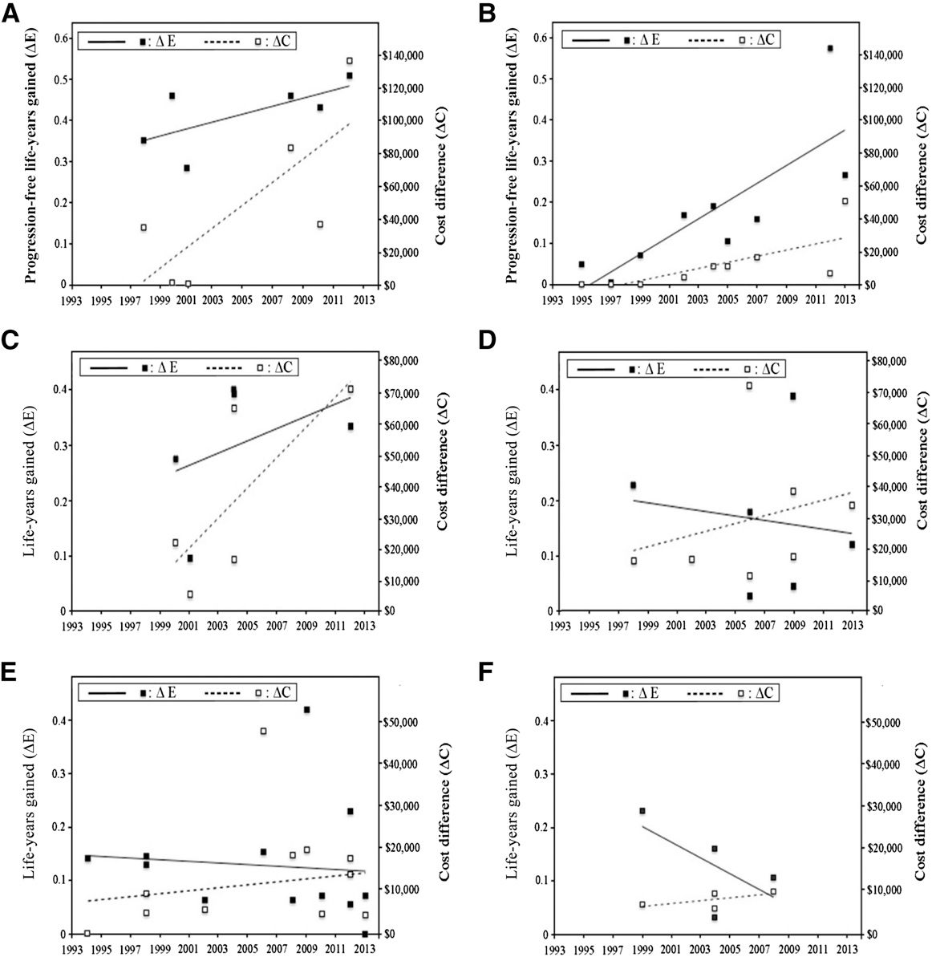

Slide 20
Time-trend for increased efficacy (solid points, solid curve) and increased cost (white points, dashed curve) of FDA-approved oncology drug regimens, relative to pivotal trial-specific comparators. Indications:
First-line metastatic breast cancer
Second-line metastatic breast cancer
First-line metastatic colorectal cancer
Second-line metastatic colorectal cancer
First-line advanced non-small cell lung cancer
Second-line advanced non-small cell lung cancer
Cressman et al, The Oncologist 2015 in press

Slide 21



Slide 22
Q: To what extent do you agree the following inputs should be considered
when setting priorities in cancer control?
Strongly
Disagree
Disagree
Neither agree
nor Disagree
Agree
Strongly
Agree
Percentage ‘often’ or ‘always’ agreeing
Regier et al, Soc Sci Med 2014

Slide 23
Q: When it comes to setting priorities in cancer control,
how often do you use the following inputs?
Never
Rarely
Sometimes
Often
Always
Agree/Strongly Agree Should be included in PS
97%
75%
60%
76%
95%
86%
97%
97%
92%
Percentage ‘often’ or ‘always’ using input
Regier et al, Soc Sci Med 2014

Slide 24
Identify the topic for deliberation
What cancer control decisions might be influenced by informed public input?
Pan-Canadian survey: What are the top 3 cancer control policy decisions that would benefit from PE? (Fall 2012)
Treatment (drugs)
Screening
Equity / Access
Consult decision makers at pCODR, MoH, BCCA, CPAC, Co-Is
Event observers: senior decision makers from CPAC, pCODR, MoH, BCCA
Notes:
For the pan-Canadian survey of decision makers in cancer control, we asked, “In your opinion, what are the top 3 cancer control policy decisions that have (or would) benefit from the degree of public engagement suggested by focus groups or citizens’ juries?” Answer was by write-in response.

Slide 25
What is public engagement?
Public engagement methods: a continuum*
communication consultation participation
Theoretical, practical bases for public engagement
Tenets of liberal democracy
Self governing, informed citizenry
Citizens’ capacity for reasonableness, self revision
Practical
Largest stakeholder; this creates an obligation to consult
Stimulates public “buy-in,” trust, civic spirit
*Rowe and Frewer 2005; Habermas 1962, 1996; Gutman 1996; Benhabib 1996
Notes:
“Public engagement”: refers to the way members of the public are involved in a policy initiative. This can include informing the public of the initiative (“passive” involvement, or one-way communication), seeking the public’s feedback or opinion on the initiative (consultative), and having the public participate in developing the initiative (“active” –reciprocity ).
Citizens’ capacity for self revision: people’s opinions can evolve and change through dialogic exchange with others. This transformative feature of deliberative democracy is crucial and differentiates it from, say, public consultation.

Slide 26
What is deliberative public engagement?
Deliberative public engagement methods*:
A specific form of civic engagement: seeks values-based collective solutions to challenging social problems
Process of learning and exchanging views (cf focus groups)
“Mini public”; include marginal groups; non experts
Free, equal, and respectful exchange of views and reasons for them
Not consensus driven; points of contention captured; ratification
Answers: How can we make the best possible decisions?
*Burgess, 2009, 2012, 2014; O’Doherty, 2008, 2012; Longstaff, 2010; Fung, A 2003
Notes:
The methods we used were developed principally by Mike Burgess, and informed by work from O’Doherty, Longstaff, Fung, Warren, etc. There are other practitioners of PE that use different methods to achieve the goal of collective decisions on policy matters (e.g., Julia Abelson, Marthe Gold, Scott Niemeyer, Susan Goold, Erika Blacksher)
Participants as non-experts: We want them to be experts about their own lives. For example, the deliberative questions were framed neutrally so as not to bias participants’ responses or require them to be experts in medicine, law, health systems, governance or ethics in order to answer them.

Slide 27

Deliberative events
BC Biobank deliberation
Vancouver April/May 2007
Mayo Clinic, Biobanks
September 2007
Rochester Epidemiology Proj.
November 2011
Western Australia
Stakeholders: Aug 2008
Public: November 2008
Salmon Genomics
Vancouver November 2008
BC BioLibrary
Vancouver March 2009
RDX Bioremediation
Vancouver April 2010
Biofuels
Montreal Sept/Oct 2012
Biobank Project Tasmania
April 2013
California Biobanks
LA: May 2013
SF: Sept/Oct 2013
Priority setting in Cancer Control
Vancouver June, 2014
Newborn Screening
California Sept/Oct 2015
Burgess et al. 2015

Slide 28
“Making Decisions About Funding for Cancer Drugs: a Deliberative Public Engagement”
Recruitment (n=24): based on 2006 Census data for BC general population
Informing participants:
Event website: CanEngage.ca
Information booklet
Expert speakers
Event audience:
BC general public (n=24)
Observers: end users from BCCA, MoH, pCODR, CPAC
Research team
Notes:
Successful recruitment: no statistically significant difference between our “target” and “actual” samples (caveat: small sample size)

Slide 29
Structuring a Deliberative Process
24 Demographically
Stratified Participants
Pre-circulated
website &
materials
First Weekend
Information
Expert & Stakeholder
Q&A
Identify hopes and concerns
Emergent
Policy, practice
& governance
Policy
Uptake
Second Weekend
Deliberation
Provide policy advice, noting areas of consensus and persistent disagreement
Reports,
articles & online
materials
12 day break
dialogue &
information
Media and
Public
Uptake
Burgess et al. 2015
Notes:
Get exact questions for each weekend

Slide 30
Key deliberative questions posed to participants
Under what circumstances is there an obligation to continue to fund a cancer drug? (disinvestment)
How much additional duration of life is needed to justify doubling the budget? (explicit trade-off b/w cost and duration of life)
How much additional quality of life is needed to justify doubling the budget? (explicit trade-off b/w cost and quality of life)
What would make drug funding decisions trustworthy?

Slide 31
Key deliberative questions posed to participants
- Participants made 30 recommendations and ratified them
For each recommendation we captured:
- Reasoning behind participants’ collective statements
- Persistent disagreements and reasons for them
Ratification and capturing disagreement: to understand how much strength to read into a recommendation
Notes:
Ratifying recommendations and capturing disagreements: this method allows us to understand how much strength to read into a given area of agreement (e.g., consensus, strong agreement, weak agreement) and to capture the nuances underlying different positions and points of contention. (Cf thematic analysis, which makes it unclear the extent to which certain concerns or “themes” reflect the sentiment of the group as a whole or just a few dominant participants. )

Slide 32
Two recommendations on disinvestment
There is an obligation to continue to fund a cancer drug…
If discontinued funding would have a negative impact on populations in rural communities and others with limited access (e.g. vulnerable populations) YES = All
If it is significantly easier to use compared to other drugs or treatments (e.g. oral vs. intravenous drugs, tolerance) YES = Most
Notes:
Participants wanted to include “for example, oral vs. intravenous drugs” because they knew decision makers were interested in their views on this issues particularly.

Slide 33
There is an obligation to continue to fund a cancer drug…
…if disinvestment has a negative impact on populations in rural communities and others with limited access.
YES = All
DEBBIE: I am thinking about other sub-groups, like maybe people with limited mental capacity, or street people, other vulnerable populations like that. [Day 2, Large group]
Equity of access apart from geographic location
Notes:
Also on Day 4, participants voted unanimously YES to “We have a responsibility to provide oral chemotherapy to those with limited access, mobility, who have special circumstances or are unable to use IV chemotherapy.” These subgroups were defined in the following excerpt from the large group, Day 4:
HOLLY: Yeah, I heard that -- I heard that as well. There's a priority for oral, for people that are in rural communities, I heard First Nations' communities, I heard people that have mobility issues, people that maybe have family obligations. Was that across the board?
VOICES: Yeah.

Slide 34
There is an obligation to continue to fund a cancer drug…
…if it is significantly easier to use compared to other drugs or treatments (for example, oral vs. intravenous drugs).
YES = Most
ABBEY: What if...the new drug [is] take[n] with milk, and all the people who are lactose intolerant cannot take that new drug. So, we are not talking oral versus IV, we are talking about a pill that now needs to be taken with milk... [Day 2, Large group]
“Easier to use” = ability to tolerate new drug,
not simply more convenient
Notes:
YES: 17; NO=4. Capture tolerance of drug, not just convenience.
Strong agreement on this statement. We also captured areas of disagreement...

Slide 35
Public guidance on disinvestment
When disinvesting, priority consideration should be given to:
“Vulnerable populations” - rural, housebound, First Nations, mobility limitations
Patients who cannot tolerate the new drug
ABBEY: “We were really concerned about fairness around the availability of drugs. ” [Day 2, Large group]
Notes:
How much strength to read into a given area of agreement
Capture fairness of access: issues of equity and access for others with limitations.
Equity issues are around options for patients

Slide 36
Trade-offs between cost and additional duration of life
To justify doubling the cost of the treatment, we recommend that:
There needs to be a minimum of 12 months of additional duration of life YES = Most
Notes:
YES=17; NO=5 GOOD ROI
There was strong agreement in both large and small groups on 12 months additional duration of life.

Slide 37
Trade-offs between cost and additional duration of life
Needs to be a minimum of 12 months of additional duration of life.
Day 3, Small group:
JODY: I will say the one thing I have noticed as a group, none of us ha[s] picked the minimum option.
JANET: Yeah.
JODY: We’ve all expected a little bit more.
PETER: Yeah, significant, yes.
JODY: -- significant improvement if we’re going to spend twice as much.
Notes:
Strong agreement on 12 months: People wanted “more bang for their buck” when doubling the budget

Slide 38
Measuring quality of life
Perfect health
100
Tests and diagnosis
98
100
90
86
Stage I localized
80
68
70
Stage II/III early/late locally advanced
60
50
38
40
Stage IV metastasized
30
20
10
Death
0
0
Notes:
Percentage or basis points
To give participants context, Stuart presented this scale on Day 3, Large group: “We can go round the room and ask people how they're feeling today. Most people will probably say somewhere in the eighties or nineties, given a bit of luck. So this will come into play when you're talking about quality of life later.”

Slide 39
Trade-offs between cost and improved quality of life
To justify doubling the cost of the treatment, we recommend that:
There needs to be a minimum of 20 points improvement in quality of life [e.g. from 50 to 70 on the quality of life scale] YES = Most
Notes:
YES = 16; NO = 6
Participants also wanted good ROI if they were to spend twice as much.
Strong agreement on 20 points increase in QoL for 2x budget. Participants also wanted good value for money for improved QoL if they were to spend twice as much.

Slide 40
Governance and trustworthiness
What would make drug funding decisions trustworthy?
There is a need for an independent body that would oversee and review drug funding decisions that involves a variety of people without political motivation (participants were concerned about patronage) YES = Most
An “independent body” = a body that reviews drug funding decisions transparently and without bias
Notes:
YES=16; NO=5
The dissenting votes were largely because participants felt that this recommendation was unnecessary because the conflict of interest point in a previous recommendation covered this issue. The previous recommendations was: “There is a need for transparency around how drug funding decisions are made, what stakeholders are involved, and possible conflicts of interest.” (YES=21; NO=0)

Slide 41
Governance and trustworthiness
There is a need for an independent body that…involves a variety of people
ANNE-MARIE: [W]e are talking…about the independent body that we want to be actually independent. We want them to be a variety of people who are educated and who are not appointed.
SARAH: Non-political motive.
ANNE-MARIE: They’re hired, not appointed.
Concern about hidden agendas of pharmaceutical companies
and patronage appointments.
Notes:
Without bias – Although not directly incorporated into the recommendation, the role of pharmacists, physicians, and the public were frequently discussed together.
DIEDRE: So, and I think the pharmacists are a great resource, because they’re the ones that are interacting with the patients. So that doctor/patient -- or doctor/pharmacist avenue would be a way of getting input from the patients that are actually using the drugs.

Slide 42
Governance and trustworthiness
“…an independent body that oversees and reviews the drug funding decision-making process”
KYLE: Oversee and review.
JODY: [O]versee kind of means they have the right to kind of step in and change things, I think. Whereas if they are just reviewing it and looking for conflicts then they can point those out.
An independent body that reviews and challenges drug funding decisions.
Notes:
Members would need to be free from apparent conflicts of interest including primarily pharma/ drug manufacturer ties, with some participants stating members could not have political influences (i.e., non-partisan)

Slide 43
Governance and trustworthiness: question from the panel
What is an appropriate way to engage Canadians in shared decision-making around drug funding?
ABBEY: Offer an incentive….We’re lab rats looking for the cheese.
VICTOR: I would actually second [her] on that….But after coming here…I get interested, into it. But initially there has to be some kind of incentive…
JODY: [W]hat do I know about cancer drugs? And I came here and I was educated. And I learned, and I was really able to contribute.
PETER: I think we’ve all been touched by [cancer] in some way. And that’s the reason I came.
Monetary incentives and non-monetary benefits of participation
Notes:
This question came from a DM on the final day: how can I engage Canadians on this topic when they are busy with their everyday lives? Something other than going “on the road” and making presentations.

Slide 44


Slide 45
Summary
Strong buy-in from policy makers
Successful recruitment: participants are BC public and patients
Participants’ recommendations represent informed, values-based solutions to current policy challenges
Participants accepted the need for trade-offs – no one said ‘fund everything’
Trustworthiness in funding decisions - patients should be part of a transparent and unbiased (independent) review process.
Building trust: participants would trust the outcomes of similar deliberative engagement processes
Notes:
This summary is high level and is about the event itself, not our specific results.

Slide 46
www.cc-arcc.ca

