Slide 1

Unintended Uses of Health Data: The Need for Robust Democratic Governance
Kieran O’Doherty, Emily Christofides, Jeffery Yen, Wylie Burke, Nina Hallowell, Barbara Koenig, Don Willison
Translation in Healthcare – Exploring the Impact of New Technologies
University of Oxford
23-25 June 2015

Slide 2
In a nut shell
Translational personalised medicine requires large amounts of personal health data
To this end, much effort is directed to building platforms to support organised collections of biological samples and personal health data
There is genuine concern and attention on research ethics and protection of human subjects, … however …

Slide 3


If you build it, they will come
There has been very little attention on potential the broader societal consequences of the existence of so much personal data existing in organised collections
My purpose is to stimulate discussion of these potential consequences with a hypothetical analysis of some of the (non-health research) uses of such organised data collections

Slide 4
Synopsis
What kind of data collections am I talking about?
Possible unforeseen & unintended uses of data collections
What we need to do and think about as we move ahead

Slide 5
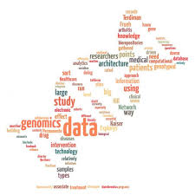
1. Types of Data
Population biobanks, cohort studies, and genome databases
Clinical and public health data
Direct-to-consumer genetic testing
Social media and fitness trackers

Slide 6

i. Population biobanks, cohort studies, and genome databases
Constructed primarily for research purposes
Though note increasing blurring of research and care in precision medicine
Aim to facilitate research relies on long-term storage of data and wide distribution
Significant efforts to share data across jurisdictional boundaries
In spite of calls for strong governance, in practice these resources are situated firmly within the scientific community

Slide 7
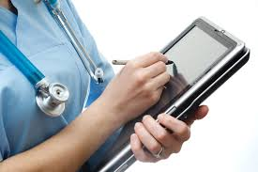
ii. Clinical and public health data
Personal health records
Hospital records
Newborn screening samples and data
Jurisdictional variation in collection and storage
Wide-spread recognition of value for health research

Slide 8
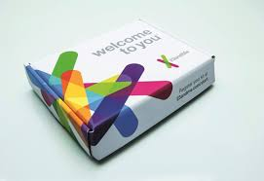
iii. Direct-to-consumer genetic testing
Offered outside of health care system
DNA and personal data provided as part of commercial transaction
In 2012, 86 companies offered genetic tests for purchase
65% had some kind of privacy policy
Of those, 50% related only to use of the website
Business model of many companies relies on the accumulation of data, not sale of genetic test

Slide 9
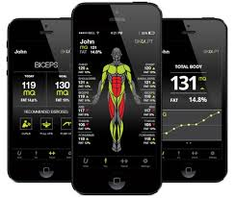

iv. Social media and fitness trackers
Accumulation of personal information more complex and sensitive to individual disclosure decisions
Receiving increasing attention from social scientists, but rarely in context of health info
Many individuals share very large amounts of personal info
Used to infer:
Social security number (Acquisti & Gross, 2009)
Sexual orientation (Jernigan & Mistree, 2009)
Health behaviours

Slide 10
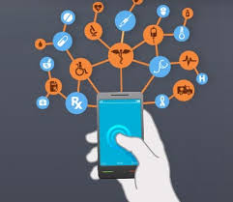
Health data collections
Arguably, collected for good reasons
Purposes:
Clinical care, public health, research, commercial activities, and social networking
Exist under different governance mandates:
Ethics of clinical care, public health ethics, research ethics protocols, commercial contracts
Different time horizons

Slide 11
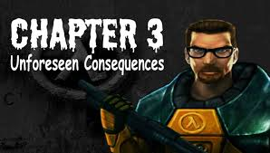
2. Unintended and Unforeseen Uses of Health Data Collections
Law enforcement and forensic (mis)uses
Border security and immigration
Health resource allocations

Slide 12
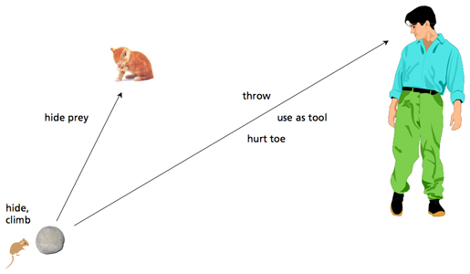
If you build it, they will come
Thinking in terms of affordances
The data structures built for research create possibilities that are of inherent interest to parties other than health researchers
Domestic government departments
Foreign governments
Financial institutions
(incl. insurance)
Other corporate
for-profit institutions

Slide 13
“Given our security design and likely attackers, our situation is something like this. It is as if we had each taken the valuable contents of our homes and deposited them, carefully indexed, in a huge warehouse somewhere in the country. We then give the warehouse owner and his employees careful instructions about who may access and use these valuables. Thoughtfully, the warehouse owner creates a special passage into the warehouse—a “portal”—by which we may access a few of our own possessions if we wish. The builder of the warehouse has equipped it with a very fancy lock (AES with 128- to 256-bit keys) that the owner may choose to use if he thinks he’s in a bad neighborhood. Meanwhile, there are four different large, well-trained, well-equipped, and materiel-hungry armies in easy marching distance. Will the warehouse owner and his employees lay down their lives, or will they open the lock? Or will they discover their warehouse is riddled with secret back doors, or that the armies have really big bolt cutters (secret supercomputers that can do a brute force attack on AES), or that the lock has an equally fancy secret master key?”
Graves, 2013, p. 113

Slide 14
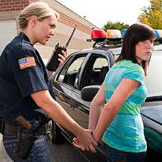
i. Law enforcement and forensic (mis)uses
Storage of NBS
8350 de-identified samples given to researchers without parental knowledge or consent (Waldo, 2010).
800 samples given to the Armed Forces DNA Identification Laboratory (AFDIL) to help create a national mitochondrial DNA database for use in forensic investigation of missing persons and cold cases (Ramshaw, 2010)

Slide 15
Function creep in use of “Big Data”
In law enforcement, once DNA samples have been legally obtained for a specific purpose, it is often unclear whether or not these samples can be reanalyzed and reused for additional investigations unrelated to the original purpose for which the samples were taken.
In the U.S., many states allow for the reuse of DNA obtained in the course of an arrest for one crime, to be used to investigate other crimes or to look for familial matches (Joh, 2014).
The United Kingdom’s National DNA Database (NDNAD) has evolved from a focus on the identification of offenders, to the identification of suspects for unsolved or future crimes (Human Genetics Commission, 2009).

Slide 16
ii. Border security and immigration
In 2013 Toronto author Ellen Richardson, was denied entry to the United States on the basis of a medical history of depression and attempted suicide (CBC, 2013)
She had written openly about her struggles with depression and suicide, but reported to the Canadian Broadcasting Corporation (CBC) that border officials cited her hospitalization for depression in June 2012 as the reason for the denial of entry
Not clear how U.S. border officials gained access to Richardson’s medical history
But revealed that contact with the police through 911 calls is routinely recorded in the database of the Canadian Police Information Centre
Sometimes these encounter reports include information about mental health (Bridge, 2011).
This database is shared with the U.S. Federal Bureau of Investigation and other U.S. security agencies (Hauch, 2013)
Richardson, however, reported that her 2012 hospitalization only involved contact with medical personnel in an ambulance, and not the police

Slide 17



iii. Health resource allocations
Health care resources are finite
Therefore, all health care systems involve rationing
Evidence that pressure on health care systems is increasing
Increasing supply of medical and health treatments (Barker, 2011)
Increasing demand, mainly owing to shift in age demographic

Slide 18

Rationing decisions (genetics)
Genetic data uses for
Setting insurance premiums
Denial of coverage (Joly et al., 2010)
Some countries do have genetic non-discrimination laws
In some instances, have been criticised as too narrow (Van Hoyweghen & Horstman, 2008)

Slide 19
Rationing decisions (microbiome)
Lung transplants for Cystic Fibrosis patients
Burkholderia cepacia complex (BCC) infection associated with adverse outcomes both before and after lung transplantation (de Perrot, et al., 2004)
Many hospitals will not give lung transplants to CF patients infected with BCC
Molecular testing may detect BCC in patients who are clinically free of BCC
Such metagenomic profiling is currently not a part of clinical services, though may be conducted on sputum from CF patients as a part of research

Slide 20
Rationing decisions (behavioural)
Health behaviours (smoking, drinking, exercise, diet) extremely good predictors of health outcomes
Critical health researchers have pointed to increasing tendency to hold individuals responsible for their health behaviours
Bell et al. (2010), stigmatisation of smokers
Consequences re. surgeons, family doctors
Presumption of individual choice versus epidemiological data

Slide 21
iv. Other uses
New forms of eugenics
Home security
Genetic predictors for criminal activity

Slide 22
3. Moving forwards
Big data is here to stay
Current debates about data sharing do not go far enough if they are restricted to short term consequences
Implications of living in a society in which the collection and electronic storage of health data become increasingly normalized
Current protections we might rely on:
Computational safeguards (security, not privacy)
REBs (IRBs)
Anonymisation
Participant-centric (dynamic) consent models

Slide 23
Democratic Safeguards
Governance
Embedded in democratic institutions
First aim, have the discussion
Why are these concerns not articulated and discussed more broadly, even in academic literature?

Slide 24


