Slide 1





Governing internal access to data and materials in large research consortia: A mechanism for facilitating translation?
Dr Michael Morrison
University of Oxford

Slide 2
Overview
What is Translation?
The Innovative Medicines Initiative as a translational enterprise
The challenges of data sharing in consortia
Developing an internal governance policy for StemBANCC

Slide 3
What is Translation?
‘Paradox of innovation’ – strong science base ≠ enough innovations to fuel economic growth and address major societal challenges.
‘broken middle’ of innovation pathways (T1, T2…)
Especially in biomedicine
‘Crisis of productivity’ in pharmaceutical industry
“a broad, often ambiguous, metaphor to describe new ways of organising and funding R&D activities in the biosciences, with clinical application the primary goal”
(Mittra 2013: 103)

Slide 4
The ‘Crisis of Productivity’
“Investment in pharmaceutical research and development (R&D) has increased substantially in the last decades. Disappointingly, this has not translated into a corresponding increase in output in terms of new drugs approved, indicating that therapeutic innovation has become more challenging…” (Vaudano, 2013:1)
Notes:
‘Innovation’ has (passively) become more challenging – not that processes were inadequate – positions innovation as not only necessary but expected.
The other, parallel burden, is the ageing population ‘driving’ healthcare costs – this is positioned as a given fact.
The solution, building on the previous definition of the problem as one of knowledge management.
Imaginaries of networks, ‘open innovation’, knowledge sharing, (echoes of ‘data deluge’ even though big data is not explicitly mentioned here) and of course of ‘precompetitive’ research as a separate, enclosed space where academics and multiple industry partners can work together ‘separated’ from interests in commercial or publication rivalry – a space of ‘common good’
PPP and precompetitive collaboration explicitly blur boundaries between ‘commercial’ R&D and academic research – yet they remain relatively uncontested spaces

Slide 5
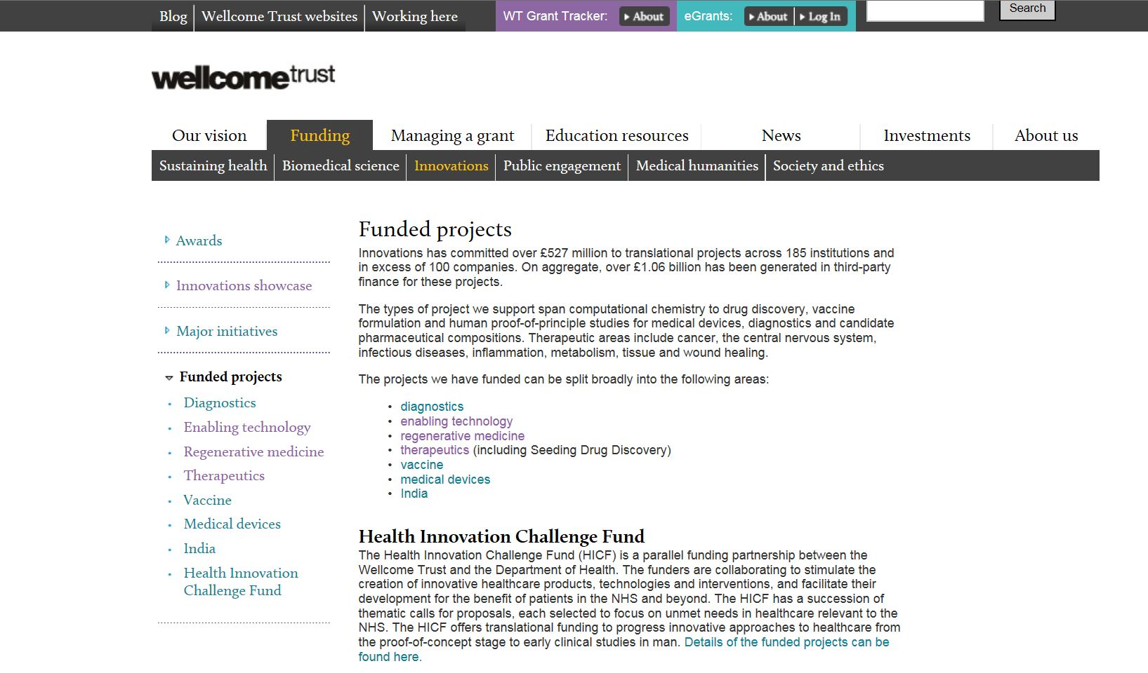
What is Translation?

Slide 6
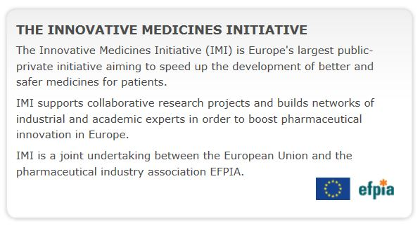
“One approach that has gained momentum in recent years is the establishment of precompetitive public–private partnerships (PPPs), [that] link up the know-how and resources of the pharmaceutical industry with external pools of knowledge, especially in universities and biotechnology companies” (Vaudano 2013: 1)

Slide 7
IMI Phase I
“ the IMI implements R&D programmes that are focused on the development of new tools and methods for the prediction of drug safety or efficacy and more efficient knowledge management.”
(Goldman 2011: 321)
Dates: 2008-2013
Total budget: € 2 billion
European funding: Framework programme 7
Number of ongoing projects: 50
Focus:
Notes:
Imagined benefits – new tools. ‘new technologies such as genomics and stem cells are here reimagined as tools to support particular components of translation – safety, efficacy and knowledge management’. Proposes barriers to translation as issues of knowledge production and management that have technological solutions. This vision of these (diverse) technologies positions them as facilitative of ‘old’ or traditional technologies – small molecule drugs.

Slide 8
Acronym | COMPACT | DIRECT | EUROPAIN | StemBANCC | SUMMIT
Focus | Biopharmaceuticals | Diabetes | Chronic pain | iPS cells for biological assays and toxicology | Diabetes
Partners (Academic) | 14 | 21 | 12 | 23 | 18
Partners (Industry) | 8 | 4 | 9 | 12 | 7
Partners (Total) | 22 | 25 | 21 | 35 | 25
No of Countries | 11 | 10 | 8 | 10 | 6
Duration | 5 years (60 months) | 5 years (60 months) | 5 years (60 months) | 5 years (60 months) | 5 years (60 months)
Total Funding | 30 Million Euro | 43.1 Million Euro | 18 Million Euro | 55.6 Million Euro | 32.6 Million Euro

Slide 9
Challenges for material and data sharing in consortia

Slide 10
Challenges for Large Consortia
“as the number of partners and people involved in the cooperation increases, their cohesiveness decreases and the information sharing becomes even more complex”
(Morandi 2013: 72)

Slide 11
Challenges for Large Consortia
Culture clash?
Novice partners may be unsure about collaboration
Partners with previous bad experiences of collaboration
“even the best technology must be complemented by activities that build trust and understanding through sustained, face-to face social interaction” (Hackett 2005: 668)
Partners with confidential or sensitive data

Slide 12
Developing a governance policy for internal access to data and materials in large research consortia

Slide 13

Bridging the Gap Between Law and Practice
The IMI acts as a broker to negotiate legal frameworks for consortia that stipulate requirements for data sharing, IP etc.
Legal agreements stipulate what must be done, but they do not explain how they should be done.
Requires translation through ‘soft’ governance arrangements such as a data access policy

Slide 14
What does Internal Data Sharing Governance Look Like?
Basic components are Data Access Policy and a Data Access Committee
Describes a human process for storing, sharing and auditing data
Committee membership can reflect different elements in consortium e.g. academic / industry, or charity or patient organisation if relevant

Slide 15
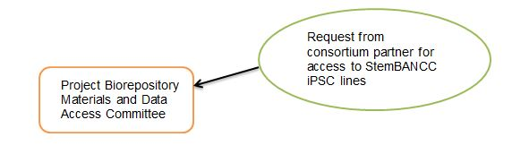
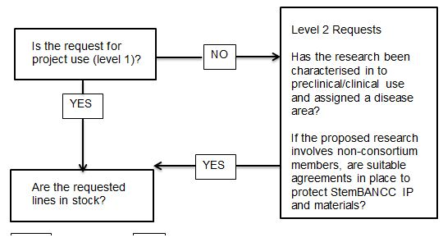
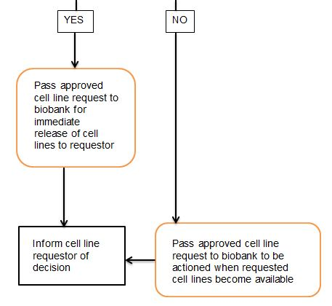
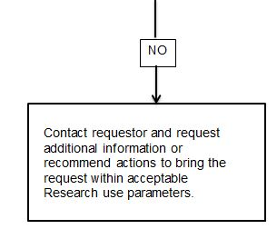
Membership
2 x Academic partners
2 x Industry partners
1 x management representative
1 x ethics and governance representative

Slide 16
Creating the Policy Document
Developed in two stages:
Small group develops basic outline from legal agreement
Then sent out to wider consortium for feedback and iterative development
Sets out role of the committee and mechanism of operation (documents, processes etc.)
Adapt to particular needs of each project

Slide 17

Building the internal governance IS building the consortium

Slide 18
Advantages of Internal Governance
Promotes transparency and accountability
Keeps record for audit purposes (inc. ethics)
Inclusive and fair: all partners contribute, all have a stake in what is agreed
Shifts burden from material holders to the committee
Human component can be flexible – can respond to changing circumstances

Slide 19

Challenges for Internal Governance

Slide 20
Challenges for Internal Governance
Desire for scientific self-regulation
Fear of bureaucracy (delay = distracts from the science = a barrier)
Time management – keep discussions targeted, create other for a for ‘overflow’
Industry lawyers may want to review the policy

Slide 21
Morrison et al (2015) StemBANCC: Governing access to material and data in a large stem cell research consortium. Stem Cell Reviews and Reports DOI:10.1007/s12015-015-9599-3

Slide 22

Acknowledgements
Special thanks to the HeLEX team on StemBANCC, Dr Sarah Coy and Professor Jane Kaye, & to Dr Harriet Teare for sharing experiences of data sharing governance on DIRECT.
Thanks also to the StemBANCC consortium team including all my co-authors on our paper.

Slide 23
References
Goldman, M. (2011) Reflections on the Innovative Medicines Initiative. Nature Reviews Drug Discovery 10: 321-2
Hackett, E.J. (2005) Introduction: Special guest-edited issue on scientific collaboration. Social Studies of Science 35(5): 667-671
Mittra, J. (2013) repairing the ‘broken middle’ of the health innovation pathway: Exploring diverse practitioner perspectives on the emergence and role of ‘translational medicine’. Science & Technology Studies 26(3): 103-123
Morandi, V. (2013) The management of industry-university joint research projects: how do partners coordinate and control R&D activities? Journal of Technology Transfer 38: 69-92
Vaudano, E. (2013) The Innovative Medicines Initiative: A public private partnership to foster drug discovery. Drug Discovery Innovations 6(7): dx.doi.org/10.5936/csbj.201303017

