Slide 1
Policy development and research behaviour: a funder’s perspective
Translation in Healthcare Conference
25 June 2015
Katherine Littler

Slide 2
Scope of talk
Accelerating the translation of research into health benefits is a core feature of the Trust’s mission
Discuss 2 policies that are relevant to this:
Health-related findings (development)
Data Sharing (implementation)
Our Policies designed to:
Respond to needs of research community
Reflect changing ethical, behavioural and social norms
Be agenda setting (i.e. open access)
Change research practice
Have global application
Notes:
Flavour of some of the issues we consider when working on a policy – major challenges is how we

Slide 3


Framework on health-related findings in research
Incidental findings: “a finding that has potential health or reproductive importance, which is discovered in the course of conducting research, but is beyond the aims of the study”
Wolf et al J Law Med Ethics (2008) 36: 219
Pertinent findings that relate to the aims of the study
All types of studies: imaging, genetics, physiological measurements
Findings with known clinical significance or relevance, not new research observations
Individual not aggregated findings
Notes:
This is a ‘framework’ not just a policy. This was a deliberate move, we have deliberately taken some of the considerations out of researchers hands by providing that operational detail.

Slide 4


Project background
Mandate from the Research Community
Frontiers meeting: “Genome-Wide Association Studies and Ethics” (July 2008)
Journal of Law, Medicine and Ethics series on incidental findings (summer 2008)
Wellcome Trust Board of Governors workshop (May 2009)

Slide 5

Project background
Literature review: legal and ethical implications of incidental findings (March 2009)
Policy analysis (2009-10): UK and international; across disciplines
Assessing the time and cost implications of feedback (Summer 2010)
Stakeholder workshops (September 2010; June 2011)
Public attitudes to health-related findings (April 2012)
Workshop on legal issues (March 2013)
Notes:
Launched March 2014 – draft went out for consultation and had workshops – included participant representatives

Slide 6
Thinking behind the Framework
Guidance needed due to legal uncertainty and lack of evidence and consensus on how HRFs should be handled
Public demand and important ethical issue
‘One size fits all’ approach not appropriate:
Lack of evidence
Different research contexts
Balance of public and individual harms and benefit must be assessed on a study-by-study basis
Principles-based, not prescriptive

Slide 7
Expectations of researchers
Have a policy on whether or not HRFs will be fed back to individuals that can be clearly articulated, and be able to demonstrate the reasoning behind their policy to research participants, funders and the Research Ethics Committee
Include clear information on the study policy on the feedback of HRFs in the consent process
In cases where the policy is to provide individual feedback on HRFs, develop a robust, practical feedback pathway that is adequately resourced

Slide 8
Issues and further work
Managing participants expectations – impact of therapeutic misconception
Who pays? Who has responsibility? – Participant shouldn’t be stranded as they become a patient
Duty of care far from clear as researchers increasingly work in a clinical setting
Ascertaining the effectiveness of the framework
Building the evidence base – funding in this area

Slide 9

Data Management & Sharing Policy
Data management and sharing policy published 2007 (updated in 2010):
maximise access to research data with as few restrictions as possible
requires data management & sharing plan, where research likely to generate data of value as a resource for the community
commit to review and support costs of plans as integral part of the grant
Reviews to date have suggested:
quality of DMPs variable, but evidence that they are improving
not clear that resource implications of plans being adequately considered or provisioned
post-award tracking remains a challenge
Notes:
Not going to make the case for data sharing as the importance has been emphasised by other speakers across this conference – Gill McVean’s slide – 5,000 to 500,000 powerful example
The Trust data sharing is a key area of policy – 10 people in policy – 7 people work on some facet of it

Slide 10


Building an enabling environment
there are significant barriers & constraints to overcome:
Infrastructural issues
Cultural issues
Technical issues
Professional issues
Ethical issues
different disciplines at very different stages; different types of data raise distinct issues
challenges will require funders to work in partnership, with each other & other key communities

Slide 11

Working in partnership – some of our current initiatives
Expert Advisory Group on Data Access – advice on emerging issues relating to data access across genetics, epidemiology and social sciences
Clinical Trial Data – funded programme of work with IOM and seeking to build an international consortia to support access to trial data
Public Heath Research Data Forum – global cross funder initiative to increase access to research data generated by public health and epidemiology research
Notes:
Includes looking at negative findings

Slide 12

Key priorities 1: Data discoverability
Report to examine potential models for enabling data discoverability published July 2014
Key conclusion: it is a solvable challenge – with exemplars in other fields that could be applied
To address this it is critical that we:
Link up existing pockets of activity
Embed good practice in metadata use
Address related issues in relation to incentives
Funders considering next steps – welcome feedback from community
http://www.wellcome.ac.uk/About-us/Policy/Spotlight-issues/Data-sharing/Public-health-and-epidemiology/WTP054675.htm

Slide 13

Key priorities 2: Incentives & culture change
Report by Expert Advisory Group on Data Access (May 2014)
Research culture and environment not perceived to provide sufficient support or rewards for data sharing
Key recommendations focused on:
strengthening processes for review and tracking of data management plans;
providing more explicit recognition for high quality data outputs in key assessment processes (especially REF)
recognising and building career paths for data managers
enhancing key data resources
http://www.wellcome.ac.uk/About-us/Policy/Spotlight-issues/Data-sharing/EAGDA/WTP056496.htm

Slide 14
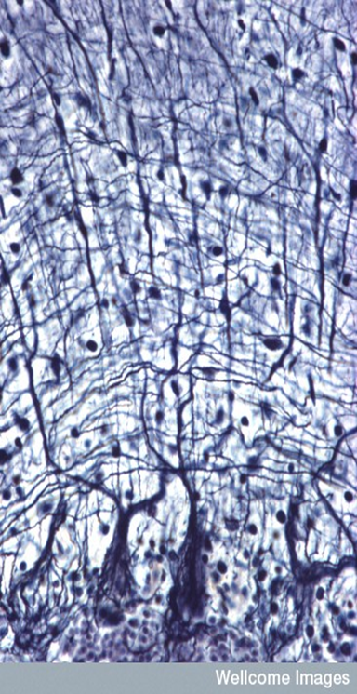
Key priorities 3: Data governance and public trust
data access must balance maximising use of data with need to safeguard privacy of research participants
several ongoing activities – for example:
EAGDA developed recommendations to Funders on managed data access
Research to explore views of research participants and others in LMICs on data sharing
need for ongoing public dialogue to build trusted governance systems

Slide 15

Key priorities 4: Data resources
High quality resources exist for some data types (e.g. EMBL-EBI) but sustainable funding is a key challenge
Many areas of biomedical and life sciences do not yet have established community data resources
High reliance on local/institutional level resources
Rapid growth of ‘unstructured repositories’ – e.g. FigShare, Dryad
No clarity yet around optimal long-term solution…

Slide 16

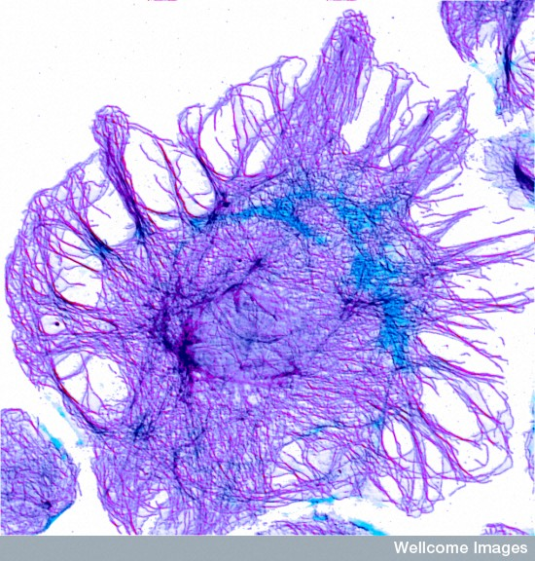
Final thoughts
Questions about how we monitor/enforce sanctions – incentives vs sanctions
Uneven playing field - How do we make context appropriate policies (equity)
How we interact with community, where we lead, and where should we look to the community to lead.
Key challenges - Commercial usage, data sharing in epidemics
Holistic approach – can’t make a data sharing policy in insolation
It’s messy, it’s difficult – practice is still emerging but we think it is worth it
Notes:
Uneven playing field – issues of engagement, international

