Slide 1

Citizen Science: Mapping Values and Relational Ethics in Crowdsourcing in Genomic Research
Sandra Soo-Jin Lee, Ph.D.
Stanford University
Stanford Center for Biomedical Ethics
Stanford Center for Clinical and Translational Research and Education
Department of Pediatrics
sandra.lee@stanford.edu

Slide 2
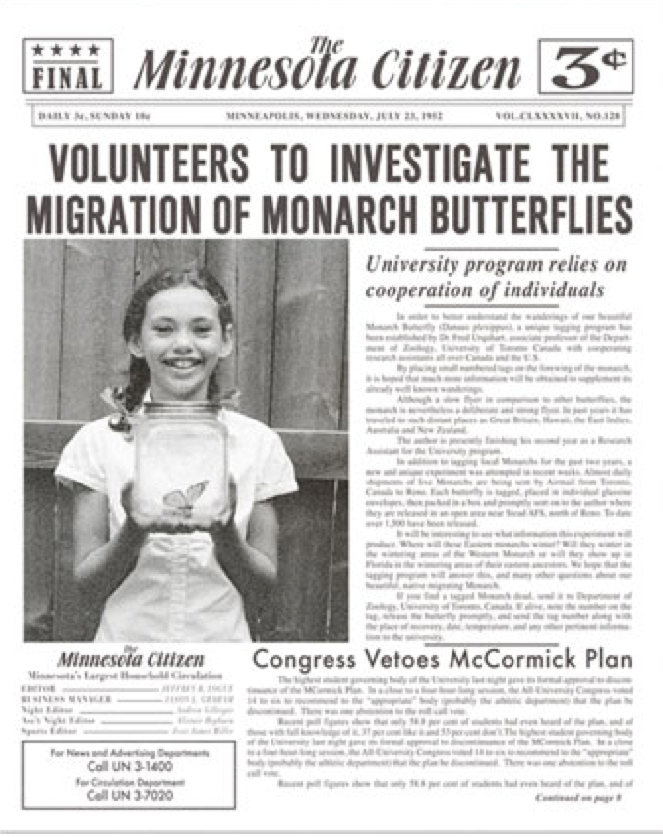
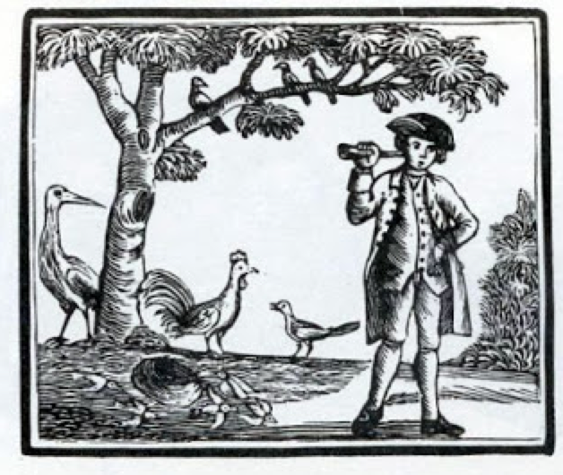
Public contributions to science- not new
Notes:
Gilbert White, regarded as England’s first ecologist, was a priest who kept detailed records of the plants and animals in his neighborhood in the 1700s. Those notes were then turned into The Natural History and Antiquities of Selborne, which is considered one of the earliest texts to record phenology.
Norah Urquhart posted ads in newspapers calling for volunteers from all over Canada and the United States to help tag butterflies, in an effort to track the butterfly routes in the hope of discovering the Monarch overwintering sites. The volunteers were called Citizen Scientists and the group became known as The Insect Migration Association.

Slide 3
Defining Citizen Science
“Volunteers collect and share data that can be
analyzed by scientists, project participants, or both.”
“Citizen science can be seen as a way ‘real scientists’ leverage the labor of large numbers of people distributed widely, or a way to leverage the brains, experience, and insights of the world’s people to advance understanding.”
Cornell Lab of Ornithology

Slide 4
Expertise
“the historical constitution of the expert/lay divide, the question of who possesses cultural competence is ‘one of the most obvious means by which we, and people in the past, discriminate between ‘science’ and ‘the public.’”
Epstein 1996: 417
Notes:
Boundary between those with expertise and those that don’t is implicit in how we think about the public; who has the authority to do science

Slide 5
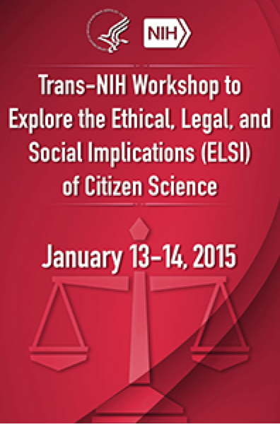
National Cancer Institute (NCI), the National Human Genome Research Institute (NHGRI), and the National Center for Advancing Translational Sciences (NCATS)

Slide 6
Goals
To identify prominent ELSI issues associated with various types of citizen science research projects (for consideration by NIH policymakers and for use by investigators leading such projects).
To identify gaps in ELSI research on citizen science relevant to NIH’s mission.
To plan for continued, expanded engagement of citizen science and bioethics communities to further develop criteria and guidance for NIH citizen science research activities.

Slide 7
Motivations for Participation
Egoism
Collectivism
Altruism
Principlism
Bonney et al. 2009

Slide 8
Egoism
The data volunteers provide enhance my research
Collaboration with scientists enables me to open my horizons to new ideas and knowledge

Slide 9
Collectivism
Collaboration with volunteers can be helpful to others in the scientific community
Collaboration between scientists and scientific volunteers is necessary to reap public benefits

Slide 10
Collectivism
“This is pretty much a game changer. If we pool of our raw data together and work with scientists, we can speed up research, which in the end is what we all want, right? The bigger the database, the better. Basically, we are all in this together- and something has got to change.”

Slide 11
Altruism
Collaboration with volunteers helps educate them about scientific methods
Contributions by volunteers is beneficial for scientists and the public

Slide 12
Altruism
“From my perspective anyway, this just wasn't about me. I wanted to see if I could leave a positive contribution to help others. Can I do anything to help everyone else? You see such misfortune around especially with health, and I thought, well, do I have anything that I can help solve some of these problems because it seems like we are making such great progress medically. I wanted to see if I could also assist with that and I wanted to donate my genetics.”

Slide 13
Principlism
Collaboration with volunteers is worthwhile because all scientific knowledge should be accessible to everyone, regardless of their expertise
Participation in science should be made directly available to the public and those outside of the scientific community

Slide 14
Principlism
“And for those of us who do want to have access and do want to take control of our health, we should be allowed to. I think most people don't want this type of thing going in their medical records. My family members certainly don't want anything to end up in their medical records, so if you go through a doctor, it automatically ends up in your medical record and then there's the potential of discrimination. And if you do it directly, nobody has access to it but you. You should be allowed that right.”

Slide 15
Emerging Relationships
Contributory projects
the public are recruited into projects conceived and designed by scientists
Collaborative projects
scientists work with the public to collaborate on research design in addition to enabling the public to contribute data
Co-created projects
scientists and the public are involved in each phase of the research, beginning with its conception and following through to co-publication
(Rotman et al. 2012)

Slide 16
New Norms for Genetic Data
Access to data is an end in itself, not the role of the service provider, but of the end user, to decide on the utility of the data.
Data flows are bidirectional from the service provider to the user but also vice versa.
Data analysis and interpretation can come from participants, not only data contributions, the definition of expertise is changing.
Exchange of data and information occurs within a growing nexus of relationships.

Slide 17
Ethical Dimensions of Citizen Science
Educative Dividend
Affiliative Capacity
Exit
Resource Control
Voice
Visible Metrics/Gaming
Goals and Tasks

Slide 18
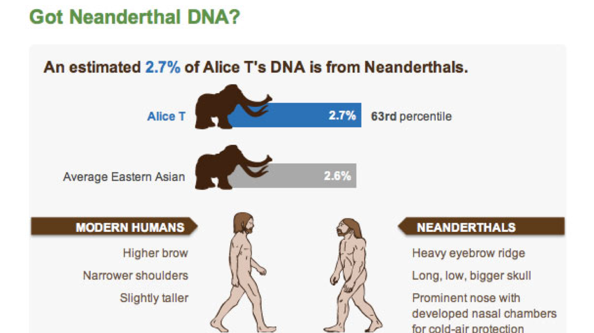
Educative Dividend/Self Discovery
Learning something new and valuable
Who is able to participate? What level of expertise?
Who curates the data? What is the nature of quality control? How are standards created?
What are the limits for “repurposing” and mining shared data in the name of “discovery”?

Slide 19
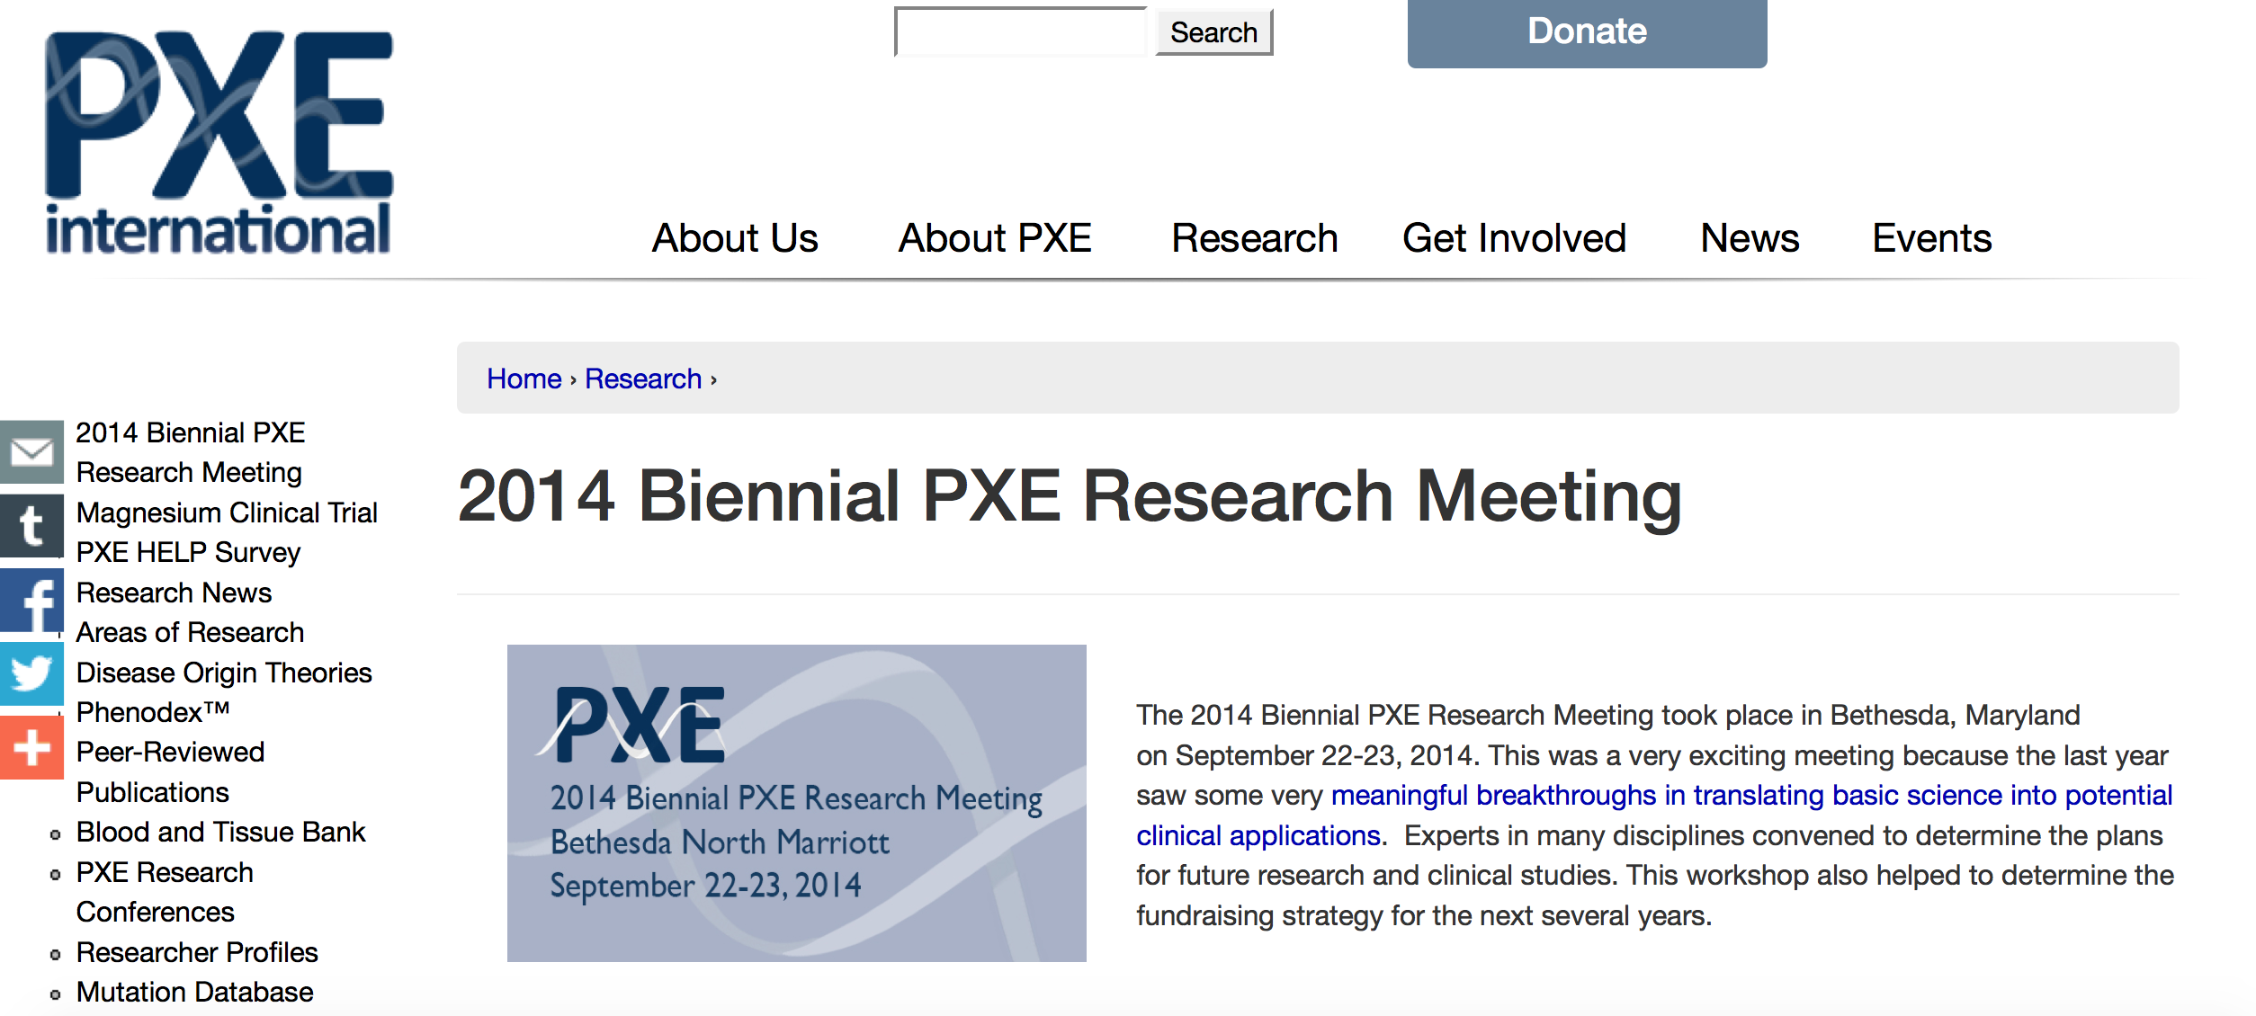
Goals and Tasks
^{Participants not}
^{only undertake}
^{tasks but help set}
^{goals}
How are goals determined? Who sets the agenda?
Who participates in research design?
Who determines what the results mean?
How are results published? What constitutes acknowledgment and responsibility?

Slide 20
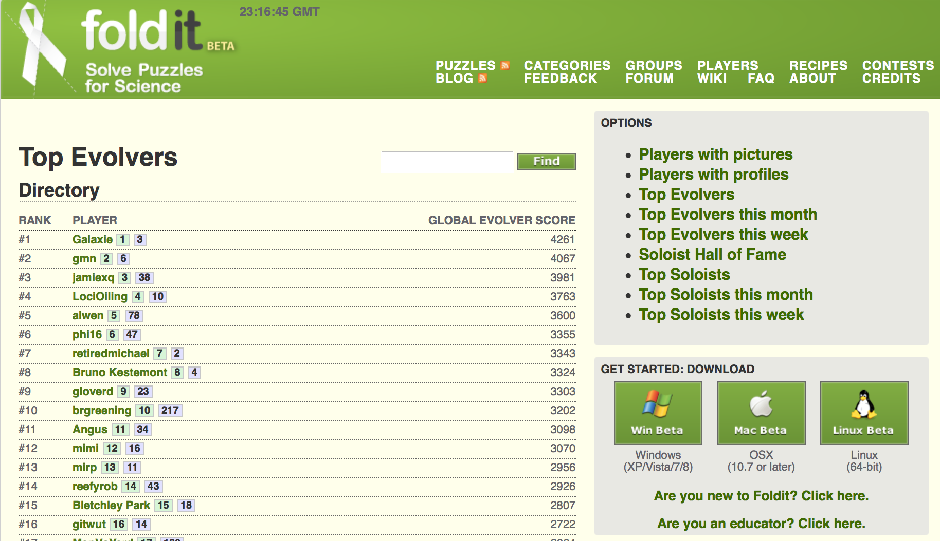
Visible Metrics/Gaming
Empirical demonstrations of the connection between participation and outcomes
What constitutes compensation for “participation”?
Are there issues with blurring of “work” and “play”?
Should we care whether it is a corporate entity or non-profit sponsoring the games?

Slide 21

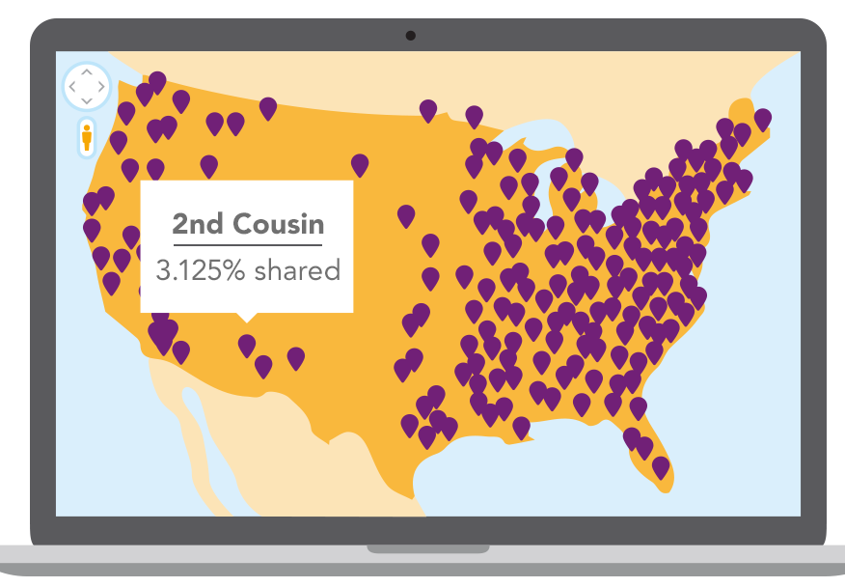
Affective/Visible Communicative Capacity
Participants have opportunities to to produce affect, affiliation, and sociability
What are expectations in the flow of information?
What should participants know about the limits of privacy and data security?
Should there be oversight of dissemination of “expertise” and self-research activities?

Slide 22

Resource Control
Participants get to control (own or use) resources, not merely produce them.
Who owns pooled resources? Are institutional interests apparent?
How does the ethos of open sharing impact the desire for control?
How is data protected and secured?
What rights do third party platforms have to resources?

Slide 23
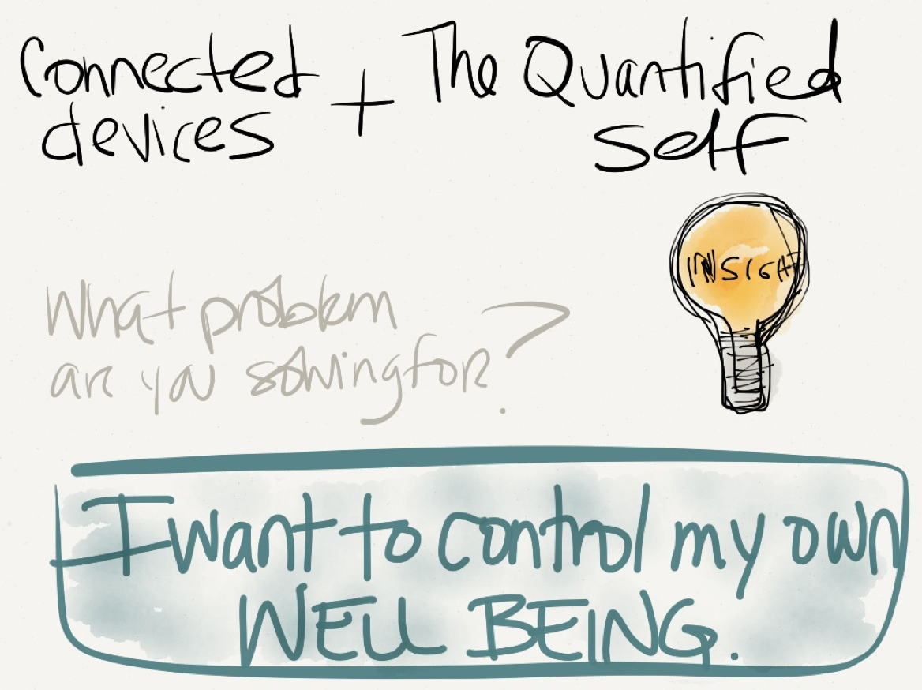
Voice
Opportunities to 'speak back' in order to influence use of data
What are the rules of engagement?
What are effective models for “speaking back”?
What is the obligation to hear?
Whose voices? How diverse and representative are participants?

Slide 24
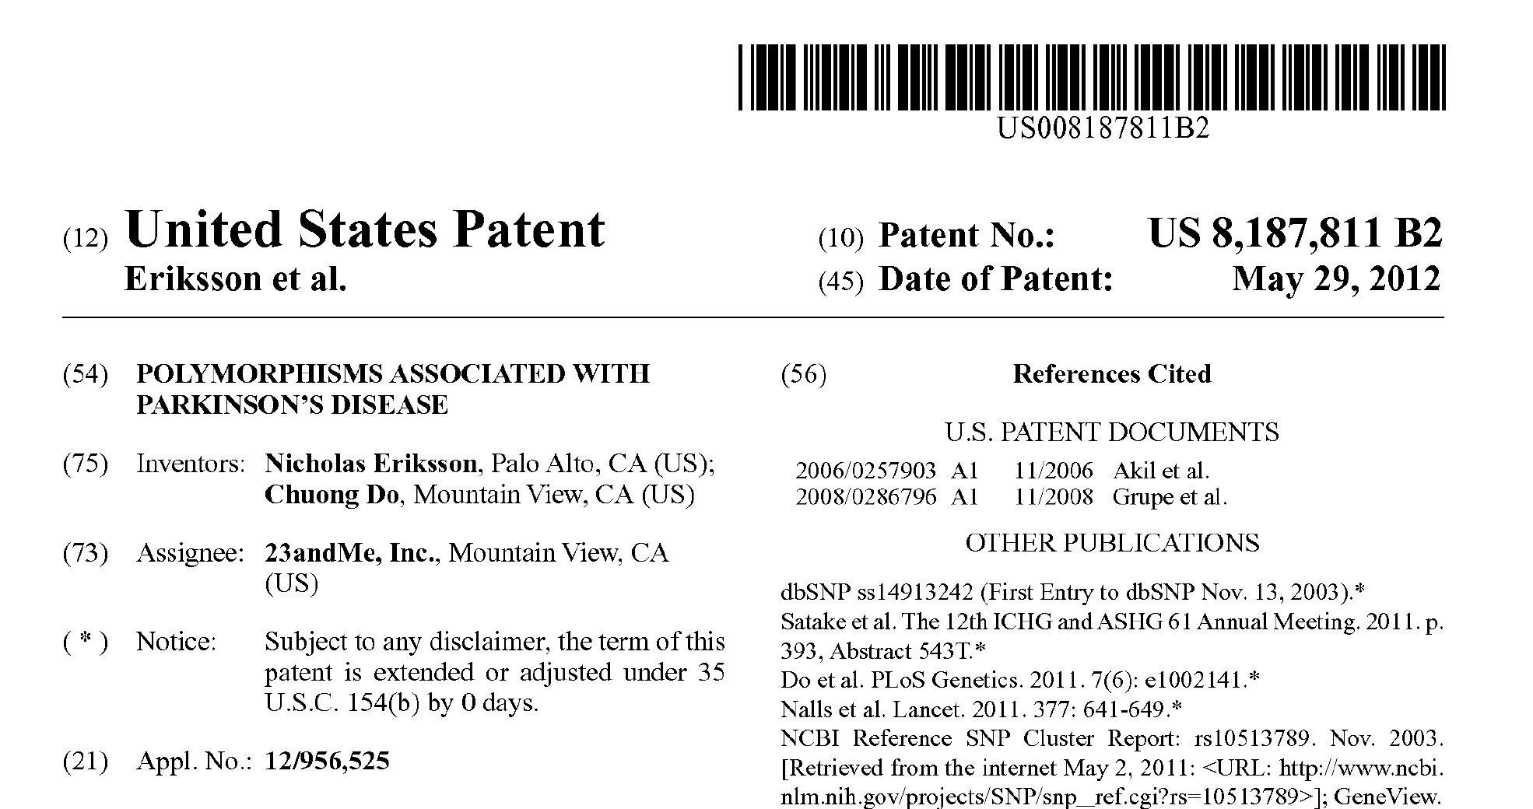
Exit
Capacity to leave without penalty and with resources
Is exiting possible?
What assurances can be made that one has exited?
How to exit without some loss of data, access to network and other resources?

Slide 25
Discerning what is new
Bottom up disruption
Open sharing and transparency
Hidden institutionalization
Elimination of responsibility
Lack of quality control
Increased scientific literacy
Exploitation of bodily capital
Leveraging of untapped knowledge
Notes:
Democratization or scence per usual?

Slide 26
References
Bonney, R., Ballard, H., Jordan, R., McCallie, E., Phillips, T., Shirk, J. and Wilderman, C. C. Public Participation in Scientific Research: Defining the Field and Assessing Its Potential for Informal Science Education - a CAISE Inquiry Group Report. , Center for Advancement of Informal Science Education,Washington, DC, 2009.
Rotman, Dana, Jennifer Preece, Jennifer Hammock, Kezee Procita, Derek Hansen Cynthia Parr, Darcy Lewis, David Jacobs. Dynamic Changes in Motivation in Collaborative Citizen-Science Projects. February 11–15, 2012
Christopher Kelty, Aaron Panofsky. Disentangling Public Participation In Science and Biomedicine. Genome Medicine. 2014, 6:8

Slide 27

Acknowledgements
National Institutes of Health ELSI Research Program. National Human Genome Research Institute. 1R01HG005086 (PI: Lee)
National Institutes of Health ELSI Research Program. National Human Genome Research Institute. Center for Excellence in Genetics and Ethics Program. 2P50 HG003389 (PI: Cho)
Hank Greely, J.D.
Mark Granovetter, Ph.D.
Jennifer Aaker, Ph.D., MBA
Kelly Ormond, M.S.
Emily Borgelt, M.A.
Simone Vernez, B.A.

