Slide 1
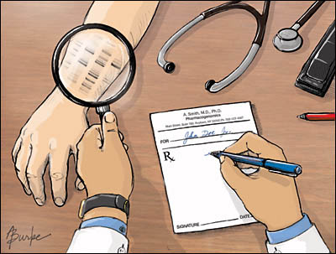

Genetics Clinic of the Future
Translation in Healthcare – Exploring the Impact of Emerging Technologies
Oxford
June 23-26, 2015
Nine Knoers
Afdeling Medische Genetica
Notes:
“Treat all patients with respect and dignity and with equal value.”
Ingaan op de optimisten en de pessimisten
Meeste optimisten zijn CEOs van companies die de techniques, hard- en software leveren voor genome sequencing
I am also on the optimistic side but in this talk I will of course also mention some of the problems or lets see challanges that we have to deal with in the ocming years
I you really want to hear a very optimistic view on thus subject go to Ted talks on the internet and listen to Richard Resnick who is CEO of genome quest a maker of genomic software.

Slide 2
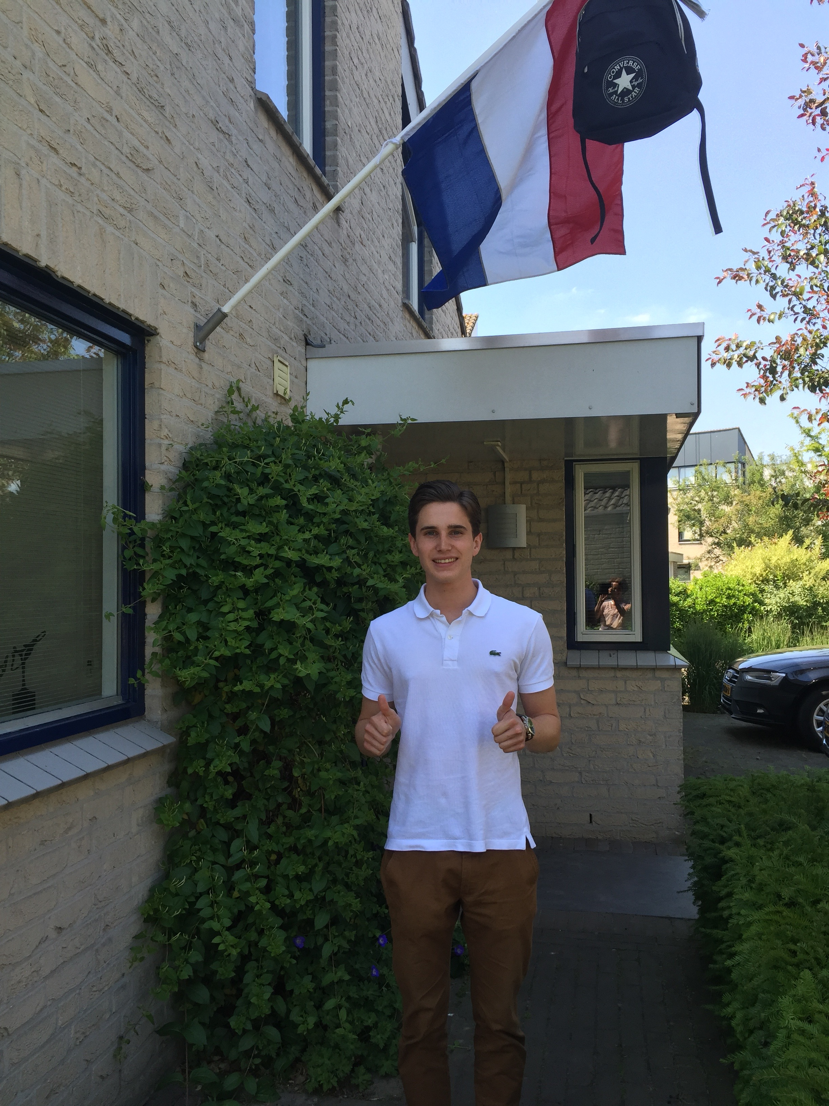
Advice to my children
Don’t go the medical school…..
…..choose (bio)informatics !!

Slide 3
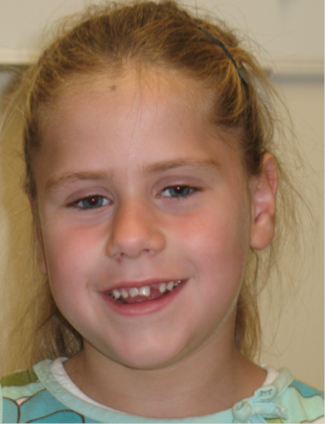
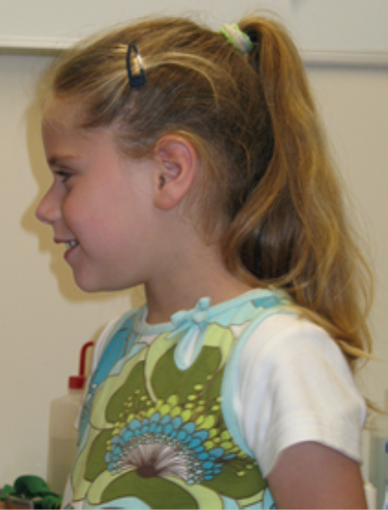
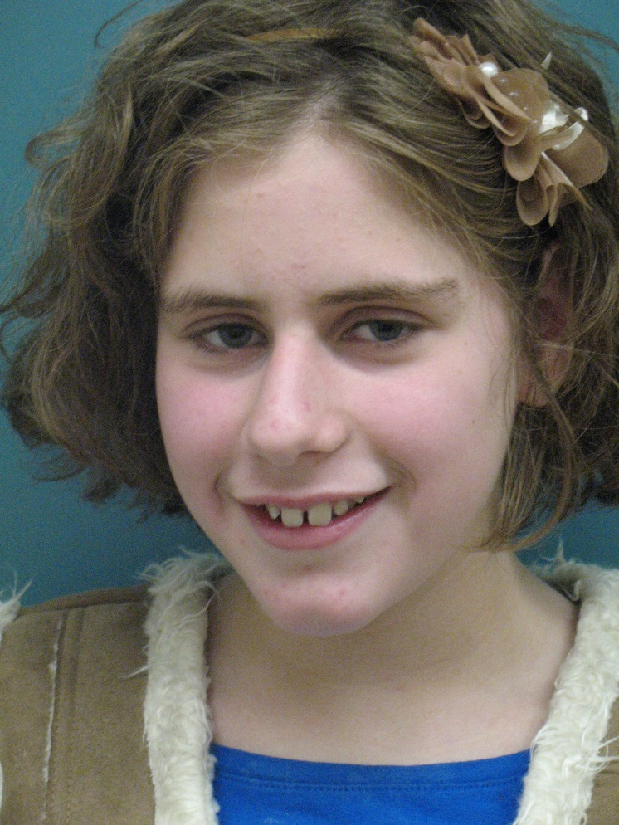
Current practice: example
Severe feeding problems
Growth retardation
Movement disorder
Developmental delay, increasing in severity
6 jr IQ 73
11 jr IQ 47
Long diagnostic process without diagnosis: SNP array, targeted DNA tests, metabolic screening, MRI brain, …..
Exoomsequencing: diagnosis Rett syndroom
Consequeces for prognosis, management, guidance and genetic counseling
End to diagnostic oddysey for patient/parents
Notes:
Ongecompliceerde zwangerschap, bij 35 weken bleek er een gastroschisis en groeiretardatie te zijn. Bij 36 weken is Ilse geboren. Het geboortegewicht was 2540 gram, de geboortelengte 47 cm, de schedelomtrek 32 cm. Post partum was er geen zuigreflex. Hiervoor kreeg ze sondevoeding, echter dit werkte niet, ze spuugde dit weer uit. Vervolgens is een infuus gegeven. Op de leeftijd van 5 maanden mocht ze naar huis. Ze kreeg toen 20 uur per dag sondevoeding, kort daarvoor kreeg ze een infuus erbij omdat ze grotere hoeveelheden niet goed verdroeg.

Slide 4
How would this patient be approached in the Genetics Clinic of the Future?
Genome-first approach:
Genome sequencing ordered by medical specialist
Genome interpreted by bioinformaticians/computer software
(Detailed) pre-test phenotyping not necessary
Post-test phenotyping guided by genetic diagnosis (reverse phenotyping)
Genetic counseling
Advice for follow-up/guidance

Slide 5
Not many things are certain about the future, but…
A ‘genome-first’ approach will be widely introduced in general healthcare
Medical model will move from disease-oriented to prevention-oriented
Treatment will move from one size fits all to personalized medicine
Patients become increasingly autonomous and informed
Notes:
The advantage of such directive – some call it ‘Dutch’ – approach, is that there is a fairly high chance of reaching some consensus. And while no one is able to predict the future, there was a striking consensus about the four elements mentioned here becoming part of the GCOF.
One can still debate on the exact meaning of terms like ‘genome-first’, autonomous, and ‘beyond-the-clinic’. For example, no one knows for sure whether ‘genome first’ means that every patient that enters the hospital gets sequenced first before everything else – or even has already done so before entering the clinic – or that it represents a general movement towards wider application of genetics, earlier in the healthcare chain. Likewise, ‘beyond-the-clinic’ immediately brings up images of risk percentages and unclear answers, but could also aid in diagnostics and family planning. Whatever differences in interpretation, these consensus elements provide a basis for the direction into which the genetics clinic of the future is heading.

Slide 6
Not many things are certain about the future, but…
A ‘genome-first’ approach will be widely introduced in general healthcare
Medical model will move from disease-oriented to prevention-oriented
Treatment will move from one size fits all to personalized medicine
Patients become increasingly autonomous and informed
Sir William Osler: “The good physician treats the disease, the great physician treats the patient”
Notes:
The advantage of such directive – some call it ‘Dutch’ – approach, is that there is a fairly high chance of reaching some consensus. And while no one is able to predict the future, there was a striking consensus about the four elements mentioned here becoming part of the GCOF.
One can still debate on the exact meaning of terms like ‘genome-first’, autonomous, and ‘beyond-the-clinic’. For example, no one knows for sure whether ‘genome first’ means that every patient that enters the hospital gets sequenced first before everything else – or even has already done so before entering the clinic – or that it represents a general movement towards wider application of genetics, earlier in the healthcare chain. Likewise, ‘beyond-the-clinic’ immediately brings up images of risk percentages and unclear answers, but could also aid in diagnostics and family planning. Whatever differences in interpretation, these consensus elements provide a basis for the direction into which the genetics clinic of the future is heading.

Slide 7
Genome information in health care
From conception to death
-2
-0.5
0
0-10
10-20
>50
60
>100
Preconception
Carrier screening
Disease prevention
BRCA, CFTR
Aging
Healthy aging
Pregnancy
NIPT (trisomy 13/18/21, sex, carrier)
Cancer
Personalised Medicine
Birth
Neonatal screening
Pharmacogenetics
Tailored treatment
Death
Molecular autopsy unexplained death
Unexplained congenital disorders
De novo screening
Whole genome scan

Slide 8
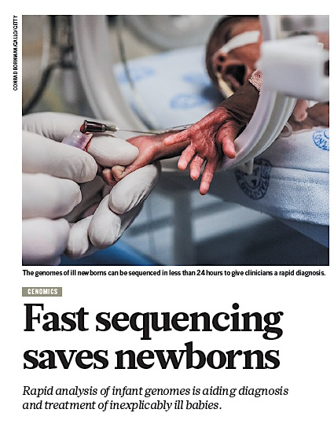
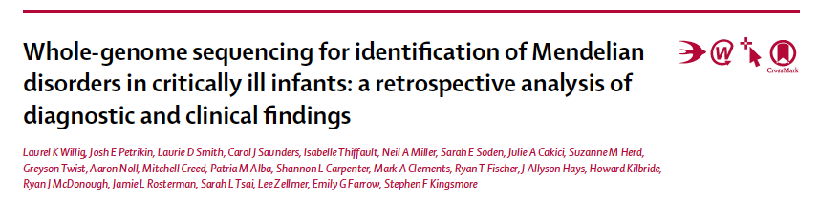
Whole genome sequencing in critically ill newborns with unexplained disorders makes sense
Kingsmore’s group
Children’s Mercy Hospital, Kansas City
20/35 infants (57%) diagnosed with rapid WGS
Immediate clinical usefullness 65%
Favorable effect on management 20%
Institution of palliative care 30%
Notes:
Gaat over dezelfde studies, in eerste instantie iets te optimistisch over snelheld
24 hours werd minimaal 5 dagen
Retrospectieve analyses

Slide 9
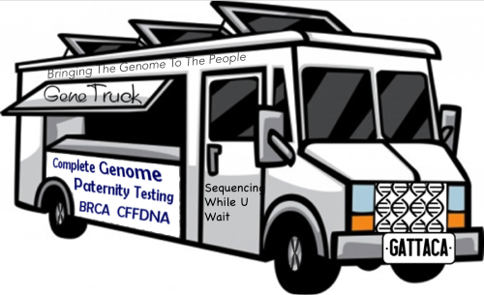
Genetics Clinic of the future: Organization
Many ..many… bioinformaticians
Less physicians
Largely multidisciplinary: communication on
consequences of diagnosis
treatment/prognosis
prevention
50% of currently existing hospitals converted to hospitals for prediction and prevention of disease using genomic tools
Genomic information is integrated in electronic health records (EHRs)

Slide 10
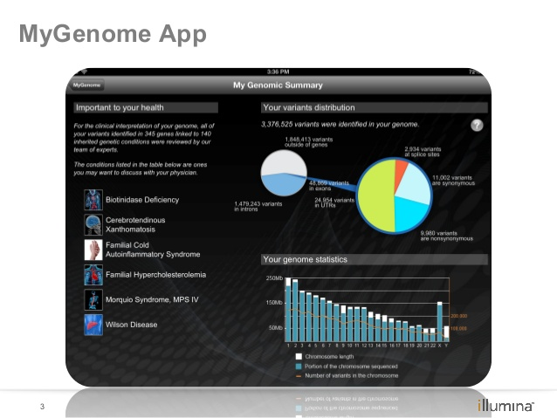

Genetics Clinic of the future: Organization
“Patients” digitally connect with doctors and have online access to their EHR (“who wants to see the doctor?” )
“Patients” are internet-informed, have their genome on an app, and actively participate in promoting their health based on knowledge of their personal genome
Patients connect with others who have the same disease or condition and track and share their own experiences
Notes:
Patients may well be healthy individuals

Slide 11
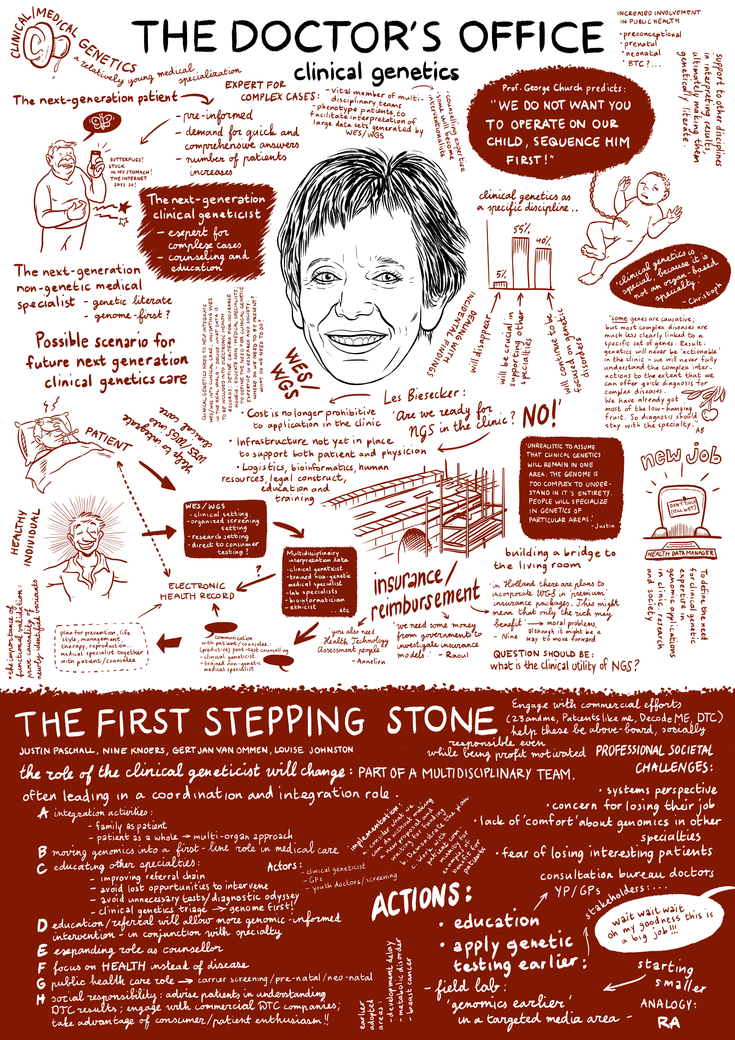
Genetics Clinic of the Future: shift in the role(s) of clinical geneticist
Role in pretest-diagnostics very limited
Vital member of multidisciplinary teams (use genomic results to guide patient care, including decisions on personalised medicine based on genetics profiles)
(Reverse) Phenotype of patients to facilitate interpretation of large data sets generated by WES/WGS
Counselling expertise
Some will become interventionalists, configuring, trialling and instituting treatment for rare genetics diseases
Boycott et al., Nat Rev Genet 2013

Slide 12
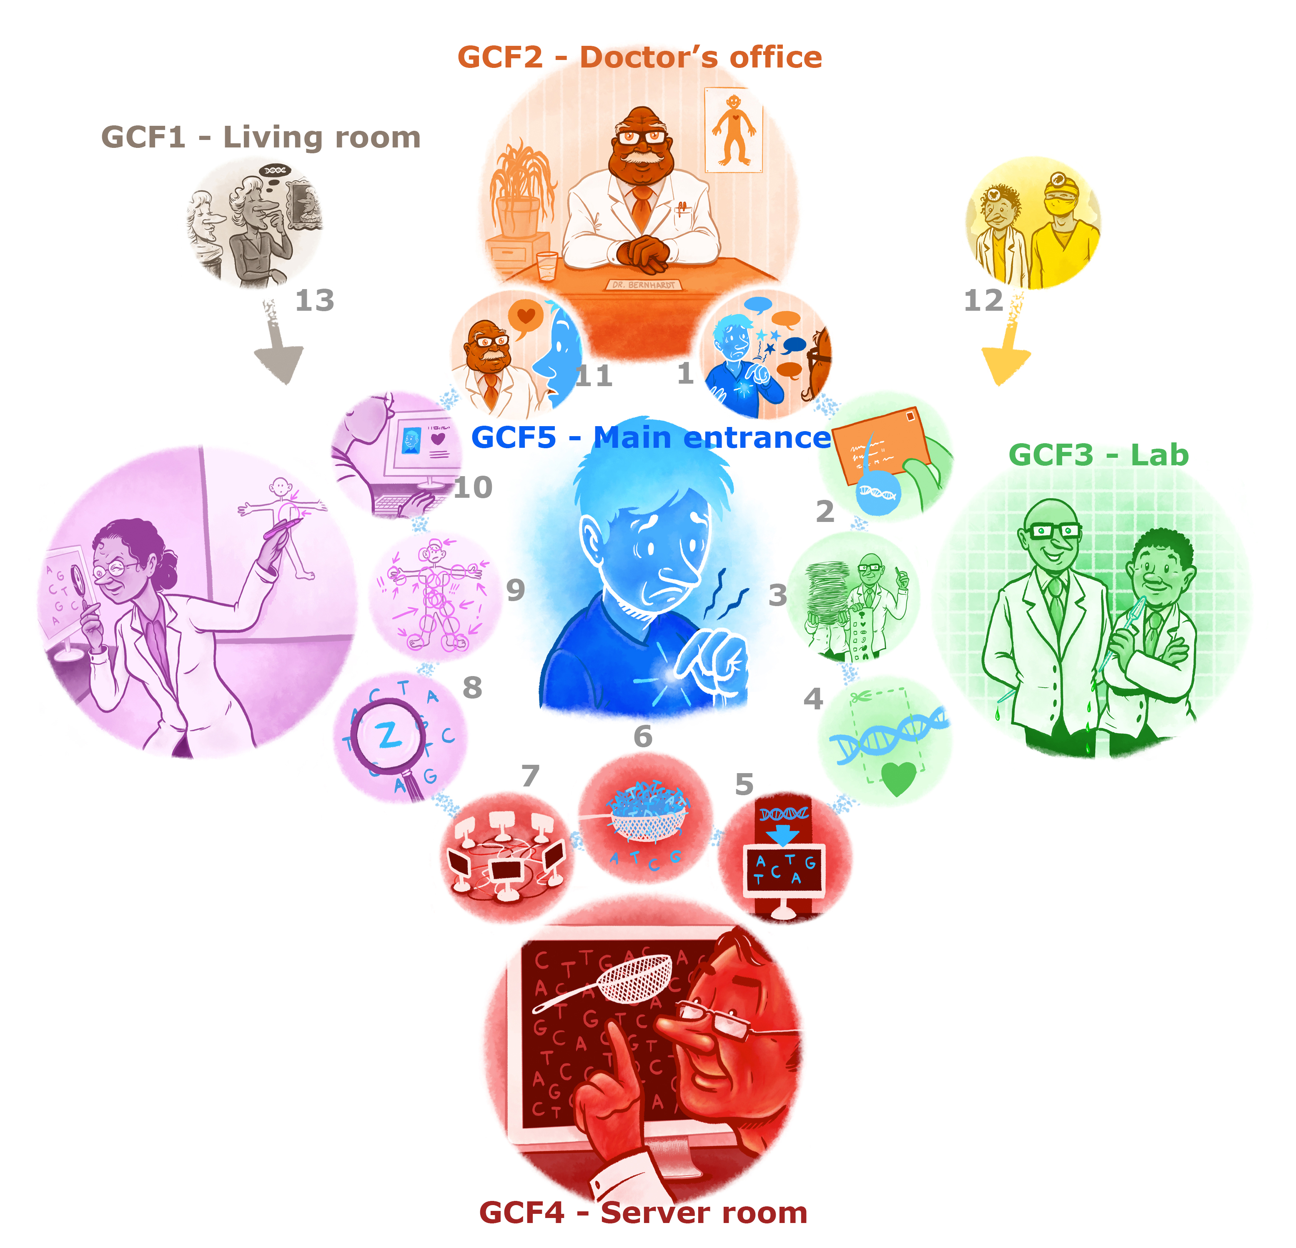
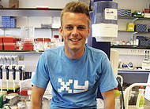
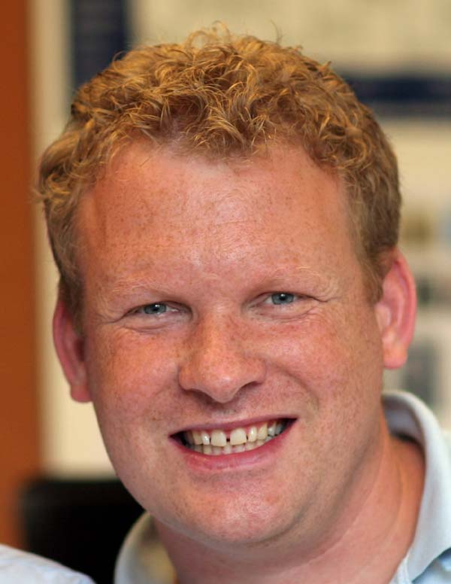
Acknowledgements
GCOF team
Terry Vrijenhoek
Edwin Cuppen
Internet
Ruben Maalman

