Slide 1
23 June 2015
Translation in Healthcare
-Exploring the impact of emerging technologies
University of Oxford
What are the challenges for translation?
-Views from Japan and Asia
Kazuto Kato, PhD
Professor, Department of Biomedical Ethics and Public Policy,
Division of Social Medicine,
Graduate School of Medicine, Osaka University
Project Professor, Institute for Research in Humanities and Institute for integrated Cell-Material Sciences, Kyoto University
Member of he Expert Panel on Bioethics of the Council for Science, Technology and Innovation Policy (CSTI) of the Cabinet Office, Japan.

Slide 2

Progress of human genome research
Human Genome
Project (HGP)
International
HapMap Project
Large scale genome
analysis
1000 Genome Project
1990 The HGP started
2005 Microarrays for SNP analysis
2000 Announcement of draft sequence
2002 HapMap Project started
2003 Completion of the HGP
2005 The 1st phase HapMap Project finished
Genome wide analysis
(GWAS, Genome-Wide Association Study)
2007, 2008 ～ New generation sequencers
→Personal genome analysis
Extremely rapid progress
of genomics
What does this mean?

Slide 3
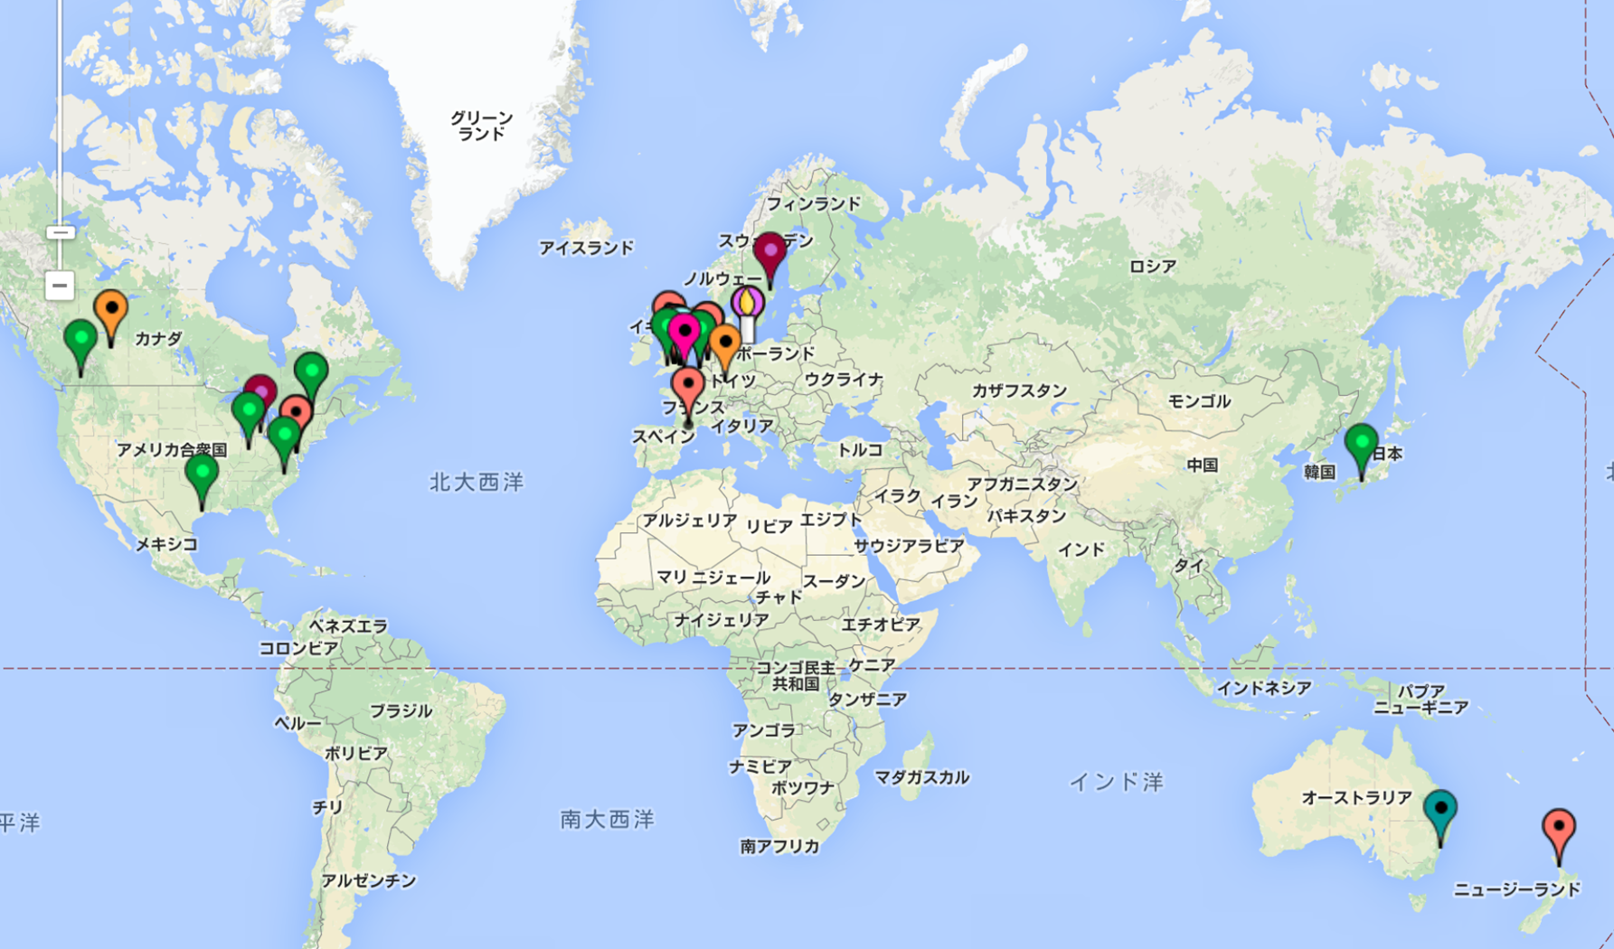
Gaps and Challenges for Translation of genomics to Healthcare
It seems there is a big gap between advanced countries and less advanced ones (in terms of genomics and its application).
Countries and regions with advanced genomic technology (US, UK, Canada etc.)
vs.
Those with less advanced technology (Asia, Africa, South America etc. To some
extent, Japan may also belong to this group?)
Asia-Oceania
How can we make sure that the tools and benefits of genomics translation spread to the entire world?
The map is from the web site of ELSI2.0

Slide 4
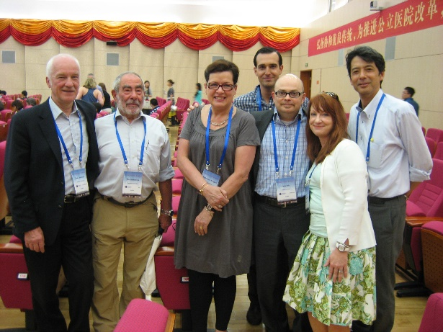

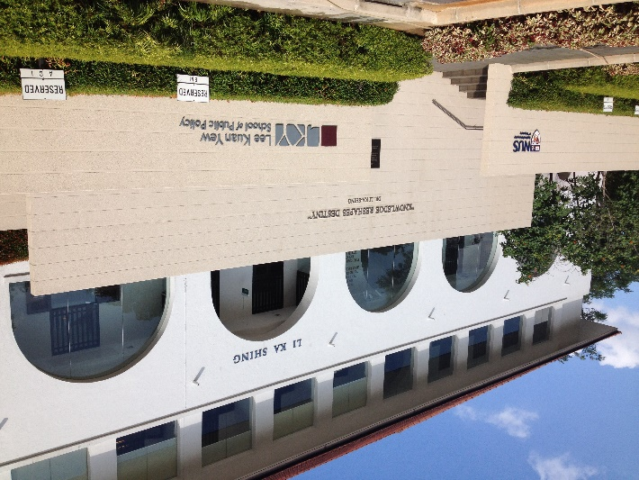
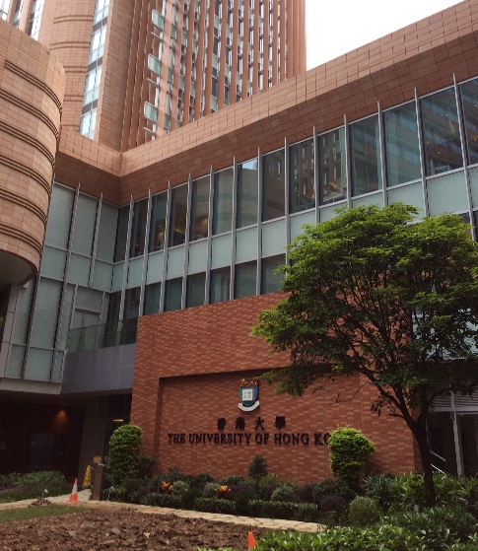

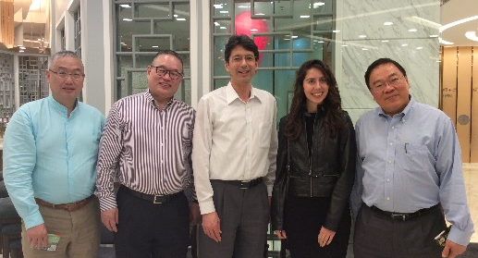
Singapore
(National University of Singapore)
Beijing (ICGC meeting)
Kuala Lumpur
(Human Genome Meeting 2015)
University of Hong Kong
(Centre for Medical Ethics and Law)
We are all struggling with issues including:
Informed consent
Ethics Review
Data sharing
Protection of genetic data
(need to have legal framework)
How to avoid discrimination
Return of results from genomic analysis (especially from NGS)
Genetic counselling
Mt. Fuji
(photo taken from Shinkansen train)

Slide 5
Gaps and Challenges for Translation of genomics to Healthcare
It seems there is a big gap between advanced countries and less advanced ones (in terms of genomics and its application).
Countries and regions with advanced genomic technology (US, UK, Canada etc.)
vs.
Those with less advanced technology (Asia, Africa, South America etc. To some
extent, Japan may also belong to this group?)
Researchers, specialists, and patient advocates etc. in the ELSI 2.0 network can play a big role to promote mutual understandings and collaborations across the globe (avoiding “silos”).
(in addition to other global efforts such as Global Alliance for Genomics and Health + United Nations?)

Slide 6
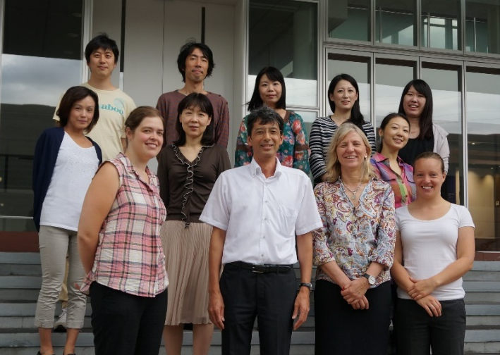
Gaps and Challenges for Translation of genomics to Healthcare
2. How can we promote good partnerships between specialists and patients/citizens.
Patients (groups) are becoming important players all over the world especially in North America and Europe.
Yet, in Japan they do not have sufficient resources and are often isolated (without information and networks).
How can we have good partnership beyond the traditional model is a challenge. (all over the world, but more so in Asia)
New system such as dynamic consent and the PEER system of the Genetic Alliance for patient participation may become important entry points.
Osaka-Oxford collaboration is ongoing for dynamic consent (towards its implementation in Japan)

Slide 7
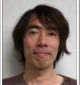
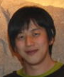
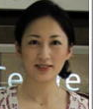
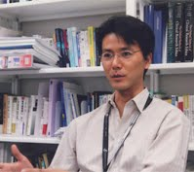

Collaborators:
Tohoku University
Fuji Nagami
Kyoto University
Soichiro Toda
University of Oxford
HeLEX:
Jane Kaye
Harriet Teare
Sarah Coy
Colin Mitchell
Michael Morrison
University of Tasmania
Donald Chalmers
McGilll University
Bartha Knoppers
Regulatory Ethics Working Group members of the Global Alliance for Genomics and Health
Members of the ELSI2.0 network
Osaka University
Department of Biomedical Ethics and Public Policy:
Go Yoshizawa
Jusaku Minari
Natsuko Yamamoto
Minori Kokado
Noriko Ohashi
Department of Medical Informatics
Yasushi Matsumura
Toshihiro Takeda
Department of Neurology
Masanori Takahashi
Department of Clinical Epidemiology and Biostatistics:
Ayumi Shintani
National Cerebral
Cardiovascular Center:
Kenji Matsui
Tokyo University of Science:
Tomohide Ibuki

Slide 8
Thank you for your attention!

