Slide 1


New ways of involving patients in genetic research:
Rare UK Diseases of bone, joint and blood vessels study (RUDY)
MK Javaid
Associate Professor in Metabolic Bone Disease, University of Oxford
Hon Consultant Rheumatologist, Nuffield Orthopaedic Centre
Lead Clinician for FRiSCy

Slide 2
background to the Rudy study

Slide 3
Rare diseases are Under-researched> 95% no treatment
3 million patients in the UK
Information for patients and doctors is fragmented
Limited evidence for informing care in children

Slide 4
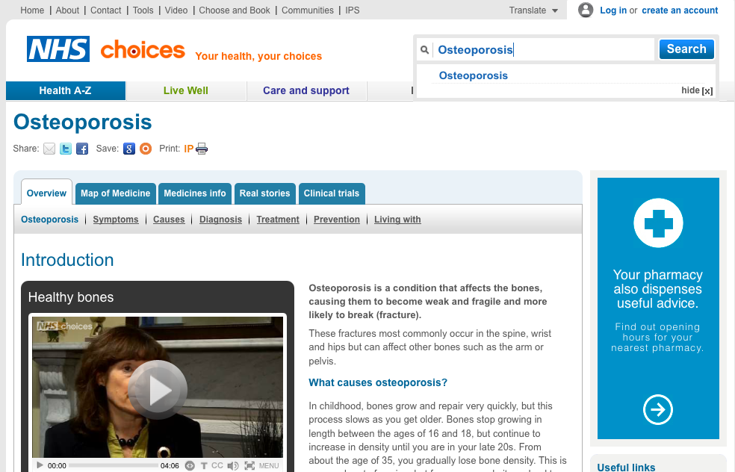

Slide 5
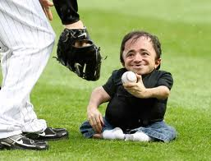
NO treatment proven to
work in adults
More fractures at 40 -50yrs
Lose lung capacity
Lose ability to work

Slide 6
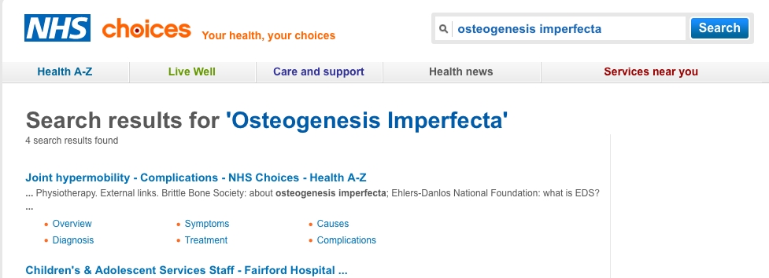

Slide 7
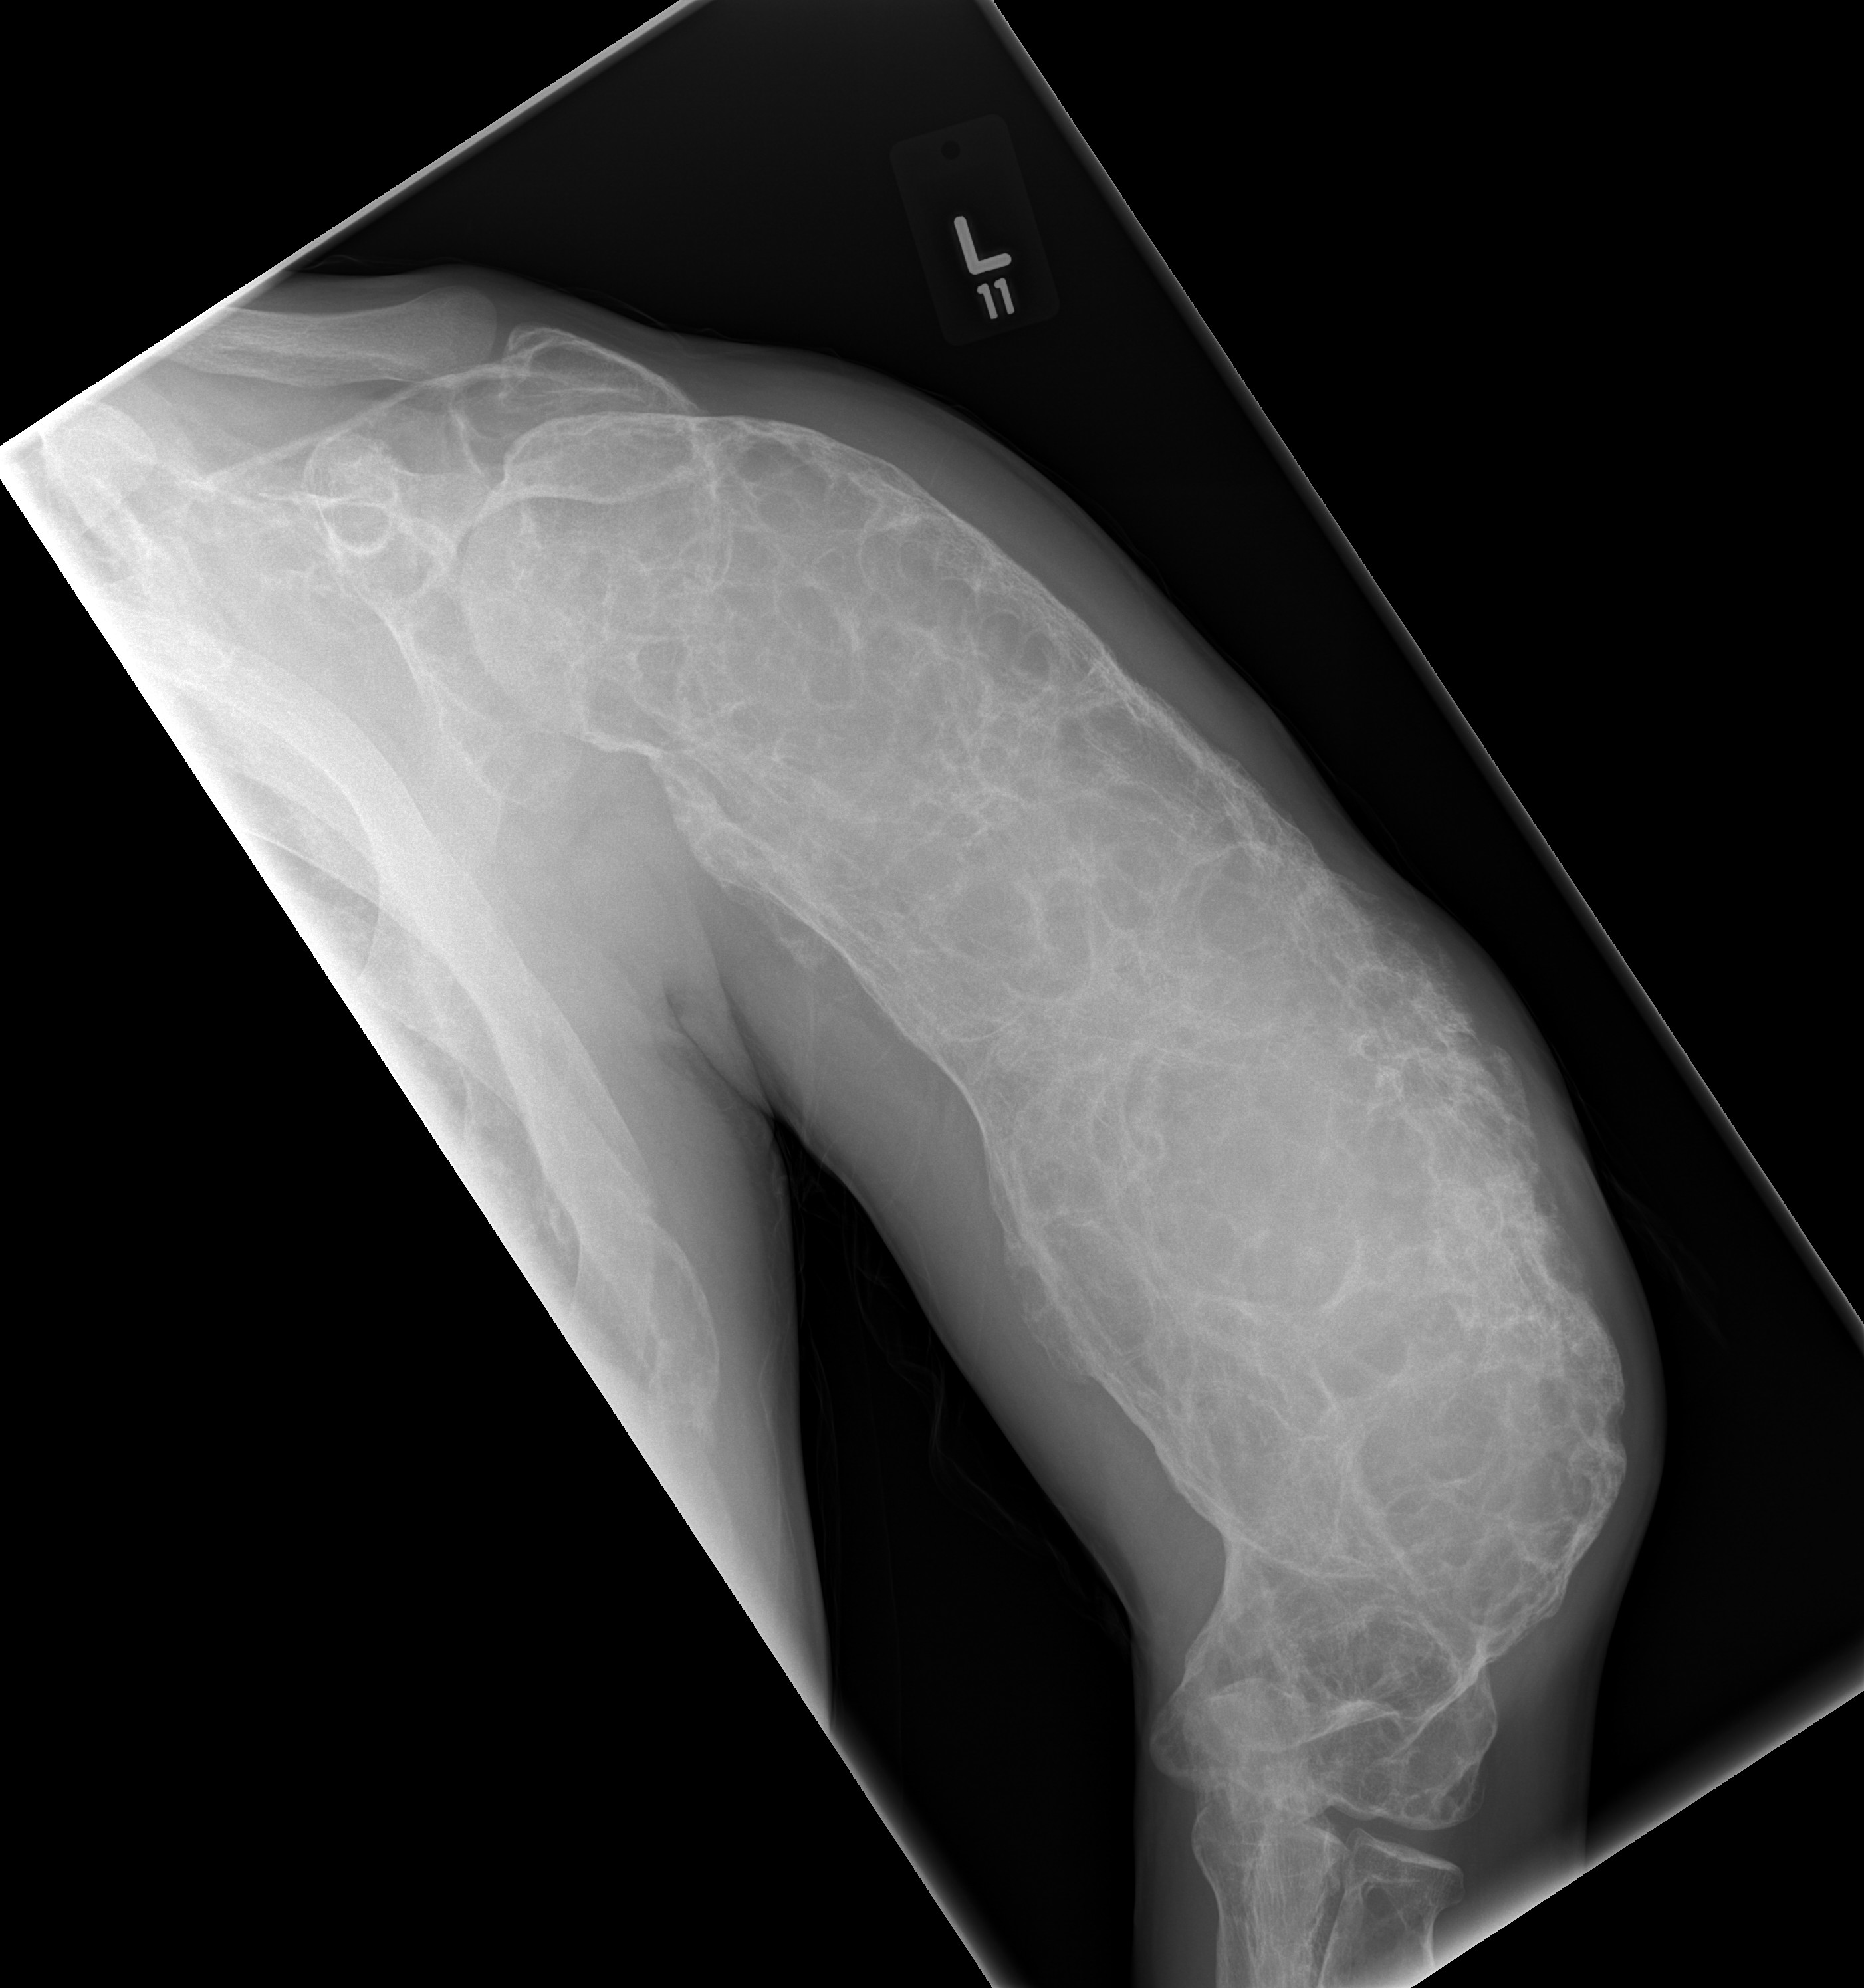
NO treatment proven to
work in adults
Bone pain
Fracture
Rarely cancer

Slide 8
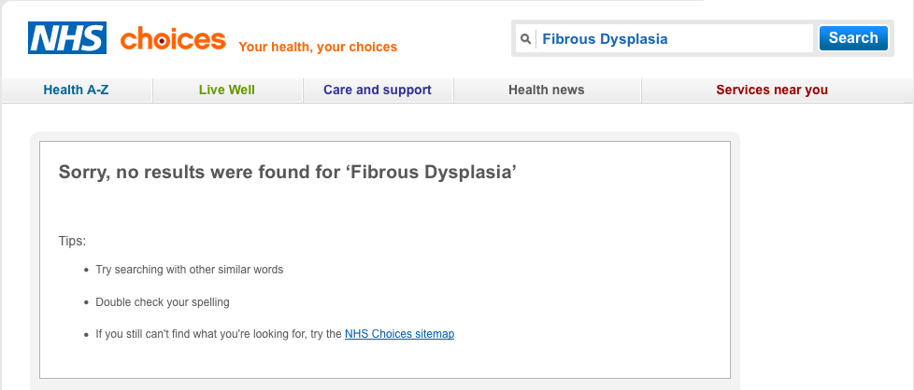

Slide 9
<5 : 10,000
5- 8000 rare diseases
95% treatment gap
40% diagnostic challenge
25% wait 5- 30 years to get a diagnosis

Slide 10
“there is so much rubbish on the internet about rare diseases”
Rudy Patient forum skype 2014

Slide 11

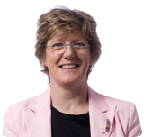
Government funded initiative
“Improving the health and wealth of the nation through research”
“maintain a health research system in which the NHS supports outstanding individuals, working in world class facilities, conducting leading edge research focused on the needs of patients and the public”
Dame Sally Davies

Slide 12

NIHR Rare Diseases Translational Research Collaboration:
Support patient centred research
Develop and delivery deep phenotyping / genomic mechanisms
Partnership with industry for novel biomarker/ therapeutics
Build research capacity > next generation researchers

Slide 13
TRC Rare Disease theme leads
Skin: Guy’s and Thomas’s BRC John McGrath john.mcgrath@kcl.ac.uk
Immunological disorders: GOSH BRC Adrian Thrasher a.thrashe@ucl.ac.uk
Neuromuscular: Mike Hanna UCL BRC m.hanna@ucl.ac.uk
Musculoskeletal: Oxford BRU Paul Wordsworth, Kassim Javaid, Raashid Luqmani
Dementia and Neurodegenerative: Nick Wood UCL BRC/BRU n.wood@ucl.ac.uk
Respiratory disease : Royal Brompton BRU Eric Alton e.alton@imperial.ac.uk
Gastrointestinal Newcastle BRC David Jones david.jones@newcastle.ac.uk
Cardiovascular: Hugh Watkins Oxford BRC hugh.watkins@cardiov.ox.ac.uk
Eye Disease Moorfields BRC Tony Moore tony.moore@ucl.ac.uk
Metabolism: Cambridge BRC Stephen O’Rahilly so104@medschl.cam.ac.uk (Rob Semple rks16@cam.ac.uk)
Cancer: Stan Kaye Royal Marsden BRC stan.kaye@rmh.nhs.uk
Paediatric cross cutting: Birmingham NIHR/Wellcome CRF Tim Barrett t.g.barrett@bham.ac.uk
Renal: Fiona Karet Cambridge BRC fek1000@cam.ac.uk
Non-malignant Haematological disorders: Irene Roberts Oxford BRC irene.roberts@paediatrics.ox.ac.uk

Slide 14

No national cohort
Multiple Institution based patient cohorts
Record different measures
Use different tools
Registry to detailed cohort

Slide 15
Solution

Slide 16
Identify and recruit – across institutions

Slide 17


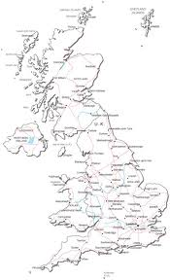


National recruitment:
Consultant team:
Hospital database
Hospital letters
Hospital clinics
Mailing list
Advertise on website
www.rudystudy.org

Slide 18
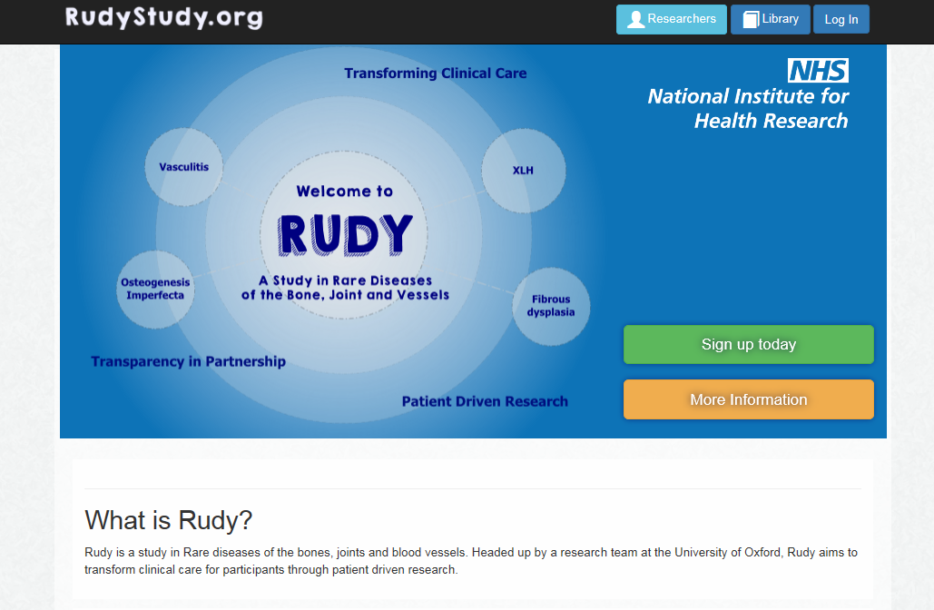

Slide 19
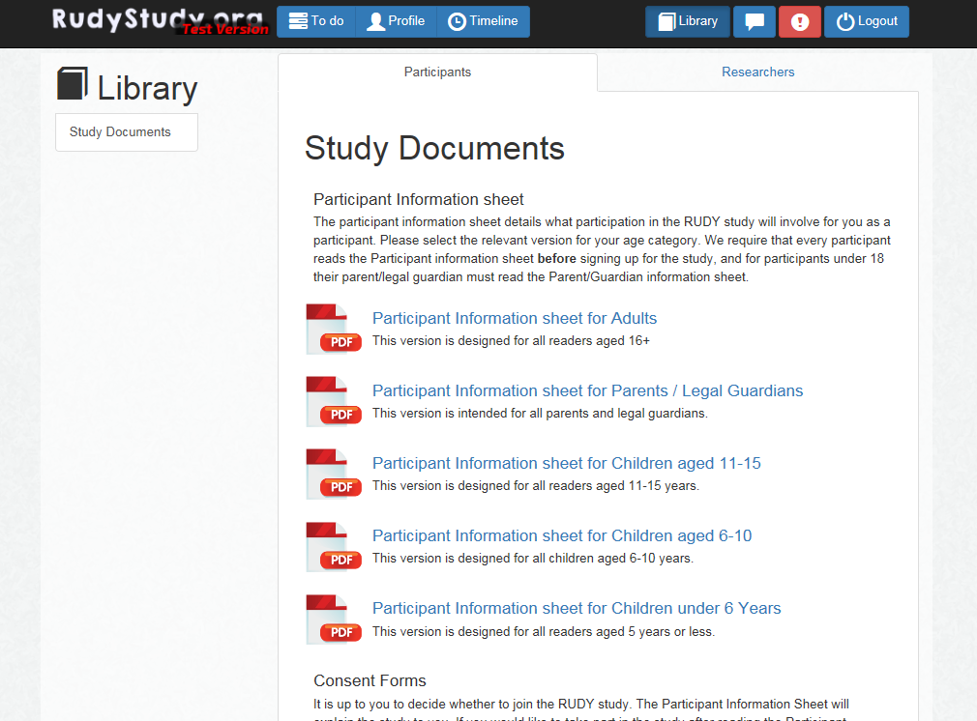

Slide 20
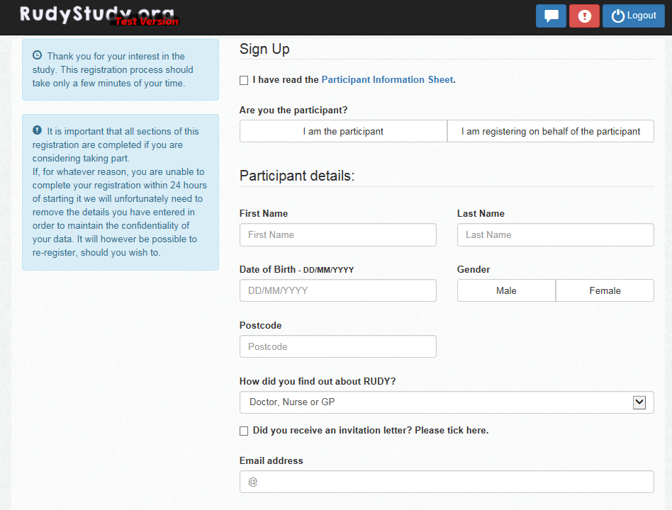
Online registration
Arrange a telephone call to consent
Consent form signed and returned
Diagnosis confirmed with doctor
Participants provided with login

Slide 21
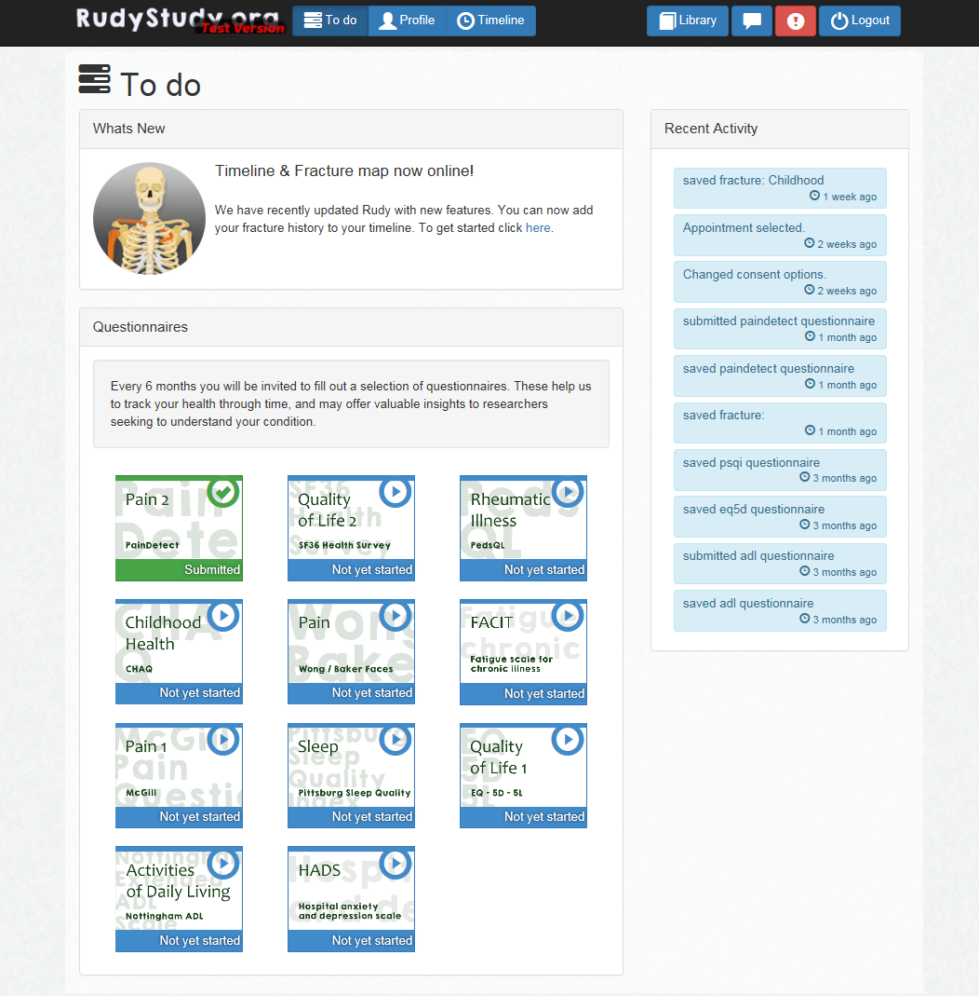

Slide 22
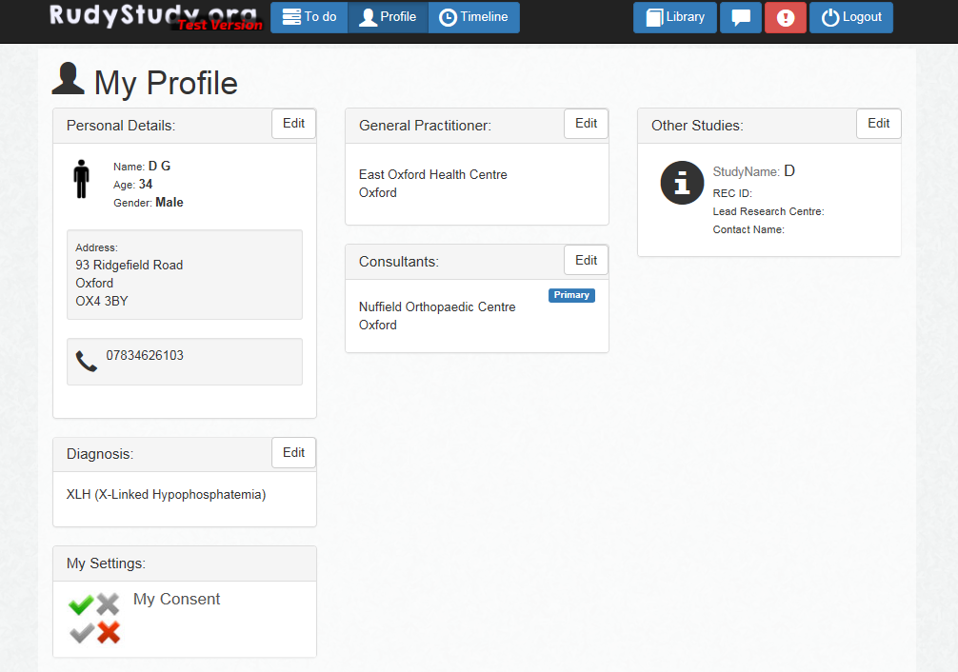

Slide 23
Not everyone with a rare disease can/ wants to contribute the same level of detail…. at recruitment during their time in the study

Slide 24
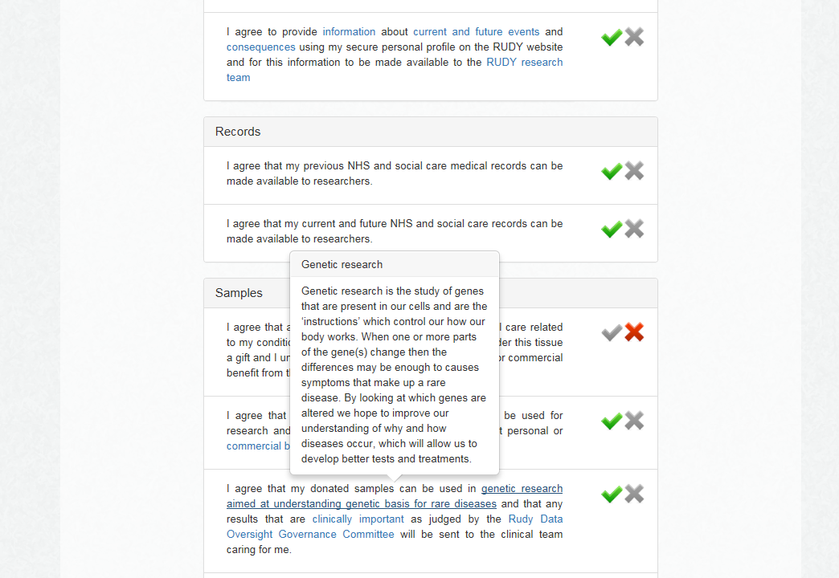

Slide 25
A two way conversation

Slide 26
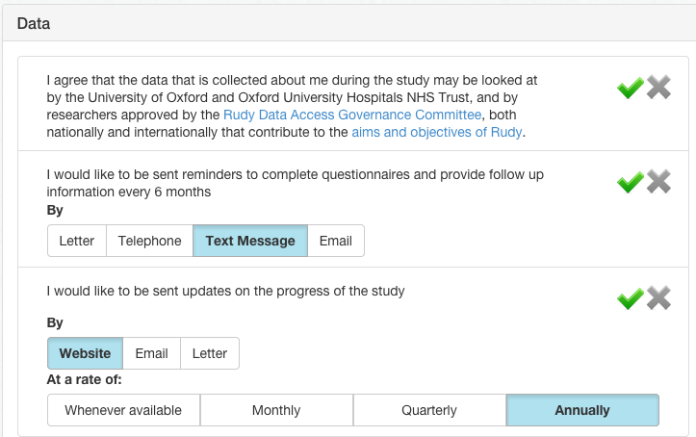
Method of communication…

Slide 27


Username +
Secure password Memorable word
Identifiable Data
(Name / Address etc)
Non-Identifiable Data
(Assessments/ samples)
Encrypted
My Copy/ My Feedback
My Disease record
My consent status
My contribution to research
Disease specific
Eligible trials
Rudy general

Slide 28


Data Oversight committee
Data Access Committee
Patient
forum
External Advisory group
Genetics Forum> GeCIP
Policy group
252 recruited

Slide 29
Two way conversation- Substantial ethical amendment
Traditional model
DC model
Post/ telephone participants
Email participants
mini-update
Arrange Face/ Face or telephone
Paper based re-consent
Send> Sign > Return
On-line consent
preferences
RE-CONSENT

Slide 30
Summary
Care gap
  Diagnostic delay
  Treatments improve outcome
Research platform
  2 way conversation
  Dynamic involvement

Slide 31



Oxford Team
Cooper, Arden, Wass, Willett, Carr, Price, Glyn-Jones, Hamdy, Ramasay
A Soni, K Leyland, S Sheard, R Warne, D Prieto Alhambra, A Judge, S Hawley,
R Pinedo-Villanueva, G Round, R Batra, A Kiran, D Hunter
Kerri Rance
Sally Hope
Sarah Connacher
Terri Morgan
Carol Weeks
Rachael Knight
Vivienne Fairclough
Tracy Dobbin
Elaine Arthur
J Chelsom
F Highfield
E de Araujo
AM Morgan
RUDY team
A Turner
J Barrett
J Hogg
R Popert
D Grey
N Grey
H Teare
J Kaye
R Luqmani
P Wordsworth
IOF team
Kristina Akesson (Sweden)
Cyrus Cooper (UK)
Mark Edwards (UK)
Charlotte Moss (UK)
Paul Mitchell (NZ)
Muriel Schneider (SZ)
Dominique Pierroz (SZ)
Judy Stenmark (SZ)
kassim.javaid@ndorms.ox.ac.uk

