Slide 1

On Equity and Evidence in Precision Medicine
Leila Jamal, ScM, CGC
Research Assistant, Baylor College of Medicine
PhD Candidate, Johns Hopkins University

Slide 2
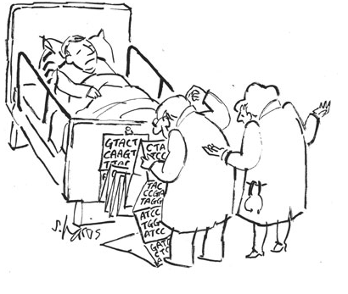
Notes:
A genetic counselor is someone who helps people process and make decisions based on genetic information that can have profound personal and familial consequences.

Slide 3
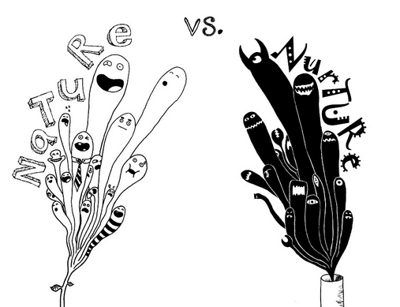
Notes:
Part of the genetic counseling process is getting to know a patient’s socially and emotionally constructed identity and integrating that with what you learn about their genetic constitution. These two selves must be reconciled if a person is to make meaning of genetic information

Slide 4
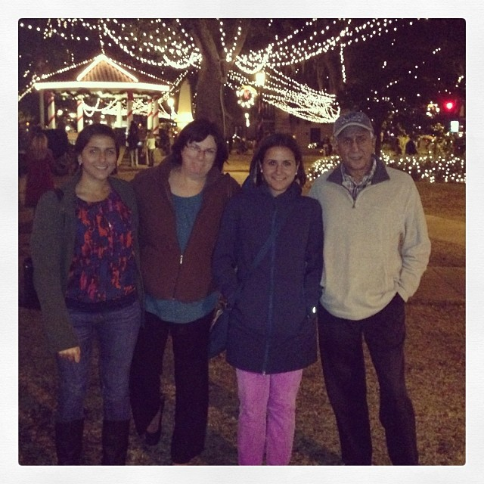
Notes:
I think my interest in identity stems from my experience of growing up as a so-called “biracial” child. As a child I fielded tons of questions about my race from people who wanted to know “what I was”, whether I felt like I was Asian or White. People seemed very uncomfortable with the ambiguity of my brownness. Depending on the context people have treated me very differently, with varying degrees of affinity or foreignness.

Slide 5
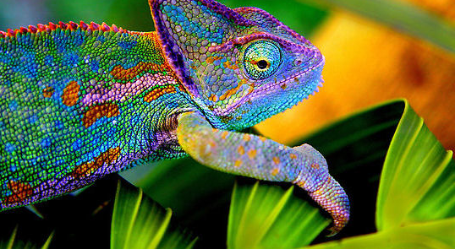
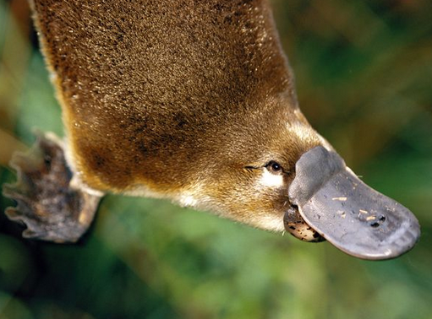
Notes:
At its best this gave me a chameleonic power to experiment with different identities as I grew up. But at its worst, I felt either boxed into inappropriate categories imposed upon me, OR I felt somehow disenfranchised from group membership. As a young person it was clear to me racial or ethnic are malleable social constructs, but also that other people had a lot of control over how they were used.

Slide 6
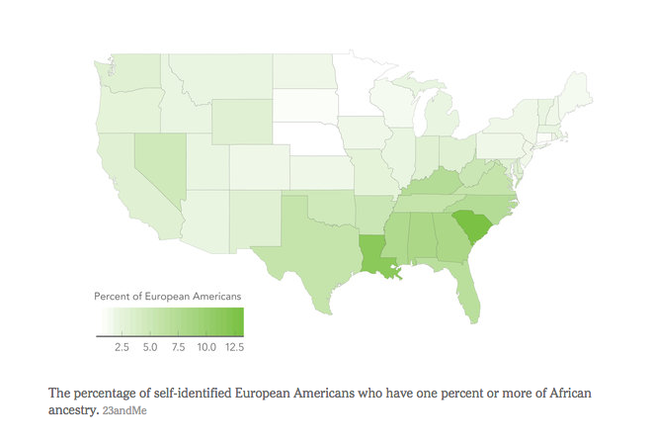
23andMe; www.nytimes.com
Notes:
And these types of identity issues are not new or unique to me, but what is new is that we are now able to quantify, much more granularly and specifically, what kind of population ancestry people have. And we can now contrast this with narratives about self-identified race and ethnicity.

Slide 7
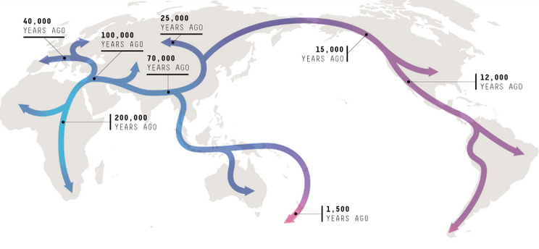
www.nature.com
Notes:
The reasons we might want to do this are not purely recreational. Because of various evolutionary pressures and forces, we know that there are population differences in the frequencies of sequence variants relevant to one’s health. And sorting through which ones are and which ones aren’t is a major task before us as we attempt to make precision medicine a reality.

Slide 8
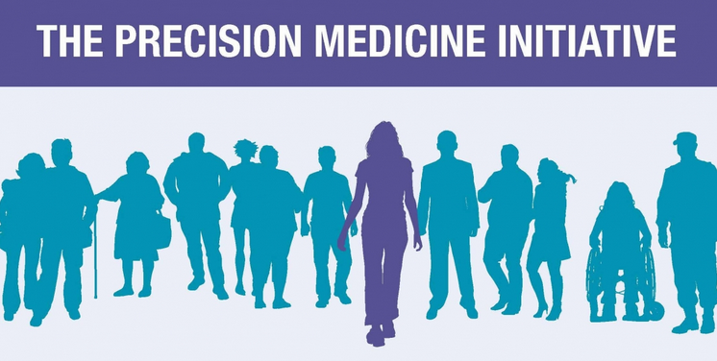
Notes:
Which brings me to the reason I am talking about this in the first place. There is much excitement about, and investment in, the idea of precision medicine at the moment. But it is worth noting that the very idea of precision medicine entails a belief that there are constitutional differences between us which can be detected at a genetic level and which may have implications for our health, well-being, and longevity.

Slide 9
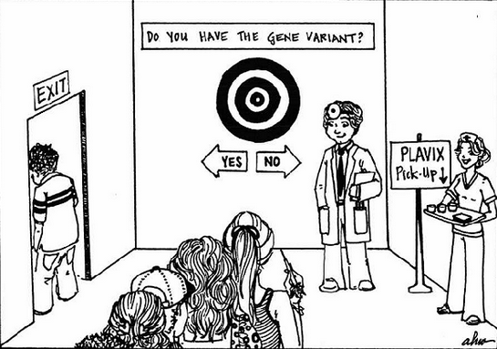
Notes:
With the advent of precision medicine, we are claiming that we will use information about people’s constitutional differences to determine what treatments they should and should not get. Whenever I hear people talking about using biological difference as a basis for treating people differently, I start to feel trepidatious even when may be no reason for it

Slide 10
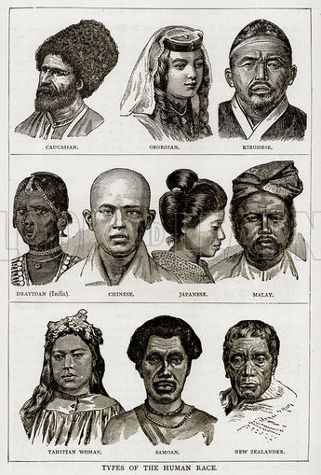
Notes:
The use of science to identify differences between people, and the ascription of value to those differences, is a historically culturally loaded subject.

Slide 11
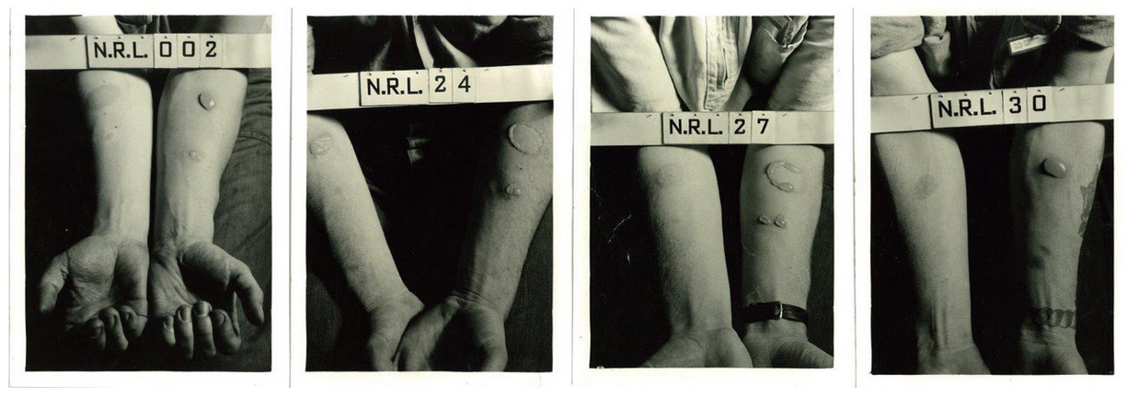
www.npr.org
Notes:
Even this week it came to light that in WW2 the United States Pentagon subjected African American and Asian soldiers to mustard gas exposure in order to compare their responses to white “controls”. And while we not longer find the exposition of race-based experiments like this very surprising, they do garner quite a bit of media attention and I think they loom large in the eyes of the public.

Slide 12
Fundamental Tension
BIOLOGICAL DIFFERENCE=OPPRESSION?
BIOLOGICAL DIFFERENCE=OPPORTUNITY?
of 20
Notes:
So I think that in order to move forward with a version of Precision Medicine that works for everyone, we are going to need to start talking more frankly about this core tension that arises from the different ways we have construed and used this notion of biological difference, both socially and medically.

Slide 13
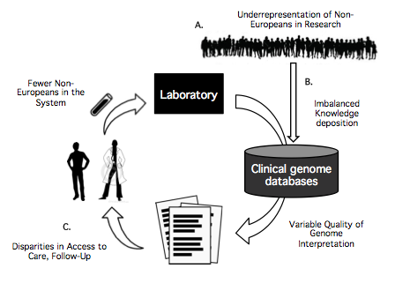
Notes:
Why do I think we need to talk about this more? There is good reason to believe that the tools and infrastructures we are using to practice genomic medicine work better for patients with primarily European ancestry than anyone else. And while we haven’t examined or quantified this problem very precisely yet, it’s undeniable that when we do genomic testing in patients, we are relying on reference data about Europeans to make clinical judgments about everyone else. And that doesn’t sound especially precise

Slide 14
Notes:
Another consideration is that genomic medicine requires extensive follow-up care and is quite expensive. In many West countries individuals with non-European ancestry are already more likely to face barriers in their access to healthcare. So I don’t think it’s unreasonable to worry that the increased use of genomics in healthcare may exacerbate existing health disparities. At the very least we need to better characterize the relationship between the two things.

Slide 15
CSER Research Participants by Self-Identified Race
Notes:
At the moment, at least in a United States context, it doesn’t seem like we are poised to do that very well because the exploratory research being done on genomic sequencing has mainly people with European ancestry.

Slide 16

Not enough variant data from non-European ancestry populations?
Oversample individuals with non-European ancestry and deposit pathogenic findings in public databases!
Notes:
The obvious solution would seem to be that we need oversample more diverse individuals in our research and to share what we learn broadly. But this alone will not work unless it’s accompanied by a clear and honest public dialogue about why we’re all of a sudden targeting certain population groups for inclusion, what the value proposition is for those groups, and how we will describe and publicize what we learn. Public engagement has to come first.

Slide 17
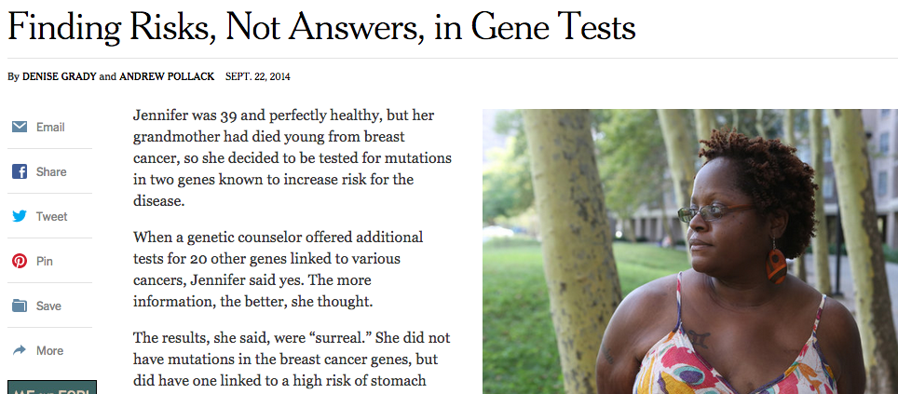
Notes:
Social and behavioral researchers have an important role to play by studying whether the burden of uninformative genetic test results is falling disproportionately on certain groups of people, and if so, what downstream effects that uncertainty has on them

Slide 18
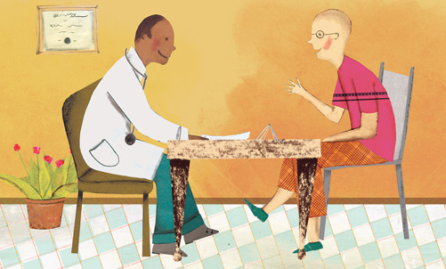
Notes:
And in a more subtle vein, it will be important to study how information about genome variation and race are communicated in a clinical context, how socioeconomic and cultural variables influence genomic risk communication and the return of results, and what misconceptions and knowledge gaps exist with respect to the use of ethnoracial labels in medicine

Slide 19
A Work in Progress..
Healthy African Americans
Randomize each patient to receive
African Americans with Mendelian Phenotypes
Randomize each patient to receive
Physician & patient outcomes
Standard of Care
+
Family History Review
Standard of Care
+
Family History Review
+
Genome Report
Standard of Care
+
Family History Review
Standard of Care
+
Family History Review
+
Genome Report
Physician reviews family history information and discloses results from Genome Report Patient’s electronic medical record
Medical Record Review
Notes:
To these ends, we are working on designing a modified version of our current clinical trial of whole genome sequencing. Our hope is that the study will examine the interplay between the clinical use of genomic sequencing, the shifting reimbursement landscape, and existing socioeconomic and health disparities

Slide 20
