Slide 1
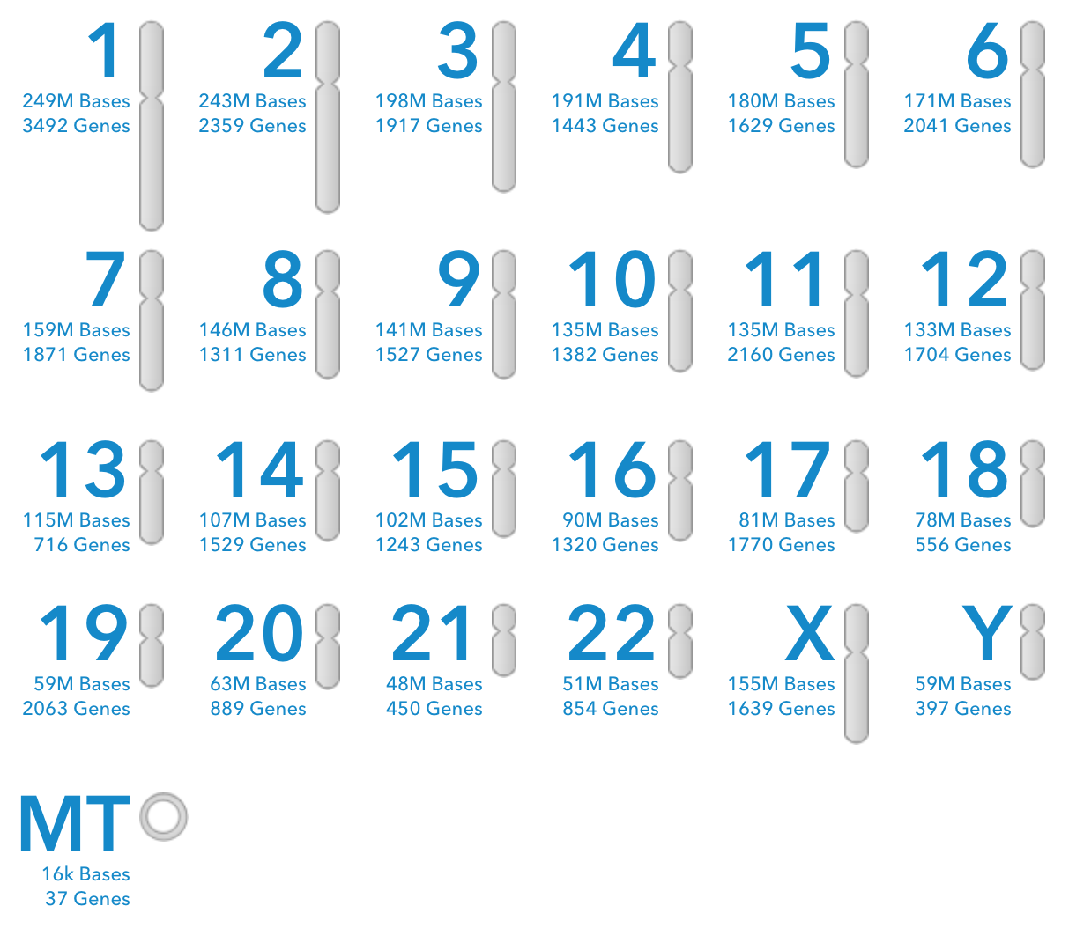
Descriptive to Creative: The Impact of Changing Technologies in the Practice of Law
Prof Nils Hoppe
Coram Chambers

Slide 2
Outline
Descriptive
Genetics as a provider of information
Dealing with knowledge/information in law
Transformation of relationships
Creative
Changing genetic information to achieve a goal

Slide 3
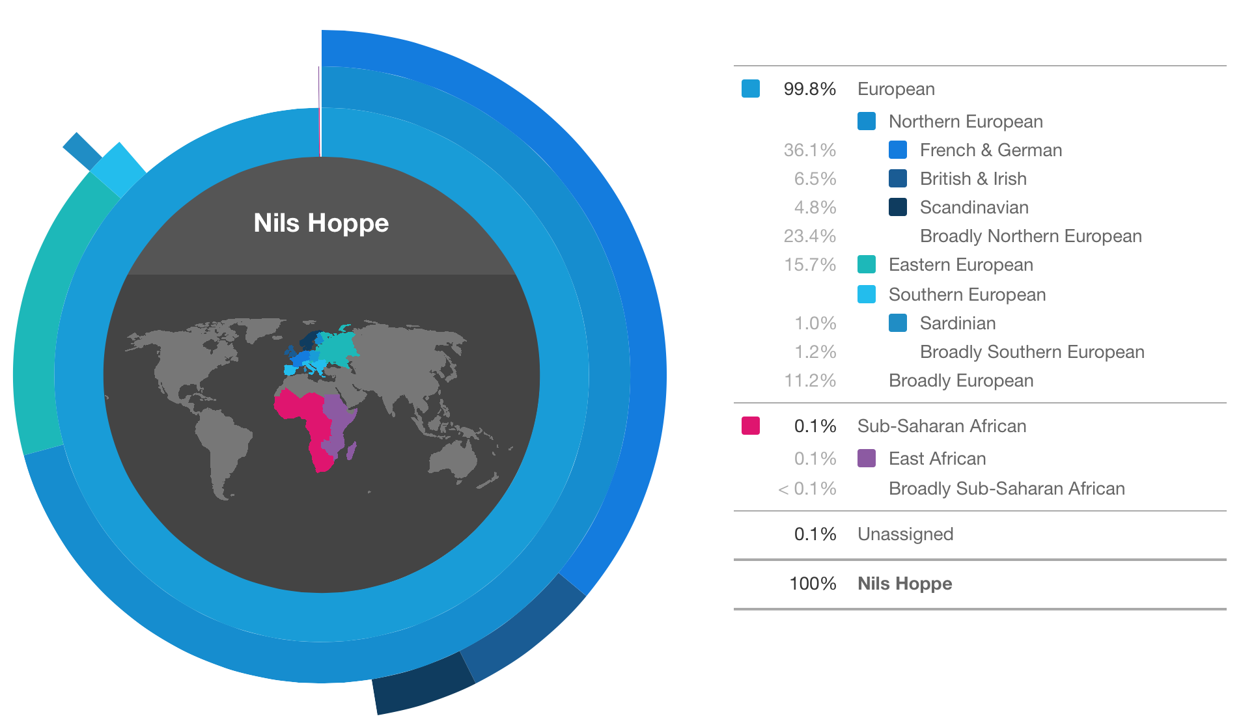

Slide 4
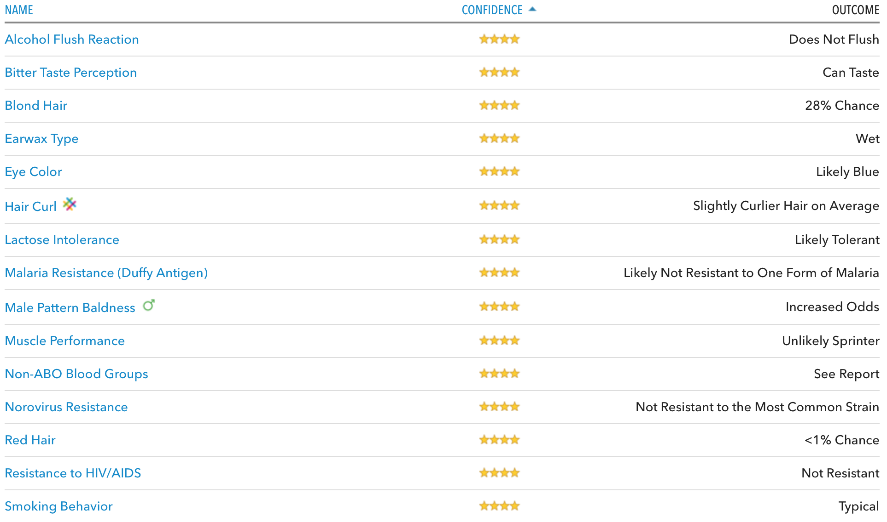
Information: Traits

Slide 5
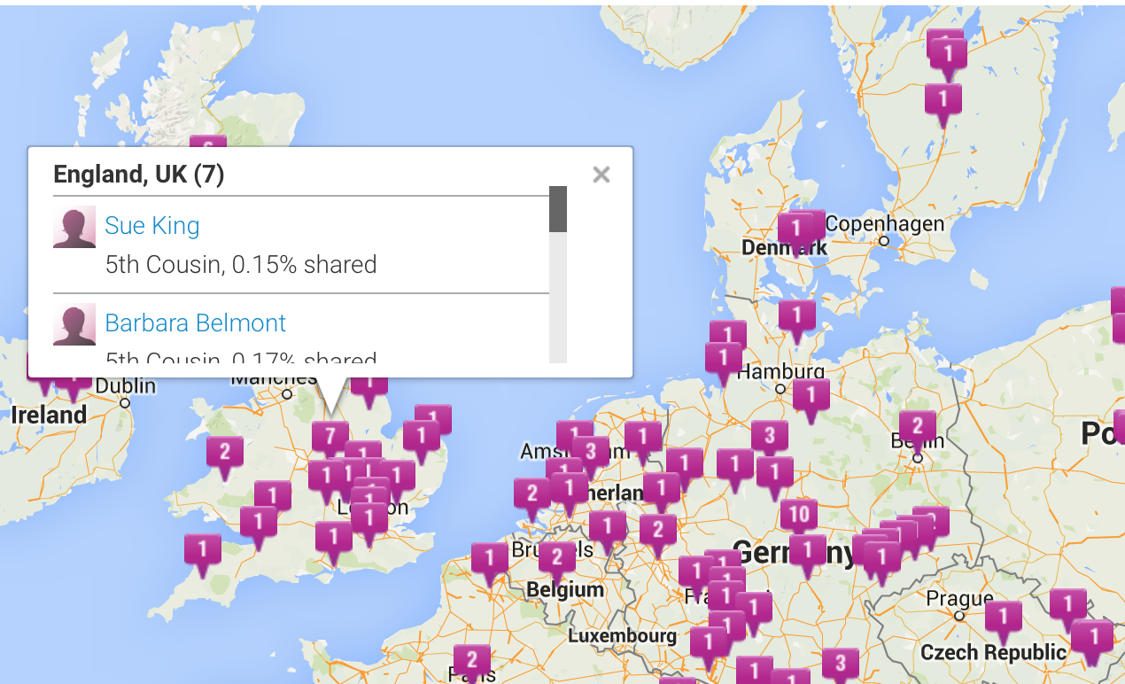
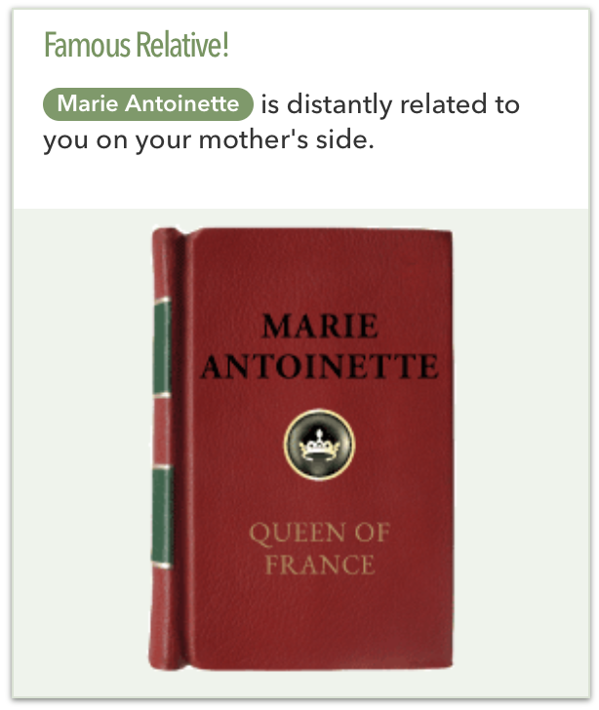
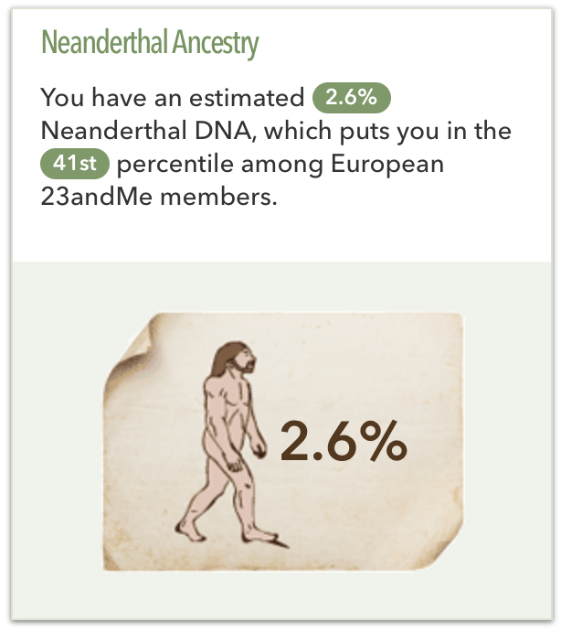
Information: Family Relations
Most obvious specific/individualised use: paternity testing.
Parenthood in refugee law (haplotype matching, parental relationships).
Identification of victims following catastrophic events.
Identifying dead monarchs in Leicester car parks.

Slide 6
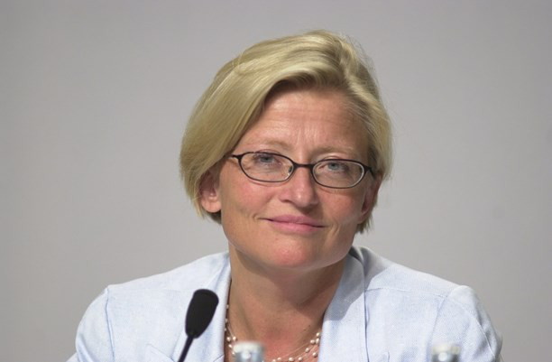
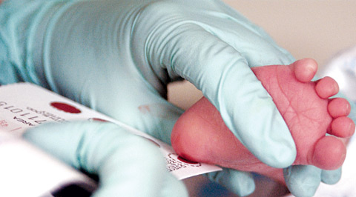
Information: Forensic
Locard’s Exchange Principle: Something is always brought to a scene and something is always taken.
Repositories of genetic material are a treasure trove for matching to crime scene material.
Volatile information; potential for false-positives/mismatching?
Familial, not individual, information.

Slide 7
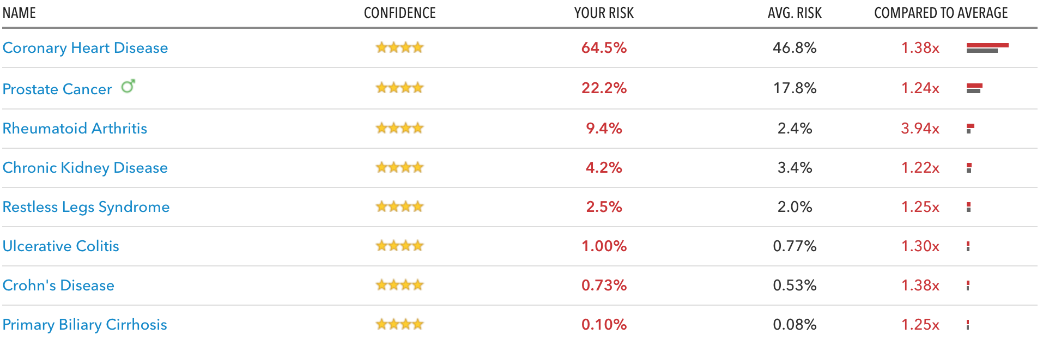
Information: Diagnostics
Risk-based information (generally not determinative)
Familial, not individual, information.

Slide 8
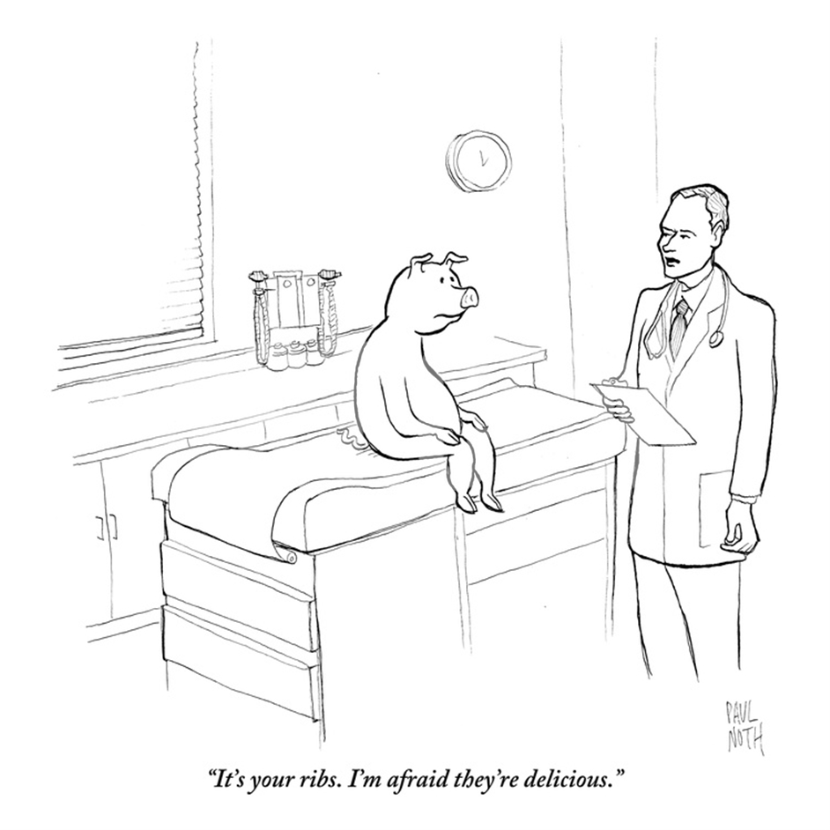
Technology: Xenotransplantation

Slide 9
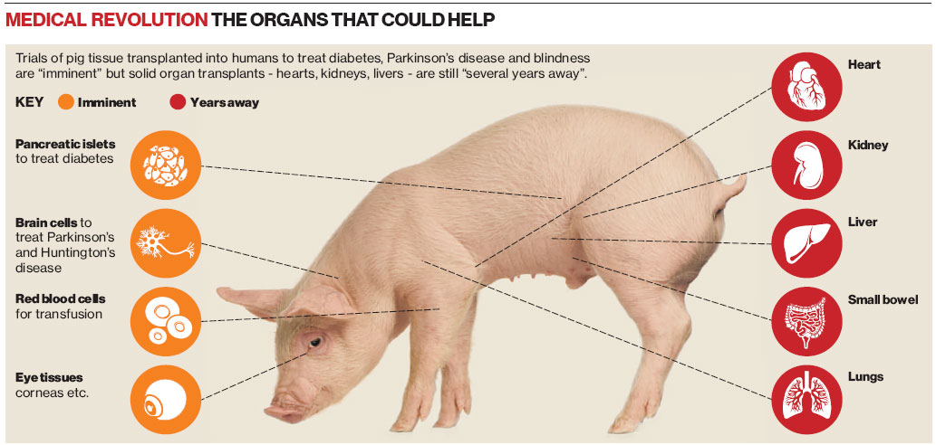
Technology: Xenotransplantation
Source: The Independent, 21 Oct 2011

Slide 10
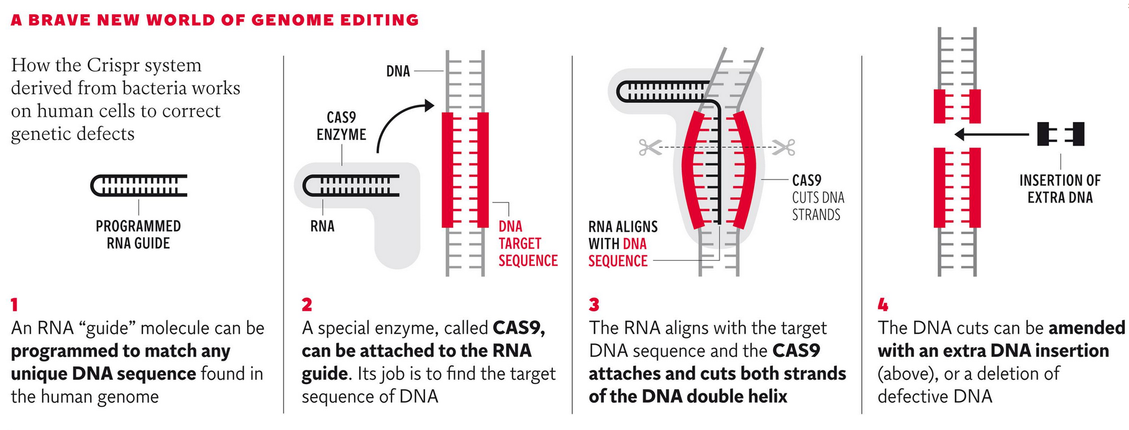
Technology: CRISPR/Cas
Source: The Independent, 7 Nov 2013

Slide 11
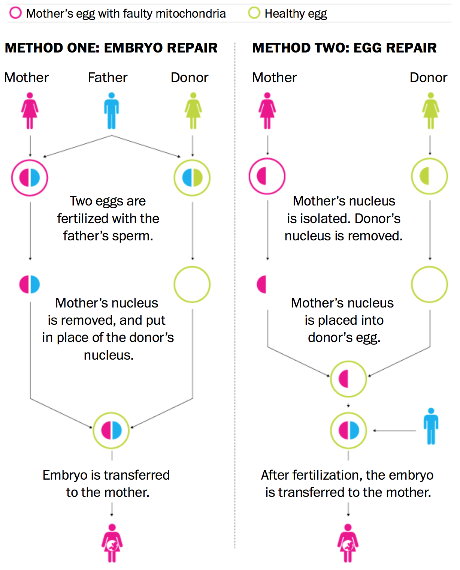
Technology: Mitochondrial Tx
Mitochondrial disease: cells are not supplied with enough energy or no energy at all.
Alpers, Leigh’s disease, MELAS. MERFF.
Often affects the brain, muscles, liver, heart and kidney.
Often leads to death in early infancy.
Source: The WasPo/HFEA, 3 Feb 2015

Slide 12
Normative Issues: Information
Is genetic information / a genetic configuration ‘special’? And whose information is this?
Traits, risks:
discrimination (workplace, insurance, etc);
commodification (workplace).
Family relations:
succession;
family law issues [X v Z (Children) [2015] EWCA Civ 34];
provides link to familial health connections.

Slide 13
Normative Issues: Information
Forensic use:
source of information (research/health) goes to issue of trust in health system / public research [X v Y [1988] 2 All ER 648; Z v Finland (1997) 25 EHRR 371];
‘Special status’ of genetic information means subject to tighter control [Marper v UK 30562/04 [2008] ECHR 1581].
Diagnostics/health forecasting:
reveals potentially actionable health information (context is relevant to legal and ethical assessment);
incidental findings in research context;
duty of care post Montgomery? [Montgomery v Lanarkshire Health Board [2015] UKSC 11]

Slide 14
Normative Issues: Creative
Xenotransplantation:
chimera creation – what makes a human being?;
Cf. Argentinian and US habeas corpus cases.
CRISPR/Cas:
“designer babies” on the horizon?;
from therapeutic intervention to enhancement?
Mitochondrial donation:
curative intervention on a future person or creation of a new person altogether?;
germ line editing as the ethical point of no return?

Slide 15
Where to next?
More uses: The availability and uses of genetic information will increase dramatically in the short term.
Changing privacy: Approaches to privacy, individualisation, informational self-determination will change with a better public understanding of genetics.
Reduce complexity: Genetic ‘evidence’ will play a pivotal role in all types of litigation; it’s important to significantly increase knowledge and understanding of the interplay of science, technology, and law in this field.
Translate science to law: There needs to be an increased flow of comprehensible, up-to-date academic knowledge about genetics into the practice of law.

Slide 16
Prof Nils Hoppe
Coram Chambers
9-11 Fulwood Place
London WC1V 6HG
Tel.: 020 7092 3700
E-Mail: clerks@coramchambers.co.uk
nils.hoppe@coramchambers.co.uk

