Slide 1
Regulation as translation: the FDA and personalised medicine
Stuart Hogarth, King’s College London
Notes:
This session will explore the role of regulatory agencies in translational research focusing on the
example of pharmacogenomics. Pharmacogenomics is the use of genomic science to study human
variability in drug response. Proponents of pharmacogenomics suggest that it will lead to a new era of
personalised medicine through a fundamental transformation in the drug discovery and development
process. Since 2000 the US Food and Drug Administration and the European Medicines Agency have
become vocal champions of personalised medicine. Both agencies have suggested that they are
uniquely positioned to shift the pharmaceutical industry from its preferred block-buster drug model
aimed at broad populations to one which is more targeted, and to facilitate the participation of
diagnostics companies in this goal. Pharmacogenomics thus presents an ideal case study of the role of
regulators in the co-production of new biomedical technologies. This process has been marked by the
creation of new socio-technical spaces in the regulatory regimes for pharmaceuticals – a preregulatory
space for the sharing of data outside the regulatory decision-making process and a precompetitive
space for the sharing of data between companies.
We shall focus in particular on FDA's efforts to use drug relabeling as an example of the ways in
which regulatory agencies are supporting the translation of pharmacogenomics from research to
clinical practice.

Slide 2


Slide 3


Slide 4


Slide 5
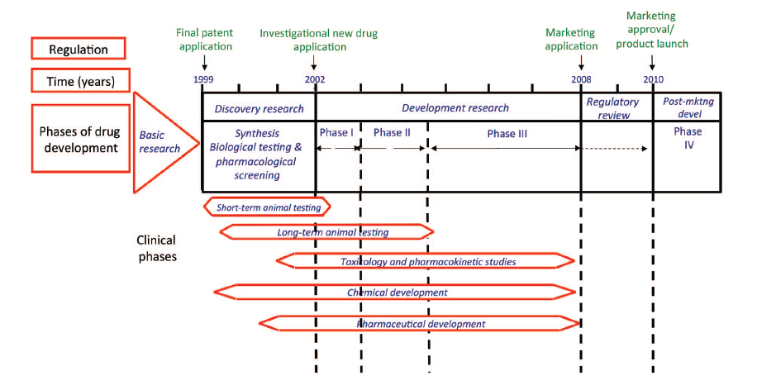
It’s just a phase I’m going through
Office of Health Economics, 2012
Notes:
20 years

Slide 6
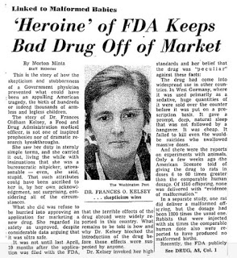
Defining development
Thalidomide scandal
1962 Kefauver Amendments
Three phases of drug development
Randomised control trials
Proof of safety and efficacy

Slide 7

Notes:
Licensing authorities and HTA agencies have quite distinct mandates and their processes and criteria for evaluation also differ significantly, but they both act as gatekeepers in the biomedical innovation process.

Slide 8

FDA changes role:
From gatekeeper to innovation enabler
... it is a ground-breaking shift in the agency's role... It is an undertaking through which the FDA, in effect, has accepted a share of responsibility for the development of novel drugs.
Lester Crawford, FDA Commissioner, 2004
Notes:
What was proposed was not just a profound change in the drug development process but a new role for the FDA. In championing these socio-technical futures the agency moved from its traditional role as guardians of public health to become promoters of innovation.

Slide 9


Slide 10
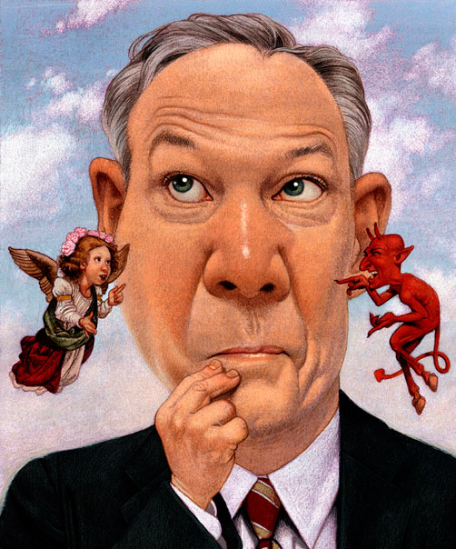
wicked problems

Slide 11

How and why did the FDA become cheerleaders for personalised medicine?
Notes:
In fact, by as early as 2004 senior officials in the FDA added their voices to the chorus of scientists and industry executives who were engaged in the visionary promotion of genomic science. Pharmacogenomics was now a crucial component in FDA’s plans for a fundamental re-engineering of the pharmaceutical R&D process. This bold new plan was set out in the Critical Path Report.

Slide 12
Regulatory scepticism
“The ratio of vision to data is very high ... We love vision, but data is our mainstay.”
Jerry Collins, Director, Laboratory of
Clinical Pharmacology, FDA, 1998.
Notes:
The second quote is from the current Commissioner of the FDA, Margaret Hamburg, in a speech she gave to the American Association for the Advancement of Science. This statement exemplifies how that sceptical disinterest turned to evangelical zeal in just a few years.

Slide 13
Regulatory enthusiasm
“This first decade of the 21st century began with the decoding of the human genome—a scientific achievement that we knew had the potential to transform our understanding of health and disease and revolutionize our fundamental approach to medicine.”
Margaret Hamburg, FDA Commissioner, 2009
Notes:
The second quote is from the current Commissioner of the FDA, Margaret Hamburg, in a speech she gave to the American Association for the Advancement of Science. This statement exemplifies how that sceptical disinterest turned to evangelical zeal in just a few years.

Slide 14
Creating a new regulatory regime
Three phases/processes
  Information gathering
  Standard setting
  Implementation

Slide 15
information
gathering

Slide 16
Public(?) engagement
  May 2002 workshop
    Co-sponsored by industry
      PhRMA, DruSafe and Pharmacogenetics Working Group
    Priority registration for industry
    Only two speakers not from FDA or industry
    No academic scientists working in the field
    No healthcare policymakers
    Subsequent workshops in 2003, 2004, 2006, 2007 and 2010

Slide 17
Policy development
“These workshops served to catalyze guidance and policy development, to build an infrastructure for regulatory review and to provide pharmacogenomics principles in drug development.”
FDA, 2013
Notes:
The workshop was followed by subsequent events in 2003, 2004, 2006, 2007 and 2010. The range of industry bodies co-sponsoring the events widened to encompass the Drug Information Association and the Biotechnology Industry Organisation

Slide 18
Industry and the FDA
“In planning the workshop we have worked with a committee including many of these companies. I found the process of coming together around this workshop signaled a new openness and a new era.”
Larry Lesko, Director of Clinical Pharmacology, FDA, 2002
Notes:
The workshop was followed by subsequent events in 2003, 2004, 2006, 2007 and 2010. The range of industry bodies co-sponsoring the events widened to encompass the Drug Information Association and the Biotechnology Industry Organisation

Slide 19
FDA as advocate
“The FDA has become a proactive and thoughtful advocate of PGx and PGt, and believes that as a public health Agency it has a responsibility to play a leading role in bringing about the translation of PGx and PGt from bench to bedside.
The FDA also realizes that it can hinder innovation and become a regulatory barrier in the translational process if it is not careful with its guidance, policies and procedures.”
Lesko and Woodcock, 2004
Notes:
The workshop was followed by subsequent events in 2003, 2004, 2006, 2007 and 2010. The range of industry bodies co-sponsoring the events widened to encompass the Drug Information Association and the Biotechnology Industry Organisation

Slide 20
Voluntary submission
  FDA creates IPRG and voluntary genomic data submission (VGDS) process – industry share PGx data outside formal regulatory review system
    creation of a new pre-regulatory space

Slide 21
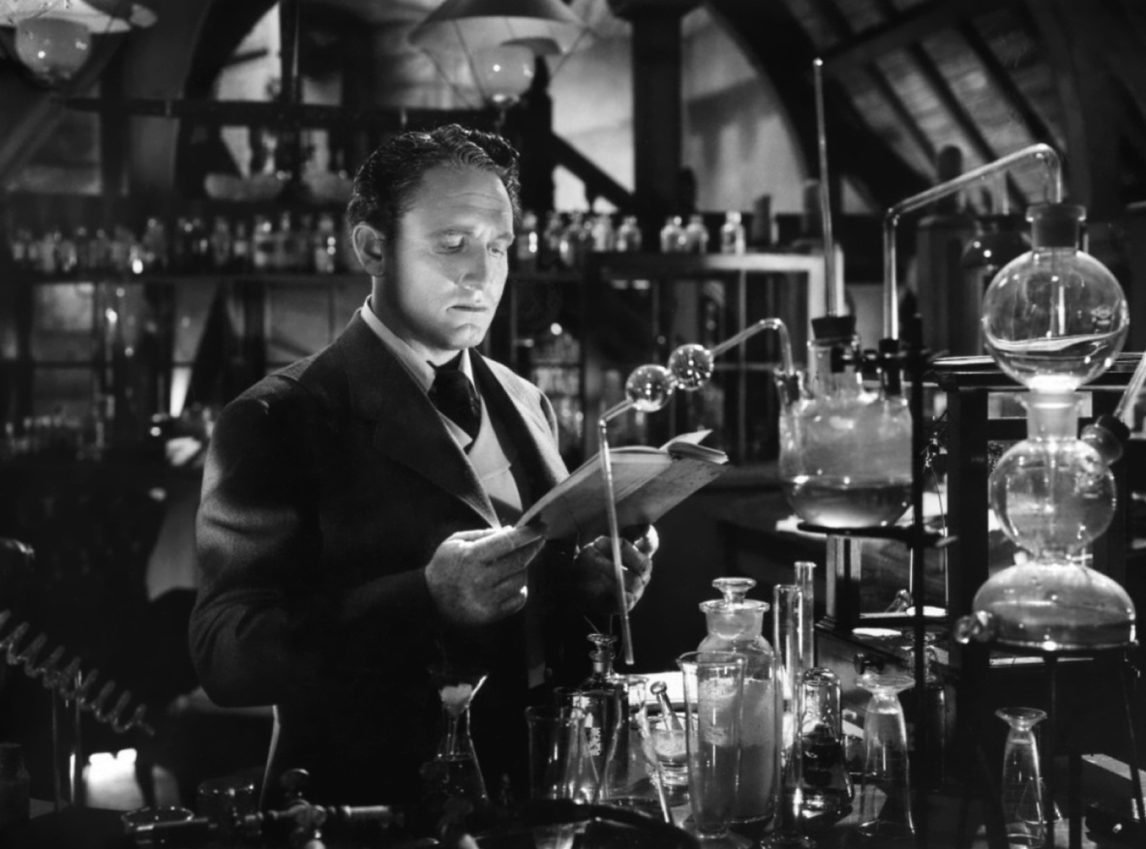
regulatory experiments
By setting up an experimental space, where, for instance, they can unleash GM organisms or options contracts without making an irreversible commitment, regulators are able to assess their own capacity to cope with novel regulatory objects, and the reactions that the partial release provokes in relevant constituencies.
Millo and Lezaun, 2006

Slide 22
neoliberal corporate bias
“... the pharmaceutical industry was, and is, permitted to have privileged strategic access to, and involvement with, government regulatory policy over and above any other interest group.”
John Abraham, 2008

Slide 23
The neoliberal assault on FDA
December 1972 - Chicago School host Conference on the Regulation of the Introduction of New Pharmaceuticals
  papers published as Regulating New Drugs
  Tufts Center for Study of Drug Development
  Center for Health Policy Research at American Enterprise Institute
Notes:
In December
1972 the University of Chicago hosted the Conference on the
Regulation of the Introduction of New Pharmaceuticals, an event
funded by pharmaceutical firms and attended by a carefully
selected group of legal scholars, industry executives, pharmacologists
and economists. The immediate result of the event was a
volume of papers, Regulating New Drugs, which provided the first
sustained critique of the regulatory regime established under the
1962 Amendments. Subsequently this network of FDA critics
established dedicated think-tanks in the mid-70s: the Center for
the Study of Drug Development (which would in time be affiliated
to Rochester University) and the Center for Health Policy Research
at the American Enterprise Institute. This new industry echo
chamber amplified longstanding industry complaints, most notably
the drug lag thesis, but articulated them within a broader neoliberal
critique of state-sponsored regulatory science “based on a presumed
inherent inability of the state e or any other person e to
comprehend as much as the market”.

Slide 24
The rise of permissive regulation
The ‘drug lag’ debate
drug lag items
1981 Reagan election
  Commission on the Federal Drug Approval Process
  Accelerated approval
  FDA budget cuts: 1979 – 8,200 staff; 1987 – 7,000 staff
1992 PDUFA (1997, 2002)
  Timeline for new drug approvals
  Industry at table with the regulator
Performance metrics
  Number of new drugs approved
  Speed of approval

Slide 25
A neoliberal agency?
Weakened in its capacity to exert its authority by cuts in funding
Increasingly reliant on industry funding and required to commit to faster review times
  Orientation of state away from welfare provision and towards supporting industry
New role as enabler of innovation blurs boundary between public and private interest

Slide 26


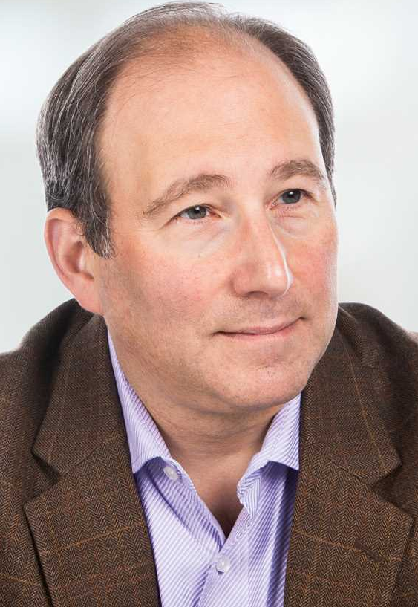
Bush’s neoliberal FDA
Scott Gottlieb
Deputy Commissioner
Mark McClellan
Commissioner
Dan Troy
Chief Counsel

Slide 27
neoliberal technocracy
“Steps to reduce the time, cost, and uncertainty of developing new drugs and devices are…important public health priorities.” FDA, 2003
Mark McClellan
Commissioner

Slide 28
neoliberal technocracy
Pharmacogenomics and the application of qualified biomarkers have the potential to decrease drug development time by helping to demonstrate benefits, establish unmet medical needs, and identify patients who are predisposed to adverse events.
Janet Woodcock, FDA, 2011

Slide 29
Setting
Standards

Slide 30
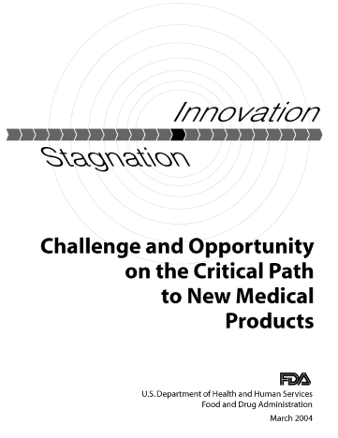
FDA as innovation enabler
“the vast majority of investigational products that enter clinical trials fail ... This high failure rate drives up costs ... the path to market even for successful candidates is long, costly, and inefficient, due in large part to the current reliance on cumbersome assessment methods
FDA, 2004, p.ii
Notes:
In 2004 the FDA launched the Critical Path initiative, an ambitious programme of work whose goal was a fundamental re-engineering of the pharmaceutical R&D process based on the development of new scientific tools for product development. Pharmacogenomics was one component of this broader regulatory reform agenda. The report was entitled “Innovation or stagnation” and its Manichean view of the state of industry R&D was dismal:
the report framed the productivity decline as the consequence of a mismatch between the rapid pace of discovery in post-genomic biomedicine and the antiquated development process for new drugs. Thus problems which had been laid at the feet of the agency - its bureaucratic caution and administrative inefficiency - were now reframed as essentially technical issues which could be addressed through the better appliance of science.

Slide 31
FDA as innovation enabler
“The sequencing of the human genome four years ago raised widespread hope for a new era in the prevention and treatment of disease created by the ongoing investment in biomedical research. But that new era has not yet arrived. Instead, 2000 marked the start of a slowdown in new drug and biologic submissions to regulatory agencies worldwide.”
Notes:
The mapping of the human genome plays an important role in framing the report’s argument. The opening chapter begins:

Slide 32
FDA as innovation enabler
“Not enough applied scientific work has been done to create new tools to get fundamentally better answers about how the safety and effectiveness of new products can be demonstrated, in faster time frames, with more certainty, and at lower costs. In many cases, developers have no choice but to use the tools and concepts of the last century to assess this century’s candidates...”
Notes:
Faced with these challenges the FDA proposed the creation of a new “product development toolkit - containing powerful new scientific and technical methods”. These would include “biomarkers for safety and effectiveness, and new clinical evaluation techniques”. There was the promise of a review of fundamental aspects of the drug approval process such as clinical trial design.

Slide 33
FDA as innovation enabler
““A new product development toolkit — containing powerful new scientific and technical methods such as ... biomarkers for safety and effectiveness, and new clinical evaluation techniques — is urgently needed to improve predictability and efficiency along the critical path from laboratory concept to commercial product.”
Notes:
The report argued that the FDA was in a uniquely powerful position to reframe biomedical innovation because its role as a regulator gave it the authority to create the standards which shape the biomedical innovation process. In doing so, the agency sought to place itself at centre of the genomic turn in the life sciences.

Slide 34
FDA as innovation enabler
“... we have an important role to play. Because FDA's standards are often used to guide development programs ... FDA is uniquely positioned to help identify the challenges to development....”
Notes:
The report argued that the FDA was in a uniquely powerful position to reframe biomedical innovation because its role as a regulator gave it the authority to create the standards which shape the biomedical innovation process. In doing so, the agency sought to place itself at centre of the genomic turn in the life sciences.

Slide 35
FDA changes role:
From gatekeeper to innovation enabler
... it is a ground-breaking shift in the agency's role... It is an undertaking through which the FDA, in effect, has accepted a share of responsibility for the development of novel drugs.
Lester Crawford, FDA Commissioner, 2004
Notes:
What was proposed was not just a profound change in the drug development process but a new role for the FDA. In championing these socio-technical futures the agency moved from its traditional role as guardians of public health to become promoters of innovation.

Slide 36
Setting standards
  Collaboration between regulatory, industry and academic scientists in new pre-competitive space
    Critical Path Institute
  Validating genomic data for use in regulatory decision-making e.g. Predictive Safety Testing Consortium – transnational cooperation between EMA/FDA, industry and academia

Slide 37
Providing guidance
Pharmacogenetic data submissions – final guidance (March 2005)
Drug interaction studies – study design, data analysis and implications for dosing and labelling (October 2004)
Drug-Diagnostic Co-Development - Concept Paper (April 2005)
Pharmacogenetic tests and genetic tests for heritable markers (February 2006)
Drug Metabolizing Enzyme Genotyping Systems – Class II special controls guidance (March 2005)

Slide 38
implementation
regulatory decision-making

Slide 39
FDA’s relabeling project
  “At the beginning of the decade, the FDA began looking for opportunities to improve the quality of therapeutics using already marketed drugs by updating the labels to include PGx information.“
  Lesko and Zineh, Pharmacogenomics, 2010

Slide 40
April 2003
  Larry Lesko, Director of the FDA’s Office of Clinical Pharmacology and Biopharmaceuticals
  What types of evidence?
  Prospective clinical trials ?
  unclear who would conduct the research
  Alternatives
  systematic reviews of academic studies ?
  expert opinions from professional groups?

Slide 41
relabeling decisions
  2003 - 6-mercaptopurine thiopurine
    TPMT = increased risk of adverse events
  2006 - Irinotecan
    UGT1A1 = increased risk of adverse events
Notes:
In 2003 the FDA relabeled the cancer drug 6-mercaptopurine thiopurine drugs to indicate the increased risk of adverse events as a result of interinfivuual variation in TPMT activity. In 2006 another cancer drug, Irinotecan, was relabeled, again to warn of pharmacogenetic risks, this time associated with the UGT1A1 gene. However, in neither case did FDA relabeling make a major impact on clinical adoption of pharmacogenetic testing.

Slide 42
clinical scepticism
  “From a liability perspective, it's kind of disturbing to have some labeling that says: “and you may want to think about doing this because these polymorphisms affect dosing.” Okay. So you do the test. Then what? And if you don't do the test with that on the label, where are you? So you're kind of between a rock and a hard place”
  Debra Leonard, AMP / SACGHS, 2006
Notes:
Laboratory directors, a key group for the successful adoption of new diagnostic tests, complained that the pharmacogenetic data on drug labels was insufficient to guide dosing decisions and that the absence of clear guidance raised concerns about liability

Slide 43
FDA vs HTA
“The clinical utility of routine reduction of initial irinotecan dose in *28 homozygotes based on UGT1A1 genotyping is unknown. No study has prospectively documented the potential beneﬁts (reduced adverse drug events) or harms (reduced proportion of responsive tumors).”
  EGAPP, 2009
  “[I am[ not sure they had all the data they needed, maybe FDA are more enthusiastic, the dossier is not absolutely compelling”
  EMA PGWP member, 2006
  Data on UGT1A1 “suggestive” but “insufficient”
  EMA reflection paper, 2008
Notes:
The HTA community were also sceptical, an attitude exemplified by an evidence review on UGT1A1 testing conducted by the Evaluation of Genomic Applications in Practice and Prevention (EGAPP) working group:

Slide 44

Warfarin:
a poster child for pharmacogenetics?

Slide 45
Warfarin: risks and benefits
One of the most widely prescribed drugs in the world
Significant increase in use over past 10 years
Intended to prevent and treat thromboembolisms
Efficacy of drug is well-established
BUT
narrow therapeutic index
wide inter-individual variability in dose requirements
major risk is bleeding: frequent and severe
Warfarin is second most common cause of drug-induced adverse events
800 severe adverse events per year in USA
Notes:
The clinical case for warfarin has multiple dimensions: it is a widely prescribed drug taken by more than 2 million patients in the USA. It is an effective treatment for prevention of blood clots but it is also a leading cause of serious adverse reactions due to its narrow therapeutic index and wide inter-individual variability in dose requirements. Establishing the optimal dose for an individual patient can take weeks of careful monitoring of their International Normalized Ratio (INR) response, and during this period there is a high risk of adverse events.

Slide 46
FDA relabels warfarin
  November 2005 - clinical pharmacology advisory
  committee (CPAC) vote 8-2 for relabeling of warfarin
  “FDA-approved tests have very fuzzy labels … but the one
  for Warfarin will be a much stronger recommendation
  the meeting was unanimous – when the FDA label change
  comes out in the summer it will be widely picked up.”
  (Interview with US scientist and member of CPAC, 2006)
Notes:
A year earlier an FDA advisory committee had voted in favour of relabelling warfarin to include guidance on the use of genetic testing to determine a safe dose for the drug.

Slide 47
FDA relabels warfarin
Timeline
  November 2005 - clinical pharmacology advisory committee (CPAC) vote 8-2 for relabeling of warfarin
  August 2007 – FDA relabel warfarin
Notes:
Nearly two years after the advisory committee had advised FDA relabel warfarin, the agency finally announced its decision.

Slide 48
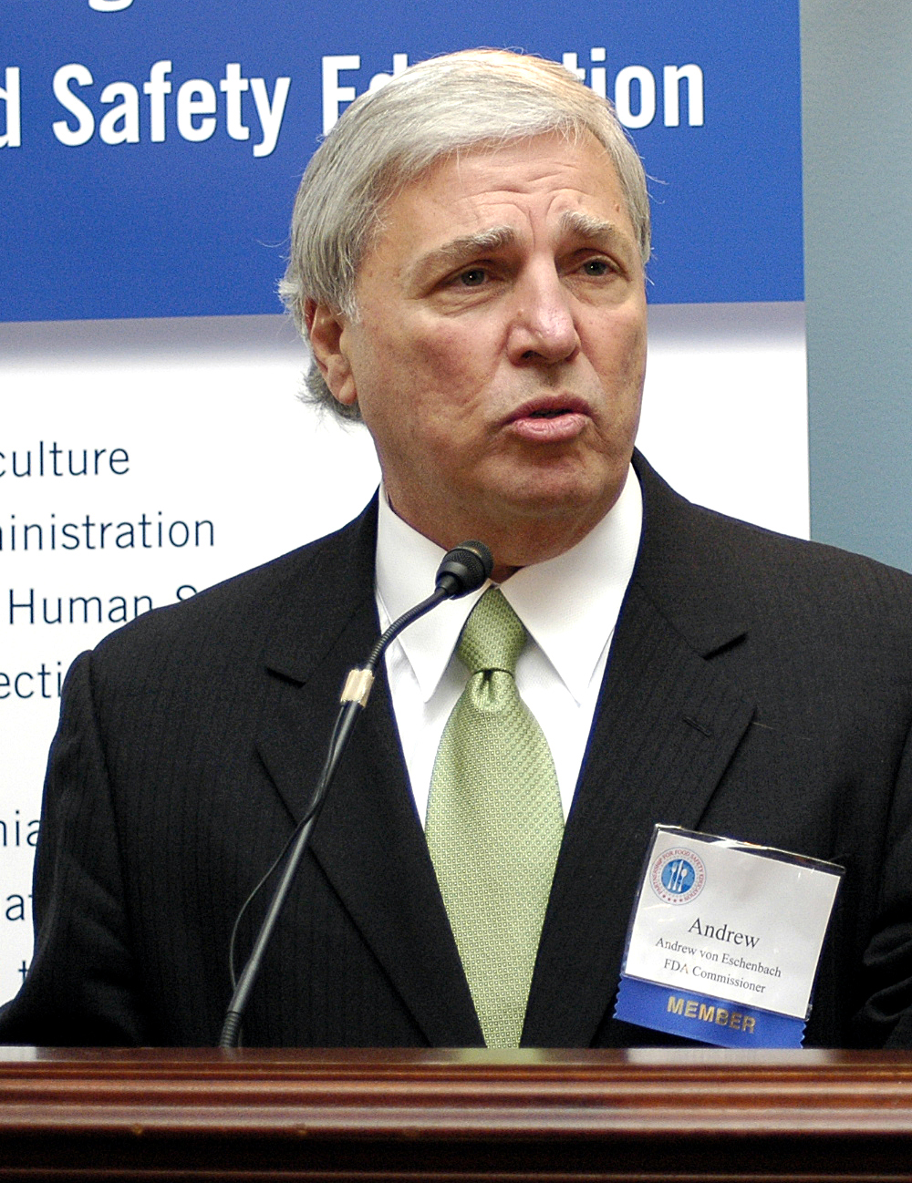
"Today's approved labeling change is one step in our commitment to personalized medicine. By using modern science to get the right drug in the right dose for the right patient, FDA will further enhance the safety and effectiveness of the medicines Americans depend on.“
Andrew von Eschenbach, FDA Commissioner, August 2007
Notes:
The FDA commissioner put his weight behind the relabeling decision with a statement in the FDA press release trumpeting it as a step towards personalised medicine.

Slide 49
“there’s a fair amount of work that would have to be done before the biomedical community would determine whether or not this would be considered part of standard therapy or not ...”
Janet Woodcock, FDA
Notes:
Woodcock herself acknowledged that there was still much work to be done to determining the role of pharmacogenetic testing in Warfarin therapy. Crucially, the FDA had not provided clear guidance on how warfarin dosing should be adjusted in line with a patient’s genetic profile.

Slide 50

Things get nasty...
Notes:
In the event, FDA’s decision to relabel warfarin amplified, rather than resolved, differences of opinion concerning the weight of evidence and types of evidence required to support the adoption of pharmacogenetic testing.

Slide 51
Relabeling decision attacked
“...a controversial ruling ... The tests cost $400 each. Waiting for the results might delay starting warfarin. The results can be confusing, as when one test suggests the need for a high dose of warfarin and the other indicates the need for a low dose. Some experts worry that doctors might rely too heavily on the genetic tests and not pay enough attention to the myriad other factors that influence how an individual responds to warfarin. Others are concerned that the new wording might prompt lawsuits from patients who do not have the test and later experience problems with warfarin.“ Harvard Health Newsletter, December 2007
Notes:
Harvard Health Newsletter summarised many of the concerns being expressed by clinicians. SLIDE The scepticism is noteworthy, not only for its succinct summary of the key issues, but for the fact that Harvard researchers were collaborating with FDA on a study to develop personalised dosing algorithms with support from the Critical Path Initiative.

Slide 52
Clinical scepticism
“[W]e suggest against pharmacogenetic-based dosing until randomized data indicate that it is beneficial (Grade 2C)”
American College of Chest Physicians
2008 anticoagulation management guidelines
“no study has yet shown this intervention to be effective in reducing the incidence of high INR values, the time to stable INR, or the occurrence of serious bleeding events.”
American College of Medical Genetics
2008 evidence review
Notes:
Two professional bodies weighed in against warfarin testing arguing that more outcomes evidence was required. The ACCP called for randomised data.

Slide 53
Payer rejection
“Pharmacogenetic testing is considered investigational for the purpose of managing the
administration and dosing of warfarin ... Genetic testing may help predict the initial warfarin dose within the first week of warfarin treatment, but the evidence does not support the conclusion that clinically relevant outcomes, such as rates of bleeding or thromboembolism, are improved..”
Blue Cross Blue Shield
March 2008
Notes:
Health care payors also weighed in. The Blue Cross Blue Shield rejection deemed warfarin pharmacogenetics as investigational, citing the lack of evidence demonstrating that pharmacogenetic testing actually improves clinical outcomes. Aetna came to similar conclusion.

Slide 54
FDA shifts the goalposts
The value of observational data
Previous warfarin PGx studies were
“conducted in a natural setting. ... Many people feel that, when normal bias is controlled, prospective observational studies reflect more accurately how drugs are actually used ... in terms of typical practice settings.”
Larry Lesko quoted in CAP Today, 2009
Notes:
FDA officials like Larry Lesko began to emphasise the value of retrospective/observational studies.

Slide 55
FDA shifts the goalposts
RCTs – not fit for purpose?
“Most development programs must rely on trial and error empirical testing, rather than on more mechanistic approaches built on new molecular and genomic knowledge.”
Lester Crawford, Acting FDA Commissioner,
Critical Path Opportunities Report, 2006
Notes:
FDA was signalling that the RCT was not fit for purpose in the age of personalised medicine, the data which the agency was privileging was mechanistic understanding of disease and drug response based on genomic data.

Slide 56
Data disputes
“There is an inherent, unresolved tension between genomics-enabled personalized medicine and the tenets of population-based, evidence-based medicine.”
Gregory-Feero, Guttmacher and Collins, NEJM, 2011
Notes:
Different perceptions about level of evidence needed

Slide 57
Relabelling as regulatory experiment
“... biomarkers have to be used to be accepted ... part of understanding the performance of these newer technologies is to use them, to see how they move with treatment or how they fail to move with successful intervention, to see how they perform in various populations and with a wide variety of drug interventions ... ”
Janet Woodcock, 2004

Slide 58

Thanks for listening
  Contact:
  Stuart Hogarth, Department of Social Science, Health and Medicine, King’s College London
  Email: stuart.hogarth@kcl.ac.uk
  Blog: genevalues.wordpress.com

