Slide 1
Different Models in Governance: National Biobanks in A Comparative Perspective
Dr. Chih-hsing Ho
Academia Sinica, Taiwan
Email: chihho@sinica.edu.tw
HeLEX Translation in Healthcare Conference
24 June 2015
1
of 20

Slide 2
Purposes
Raising questions
Spotting issues
Getting feedback
2
of 20

Slide 3
“Translation”
Legal aspect
Transmission of Rules?
Legal Transplant ?
3
of 20

Slide 4
“Translation”
A process of negotiation between global and different local settings..
4
of 20

Slide 5
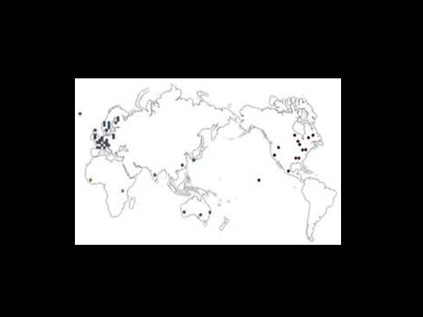
Q: Why biobanking?
Q: How has biobanking become a “global phenomenon”?
5
of 20

Slide 6
Perspectives
Re-contextualisation
Global bio-economies
Political Economy
6
of 20

Slide 7
Perspectives
Health vs Wealth
Trust
7
of 20

Slide 8
Governance Models
Soft vs Hard
Consent (dynamic, broad; group consent)
Secondary use of samples and data
Privacy and data protection
8
of 20

Slide 9
Taiwan Biobank
Target: 200,000 samples (out of 23 millions), a population-based large cohort study
Sample Collected from 2009 (now about 9,000 -10,000 samples)
Sampling: “Taiwanese” includes Hoklo (70%), Hakka (15%), Mainlanders (13%), Taiwanese Aborigines (2%)
9
of 20

Slide 10
Taiwan Biobank
BioMed Technology Island Plan (2004)
National Health Insurance Scheme (99%: compulsory enrolment)
Household Registration Database
Developmental State
10
of 20

Slide 11
Health + Wealth
The Role of the State: Dual
Globally: market player vs Locally: health guardian
Ethical Controversies
Trust
11
of 20

Slide 12
Taiwan Biobank
Dual Governance Frameworks
IRB + EGC
Taiwan Biobank Management Act, 2010
12
of 20

Slide 13
Consent
Broad Consent
Group consent for Taiwanese Aborigines
How to define “group”?
Representative Issue
Indigenous Basic Law
13
of 20

Slide 14
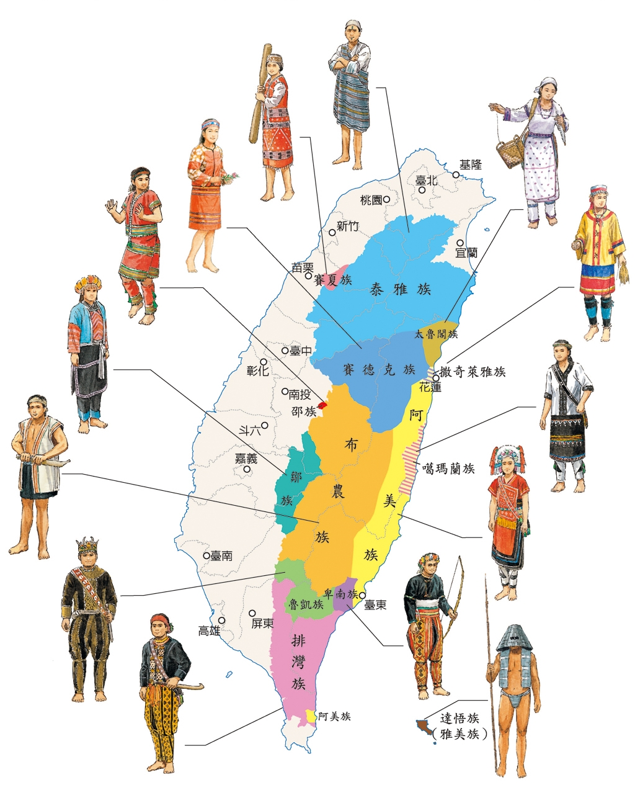
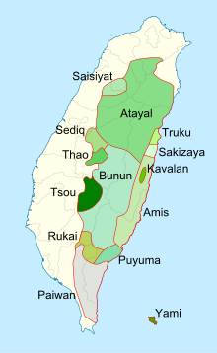
14
of 20

Slide 15
Secondary Use
From biobank to “big data”
Taiwan Health Cloud Project (2015-2019)
Extension of biobank research?
Re-consent?
15
of 20

Slide 16
From Biobank to “Big Data”
Data Linkage (disk --> VPN)
Cloud Computing
Safe Harbour vs Consent ?
16
of 20

Slide 17
From Biobank to “Big Data”
Data Sharing
International Harmonisation of Rules
Accountability
Opt-Out option
17
of 20

Slide 18
A Comparative Perspective
Icelandic Health Sector Database (HSD): exclusive license to deCODE (commercial)
UK Biobank (public, common good)
Taiwan Biobank ?
18
of 20

Slide 19
“Translation”
Legal aspect: a dialogue between global and local rules
Neither top-down, nor bottom-up
A process of negotiation btw different levels of authorities and different agencies
19
of 20

Slide 20
Thank you for your attention
20
of 20

