Slide 1


Jayne Hewitt RN BN LLB LLM
PhD Candidate
Griffith Law School
Griffith University
Queensland, Australia

Slide 2



Slide 3

pharmacogenomics

Slide 4



HLA-B*5701

Slide 5


Slide 6
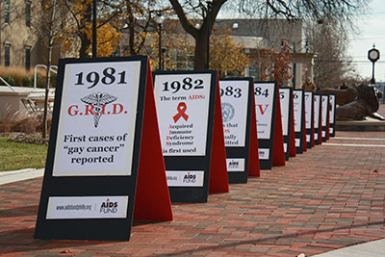

Slide 7



Slide 8
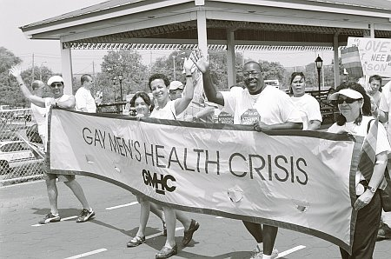

Slide 9
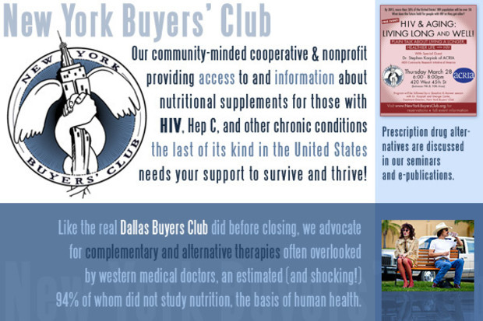

Slide 10




Slide 11


Slide 12

Regulatory Change
Notes:
In 1991, a group of physicians, activists, and people with HIV, tired of the slow pace of government-sponsored and academic research, took action. Under the leadership of prominent doctors and researchers, these men and women brought the first-ever activist, community-based approach to the study of new treatments for the disease. Since then, ACRIA’s Robert Mapplethorpe Clinical Trials Program has contributed to the development of a remarkable 20 medicines that have gone on to receive FDA approval.

Slide 13

Accelerated approval

Slide 14

ABACAVIR

Slide 15


Slide 16

Hypersensitivity

Slide 17


Slide 18



Slide 19
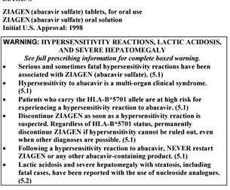

Slide 20

2014
766 subsidised tests

