Slide 1



What’s in a name? Identifying multiple representations of women who provide eggs for mitochondrial research.
Erica Haimes and Ken Taylor
PEALS Research Centre
Newcastle University, UK
‘Translation in Healthcare’, HeLEX, Oxford University.
June 23-25, 2015
Notes:
Title slide showing: less than one minute hello and thanks for invite.

Slide 2
Who is being named?
A young woman living in the North East of England.
Hears about the need for eggs for research.
Contacts the fertility centre that works with scientists.
Visits the clinic to get more information.
Finalises decision and consents to provide eggs.
Medical screening.
Receives training and begins hormone injections, one per day.
Visits clinic for one or two check-ups over four weeks.
Attends clinic and, if all is well, receives training in preparing new hormone.
Two injections per day for one week and another monitoring visit to clinic.
Attends clinic for egg collection.
Receives £500.
Recovers from procedure.
Notes:
Keep to four minutes, but don’t rush. Time emphasises contribution made by provider.
NB Finalising decision, consenting and having medical screen (t-v ultrasound and bloods) can all happen on one visit or may be over two.
Each of these items can be expanded; each is only a summary of a complex social process.
Take point 10, egg collection – or ‘harvesting’ as it is often known by clinicians.
The next two slides gives a glimpse into that process. Not the clinic we work with, but images freely available on the web, put there by businesses selling the equipment required.
Max 5mins to next slide.

Slide 3



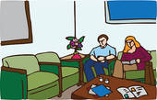

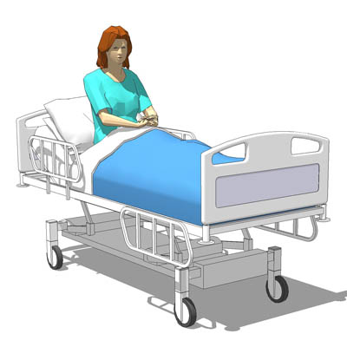


‘Egg harvesting’ translates to …
Notes:
Need to click for animations.
Run through – include childcare, taking a friend or relative, maybe car maybe public transport, waiting alongside fertility patients – usually couples.
Sedation, not general anaesthetic. Recovery over a couple of hours. Cheque presented while in recovery.
Taxi or private car home.

Slide 4
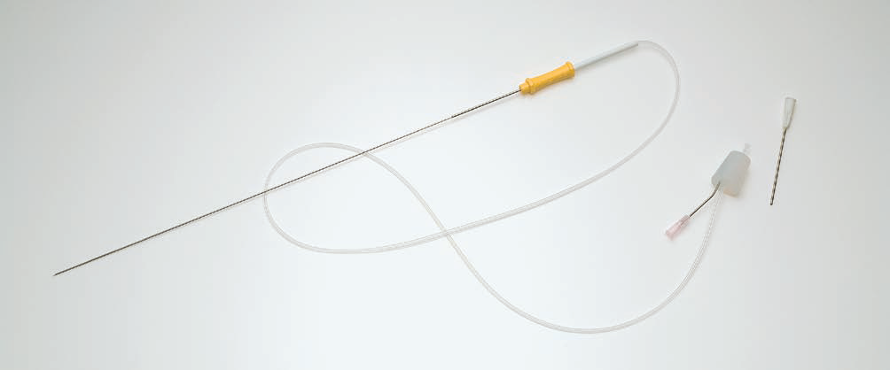
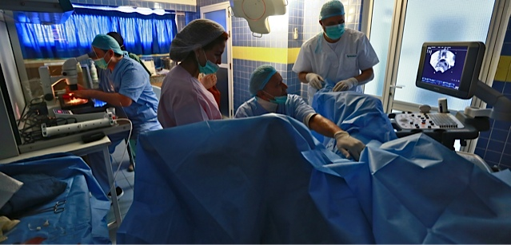
Egg ‘harvesting’
Notes:
Note the number of people in the room.
The way that, even here, the woman is hidden under surgical covers.
If you can imagine it, the needle shown at the top is 30cm long – the tube coming out the end is connected to a vacuum source.
The needle is manipulated under the guidance of ultrasound images. There’s more of that later.

Slide 5
So what name is given to this woman?
If she is named at all:
to the Nuffield Council on Bioethics (in their ethical review in 2012) she is
most often a ‘mitochondrial donor’
though occasionally an ‘egg donor’
but should not be ‘given the same status in all aspects of regulation as a reproductive egg or embryo donor’
to the Department for Health (2014/15) she is
a ‘mitochondrial donor’ who ‘should be treated more like [an] organ donor’
is not to be considered a ‘parent’
and is someone who should remain anonymous
Notes:
Start by asking what name the audience would give to a woman who goes through all that.
Here are some ways in which she is categorised by the major stakeholders in the recent debates in the UK.
Mito donor is most commonly used term throughout.
Two minutes for this slide.
Max Xmin to next slide.

Slide 6
Further names for this woman
to Parliamentarians in debate (2014 and 2015) she is
Usually invisible, unless she is a ‘vulnerable woman’
to the regulator, the Human Fertilisation and Embryology Authority, since 2011 she has been
a ‘mitochondrial donor’ and has ‘the status of a tissue donor’
not equivalent to an egg donor for treatment
and is someone who should remain anonymous
to the clinicians and scientists involved she can be
an ‘altruistic egg donor’ or an ‘egg donor for research’
or ‘just a tissue donor’.
Notes:
Construct of vulnerable woman echoes some bioethics terminology but is most often invoked in debates around embryo research by those who are opposed on moral or religious grounds. The egg provider is only made visible by those who want the whole process stopped.
Can mention that in the HFEA consultation exercise, the video they produced represented the intending parents as cartoon outlines of a man and a woman, the egg provider was represented by a cartoon drawing of a power station.
Two mins for this slide.
Max xmin to next slide.

Slide 7
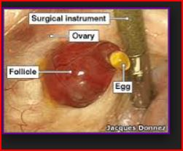
The absent presence of providers: Harvesting eggs – hiding women (Haimes 2014)
The woman often only appears as a disembodied egg in a laboratory.
Notes:
The absent presence of tissue and organ providers
(but Lesley Sharp’s work)
NB Naming of component parts, even the instrument and the photographer – but not the woman.
Providers’ views and experiences:
The silent party; open up the black box of the social contexts of provision and acquisition
Pragmatic definition of donation: NCoB [but not donors – use elsewhere?]
Listen to what they say rather than stipulate the significance of what they might be thought to think
Framings and boundaries of relevance from their perspective
‘Styles’ of participation as well as demographic characteristics (H&WB,xxxx)
Reasons for non-provision?
Should it be easier or harder to be a provider?
But providers generally rendered invisible (but assumed to be benign e.g. ‘Womb donors’, but H,T&Z, 2014)
or kept at a distance (because seen as undesirable)
or kept silent (because assumed to raise too many complexities to involve them, e.g. ‘just tissue donors’ NCoB mito; and draft legislation? CHECK!),

Slide 8
Further categorisation of this woman
To journalists she is
a contributor to a ‘three-parent baby’
To us she is
An ‘egg provider’ (Haimes and Taylor 2009, 2010; Haimes, Taylor and Turkmendag 2012; Haimes 2013)
Our attempt to start from position of analytical neutrality; less presumption of motive
In the bioethics literature…
Not often mentioned; literature focusses on the ethics of the procedure, the impact on any potential child, and of germ-line modification, eg
Bredenoord and Braude (2011) BMJ, 8 Jan, 342, 87-9.
Bredenoord, Dondorp, Pennings and De Wert (2011) Ethics of modifying the mitochondrial genome, J Med Ethics, 37, 97 – 100
But see also Baylis (2013) RBM Online 26, 531-4
Notes:
The construction of ‘three parent baby’ has been around for some time and is a way in which journalists and other commentators convey a genetic contribution from two women and one man to a child. The conflation of genetic contributor and parent is only one instance of a lack of nuance and clarity in public debates that I presented on last week and which Erica and I will explore in a forthcoming paper.
In our abstract we referred to her as a ‘second woman’. ‘Second woman’ was changed to ‘the other woman’ in an abstract written later than this one. The second woman is of course the first woman in her own life.
The idea of ‘the other woman’, with all the connotations that has for speakers of English, is deliberately provocative. Usually hidden, her exposure causes disruption and often disgrace on her.
In the debates as they have happened, it is as though the stakeholders regard the egg provider as ‘the other woman’; someone to be hidden behind terms such as ‘mitochondrial donor’.
And perhaps at the root of concern about receiving a donated egg, fertilised by partner’s sperm?
2. Bredenoord, Dondorp, Pennings and De Wert (2011) Ethics of modifying the mitochondrial genome, J Med Ethics, 37, 97 - 100
Quote – By focusing on the issue of identity, we will leave aside other potential objections against nuclear transfer to prevent mtDNA disorders, such as safety issues, the moral evaluation of ‘three genetic parents’… (p97)
Identity in this case is the potential future child.
There is also an acknowledged perpetuation of inaccurate terminology,
Although it would therefore be more precise to talk about ‘mtDNA replacement’ rather than ‘mtDNA modification’, we nevertheless use the term ‘modification’ as this is the term usually deployed in the literature. (p98)
This has the effect of shifting the focus onto the intending parents and away from the provider of the mitochondrial genome that is required in order for the parents to have the genetically related child, free from mt-disease, that they desire.
The authors conclude that the change of mt-DNA (however described) does affect the essential characteristics of the future child – as do we.
But the modified, or rather replacement, mitochondria come from a woman who is excluded from consideration by the continued use of inaccurate terminology.
Some of these authors, eg Pennings, have given some consideration to egg ‘donors’ but not in the context of mt-donation.
Three mins for this slide.
Max 11 min to next slide.

Slide 9
Questions raised by the multiple representations of the egg providers
Do any of these characterisations adequately convey the practical, physical or social role played by these women?
Is this a case of ‘making up’ donors (Hacking 2002, 2006)
Do these characterisations translate ethical issues into technical issues and thence to technical solutions?
McCallum 2014
What impact on debate amongst the various publics, parliament, in the press?
Notes:
Notes.
The answer to the first is self evident.
I will focus on the last of these.
Max x min to next slide.

Slide 10
Strategies of persuasion (Haimes 2014)
Framing the debate by enrolling particular characterisations (translations) of the women who provide eggs
Instruction to participants to hear the terms of debate in a particular way
Persuades the audience to diminish the role of the egg provider
Simultaneous diminution of the significance of the procedure; ‘only 13 genes’
Notes:
Notes.
Two to three min for this slide.
Max 15 min to next slide.

Slide 11
Some effects of this translation
Reduces the egg provider to ‘just tissue’, ‘only mitochondria’, ‘only 13 genes’
Permits debate to be framed in terms of pre-existing tissue/organ donation practices
Already established practice
Normalisation; business as usual
Smoothing the path to legalisation (2015)
Results in different treatment of (and perhaps ethical protections for) egg providers for mt-DNA replacement compared to other egg providers
Notes:
Notes.
Three to four mins for this slide.
Max 19 min to next slide.

Slide 12
Final thoughts
Winston (BMJ): supports the science and its translation to therapy but suggested there has been misrepresentation to gain acceptance.
We add to this concern the effects on the debate of the categorisation of the role played by the women who make the science possible.
Our research seeks to uncover the way these women talk about and describe themselves and their role.
Our role is as a critical friend
Contribute to transparency in public discourse.
Notes:
Notes.
Summarise in one to two mins.
End at 20 min.

Slide 13
Acknowledgements
Interviewees
Wellcome Trust, UK
Professor Alison Murdoch and the Newcastle Fertility Centre, UK
Project Advisory Group
PARTS International Research Network

