Slide 1
Clara Gaff Program Leader Melbourne Genomics Health Alliance
Clinic of the future: near and far

Slide 2

Notes:
I am going to start with a confession, Back in 1990 as the HGP was beginning I was pretty sceptical about it. I was a PhD student in a molecular biology lab who knew how much work it was taking me to sequence less than a kb of sequence and I could not conceive of developments that would mean it was less than 10 year. I’ve pretty consistently underestimated the speed at which technology progresses and knowledge is generated.
But as a genetic counsellor for the last 20 years, I’ve had the opposite experience. Translation into routine practice is not nearly as rapid. 1997

Slide 3




Melbourne Genomics Health Alliance
Notes:
Two years ago I was asked to describe how genomics should be used and how could they work there to get thatwith the ‘system of the future’ – what genomics in practice would look like in 5 years time and a plan to get from then to that point.

Slide 4

The (distant) future of genomics

Slide 5


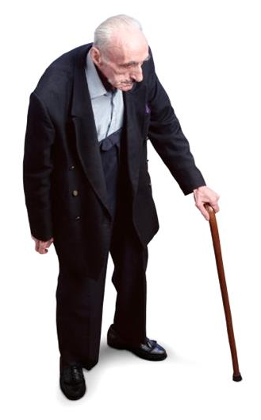
Throughout life
Notes:
Genetic information underpin, spectrum.

Slide 6

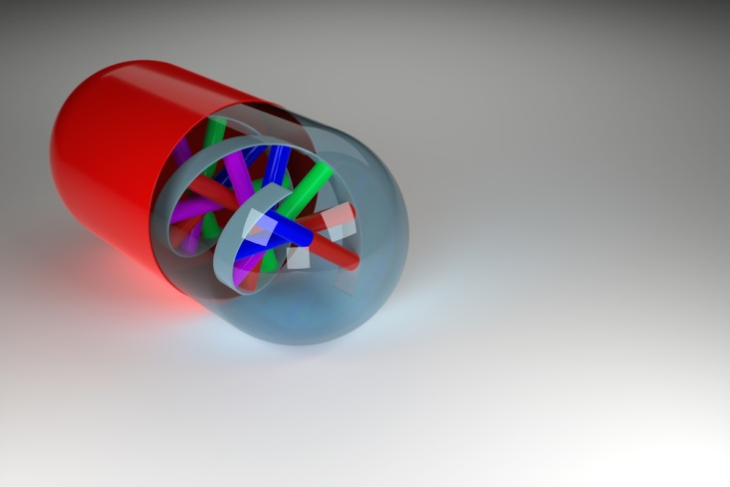

Prediction
Prognosis
Treatment
Future disease
Notes:
Of course, the point of this testing is to use the information to improve our health. Diagnosis, - those who have diseases. People who are benefiting right now are those who have not got a clear diagnosis. This little boy’s name is Bertrand Might.
His father, Matt has blogged his journey from having not motor control to 9 months as Bertrand deteriorated and had investigation after investigation, treatment after treatment with little or not ongoing effect and no certainty. Encourage. After all Bertrand’s genes were sequenced, they were able to learn that he was the first person in the world found with a particular enzyme deficiency. As a result of Matt’s blog, 8 more families were found. Now able to make decisions about treatment and management based on the cause of the condition, rahter than speculation. Over 18 mth period had been rushed to hosiptal more than a doz times, but in last 18 months not once.
People with a condition caused by many genes, or where there are many differential diagnosis.
Codeine -

Slide 7
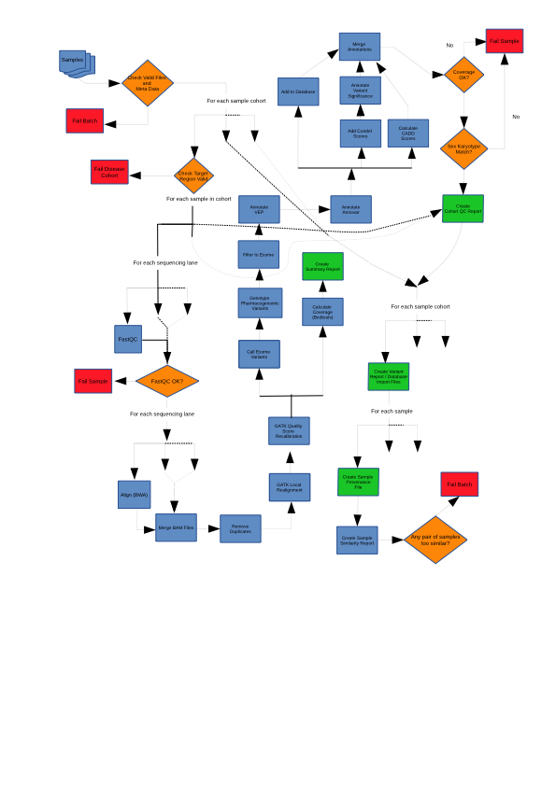
Computational pathology
Notes:
Looking five years ahead to how genomic sequencing (wes/wgs) might be usedFive year
First tier test
Selective analysis – along the principle that this is one assay but potentially many tests. Doctors order tests appropria
Shared data
GOT EACH CAPABILITY: working on is bringing those capaiblities together and testing out how model works across these organisations

Slide 8
The test will be the analysis, not the assay

Slide 9
Principles of good clinical practice will still apply
(Selective analysis)
Notes:
Looking five years ahead to how genomic sequencing (wes/wgs) might be usedFive year
First tier test
Selective analysis – along the principle that this is one assay but potentially many tests. Doctors order tests appropria
Shared data
GOT EACH CAPABILITY: working on is bringing those capaiblities together and testing out how model works across these organisations

Slide 10
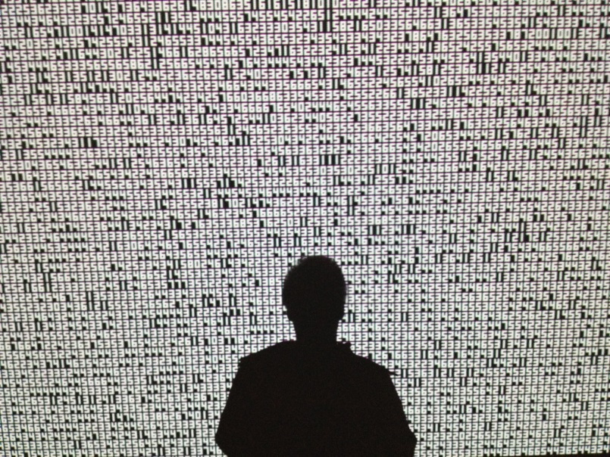
Information not data
Notes:
Study here at Melbourne Unviersity John Hopper and Mark Jenkins

Slide 11
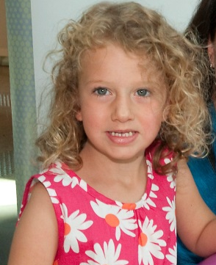
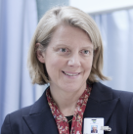
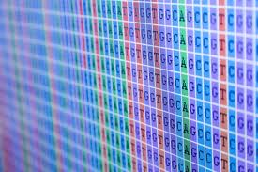

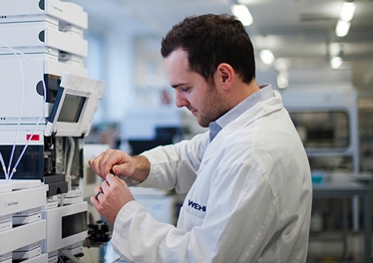
Prototyping the near future
Patient engagement
Clinically driven
Single, shared genome repository
Multidisciplinary Review
Research use and data linkage

Slide 12
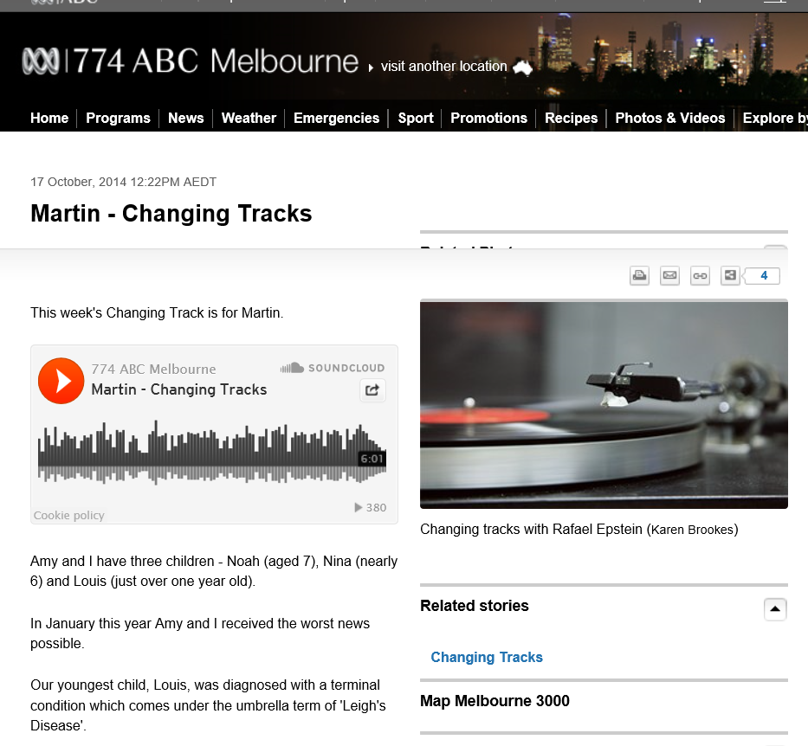
beyond any expectations, it is a gene mutation that responds to treatment…
…We couldn't quite comprehend the change in our lives, and the change for our other children...
Notes:
All clinicans involved in genomics will have their own examples of transformative power of new technologies as they are translated into practice. Incremental improvements in dx – chromosome, genetic test, microarray, NGS panels, WES and WGS.
In our setting, they’ve often been lobbed into practice, driven by laboratories desire to be at cutting edge rather than through a carefully thoughout, forward looking.

Slide 13


Slide 14
Patient expectations & choice
“The doctors told us not to expect a diagnosis and we didn't get one so we're a bit disappointed but we were told this was likely”
Research choices
Reidentifiable research participation 252/255
Anonymised research participation 236/255

Slide 15
Steady change
“Well it’s definitely increased it enormously but I am also aware of how much knowledge I lack”
N04
“Just someone that we can call to discuss or request that they see a patient or – just more ready access to the knowledge base” N02

Slide 16
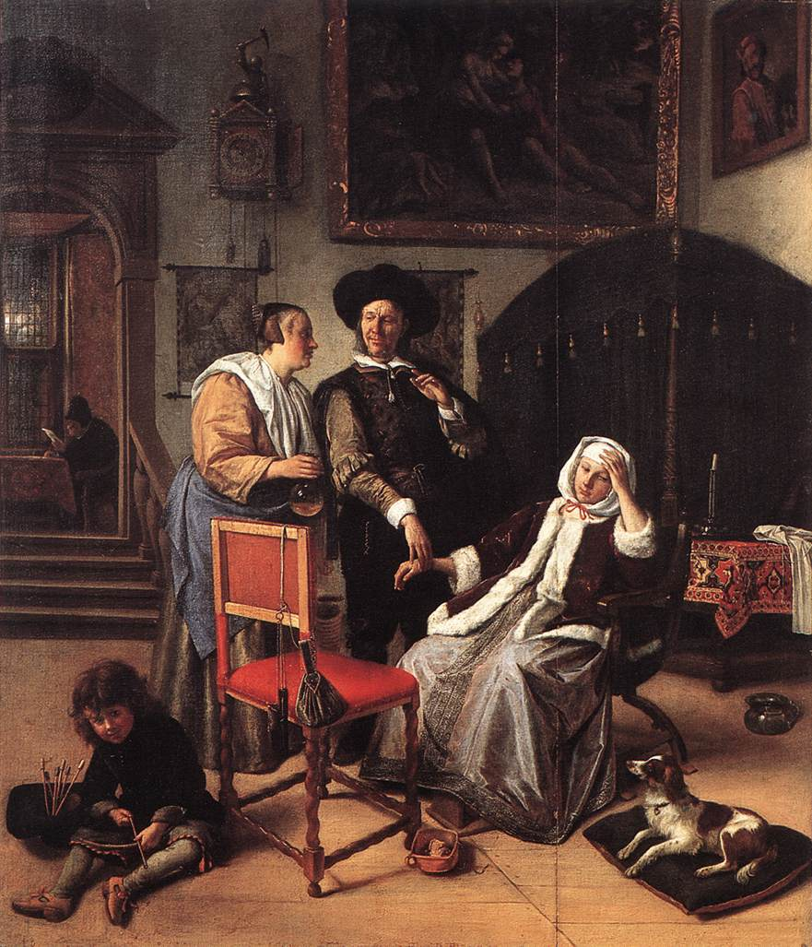
The Doctor’s visit
Jan Steen

Slide 17

Genomic era
Notes:
Nonetheless, as that improves, using information about our genetic make up could become is as routine as taking blood pressure. And this will be the genomic era – where information from many or all genes at once, and that is available to all of us, not just those with strong family histories

