Slide 1




Living with mitochondrial disease and responses to novel (and controversial) reproductive technologies
Dr Rebecca Dimond
DimondR1@Cardiff.ac.uk
@BecDimDiff
Translation in Healthcare - Exploring the Impact of Emerging Technologies 25th June 2015

Slide 2
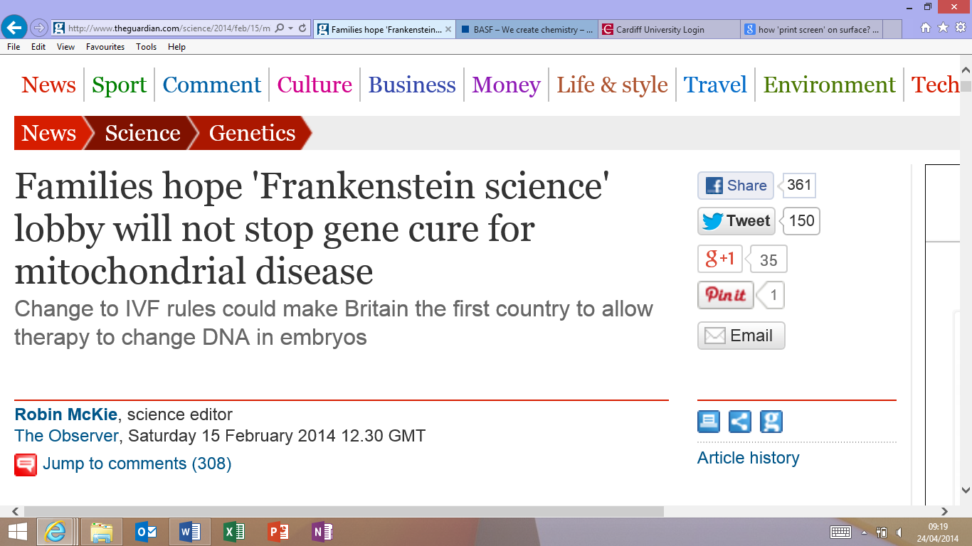

Slide 3
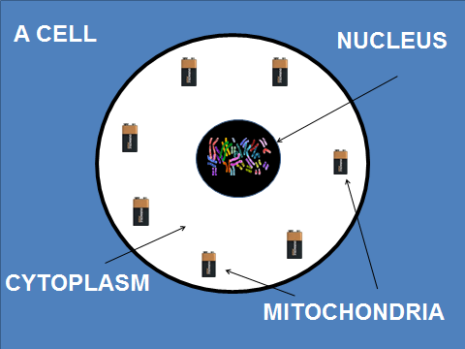
What is Mitochondrial disease?
Range of symptoms (can be late onset) – extreme tiredness, heart problems, diabetes, difficulties with mobility/ balance, deafness, epilepsy
Symptoms can depend on the ratio between faulty mitochondria to healthy mitochondria
Mitochondrial disease is rare - mitochondria research centres at Newcastle, Oxford and London
Mitochondrial disease can be due to mutations in nuclear DNA or mitochondrial DNA
Diseases caused by mutations in mitochondrial DNA are inherited through the maternal line.
Current reproductive options include prenatal diagnosis, PGD and egg donation

Slide 4
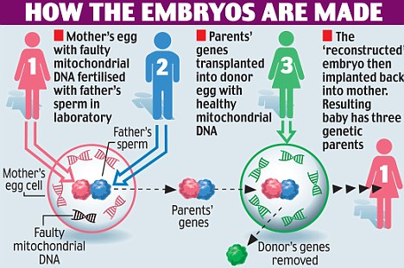

Slide 5
Mitochondrial donation…
Similar to egg/sperm donation or organ/tissue
transplantation?
Is the mitochondria donor a ‘third parent’?
What information about the donor should the child be
able to access?
Is this a slippery slope towards human cloning and
designer babies?
Are the techniques safe?
Notes:
What does safe mean in the context of IVF? Can new kinds of IVF ever be ‘safe’? And what evidence could be used to prove its safety? Is its not ‘unsafe’ adequate?
Historical amnesia
Redefining definitions (and changing laws)
Fixing meanings – reducing complexity,
Treatment/cure
Overall – a PR exercise – multimedia, multiprobed attack to win the hearts and minds of voters, patients have key role baring their bodies – assumption of technological determinism.

Slide 6
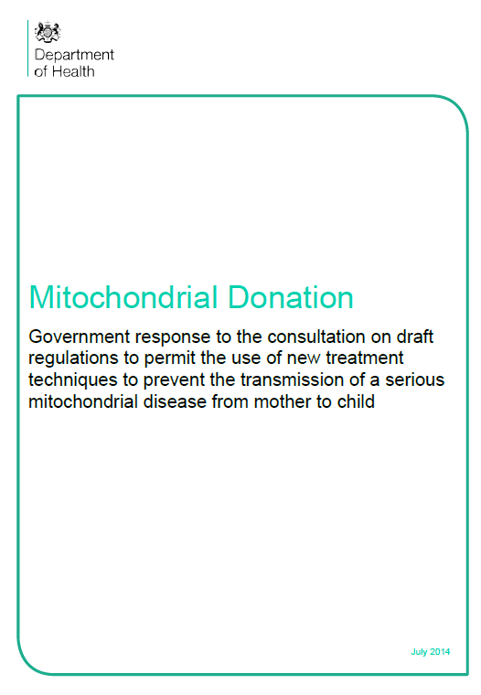
Department of Health consultation
The key consideration is that these techniques only replace, rather than alter, a small number of unhealthy genes in the “battery pack” of the cells with healthy ones. Most importantly, mitochondrial donation techniques do not alter personal characteristics and traits of the person [...]
While there is no universally agreed definition, the Government has decided to adopt a working definition for the purpose of taking forward these regulations. The working definition that we have adopted is that genetic modification involves the germ-line modification of nuclear DNA (in the chromosomes) that can be passed on to future generations. This will be kept under review.
On the basis of that working definition, the Government’s view is that the proposed mitochondrial donation techniques do not constitute genetic modification. [p15]

Slide 7
Representing an extreme vision…
Dr Julian Huppert (Cambridge) (LD):
…Cells fail to function, and people can get seizures, strokes, blindness, deafness, heart failure, lung failure and liver failure. Most of the people afflicted will not survive to adulthood. There is no treatment and no cure, and about 1 in 6,500 babies born will suffer from something like this. That is something I would hope everybody in this House would want to stop, and I simply do not understand how opponents of this can argue that they want to continue to inflict that sort of suffering on so many children, because that is the consequence of not finding a way to treat these disorders.
Having healthy children
“There are currently no alternative techniques to prevent transmission of disease other than abstaining from having genetically related children … If the affected family do not wish to have a genetically related child, they could opt for egg donation or adoption but we feel that affected families should be given the choice” [Lilly Foundation website]

Slide 8
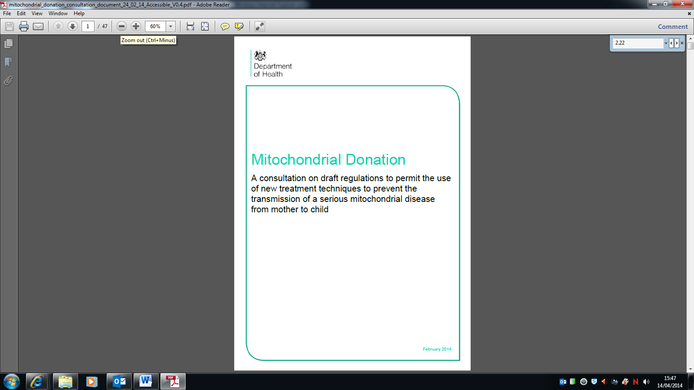
Department of Health consultation
1.11 The initial estimate by researchers at Newcastle Centre for Life is that the proposed mitochondrial donation techniques would prevent around 10 children a year suffering from serious mitochondrial disease. This is being kept under review. [p10]

Slide 9
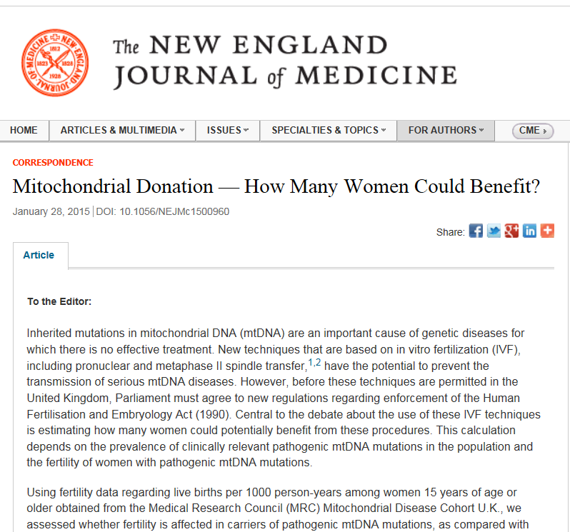
In the United Kingdom, the Human Fertilisation and Embryology (Mitochondrial
Donation) Regulations 2015, if passed by Parliament, would enable the licensing of clinics to perform these IVF procedures to the potential benefit of about 150 births per year if all women opted for the procedure.
Notes:
Many ways debate is old-fashioned, doesn’t recognise agency, priviliges technology, assumes ‘technology can speak for itself’

Slide 10
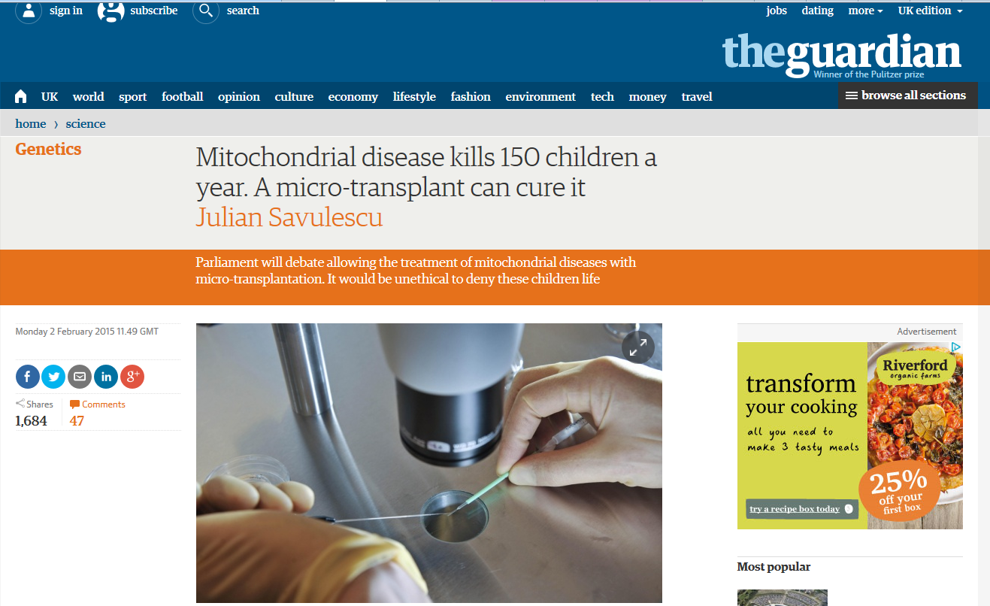
Imagine that there was a law which prevented 150 children a year suffering from a life threatening liver or kidney failure from receiving a transplant. This would be unethical. But this is precisely the current state of affairs for around 150 children every year in the UK suffering from mitochondrial disease, or mitochondrial failure.

Slide 11
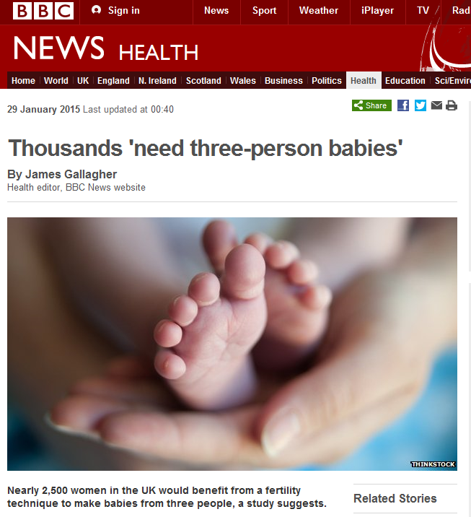

Slide 12
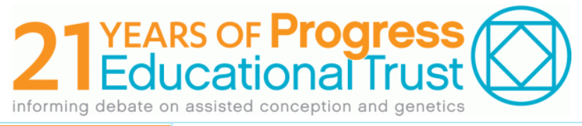
The chair asked the speakers for final thoughts. The women who had spoken about their experiences of having children with mitochondrial disease spoke last. One stood up and said “mitochondrial disease is devastating, if we have the technology, then the outcome can be positive, it is a huge cost for families living with the disease”. The other woman added “please don’t take away this opportunity”
The chair then addressed the audience, “If you were a politician who was asked to make a decision then and there to allow the techniques, would you agree…?” [the majority of the audience raise their hands] “Or disagree…?” [just a few people raise their hands]
Fieldnotes from a public Progress Educational Trust meeting
‘Freeing us from our Cells – Avoiding inherited mitochondrial disease’
London 2012

Slide 13
We can eradicate this from our family … It’s being pushed through Parliament or ethics or whatever, it’s just not going to be in our life time. But hopefully we can eradicate. That is the one thing that carries me through. If I had known that I was gonna pass [it on to son] which we didn’t even know about at the time, I was thirty…. [woman age 62]
Notes:
Interviews I conducted – 28, various ages, men and women, different symptoms
This is a typical account, this woman has severe symptoms herself, she won’t benefit but her family and future family will.
There is no doubt widespread support for these techniques.
Nuffield report response
Muscular Dystrophy campaign has financially supported the work at Newcastle
Newcastle appealed for egg donors to come forward…
Parents are investing in what Carlos Novas described as a ‘Political Economy of Hope’, becoming involved in the debates so that they can influence the scientific agenda.
However, my interviews with patients with mitochondrial disease suggest the hope of genetic technologies does not reflect the reality

Slide 14
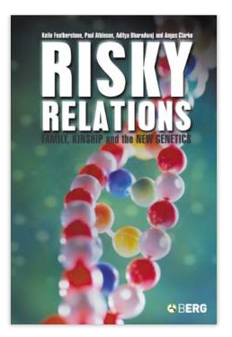
Negotiating risk and responsibility
‘Genetic responsibility’
Weiner, 2011; Raspberry and Skinner, 2011
‘Webs of genetic connectedness’
Novas and Rose 2000; Featherstone et al. 2006
Lay understandings of risk
Parsons and Atkinson 1992; Prior 2003
Adaptation to genetic risk
Cox & McKellin, 1999; Gaff et al., 2007
Familial communication strategies
Forrest et al., 2003; Keenan et al., 2005, Gregory et al., 2007

Slide 15
I knew there was this thing within the family and it was making the people poorly, and it was genetic, but that was it. I didn't really take much interest in it. I didn't know a lot about it to be fair. Then when my mum started to have the fits, really that was kind of, hold on a second, I didn't realise this was going to be so serious... [woman age 35]
Notes:
This woman was diagnosed with mitochondrial disease when she was around 20, along with other members of her family (they all went to clinic together)
This woman had a child when she was about 32. The child will have inherited faulty mitochondria from her, although he hasn’t yet had any testing.
It was only after her mother died, that for her second child, she started to think about assisted reproductive technologies.
When thinking about reproductive choice and responses to genetic risk, one of the key issues is that disease can become normalised. People just live with aches and pains, and they might get worse and simply adapt to a reduced life style. Older members of the family can be seriously ill, but that is often described as part of normal aging, for example, ‘oh its just my aunts moaning’. It appears that a diagnosis of mitochondrial disease does not necessarily and not immediately produce the kind of ‘biographical disruption’ that Bury has talked about.
Why this is important is that genetic technology has changed the relationship between the diagnostic process and the experience of illness. It is now possible to be classified as a ‘patient without symptoms’ for example, a carrier of a genetic disease (CF) or someone at risk of late onset disease (HD). This can be the case with mitochondrial disease.
One of the key findings of my project was that there was a generational gap. Those who are the target of reproductive technologies, for example, women between 20 and 40, might have received a diagnosis but might not feel ‘at risk’.
For me this means that assumptions of technological determinism – that if these technologies are available then they will be used – is seriously flawed.
Young women, who are the target of reproductive technologies, might have received a diagnosis yet might not feel ‘at risk’.

Slide 16
Can technology, science policy and regulation ever be value free?
Who has the power to define the terms of debate ?
How are patients enrolled into the debate?
What versions of health and illness are represented
and what are omitted?
At what stage do controversial scientific or medical advances
come to public attention?
Notes:
Sociology of science and medicine have been concerned about public understanding – how can people make judgements when they don’t understand the complexity?
My position on the mito debate is a bit different – people are knowledgeable, but the debate is so embued with emotion that the science can not be judged on its own merit.
But why should it?
Within the policy context we need to know what effect the technqieus would have on children, what risks there are, whether the risks outweight the benefits – all these are not facts but carefully constructed ideas that are designed to persuade.
Why is mito debate sociologically interesting?
Challenges the iconic status of the ‘gene’
Construction and representation of diagnostic classifications
How do women with mitochondrial disease make reproductive decisions
The grounded experience of health and illness
Lay understandings of genetic risk
Diagnosis as biographical disruption
Familial communication patterns, stigma and secrets
Normalisation
The role of the ‘expert patient’
‘Political economy of hope’
Produces new opportunities for understanding ‘kinship’
A reminder that “technology does not speak for itself”
To alleviate suffering is really powerful

