Slide 1
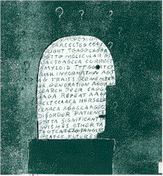

The Clinic of the Future:
“Revolution” Free?
(I hope so!)
Timothy Caulfield
Oxford 2015
Twitter: @CaulfieldTim

Slide 2

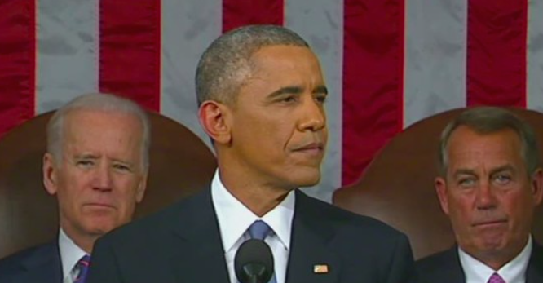
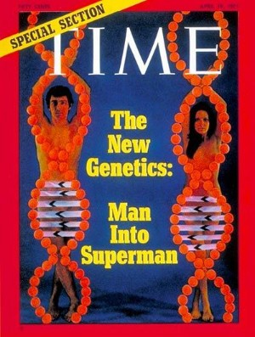
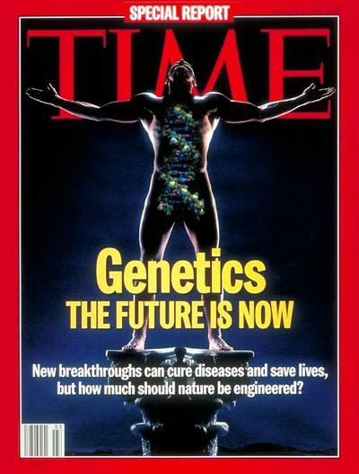

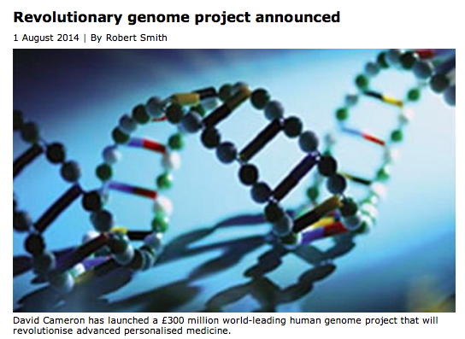
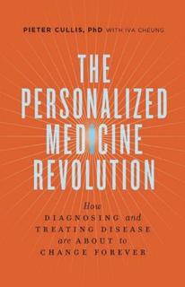
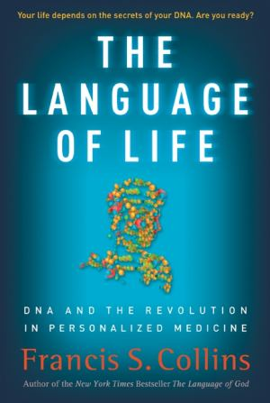

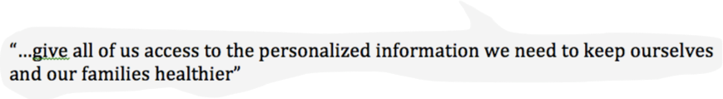
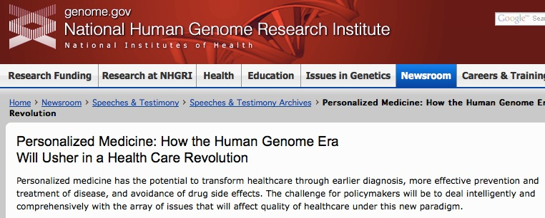
1971
1994
2003
POWERFUL REVOLUTION?

Slide 3



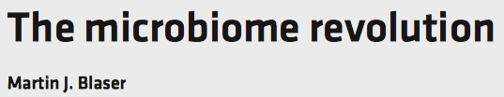


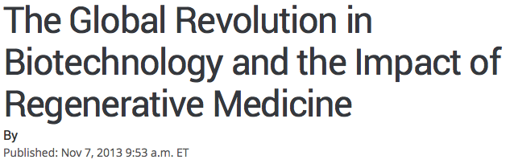
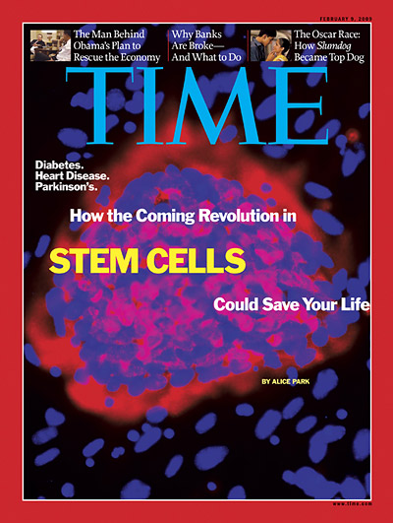
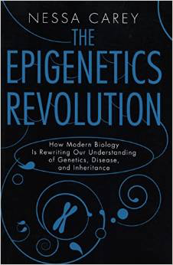


Little evidence the more
=
Health benefit
Revolutions of more…

Slide 4

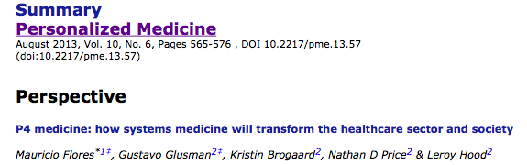
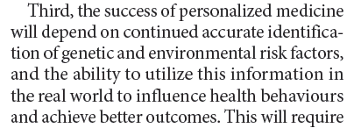
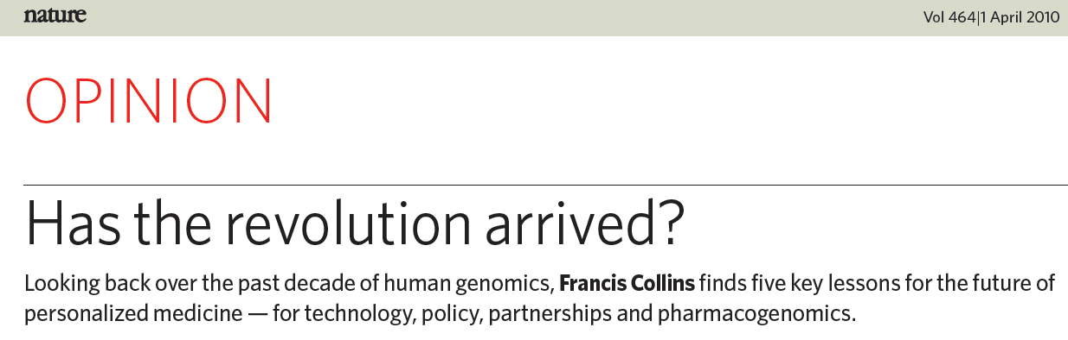
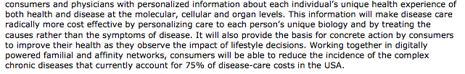
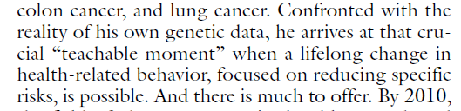
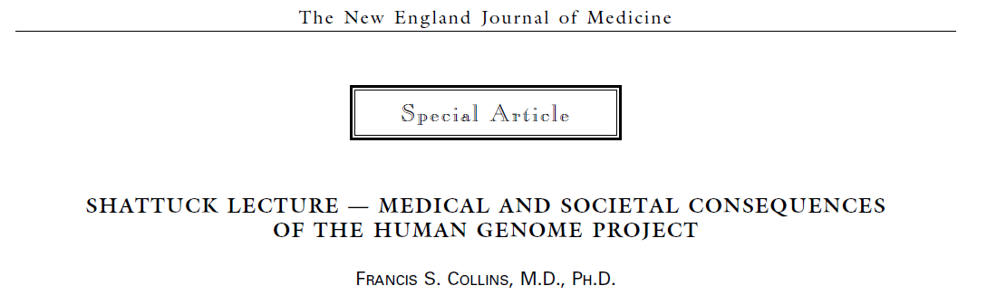
2010
1999

Slide 5

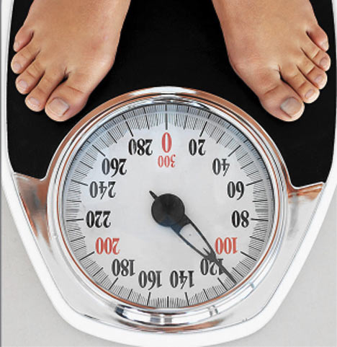

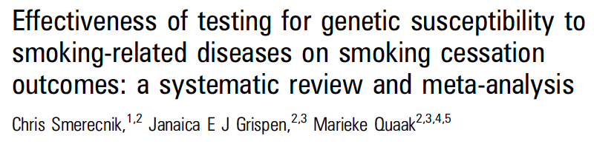
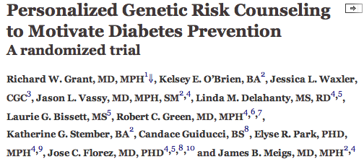
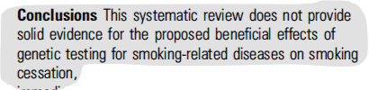
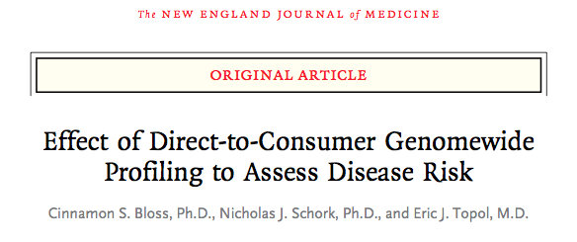
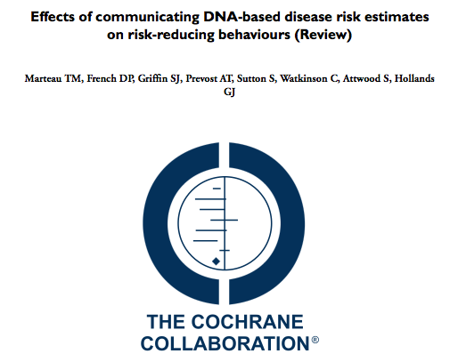
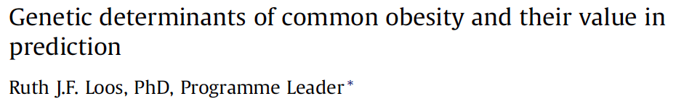
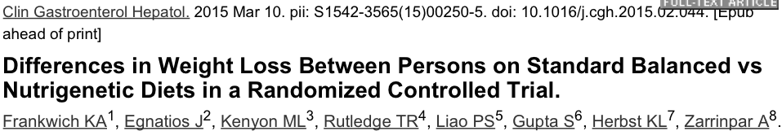


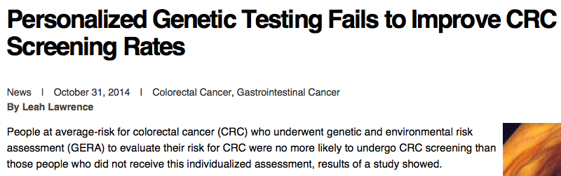
Behaviour Change?
“Any risk communication expert would laugh at the suggestion [that genetic risk information would motivate behaviour change] … We have long known from other areas of research that the communication of risk is necessary but rarely sufficient. And even if people do change, they all relapse.”
Colleen McBride, Chief and Senior Investigator for the Social and Behavior Research Group at the National Human Genome Research Institute.
“The few studies conducted to date suggest that DNA risk information may be less likely to achieve behaviour change than other types of health risk information.” Marteau, T. M., and J. Weinman. 2006. Self-regulation and the behavioural response to DNA risk information: A theoretical analysis and framework for future research. Social Science & Medicine 62: p.1360-1368.≈≈

Slide 6
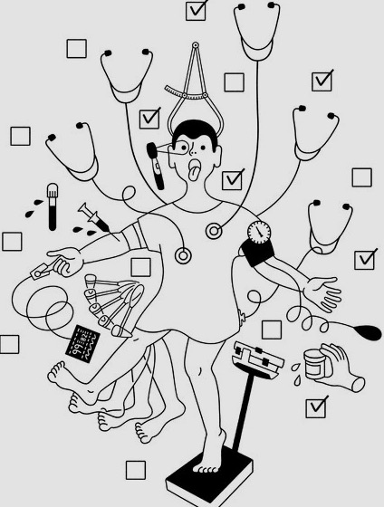
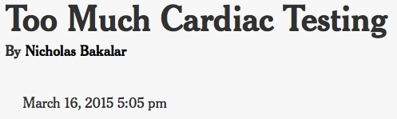
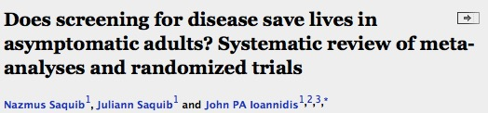
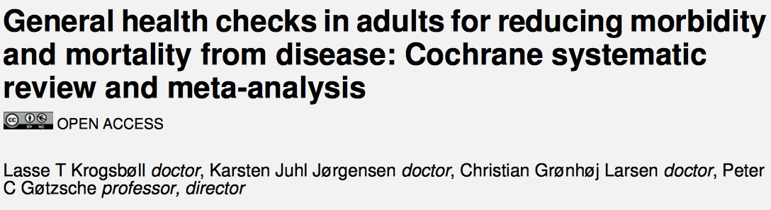
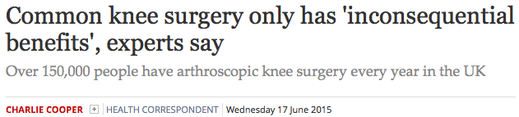
Do less?

Slide 7
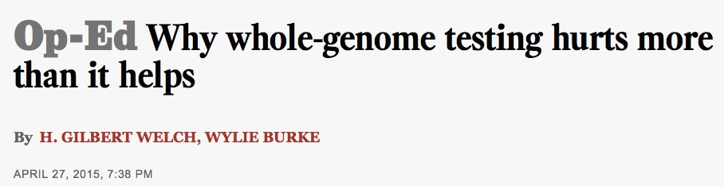


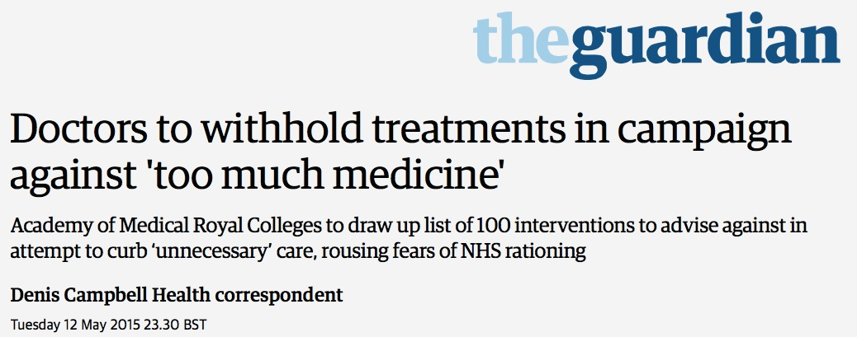
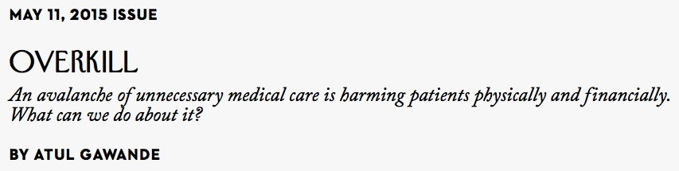
Do less?

Slide 8
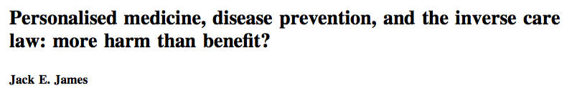
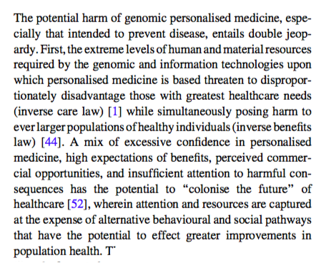
Revolutionary translation pressure?
Pressure to find an application!

Slide 9
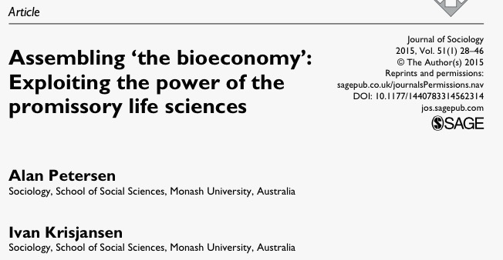
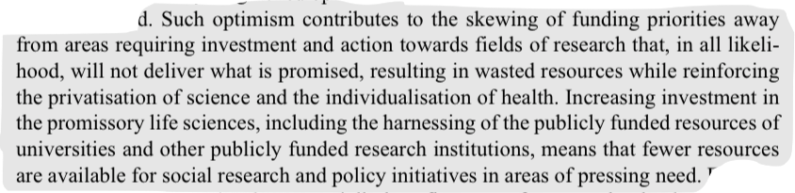

Slide 10


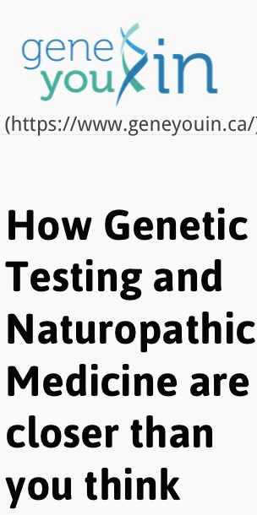
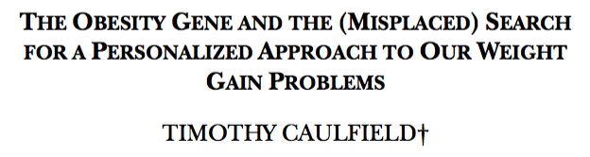
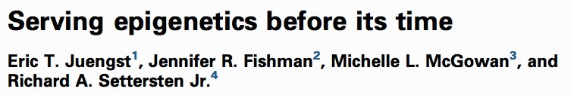
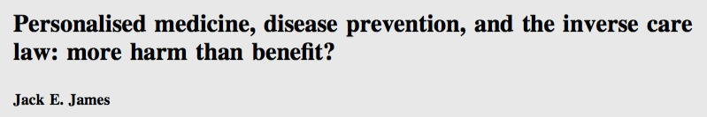
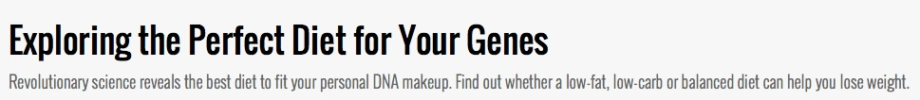
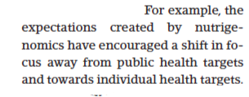

Revolution rhetoric = Shift in priorities: more cool science, less public health?
SCIENCEPLOITATION!

Slide 11
Revolution Rhetoric
Premature implementation
(Inappropriate) Exploitation by market
Poor research policy/funding decisions
Poorly informed social/ELSI policy
Poor individual health decisions
Loss of public trust (backlash?)

Slide 12
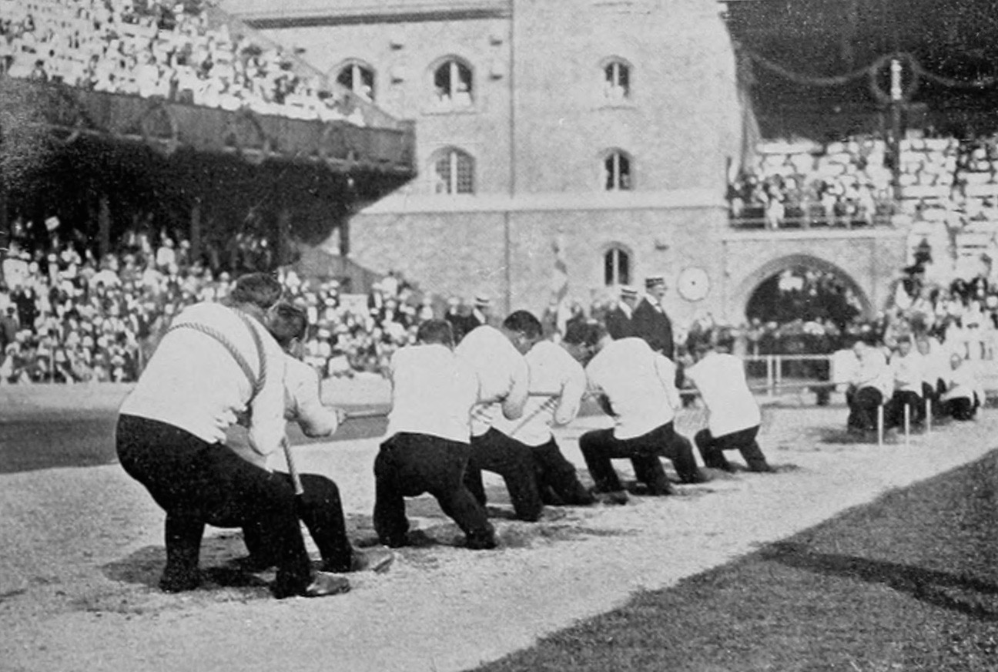
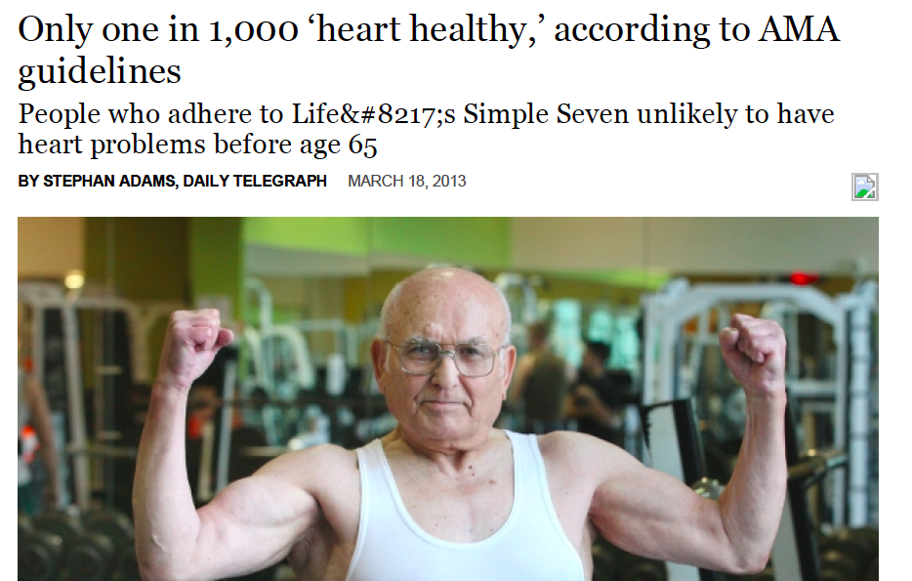
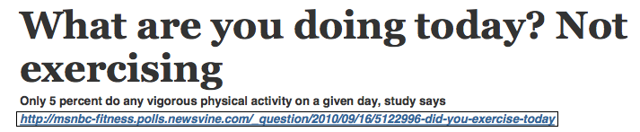
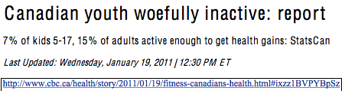

Resolving the tug of war…

Slide 13




My revolutionary advice?

Slide 14












Thank you!
Twitter: @CaulfieldTim
Ubaka Ogbogu, Robyn Hyde-Lay, Christine Rachul, Maeghan Toews, Marianne Clarke, Kalina Kamenova, Li Du, Candice Kozak and the UofA and HLI team!

