Slide 1

Think before you spit: ELSI and the Direct-to-Consumer Genetic Testing Space
Jan Charbonneau, Dianne Nicol & Don Chalmers
Centre for Law & Genetics, University of Tasmania

Slide 2
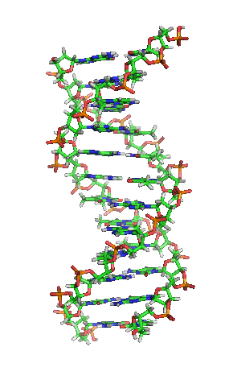
This research has three main components
1 – mapping the direct-to-consumer genetic testing space
2 – determining what drives likelihood of purchase
Swinburne Monitor 2013
3 – assessing consumer engagement with DTC Qualtrics Online Panel 2015
Acknowledgement: This research is funded by the Australian Research Council Discovery Grant Personalised Medicine in the Age of Genomic Medicine DP11010069

Slide 3
DTC Genetic Testing represents a paradigm shift from …
Legal System
Government & Professional Oversight
Patient
Medical Gatekeeper
Financial Gatekeeper
Quality Gatekeeper
Regulations
To …

Slide 4
Legal System
DTC Certified Practitioner / Healthcare Professional
R
D
T
A
T
D
R
Company Lab
Consumer
T
DTC Company
D
D
R
Contract Lab
A
R
T
T
R
Healthcare Professional
Over the Counter
D
DNA Sample
T
Test Kit
R
Results
A
Advice
Regulations

Slide 5
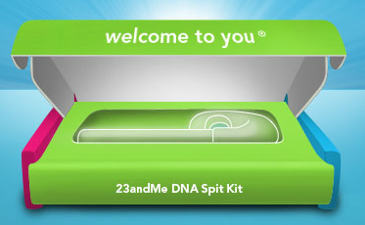
Confidence in DTC
30% were confident the company would provide all information needed for healthcare decisions.
42% were confident in their ability to interpret genetic test results.
35% were confident DTC tests are accurate.
43% were confident genetic information would only be shared with permission.

Slide 6
Care to Share?
DTC / Company
Consumer
Online
Sharing
R
R
Researcher
Raw Data
Raw Data
R
DTC Testing or Sequencing Company
Online
Interpretation
R
Results

Slide 7
Online behaviours
61% – would go online to better understand DTC results – 54%
Actual behaviour - 80% looked for health-related information online in last 12 months
57% used the Internet for self-diagnosis
35% – would go online to find others with similar test results – 34%
35% – would go online instead of visiting their doctor – 34%
19% – would share genetic information in online communities – 19%
Actual behaviour - 27% shared health-related information online
20% shared genetic information online
Diabetes
Colorectal Cancer

Slide 8
Spit for Science?
Partner/ Affiliated Company
R
Company Lab
Consumer / Research Participant
T
DTC Company
D
D
R
Contract Lab
A
R
R
R
Healthcare Professional
DTC / Company / Researcher
T
Test Kit
DNA Sample
D
R
Results
A
Advice

Slide 9

DTC Research
47% were happy for the DTC company to make their genetic test information available at no cost to university researchers.
43% were happy for the DTC company to use their genetic test information for their research even if they get no financial or other benefit.
25% were happy for their genetic test information to be sold for profit by the DTC company to another company for their research.

Slide 10
Likelihood of Purchase
29% were likely to purchase a DTC test from an onshore company.
17% were likely to purchase a DTC test from an offshore company.
38% were likely to purchase a DTC test if the results were returned to their doctors.
2013 Monitor indicated likelihood of purchase increased if condition was life threatening & there was available treatment

Slide 11
Spot the ELSI!
Patient
Doctor
R
R
Consumer Company
R
Results

Slide 12
Thank you!
Questions?

