Slide 1










Is there a duty to re-contact in light of new genetic information?

Slide 2

Framework

Slide 3
Definition of re-contacting
Healthcare professionals’ (HCP) ethical responsibility/legal obligation to re-contact former patients about new genetic information.
Ethical responsibility/Legal duty
Excludes ongoing treatment relationships
Clinical/research practice

Slide 4
Re-contacting Facts
There is no professional consensus on best practices for re-contacting. Re-contacting not currently considered an ethical or legal duty in the UK
American and Canadian courts have established a duty to re-contact in cases of defective drugs or devices (cases). Nonetheless, it is unclear for how long the duty to re-contact might apply and with whom responsibility lies (Knoppers 2001), nor what kind of information change might trigger a duty to re-contact
Research exploring re-contacting is limited, even while it is recognised as being of increasing importance in genetic medicine (Sharpe and Carter 2006; Pyeritz 2011)

Slide 5
Why is re-contacting important?
Greater integration of genomic knowledge into medical practice is of recognised importance in the NHS (e.g., Human Genomics Strategy Group 2012)
Tests more accurate and cheaper
New findings of clinical significance are becoming available to an increasing number of patients, such as new information about the significance of particular genetic profiles for cardiac health

Slide 6
Systematic review of the literature (Otten, Plantiga et al. 2014)
61 articles United States; Canada; Europe; Australia; India; Israel
Period 1991-2014
Ethical, Legal, Social, Psychological, Clinical and Practical Issues (80%) with clinical author
28 articles formulated conclusions
6 concluded a duty to re-contact apply (early papers, legal)
22 concluded that it does not
Different interpretation of ‘duty’ from legal considerations to moral ethical professional duty

Slide 7
Re-contacting situations
New treatment options or screening recommendations
New technique or genetic test available
New lab information (e.g. new interpretation of former test results, new gene associated with a disease formerly tested for, new knowledge about Variants of Unknown Significance, expansion or reinterpretation of results from Whole Genome Sequencing)

Slide 8
Re-contacting problems 1. Patient Autonomy
Promote autonomy (new information=new possibilities)
Consent to be re-contacted can never be autonomous as patients do not know what type of information will be disclosed
Negative impact (breach of confidentiality, increased anxiety, stress)
Familial implications

Slide 9
2. Relevance of information
Greater justification for re-contacting former patients with clinically relevant information about a life-threatening disease than a small increased risk for a slowly progressive disease

Slide 10
3. Healthcare professional liability
Re-contacting could prevent HCP from being held liable for negligence by former patients
Embracing re-contact policy may make HCP liable if they cannot meet expectations
Breach of patients’ right not to know

Slide 11
4. Ethical Desirability vs. Practical Unfeasibility
Re-contacting barriers:
Lack of infrastructure for tracking data of former patients (e.g. informatisation of databases)
Lack of time and resources (staff, money) to perform re-contacting
Lack of up-to date patient addresses

Slide 12
Re-contacting solutions
Shared responsibility: Involve patients in process of re-contacting
Contact department regularly
Update department about change of address, family history, etc.
Check for new information on genetic developments on websites
Role of media, support groups
Implementing digital communication system between laboratory, clinicians and patients
Treat WGS like every other diagnostic test by only focusing on data concerning the diagnostic question and discard the rest
Phone App, layered information

Slide 13
Empirical data available
Survey – focus groups (patients, HCPs)
Most but not all patients value being re-contacted
Divergence between HCP (→ shared model) and patients (→ HCP) expectations about responsibility for re-contacting

Slide 14
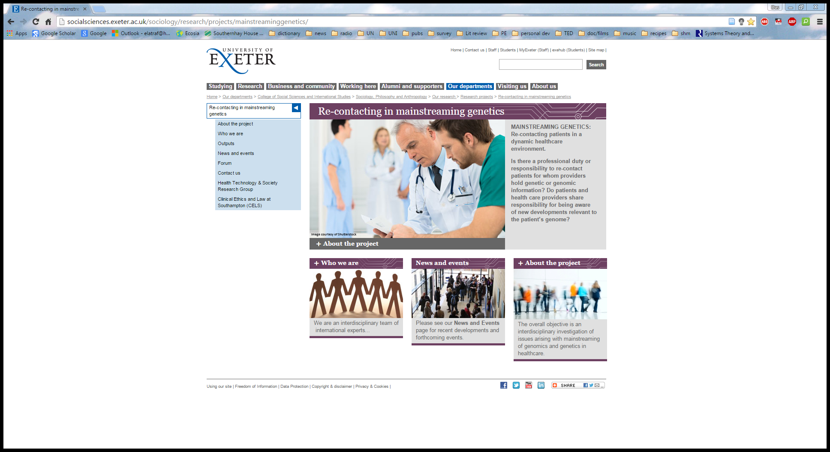
Project

Slide 15
Team
Principle Investigator
Susan Kelly, Associate Professor in Medical Sociology, Sociology, Philosophy and Anthropology, University of Exeter
Co-Investigators
Angus Clarke, Clinical Professor, Institute of Cancer & Genetics, Cardiff University
Anneke Lucassen, Professor of Clinical Genetics, Honorary Consultant in Clinical Genetics, Wessex Clinical Genetics Service, Co-ordinator: Ethics and Law teaching Southampton Faculty of Medicine, University of Southampton
Peter Turnpenny, Consultant Clinical Geneticist Royal Devon & Exeter (RD&E) Hospital, Honorary Associate Professor, University of Exeter Medical School
Legal Consultant
Johnathan Montgomery, Professor of Healthcare Law, University College London
Research Fellows
Daniele Carrieri, University of Exeter
Sandi Dheensa, University of Southampton
Shane Doheny, Cardiff University
Advisory Board
Andrew Green, Professor of Medical Genetics, National Centre for Medical Genetics, Crumlin Hospital, Dublin
Andrew Hattersley, Professor of Molecular Medicine and Consultant Physician in Diabetes, University of Exeter Medical School
Alastair Kent, Genetic Alliance UK
Frances Flinter, Professor of Clinical Genetics, Guy's and St Thomas' NHS Foundation Trust
Gillian Crawford, Registered Genetic Counsellor, University of Southampton
Imran Rafi, Chair of Royal College of General Practitioners Clinical Innovation and Research
Mila Petrova, Department of Public Health and Primary Care, University of Cambridge

Slide 16
Mainstreaming Genetics/Genomics
The process of making genetic/genomic testing part of routine medical care, where genetic/genomic tests are being ordered by health professionals outside clinical genetics (e.g., oncology, cardiology, paediatrics)

Slide 17

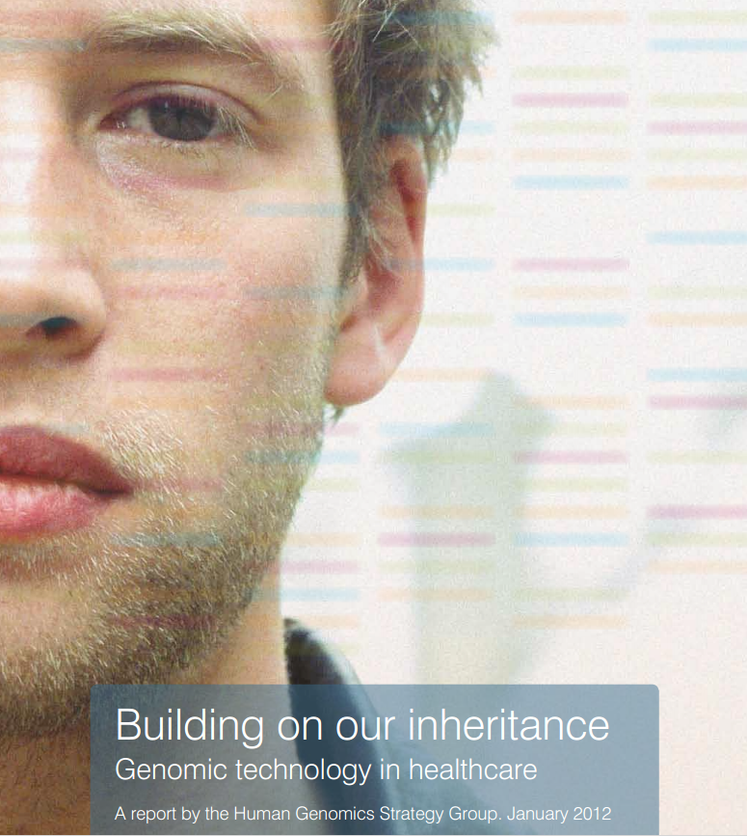

Slide 18
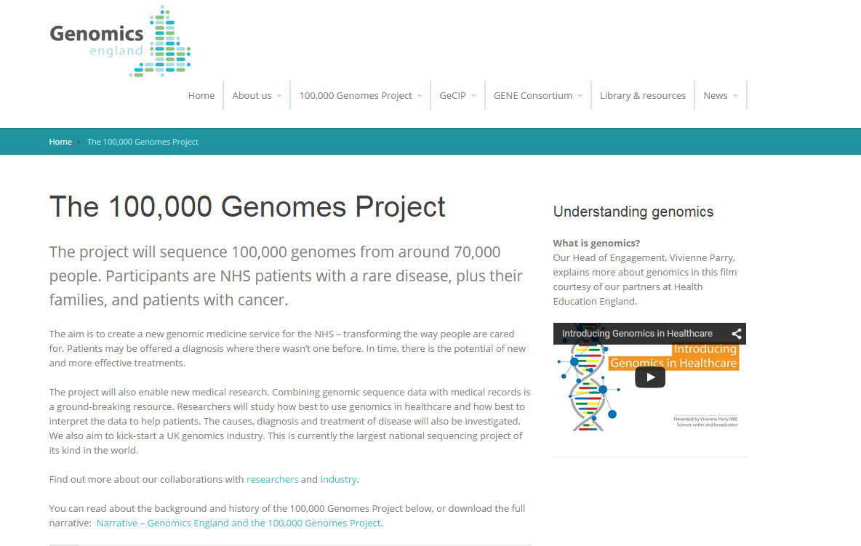
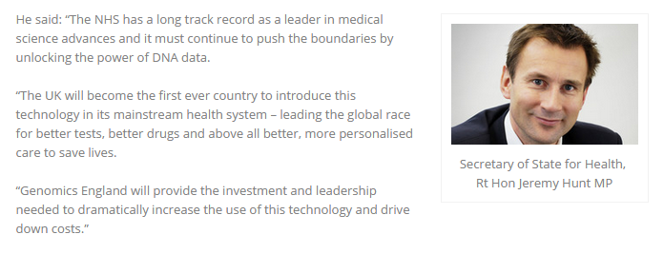

Slide 19
Re-contacting Hypotheses
Mainstreaming genetics and genomics in healthcare raises clinical, sociological, ethical and potentially legal questions concerning how genetic or genomic information is handled
How test information is handled typically varies from specialty to specialty (differences in medical subcultures – norms, values, customary practices)

Slide 20
We draw from sociological insights that each healthcare professions has evolved a set of values, problem solving approaches, and behaviours, including ‘cultural’ or ‘normative’ differences in the weight given to particular problems or forms of knowledge (Hogarth, Hopkins et al. 2012)

Slide 21
Re-contacting is one area where responsibility overlaps across specialties
Differences in professional norms and practices, as well as uncertainty regarding lines of responsibility
Disputes over who is responsible for evaluating new tests are recognised as a challenge in the integration of genomics into healthcare (Nass and Moss 2007)

Slide 22
Research Questions
Is there a ‘duty’ (ethical, legal, professional) to re-contact patients for whom providers hold genetic or genomic information?
What expectations do patients and healthcare professionals have regarding re-contacting?
How will re-contacting (duty/expectations, professional responsibilities) be negotiated across medical specialties?

Slide 24
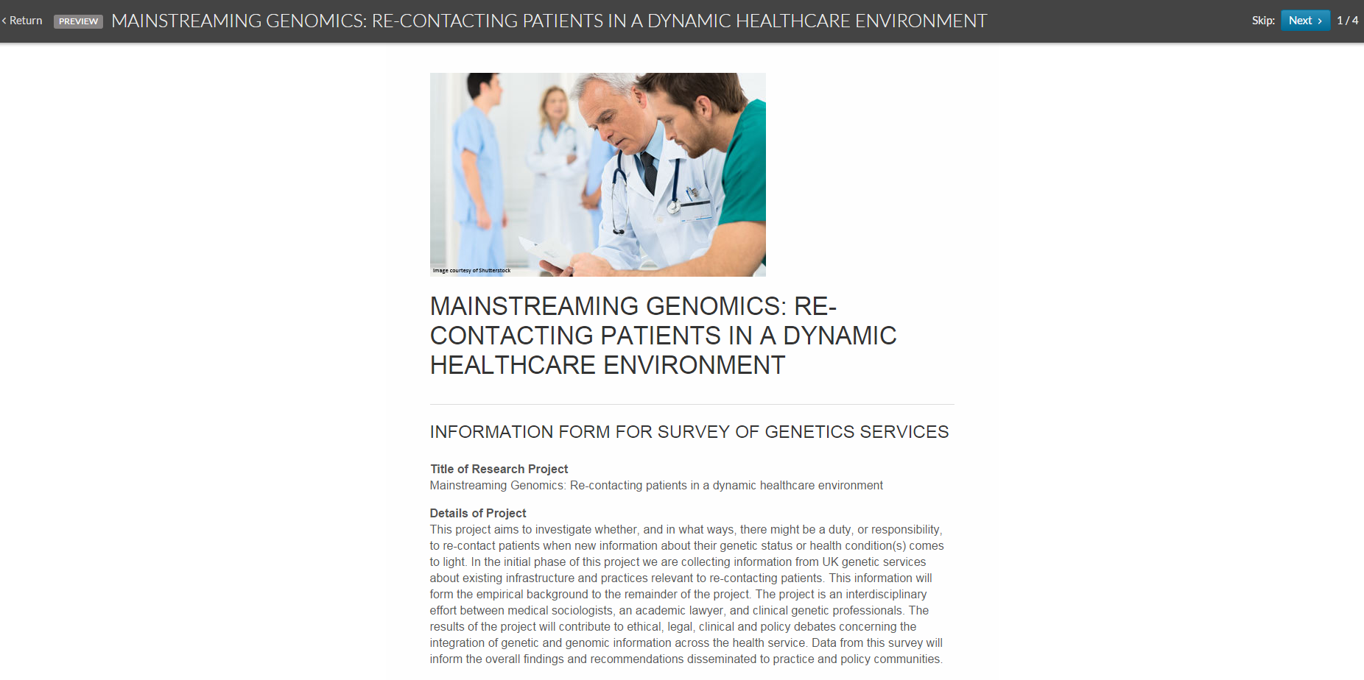
Survey

Slide 25
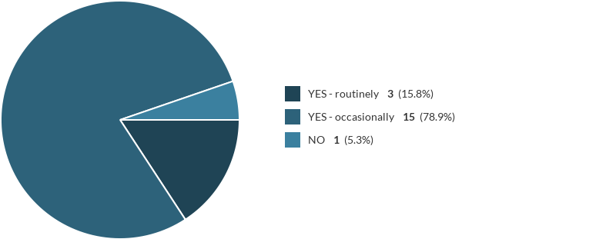
Re-contacting happens, and mainly on an occasional basis
Many different reasons for re-contacting patients are reported (e.g. lab reports, review of patients’ notes, new test becomes available, new research results that have clinical, actionable implication for patient and family, patient reaches reproductive age)

Slide 26

Most centres use clinical databases for re-contacting purposes
Databases were mainly used to identify patients, less often to review notes and flag patients

Slide 27

The majority of centres do not routinely ask patients about their re-contacting preferences
The idea of an ‘open door policy’ surfaced often. Whilst some centres stated to have re-contacting questions in their consent forms for genetic testing, others expressed concerns about raising unrealistic expectations in patients- and therefore did not mention re-contacting to patients and /or did not record patients preferences

Slide 28

A significant number of centres consider there would be reasons (clinical implications) to re-contact patients even if patients formerly indicated they would not want to be re-contacted
In this case the GP is mentioned several times as a (first) point of contact to involve in this process

Slide 29

Almost half of the centres are unsure about whether genetic services should implement re-contacting systems
Re-contacting procedures are different across centres (e.g. using patient database, via GP, phone, letter, patients’ preferences about re-contacting taken when taking consent for a genetic test). This is a sign of potentially unequitable care.
Lack of time/resources/infrastructures is a common issue.

Slide 30
Thank you very much for your attention!
Project webpage: http://ex.ac.uk/mgc
Project email address: recontact-genomics@exeter.ac.uk

