Slide 1


Patient and Interest Organizations’ Views on Personalized Medicine
Isabelle Budin-Ljøsne
Centre for Medical Ethics, UiO
«Translation in Health care – Exploring the Impact of Emerging Technologies» Oxford, 24 June 2015

Slide 2
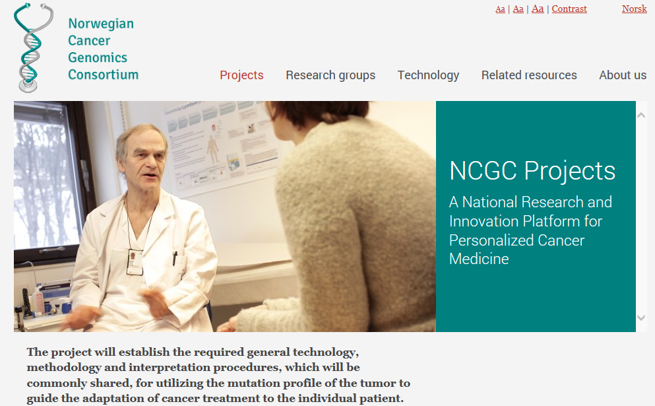
Ethics work package of NCGC
“Address crucial ethical and social challenges that may emerge when genetic and genomic information is produced about individuals with the objective to realize personalized medicine”.

Slide 3

Outline
The promises of personalized medicine
Objectives of the qualitative study «Patient and Interest Organizations’ Views on Personalized Medicine”
Preliminary study results
Take home message
www.Genomicslawreport.com

Slide 4
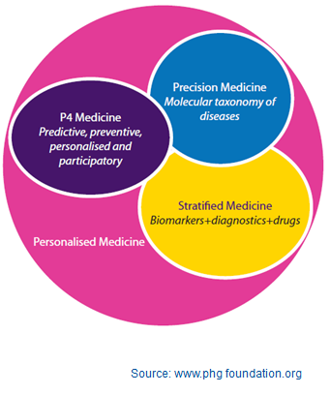
“Personalised medicine is an emerging practice of medicine that uses an individual's genetic profile to guide decisions made in regard to the prevention, diagnosis, and treatment of disease”.
Source: Talking Glossary of Genetic Terms, National Human Genome Research Institute

Slide 5
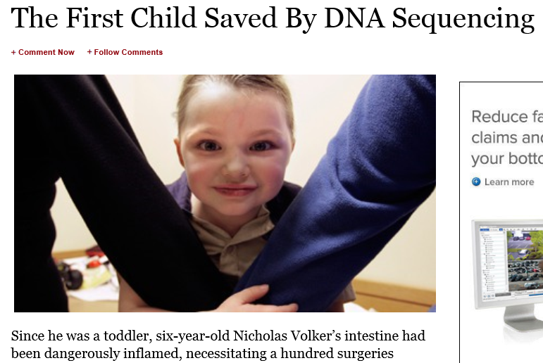
The promises of personalized medicine
Earlier, better detection and prevention
Better taxonomy of disease and diagnosis
Better drug development thanks to stratification of patients
More efficient treatment thanks to better understanding of adverse effects
Source: http://www.forbes.com/sites/matthewherper/2011/01/05/the-first-child-saved-by-dna-sequencing/
Notes:
Why now?
Today too many patients do not benefit from treatment
- Conventional approach to disease and treatment is inefficient
- Health care expenditures are exploding
Difficult to treat aging populations/chronical diseases
- The technology is available NOW!

Slide 6
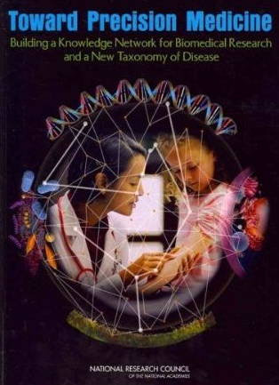
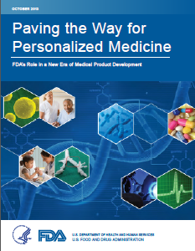
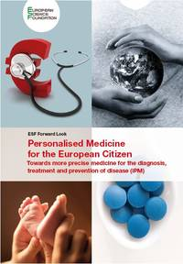
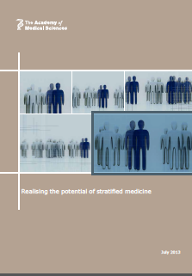
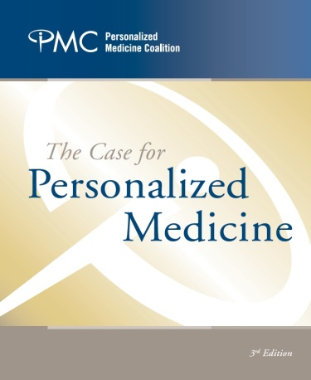
The promises of personalized medicine
Many stakeholders of PM
Patients
Public and private research organizations
Health authorities and policy makers
Pharmaceutical industry
Educational institutions
Patient and interest organizations
…
Emphasis is placed on stakeholder participation
Notes:
Toward precision medicine: National Research Council of the National Academies

Slide 7
“Patient groups have an important role in increasing literacy and empowerment.” (EAPM report 2013)
“It is (…) entirely appropriate for patient groups to participate in dialogue with HTA bodies and the drug’s developer, explicitly evaluating the benefits and risks of accelerated development”. (EAPM report 2013)
“Patients and the public also need carefully positioned, realistic, and easily understood information about both the potential and the limitations of personalized medicine in general, and about genomics-based molecular diagnostics in particular. The patient advocacy community represents a strong and valuable player in this arena (…)” (Report of the President’s Council of Advisors on Science and Technology 2008)
“(…) incentives should be developed that encourage public private partnerships involving government, drug developers, regulators, advocacy groups and payers. (Toward Precision medicine, 2011)

Slide 8
Objectives of the study
Investigate the views of leading representatives from patient and interest organizations (PIOs) regarding:
PM/relevance of PM
Challenges and opportunities for the realization of PM
Recommendations to make PM accessible to as many patients as possible
Tools and strategies (if any) of PIOs to enhance the realization of PM
Challenge: PIOs vary in size, denomination and mandate
“patient advocacy organizations”, “voluntary health organizations”, “interest organizations”, “health charity organizations”, “disease advocacy organizations”
PIOs representing a variety of disease areas spanning from cancer and genetic disorders to metabolic and infectious diseases.

Slide 9
Methods
Between September 2014 and January 2015:
Email invitations sent to a small poll of PIO representatives in the NCGC network, snowball sampling
Email invitations sent to representatives of 20 disease-specific PIOs members of the European Patients’ Forum (EPF)
Recruitment until point of saturation was reached
Semi-structured individual telephone interviews, on average lasting 45 minutes
Results transcribed and analyzed according to conventional content analysis approach
Study approved by the Norwegian Social Science Data Services
Notes:
The European Patients’ Forum (EPF) is an umbrella organisation that works with patients’ groups in public health and health advocacy across Europe. Our members represent specific chronic disease groups at EU level or are national coalitions of patients.
EPF currently has 65 members (47 Full Members, 18 Associate Members) that are pan-European patients’ organisations and national platforms of patient organisations. The

Slide 10
Results
8 PIOs recruited through snowball sampling, 5 through EPF (total 13 PIOs)
Cancer (4)
Hereditary and genetic disorders (3)
Mental health (1)
Diabetes (1)
Psoriasis (1)
AIDS (1)
Lupus (1)
Primary immunodeficiencies (1)
PIOs are national (8) or international (5)
From less than a hundred individual members to more than a 100,000 members
Umbrella organizations (6) have organizational members (from 20 to > 1,000)
PIOs located in Norway (7), the UK (2), Belgium (1), Croatia (1), Denmark (1), USA (1)
Notes:
EPF members:
20 disease specific PIOs contacted
6 refused (3 did not have time, 3 did not want to participate)
4 accepted

Slide 11
Results
In general about PM
All express interest in PM
Current medical needs are largely unmet
Issues of side effects, overtreatment and “undertreatment”
“We see benefits for patients, the more personalized diagnosis and treatment can be offered to the individual, the better treatment the patient receives, the more effective the treatment, the less side effects, this whole package is the goal of medicine, not just good treatment to large groups but also to the individual.”

Slide 12
Results
In general about PM
New topic for most PIOs, few have specific strategy to support PM although advocate for “patients to receive the right diagnosis and the right treatment at the right time and at the right quantity”
Believe that focus of PM primarily on cancer, may not be relevant for other disease groups
PM may be perceived as little accessible, for the richest only
PM concept difficult to grasp:
“My understanding of PM is that actually the doctors will dedicate much more time to each person and have a holistic approach to the problem, this is something that can really make a change.”

Slide 13
Results
PIOs activities of relevance for the realization of PM
Advocacy work toward regulatory bodies, the pharmaceutical industry and the research community
Keep themselves and their members updated about current medical and scientific developments
Develop educational tools
Support the realization of research projects/development of data sharing tools
“We spend time to make sure that we have a voice on the committees, that we are in the rooms where the decisions about the licensing and use of stratified medicine, PM and other interventions, are made.”

Slide 14
Results
Challenges to the realization of PM according to PIOs
PM may be too expensive for health care systems
Price of targeted drugs too high, not fully covered by private insurers
Heterogeneity of access to drugs already an issue
HC systems under strong financial pressure
May require more medicalized follow-up, thus increase costs
Genetic prevention may create additional burden on HC systems
The cost of PM may lead to inequitable access to PM
Some patient groups may be forgotten
“The main benefit that PM could have could also become a bit of a threat, the more personalized you go the more costly the treatment becomes, maybe not because of the drug , you might lower doses and make them cheaper but at the same time you need to have a more medicalized follow-up, including specific tests which are very expensive.”

Slide 15
Results
Challenges to the realization of PM according to PIOs
The necessary infrastructures for realizing PM are missing
HC systems too slow to adapt to changes (e.g. drug licensing, lack of harmonization, politicians not interested)
Infrastructures for data sharing insufficiently developed
Privacy concerns may hinder data sharing
“When it comes to access to this kind of information in relation to biobanks, there are so many rules already dealing with this, I know that many are concerned about this (…), but what are we scared about? There are rules for how [information] can be managed and used, I do not see any danger that [information] will be misused”.

Slide 16
Results
Challenges to the realization of PM according to PIOs
Patients and heath care professionals may not be ready for PM
Understanding genetics may be difficult for many
HC professionals often insufficiently trained in understanding a variety of diseases
Prevention based on genetic predisposition may not work (ref. public health prevention)
General public little aware of the need to share data
“We are spending a lot of time and money on the genetic information, that’s great, but we are not spending a lot of time and money on making people comfortable with sharing their information”

Slide 17
Recommendations
Conduct more basic research, involve PIOs and patients
Develop equitable and sustainable drug pricing and reimbursement mechanisms
Develop good privacy protection mechanisms
Develop infrastructures for data sharing, ask for permission before sharing data
Implement PM gradually, start pilot projects with patients groups that are most in need
Develop criteria for priority setting
Make sure that action can be taken once genetic results are unveiled
“We are concerned that the information may be misused but we are more focused on punishing those who abuse information rather than preventing the information from being collected”.
“People are not going to tolerate having their data used without their permission”.

Slide 18
Recommendations
Engage PIOs as early as possible in the realization of PM as they can:
Comment on development of PM
Engage with regulatory bodies
Educate patients and other stakeholders in PM
Support research
Be watchdogs
Identify areas in which PM is most needed/ patients who need PM the most
Support data sharing
“Patient organizations, users and relatives’ organizations should have a real impact already now on how results are managed. One should have established a council, a group, a committee discussing the dangers of this, the advantages and disadvantages, to make sure that we get the essential information from patient groups and their families”.

Slide 19
Recommendations
Provide (genetic) information to patients in a good way
Make it understandable and useful for the patient, genetic counselling important
Important to have a good communication between patient and HC provider
Respect the patient’s right not to know
Protect patients from genetic discrimination
Varying views regarding the usefulness of educating patients/general public:
“(…) Providing good information, whatever the level, (…) it is definitely part of patient empowerment”
“I personally think that it is okay [for patients] to have a rough idea about what [genetics] is, on the other hand, you should not need to become an expert because you have a disease. Let’s leave this to those who go to school for seven years and become GPs, (…) let’s give them this responsibility.”

Slide 20
Recommendations
Take into consideration patient values and perspectives
Do not reduce people to their genetic profile
HC should not become too technology-oriented (technology as a means, not an end)
Enable patients to participate in research
Give patients a voice (e.g. in ethics committees)
“I think it’s essential that the patient remains at the center, that he doesn’t become a data or an entity, it’s really a patient and a face and we need to treat that patient, that’s the main goal.”

Slide 21
Take home message
High interest in PM although the concept of PM is blurry
Cancer groups more aware of PM than other groups
Despite interest in PM, concerns regarding its realization (cost, lack of infrastructure, stakeholders not prepared)
Equity of access is fundamentally important
Pragmatic approach to challenges (need for research, infrastructure, education)
Patient values must remain central
Strong willingness to contribute to the realization of PM, PIOs are a underused resource

Slide 22
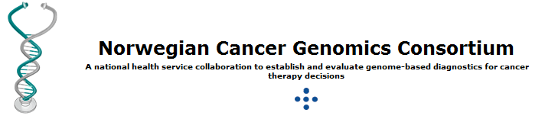
THANK YOU!
Isabelle Budin-Ljøsne
Email: i.b.ljosne@medisin.uio.no

