Slide 1

of 20
Notes:
Now, few commentators realize that translating means experimenting new cures – and that this process poses an ethical dilemma: is our current clinical research ethics framework fit for translational purposes?

Slide 2

Notes:
CT is often described as going across California’s valley of death: each new medicine entering a clinical trial has 90% chances ending up like the poor cow here.

Slide 3

Notes:
The problem with CT, it is said, is that we know more and more about physiology and physiopathology but we can’t reap the therapeutic fruits of this massive amount of data and knowledge. For example we can grasp the full human interactome, but…

Slide 4

Notes:
…but CT remains a snails race. The pace of biomedical innovation doesn’t nearly match that of scientific discovery. Translation lags dramatically behind scientific progress theses days.

Slide 5
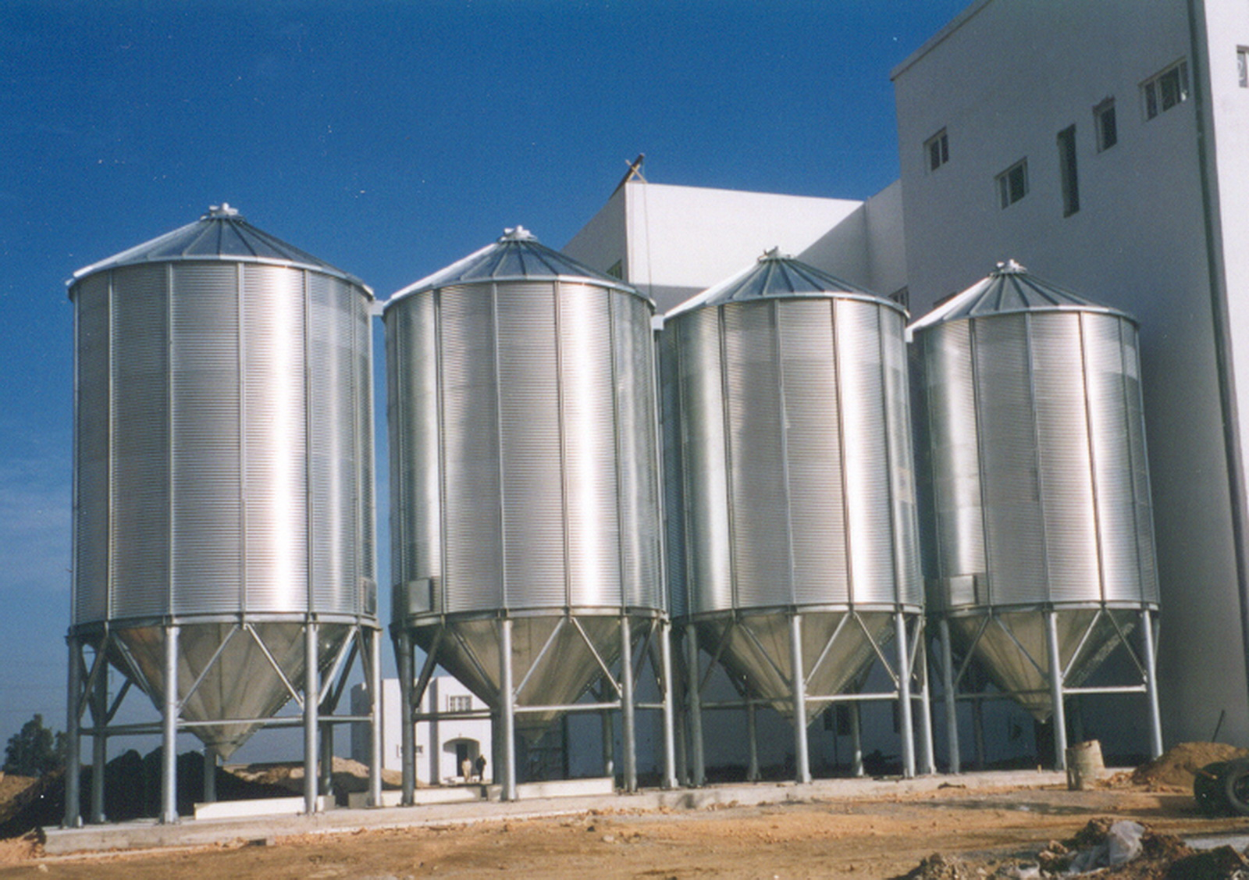
Notes:
Among the causes for this translational lag is the fact that scientific disciplines tend to form a silos-like system instead of promoting interdisicplinarity and cross contamination

Slide 6
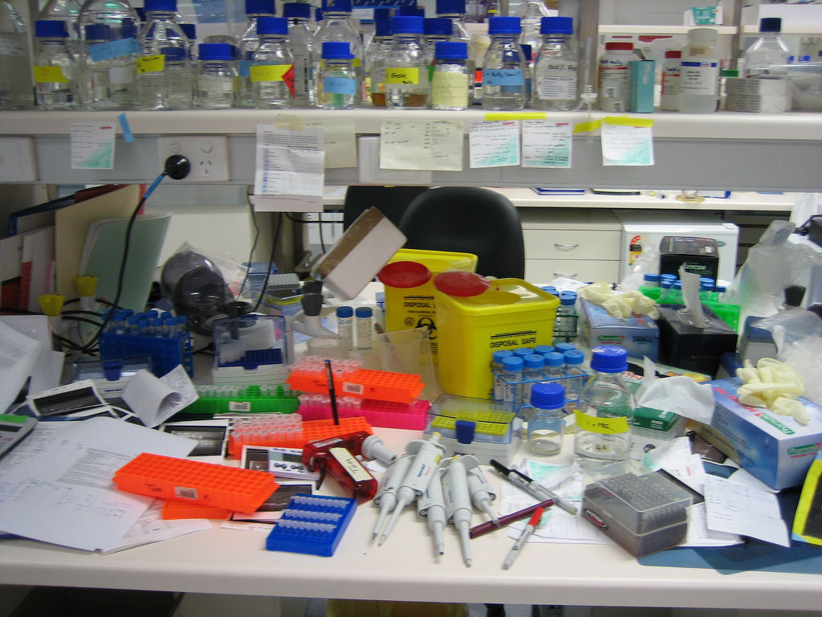
Notes:
A second cause of the transaltional lag is thought to be the inefficient organization of science in terms of Funding, infrastructures, rewards, incentives, sharing of data and so on

Slide 7
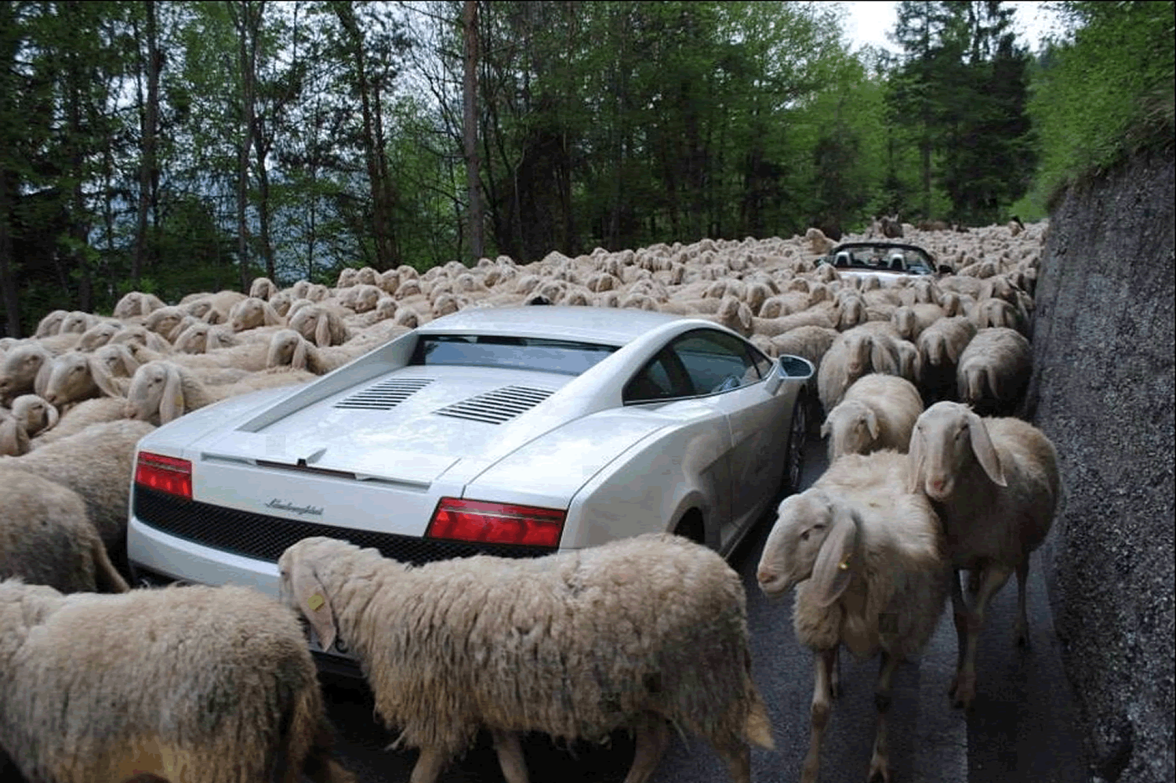
Notes:
Yet another frequent major indicted for the translational lag points to over-demanding regulation as a factor that greatly slows down the pace of innovation

Slide 8

Notes:
Finally, ethical roadblocks – like restrictions on scientific freedom - also feature among the responsible for the slow pace of CT

Slide 9

Notes:
All these diagnoses point to the need to take initiative to drastically accelerate the velocity of CT. I like to call policies aimed at repairing the translational lag, clinical politics as they aim at increasing the clinical output of science – in various ways.

Slide 10

Notes:
One way of doing it is to invest on even greater supply of scientific knowledge in the hope that some linear relation occurs between scientific input and translational output

Slide 11

Notes:
Another way is to expand demand for new therapies for example by implementing earning by doing experimentation. think of adaptive licensing schemes, or conditional marketing authorization for regenerative medicine products in japan.

Slide 12

Notes:
Thus far, form an ethical perspective, clinical research has been sharply distinguished from clinical practice: the former aims at producing generalizable knowledge while the latter aims a treating patients

Slide 13

Notes:
Ethics in this context has a gatekeeping role, to make sure participants do not expect any therapeutic benefit from participation. Is this model still viable? Apparently not.

Slide 14

Notes:
Learning by doing sounds like a fantastic new prototype of clinical research: however, in practical terms it means that new drugs will be released on the market earlier while their efficacy will only be tested afterwards.

Slide 15

Notes:
This means that the pivotal ethical distinction between knowing and curing, between research and practice no longer does its job of distinguishing two domains that are actually merging

Slide 16

Notes:
This new model puts patients’ choice at the center of the scene, since, especially for patients who have exhausted all other therapeutic options, getting access to a novel procedure will constitute an opportunity they may wish to take even in spite of lack of evidence

Slide 17

Notes:
However, real-time learning implies accepting a great deal of uncertainty – and this looks very much like trading off early access to new drugs with a lower degree of evidence about that drug

Slide 18

Notes:
This calls for appropriate ethical safeguards: we want to avoid the demise of evidence-based medicine in the name of accelerated translation.

Slide 19

Notes:
But we need a new ethical reference framework. We need evidence-based translational ethics. The latter takes seriously the idea of learning by doing, but still protects vulnerable patients from the risk of being instrumentalized in the name of translational acceleration

Slide 20

Notes:
Evidence-based translational ethics shall advance a new vision about clinical experimentation, and find a way to speed up translation while protecting the ethical and epistemic value of scientific evidence

