Slide 1



Centre for Research Ethics & Bioethics
Antibiotic Resistance
Mirko Ancillotti

Slide 2
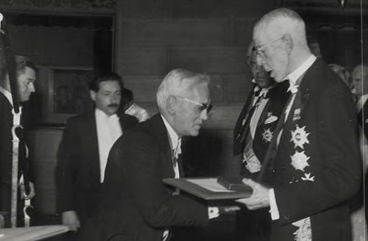

Slide 3

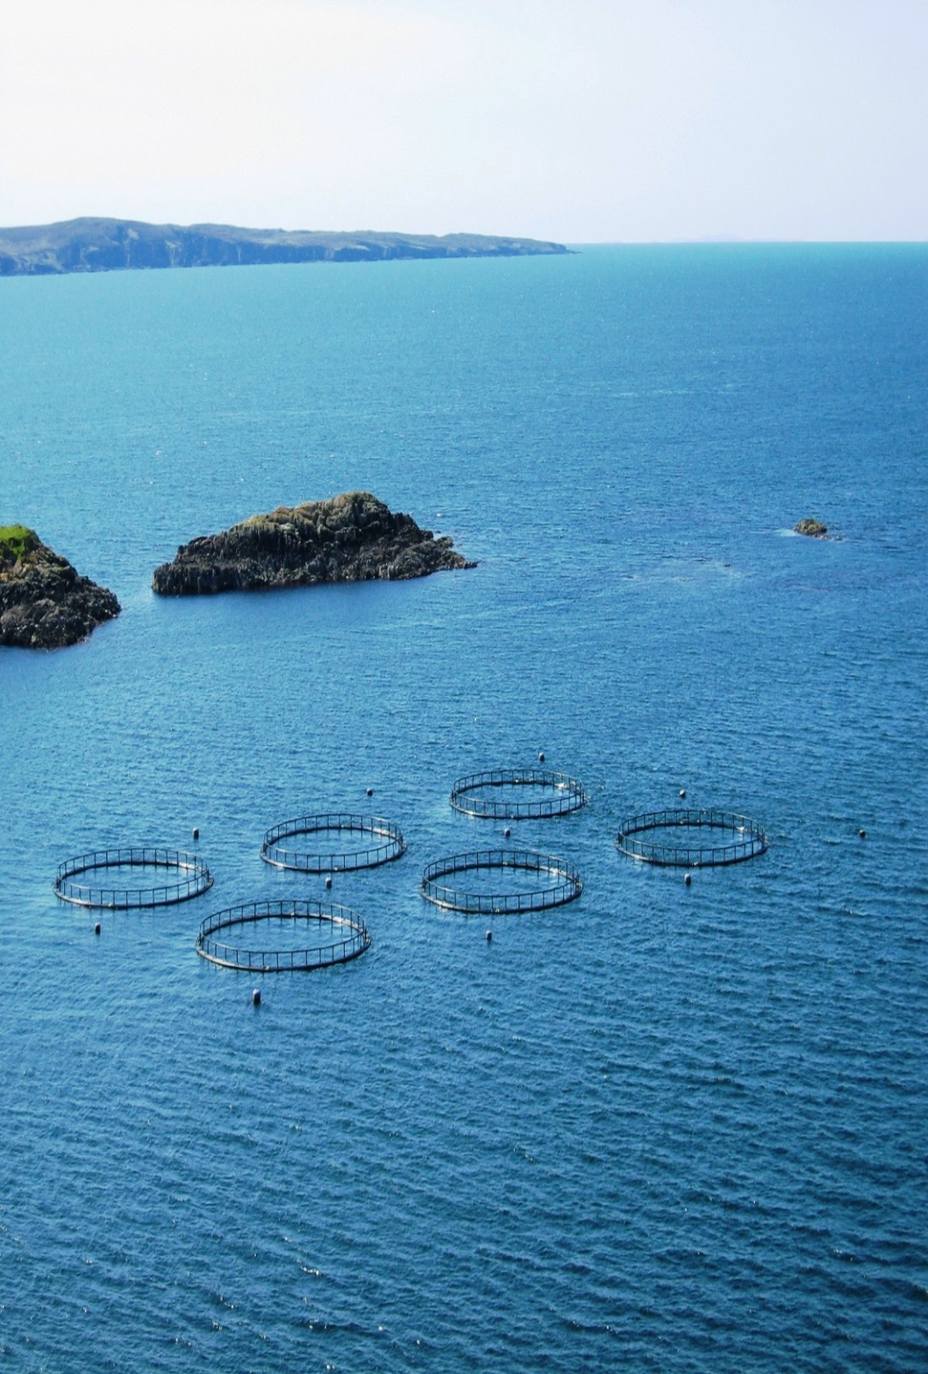


Slide 4


Slide 5
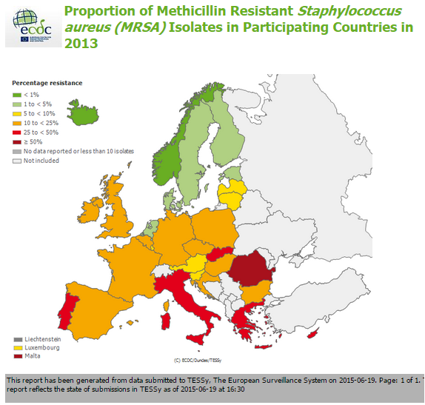

Slide 6


Slide 7
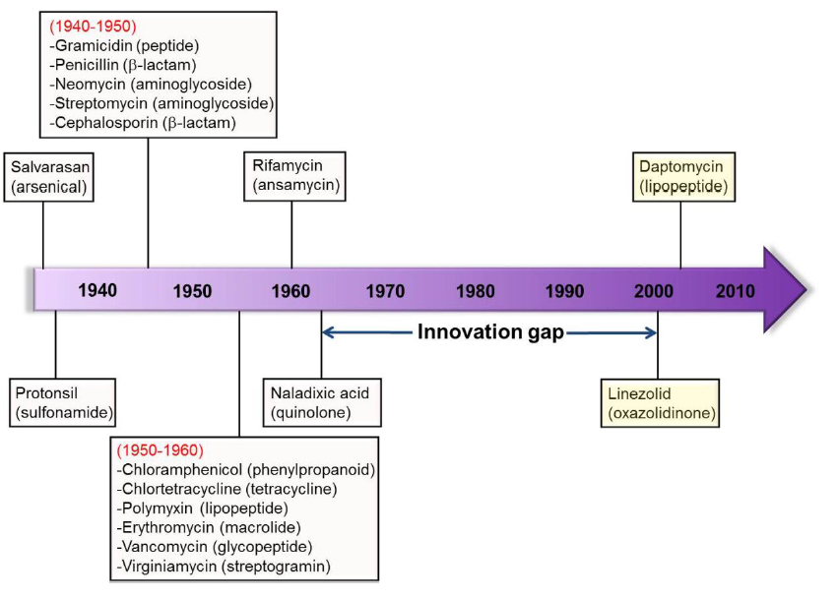

Slide 8


Slide 9



Slide 10


Slide 11



Slide 12
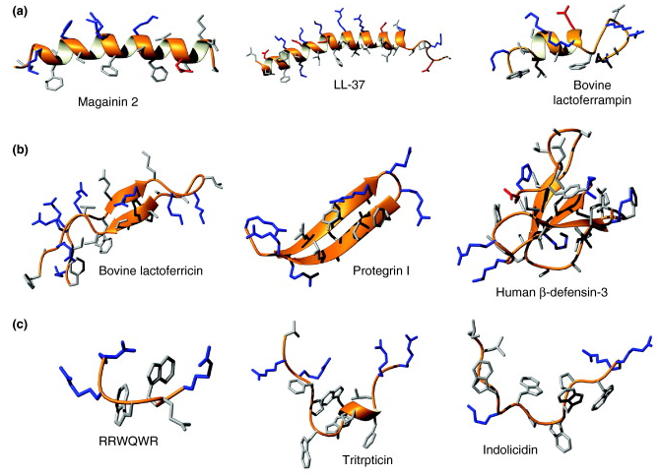

Slide 13
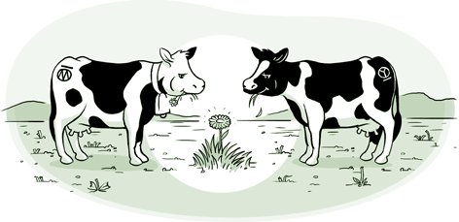

Slide 14


Slide 15


Slide 16

Risk
ethics
DCE
Quantitative
Qualitative studies
Policy

Slide 17


Slide 18


Slide 19
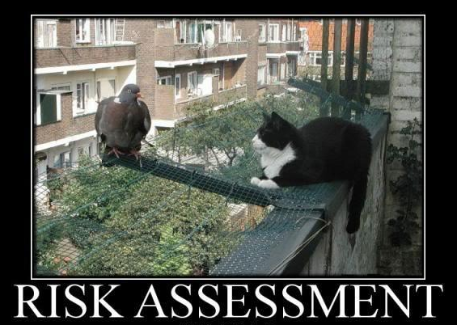

Slide 20

Thank you

